Slide 1
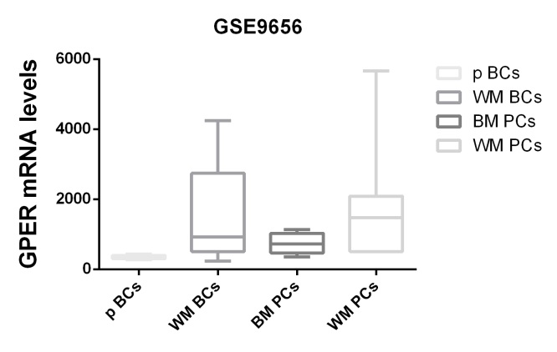
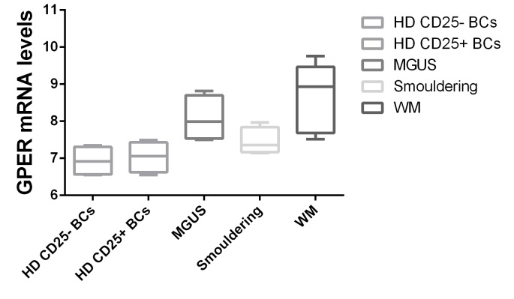
Figure S1
A
*
*
B
GSE61597
*

Slide 2
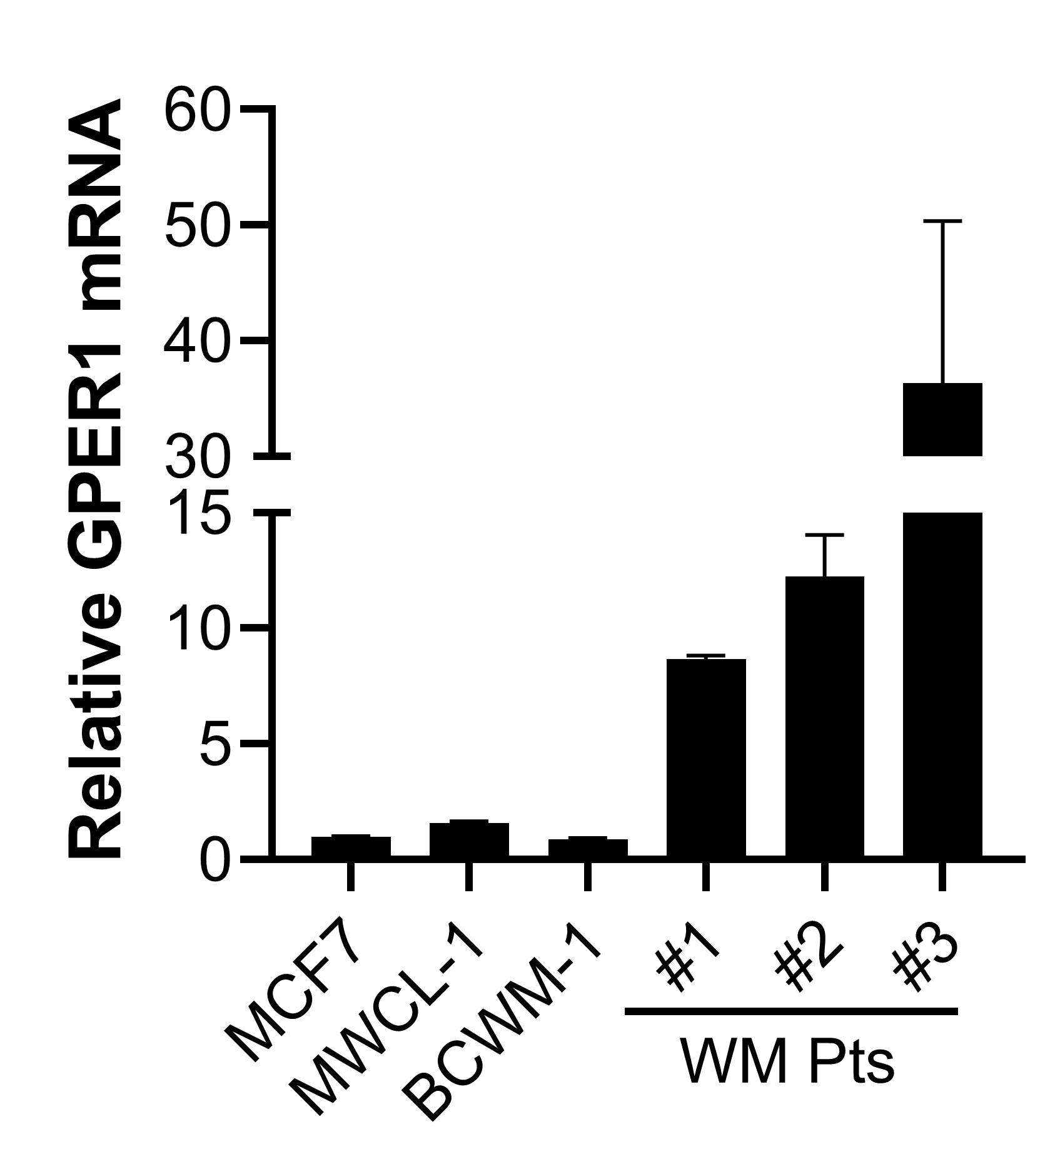


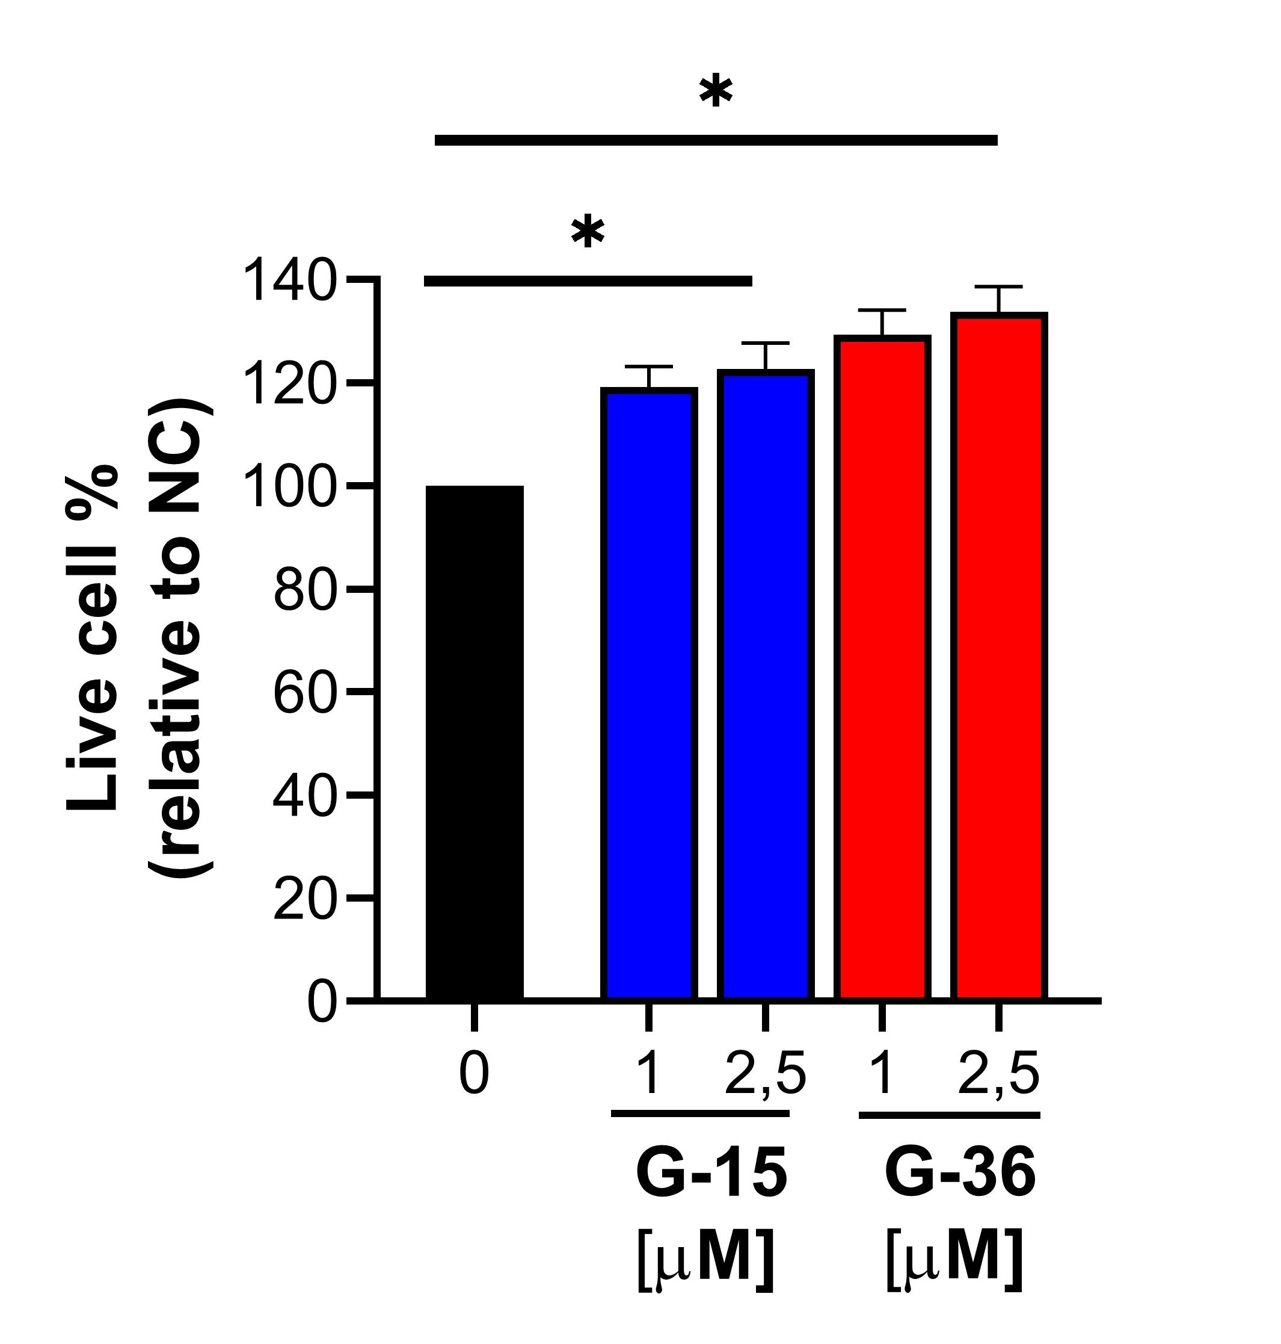
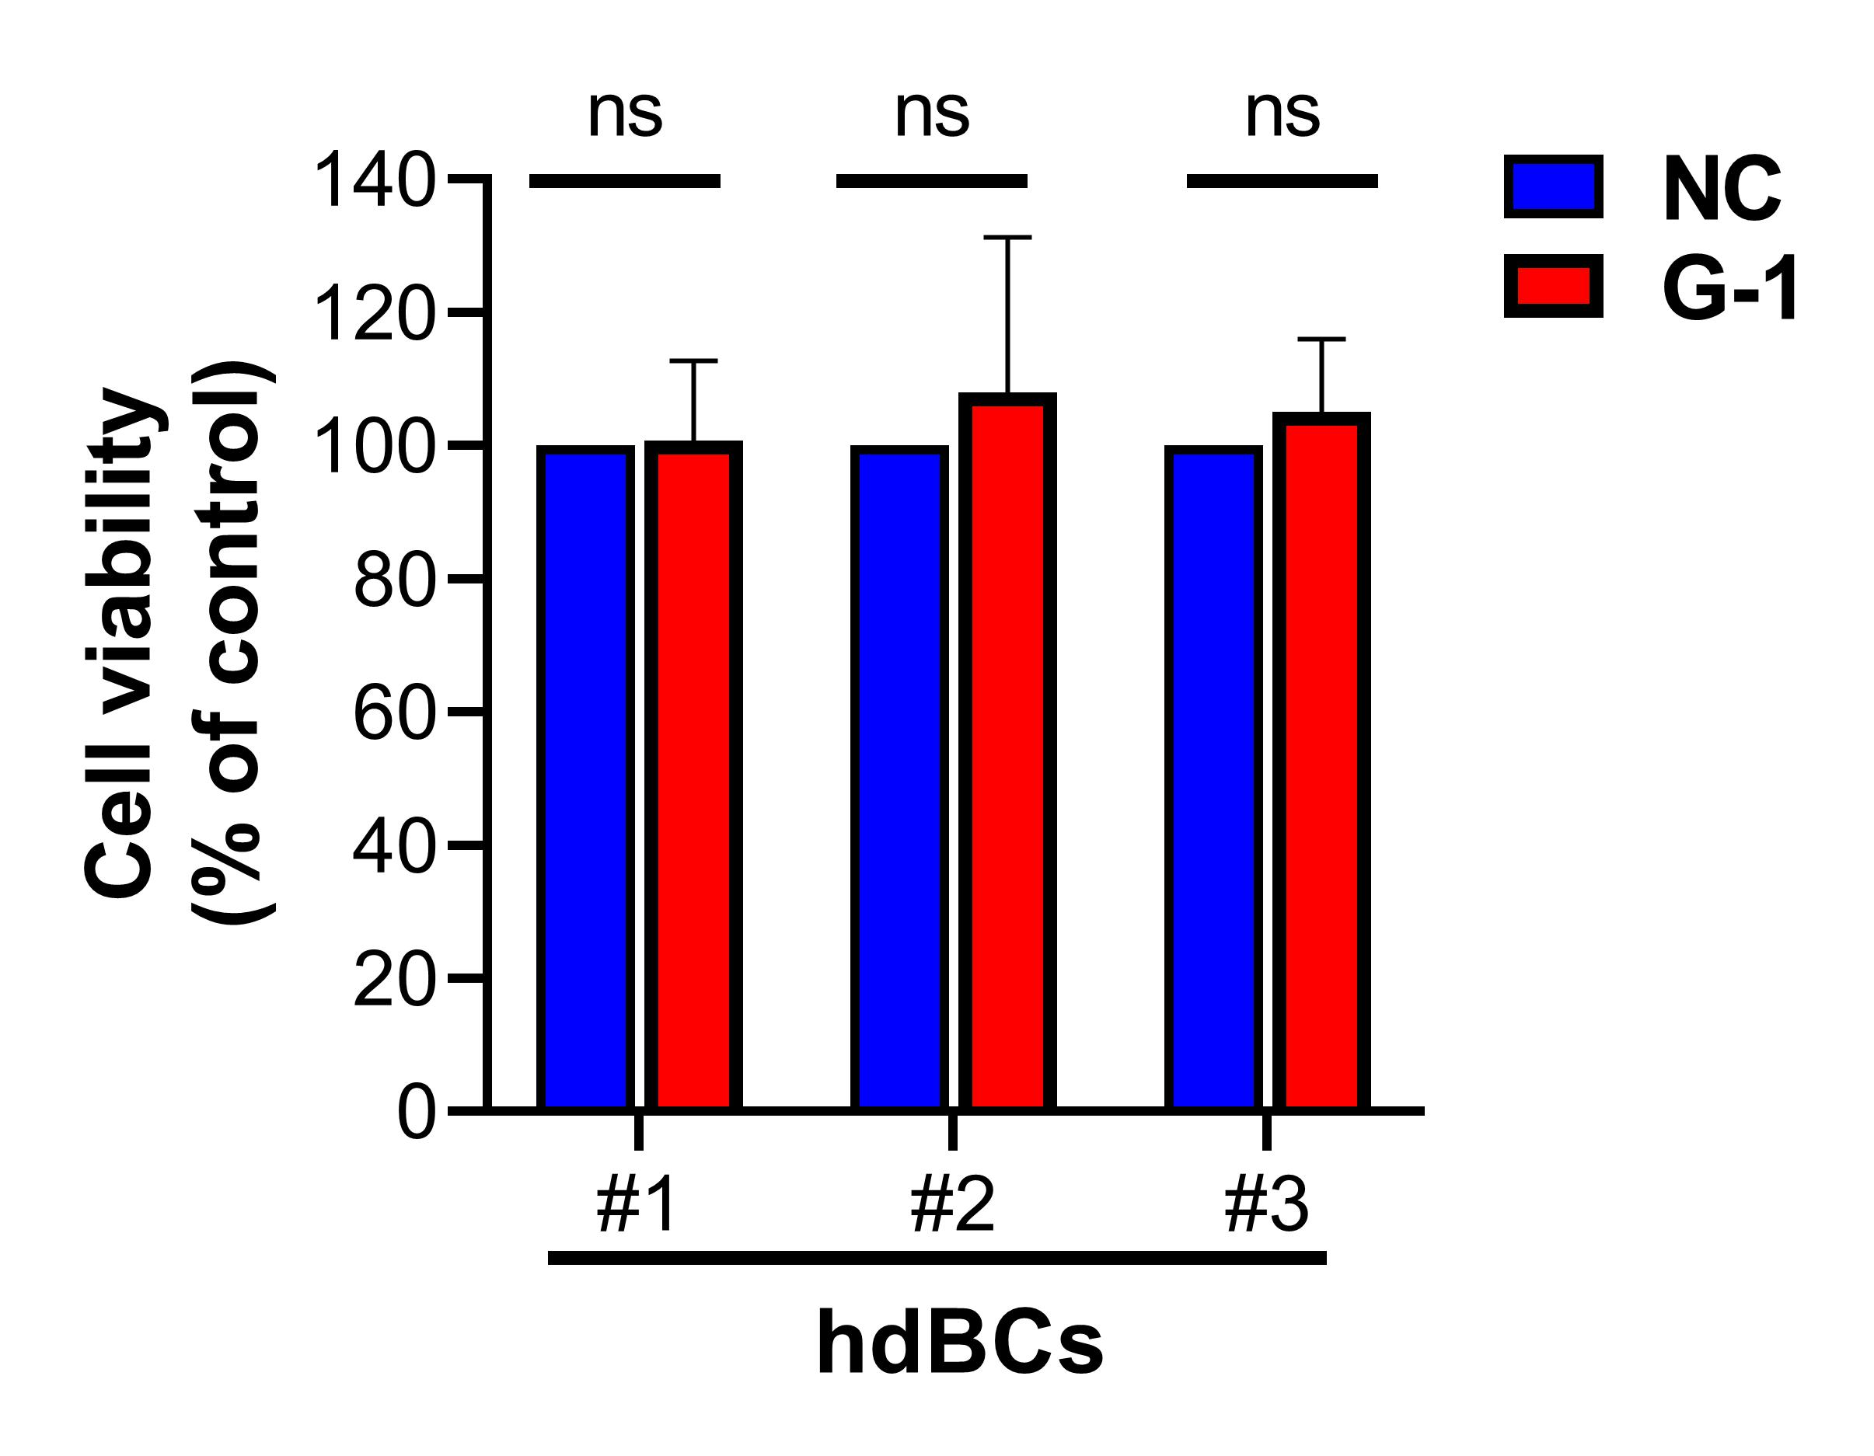
Figure S2
A
B
BCWM1
MWCL1
MCF7
GPER1
ns
GAPDH
C
D

Slide 3
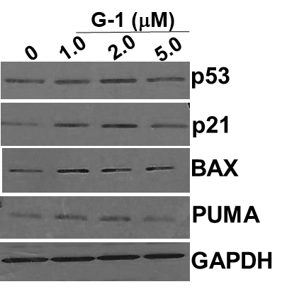
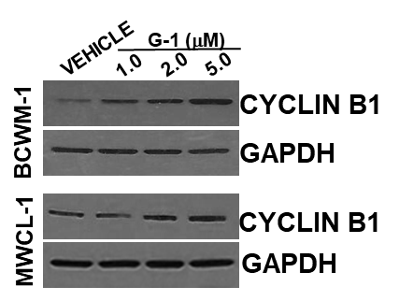

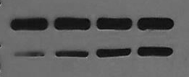

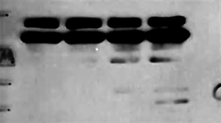


Figure S3
A
B
C
*
*
*
*
*
D
E
VEHICLE
G-1 (μM)
VEHICLE
G-1 (μM)
1.0
2.0
5.0
PARP
1.0
2.0
5.0
cl. PARP
*
cl. CASP3
*
cl. CASP9
GAPDH
BCWM-1
MWCL-1

