Slide 1
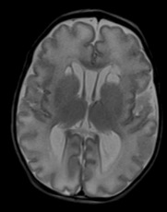
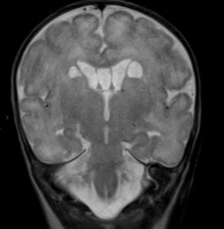
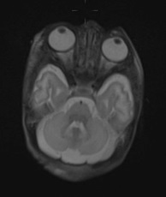
Figure S1
a
b
c
d
e
f
II.4
g
h
i
j
II.1
k
l
m
II.3
Notes:
Figure S1: Selected brain MRI images for family 2’s affected individuals (II.4 (a-e), II.1 (g-j)) and family 1’s affected individual (II.3 (k-m)) . II.4 (a,b at 6 months; c,d,e,f at 16 months), a. axial T2 with volume loss, b. axial diffusion weighted imaging (DWI) with restriction in basal ganglia. c,d. axial T2 and coronal T2 weighted image demonstrating progressive diffuse cerebral volume loss. e. axial DWI, more inferior slice showing restricted diffusion in the bilateral midbrain. f. axial DWI with restricted diffusion in the bilateral basal ganglia, external capsules and periventricular white matter. g-i (II.1, at 2 months) axial T2 and coronal T2 with diffuse cerebral volume loss and bilateral parietal parenchymal hemorrhages. j. axial gradient recalled echo (GRE) sequence demonstrating multiple bilateral parenchymal hemorrhages in temporal lobes and cerebellar hemispheres. (II.3 (k,l)) at 16 days of age, axial T2 and coronal T2 showing progressive diffuse cerebral loss and periventricular cysts. m. axial T2 showing normal cerebellar hemispheres.

Slide 2
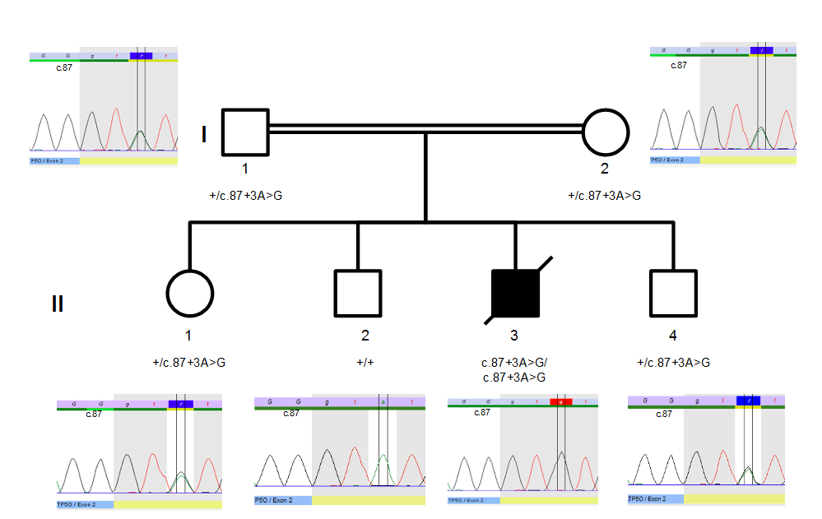
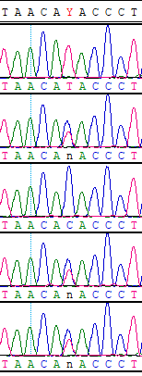
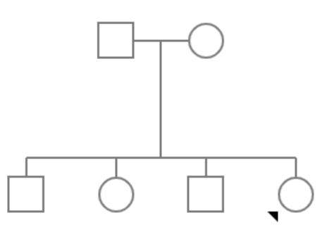
Figure S2
a
b
Family 1
Family 2
II.2
II.3
I
1
2
+/c.87+3A>G
+/c.87+3A>G
II.4
II
I.2
1
2
3
4
c.87+3A>G
/c.87+3A>G
+/+
+/c.87+3A>G
c.87+3A>G
/c.87+3A>G
I.1
Notes:
Figure S2: Sanger sequencing of c.87+3A>G variant in members of family 1 (a) and 2 (b). For family 2, sanger confirmation data for II.1 is not shown (clinically confirmed).

Slide 3
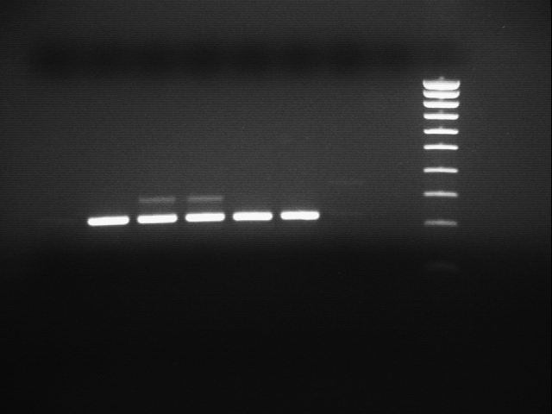
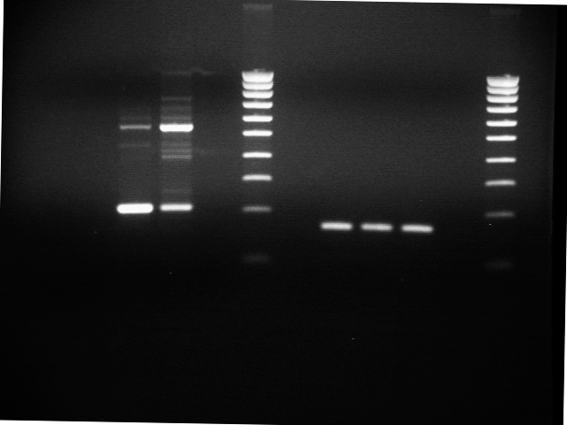
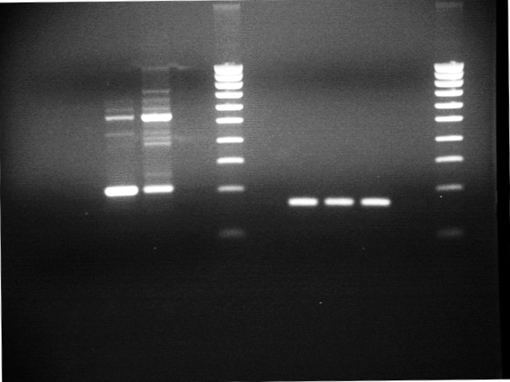
Figure S3
a
pSplicePOLR2G.3 vector
ATP5PO
pSplicePOLR2G.3 vector
Ex2
Ex2
Ex3
b
PCR1
ATP5PO c.87+3 A>G
pSplicePOLR2G.3
ATP5PO WT
no RT control
NTC
Ladder
285 bps
300 bps
234 bps
200 bps
c
PCR2
pSplicePOLR2G.3
ATP5PO c.87+3 A>G
no RT control
ATP5PO WT
NTC
Ladder
222 bps
200 bps
200 bps
ACTB
Notes:
Figure S3: Mini-gene assay: A) A genomic fragment including ATP5PO exon 2 and it’s intronic flanking regions (190 bps of intron 1 and 172 bps of intron 2) was PCR amplified using the forward primer aggaacatgcgaattcGGCATAATCCTCATTGGGTAA and the reverse primer ggaggctcaggaattcTACTCAACACCATTCCTTTCC. The extensions which are homologous to vector ends, needed for the in-fusion cloning reaction (clontech) are underlined. Once cloned into our in-house splicing vector: pSplicePOLR2G.3, the ATP5PO cassette was confirmed by Sanger sequencing (Applied Biosystem). Using the WT construct the ATP5PO c.87+3A>G variant was introduced by site-directed mutagenesis (Agilent) using the forward primer GACCATTTGCCAAGCTTGTGAGGGTATGTTAATTTATATTCTTCTGTAATG and the reverse primer CATTACAGAAGAATATAAATTAACATACCCTCACAAGCTTGGCAAATGGTC following the manufacturer’s recommendations. The construct with the variant was confirmed by Sanger sequencing.
B) Splicing assay was performed as previously described (Raud, et al; 2019) in HEK293T cells. Total RNA was extracted 48h post-transfection with a spin column procedure including a genomic DNA removal step. After DNAseI treatment, cDNA was produce using an oligo-dT(22) and the superscript III enzyme (Invitrogen) following the manufacturer’s recommandations. PCR1 - the exogenous transcript was PCR amplified using the forward primer caacttgctcaacacggtgaag and the reverse primer gaattgcccttcttgttgacctg.
C) In order to track ATP5PO exon 2 inclusion we designed a second PCR (PCR2) using the forward primer gtgcgatgcttcagtacctctg (located within ATP5PO exon 2) and the reverse primer gaattgcccttcttgttgacctg. A PCR targeting actin beta transcripts was performed in parallel to control the amount of cDNA in each condition.
The expected PCR fragment sizes are indicated.

Slide 4
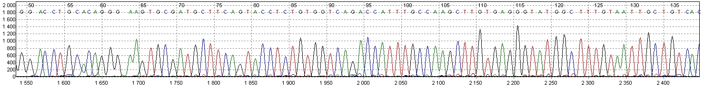
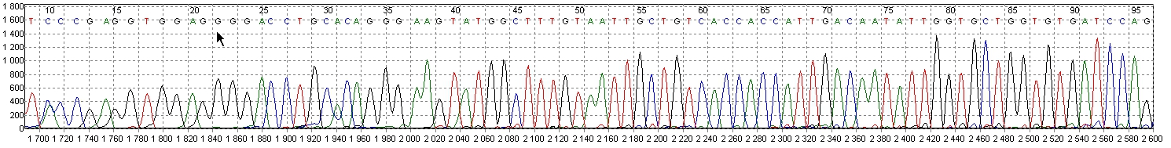
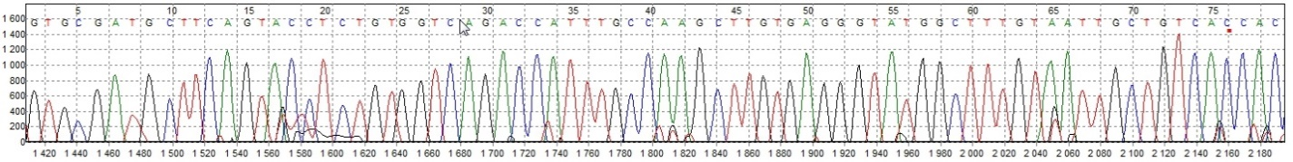
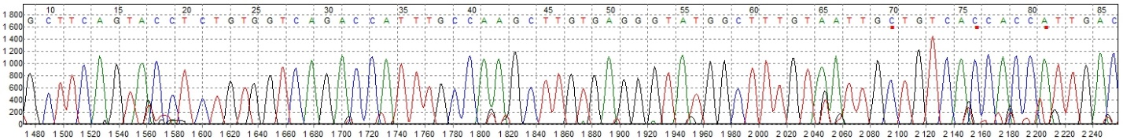
Figure S4
PCR1
Exon 2 PolR2G
Exon 2 ATP5PO
Exon 3 PolR2G
ATP5PO exon 2 inclusion
Exon 2 PolR2G
Exon 3 PolR2G
ATP5PO exon 2 skipping
PCR2
Exon 2 ATP5PO
Exon 3 PolR2G
ATP5PO WT exon 2 inclusion
Exon 2 ATP5PO
Exon 3 PolR2G
ATP5PO c.87+3 A>G exon 2 inclusion
Notes:
Figure S4: The PCR products were extracted from gel and analyzed by Sanger sequencing.

Slide 5
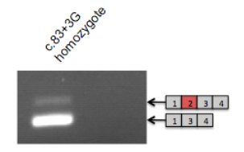
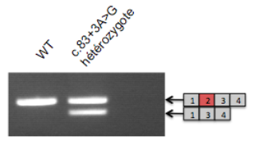
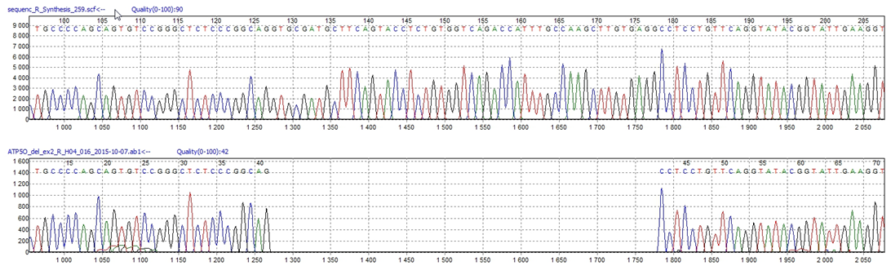
a
b
Figure S5
c
Notes:
Figure S5: cDNA studies using a muscle sample of the affected individual in family 1 (II.3) a) showed ATP5PO exon 2 skipping and the presence of residual WT spliced product b) cDNA study in WT and heterozygote using a blood sample. c) Sanger sequencing of the smaller(intense) cDNA product.

Slide 6
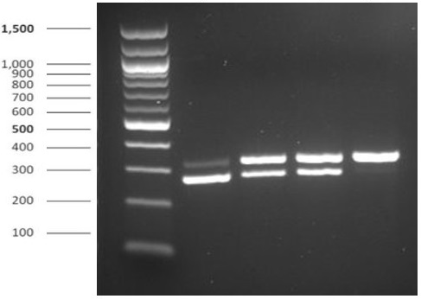
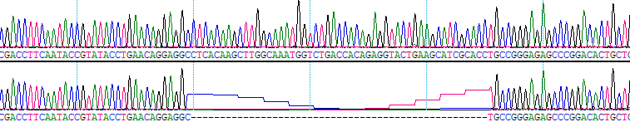
d
Figure S5
ladder (100bp)
II.4
I.2
I.1
II.2
ex1
ex2
ex3
ex4
ex5
ex6
ex7
324bp product
ex1
ex3
ex4
ex5
ex6
ex7
273bp product
e
II.2
II.4
Notes:
Figure S5: cDNA studies using a peripheral blood sample of the unaffected individual (II.2) and affected individual (II.4) in family 2 using a blood sample d) II.4 sample showed ATP5PO exon 2 skipping and the presence of residual WT spliced product e) Sanger sequencing of the cDNA PCR products (II.4 & II.2).

Slide 7
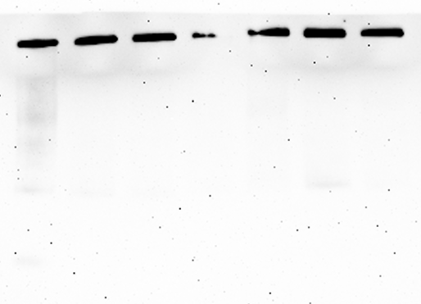
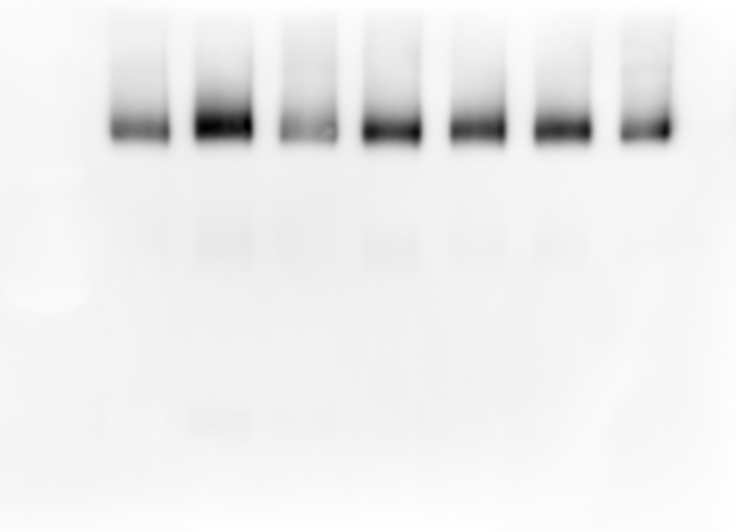
Figure S6
a
c
Family 1 (II.3)
Family 2 (II.4)
MW marker (ferritin)
HEPG2
CAM
II.4
Ctr neg. 1
Ctr neg. 4
Ctr neg. 2
II.3
Ctr neg. 3
II.3
Ctr pos.
control
Hybridizations :
NDUFS1
NDUFS2
Hybridization :
NDUFS2
850-
Complex I
460-
400-
230-
100-
b
ATP5F1A
ATP5F1B
SDHA
Complex I
Complex V
Complex II
Notes:
Figure S6: Assembly of complex I in Family 1 (II.3) and Family 2 (II.4) using fibroblasts
The assembly of complex I is followed in solubilized internal mitochondrial membranes after separation by blue native polyacrylamide gel and detection with an antibody against NDUFS2, a subunit involved in the earliest assembly intermediates. No pathologically abnormal intermediates are observed.
Figure S6: Assembly of complex I in Family 1 (II.3) and Family 2 (II.4) using fibroblasts. The assembly of complex I is followed in solubilized internal mitochondrial membranes after separation by blue native polyacrylamide gel and detection with antibodies targeting complex I subunits, i.e. Left panel: antibodies against NDUFS1 and NDUFS2 and Right panel: antibody against NDUFS2 subunits involved in N module (NDUFS1) and the earliest assembly intermediates (NDUFS2). No pathologically abnormal intermediates are observed. Left panel: Membrane was subsequently hybridized with ATP5F1A and ATP5F1B subunits for ATP synthase and SDHA subunit for complex II. Experiments were performed on 4 different control fibroblast cell lines from healthy donors (Ctr neg. 1-4), fibroblast cells from the affected individual II.3 in duplicate and a patient fibroblast cell line carrying a homozygous pathogenic mutation (c.317-2A>G) in TMEM70 gene as a positive control for complex V assembly defect (positive control: Ctr pos.). Right panel: The HepG2 cell line treated with chloramphenicol shows mild assembly intermediates at 100, 230, 400, 460, and 850 kDa, which are absent in the control cell from healthy donors (control), and are also absent in the fibroblast cells from the affected individual II.4

Slide 8
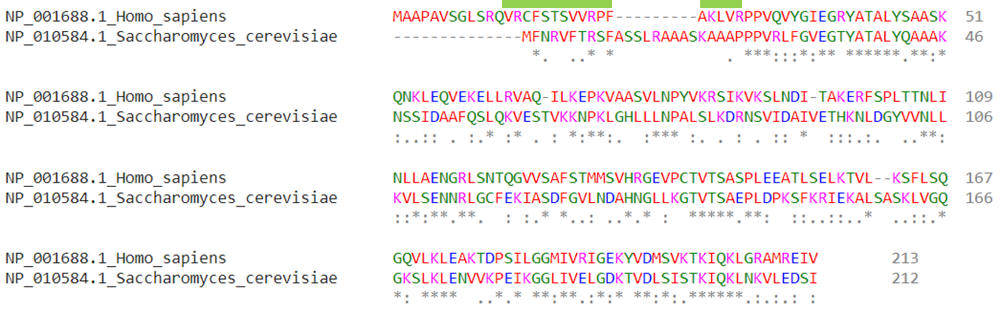
Figure S7
Notes:
Figure S7: Sequence alignment of human ATP5PO and the Yeast homolog ATP5 proteins (34.67% sequence identity) using Clustal 2.1. The Yeast ATP5 is a single exon gene. The green bar marks the 17 amino acids in the coding exon 2 of human ATP5PO (NM_001697.3).

Slide 9
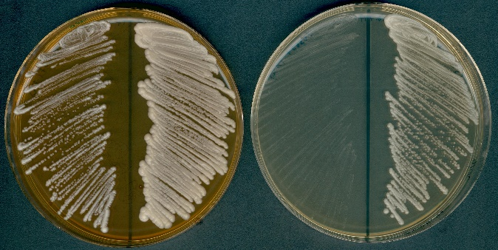
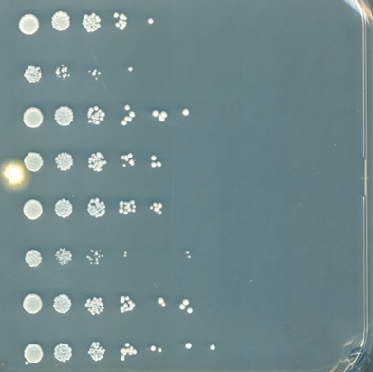
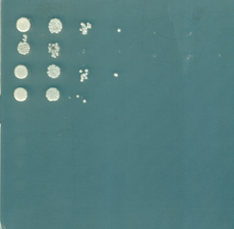
Figure S8
a
Y03657
atp5Δ
Y23657
ATP5/
atp5Δ
Fermentable medium
Respiratory medium
b
yATP5
hATP5PO-WT
hATP5PO-∆ex2
Transformation of
atp5∆ yeast haploid
cells
Isolation of the transformants on fermentable medium
vector
WT strain
yATP5
hATP5PO-∆ex2
Growth test on
respiratory medium
hATP5PO-WT
vector
atp5Δ strain
yATP5
hATP5PO-∆ex2
hATP5PO-WT
Fermentable medium
Respiratory medium
Notes:
Figure S8: atp5∆ yeast cells are respiration-deficient.a) The haploid Y03657 atp5Δ strain and the diploid heterozygous Y23657 atp5Δ/ATP5 strain were streaked on a fermentable medium (YP + 2% glucose) and on a respiratory medium (YP + 2% ethanol). As expected, contrary to the diploid heterozygous atp5Δ/ATP5 strain which grows well on a respiratory medium, ATP5 deletion in a haploid strain results in a respiratory growth defect, indicative of a defect in oxidative phosphorylation. b) Yeast ATP5 gene (yATP5), human WT (ATP5PO-WT) and mutant ATP5PO cDNA (ATP5PO-∆ex2) were cloned into pRS426 vector (URA3 selection marker), under the control of the strong constitutive GDP promoter. atp5Δ yeast cells were transformed with each of the plasmid and transformants were selected on medium containing glucose and lacking uracil. To assess the rescue potential of each gene, serial dilutions of cells were then spotted on a respiratory medium (YP + 2% ethanol) and on a fermentable medium (YP + 2% glucose) to compare their growth. None of the construct was able to rescue the respiratory growth defect of atp5Δ cells which had lost their mtDNA.

