Slide 1
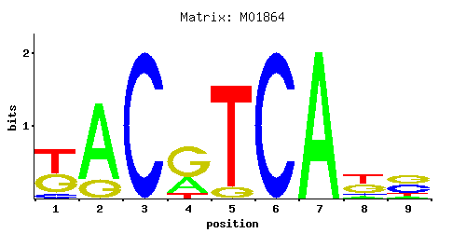
ATF4 binding sequence
-GTGACGT[AC][AG]-3')
Supplemental Figure S3. The IGFBP2 promoter analysis using the ConTra V3 web server.

