Slide 1
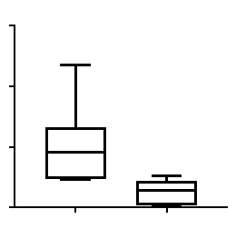
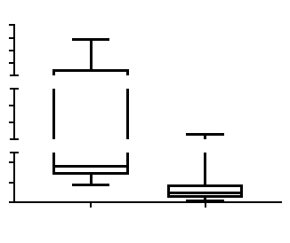
A
B
1500
P=0.008
40
TT
n=8
1000
35
Tumor weight (mg)
Weight (g)
500
n=8
30
0
25
2
4
8
10
Vehicle
ONC201
0
6
Time (weeks)
C
D
P=0.008
8000
n=8
4000
34
MZCRC1
2000
32
Tumor weight (mg)
30
1000
n=8
Weight (g)
28
400
26
200
24
0
0
2
4
6
8
10
Vehicle
ONC201
Time (weeks)
Supplemental Figure S4. A, C) Tumor weight was measured at the end
of treatment at 8 weeks. Error bars, ±SD (n=8). Mann Whitney test.
B, D) Weekly weights of control and treated mice. Error bars, ±SD (n=8).

