Slide 1
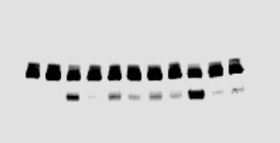
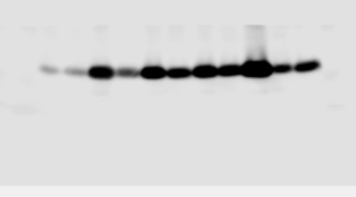
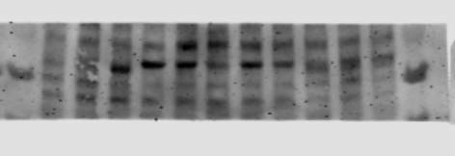
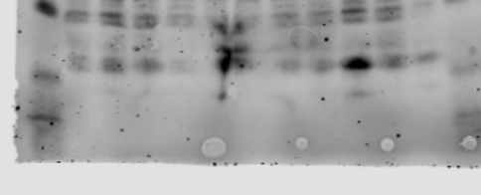
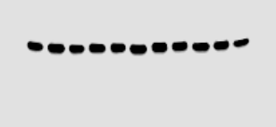
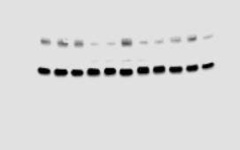
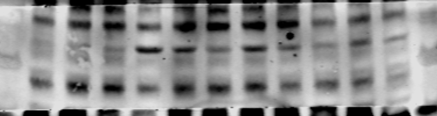
Figure 2F
Lane1-8 are on the figure
1 2 3 4 5 6 7 8
PARP
p-H2A.X
1 2 3 4 5 6 7 8
p-CHK1
1 2 3 4 5 6 7 8
c-Casp3
1 2 3 4 5 6 7 8
P53
GAPDH
p-P53

Slide 2
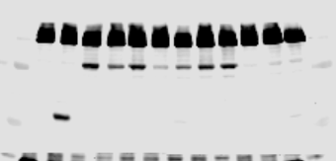
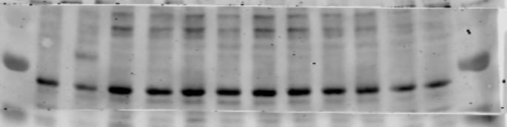

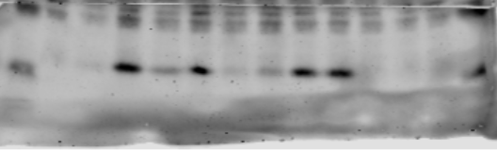
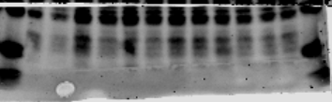
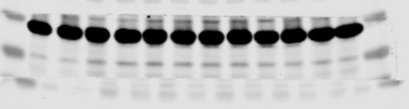
Figure 2G
Lane1-8 are on the figure
PARP
1 2 3 4 5 6 7 8
p-CHK1
1 2 3 4 5 6 7 8
p-P53
P53
1 2 3 4 5 6 7 8
p-H2A.X
c-Casp3
1 2 3 4 5 6 7 8
GAPDH

Slide 3
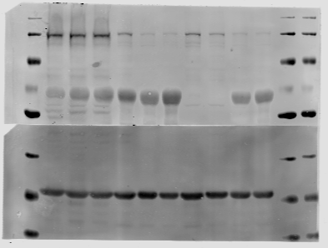
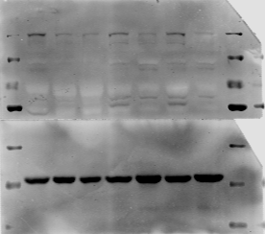
Figure 3G
Figure 3H
CCLP1
TFK1
HCCC-9810
siKIF11 #2
CC143476
siKIF11 #1
Marker
SK-CHA-1
HIBEpiC
Marker
CCLP1
NC
TFK1
RBE
Marker
siKIF11 #2
siKIF11 #1
Marker
NC
180 KD
180 KD
130 KD
KIF11
130 KD
KIF11
70 KD
100 KD
70 KD
70 KD
50 KD
50 KD
40 KD
40 KD
35 KD
GAPDH
35 KD
GAPDH
25 KD
25 KD

