Slide 1
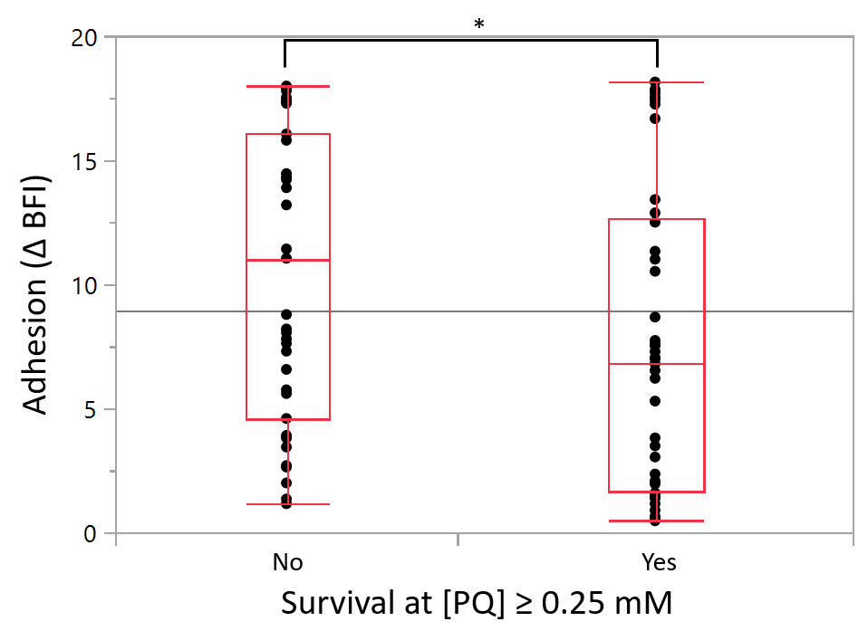
Supplementary data S5. Distribution of the survival rate of the 83 C. jejuni strains exposed to at most 0.25 mM PQ according to their adhesion capacity.
Statistical significance was determined using the ANOVA test (*p ≤ 0.05).

