Slide 1
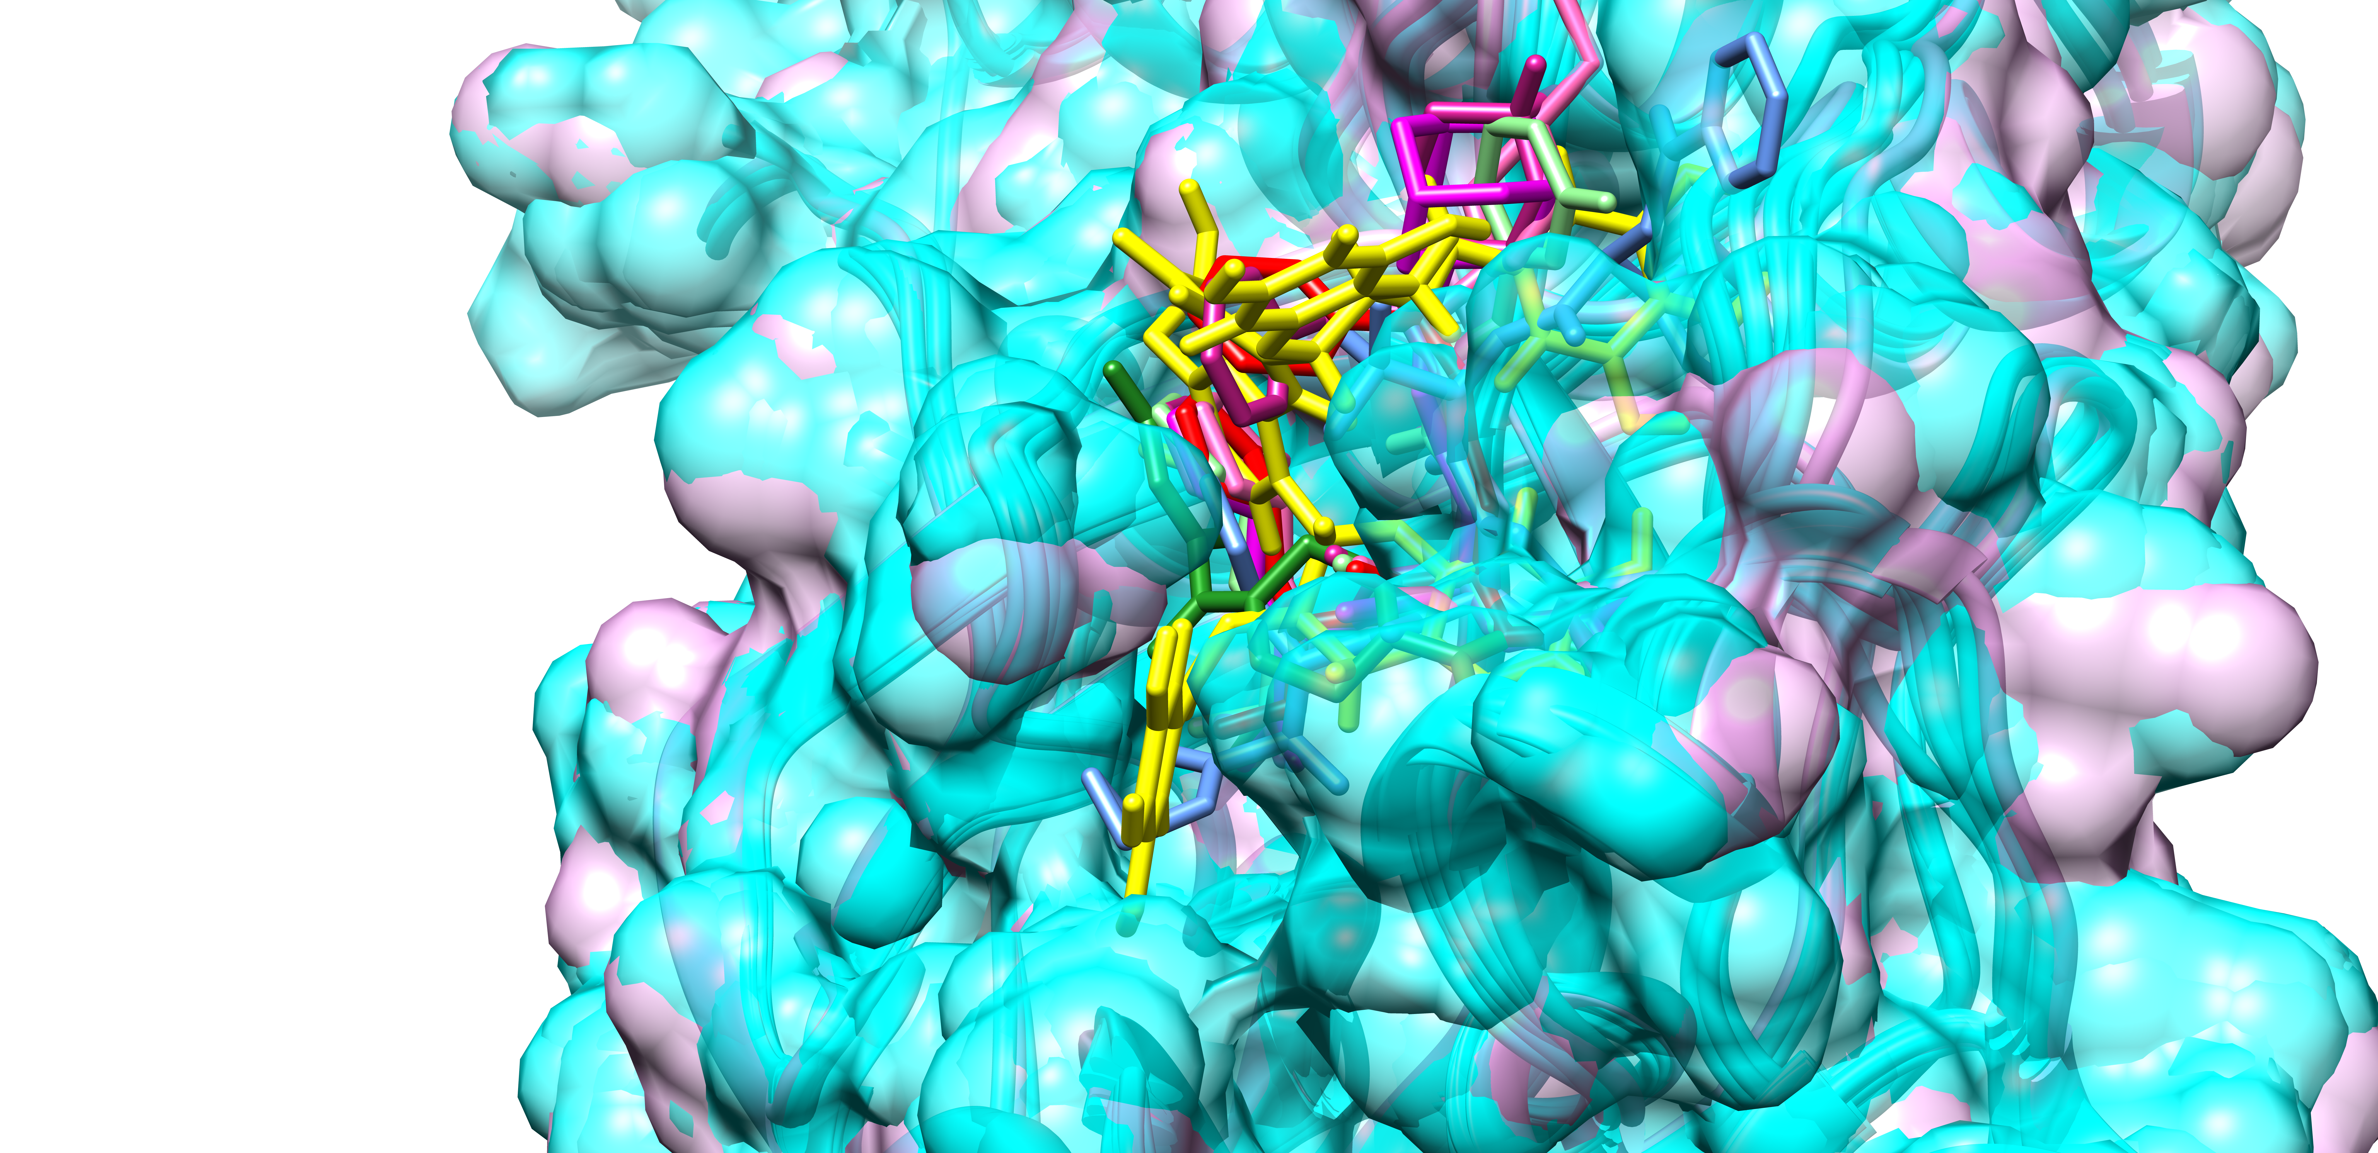
Supplementary figure 1A: Comparison of crystallographic poses of reference compounds with docked pose of TG. The superimposed main protease crystal structure surface is shown at 50 percent surface transparency. Superimposed protein crystal structure in cyan, whereas TG has been highlighted in yellow. The figure depicts noncovalent inhibitor YD1 in forest green, SV6 (telaprevir) in blue, YKS in violet-red, YLJ in light green, YNI in hot pink, and Y4V in green magenta, K36 (feline coronavirus inhibitor GC3760) in red.

Slide 2
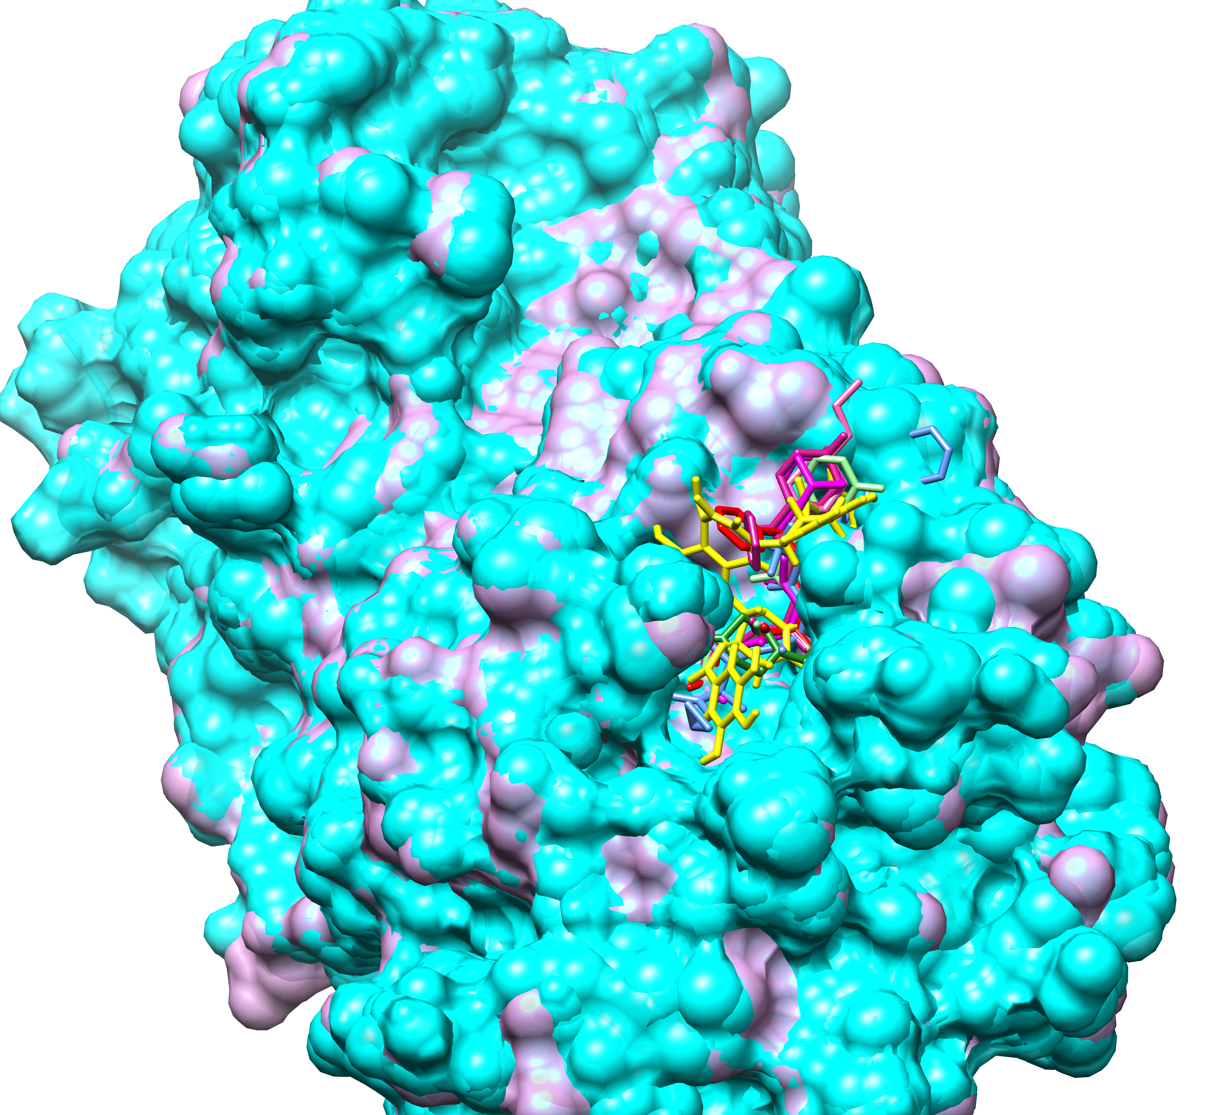
Supplementary figure 1B: Comparison of crystallographic poses of reference compounds with docked pose of TG. Superimposed protein crystal structure in cyan, whereas TG has been highlighted in yellow. The figure depicts noncovalent inhibitor YD1 in forest green, SV6 (telaprevir) in blue, YKS in violet-red, YLJ in light green, YNI in hot pink, and Y4V in green magenta, K36 (feline coronavirus inhibitor GC3760) in red.

Slide 3
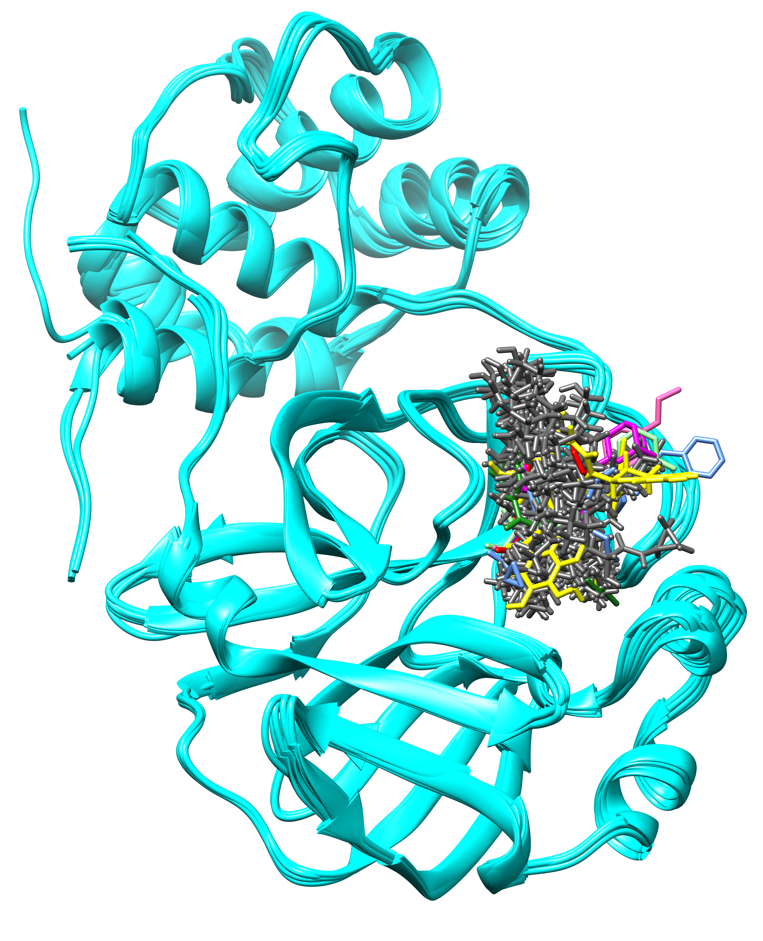
Supplementary figure 1C: Comparison of crystallographic poses of reference compounds with docked pose of reference set. The top 20 docked poses of reference set based on docking score are shown in dim grey. Superimposed protein crystal structure in cyan, whereas TG has been highlighted in yellow. The figure depicts noncovalent inhibitor YD1 in forest green, SV6 (telaprevir) in blue, YKS in violet-red, YLJ in light green, YNI in hot pink, and Y4V in green magenta, K36 (feline coronavirus inhibitor GC3760) in red.

Slide 4
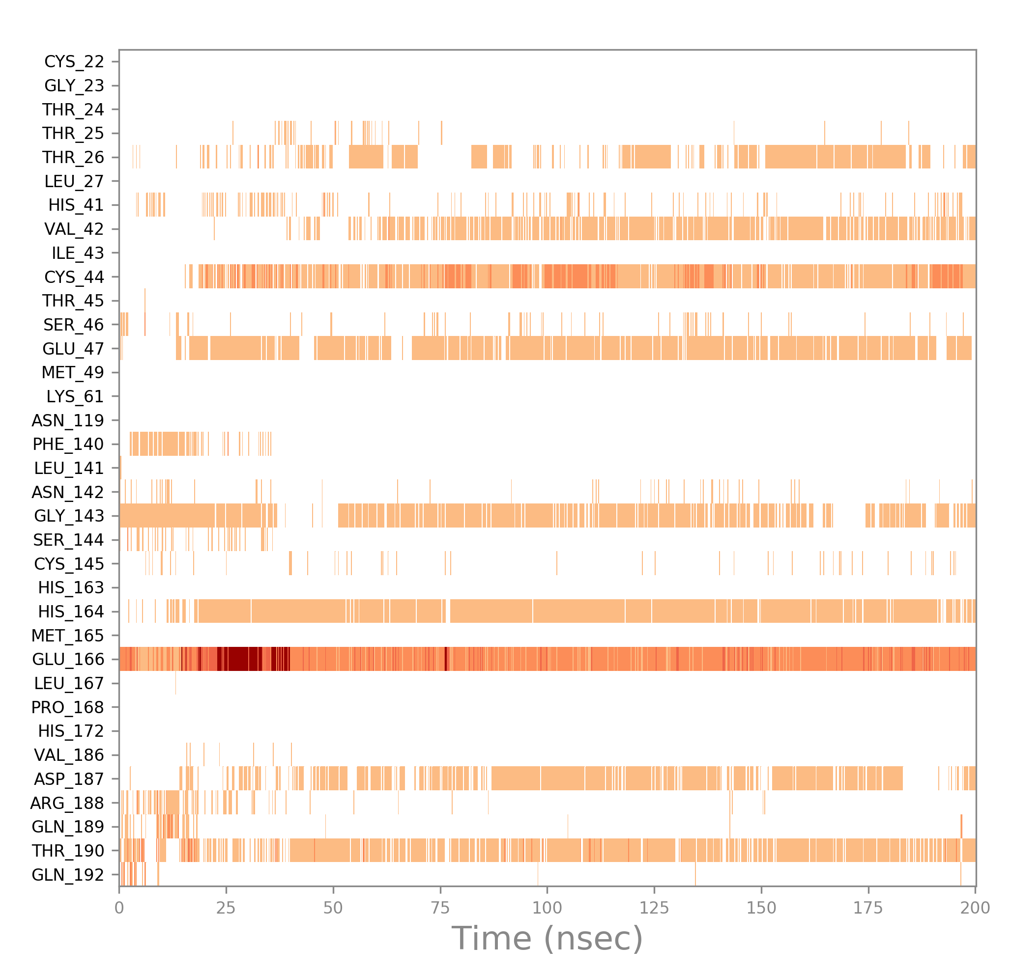
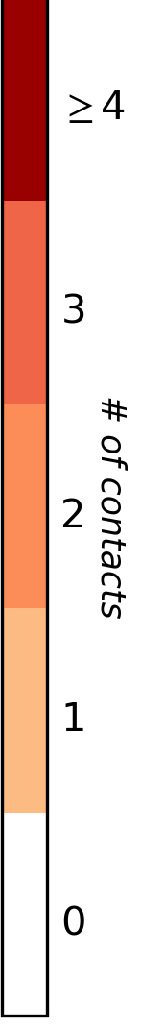
Supplementary figure 1D: Number of hydrogen bond contacts observed during the simulation of 200 ns. The X-axis represents the simulation time, whereas Y axis represents the interacting residue. Glutamate166 was the dominant interacting residue, followed by threonine190 and histidine164.

Slide 5
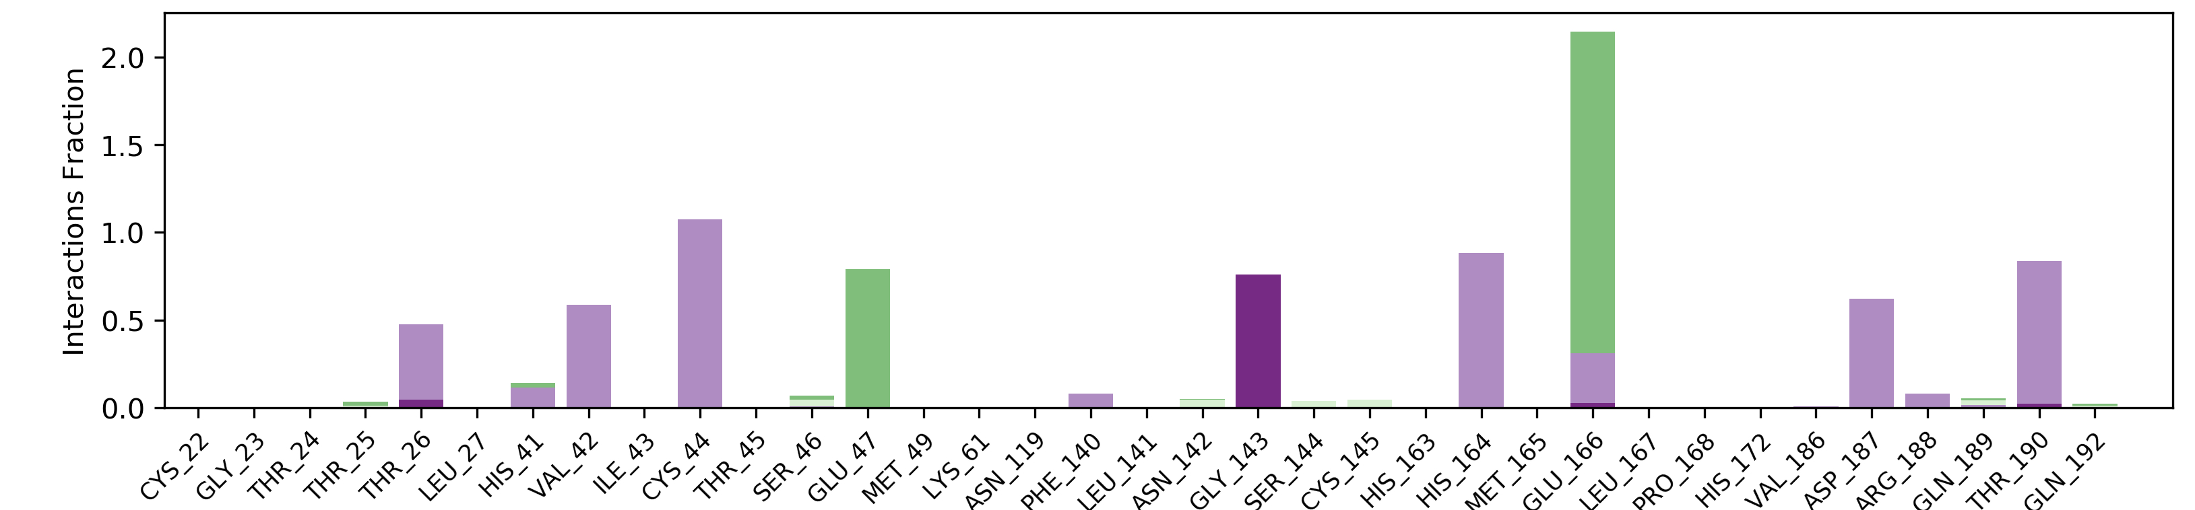
Interaction fraction (occupancy)
Supplementary figure 1E: Interaction fraction (occupancy) of H-bond between main protease and theaflavin digallate. An interaction fraction of 0.5 indicates that the H bond was maintained (occupied ) for 50 percent of simulation time. The H bonds are depicted based on four subtypes, i.e., backbone donor, backbone acceptor, side chain donor, and side chain acceptor. The H bond between Glu166 and theaflavin digallate is maintained approximately for 200 percent of simulation time. As the residues can make more than 1 hydrogen bond during the simulation time, occupancy can be more than 100 percent.

Slide 6
Supplementary figure 2A: Root mean square deviation plot of C- alpha atoms of main protease in the presence of theaflavin digallate. The simulation was carried out for 100 ns on GTX 1070 GPU with Amber18 and Amber ff99SB force field. X-axis represents the simulation time in nanoseconds.

Slide 7
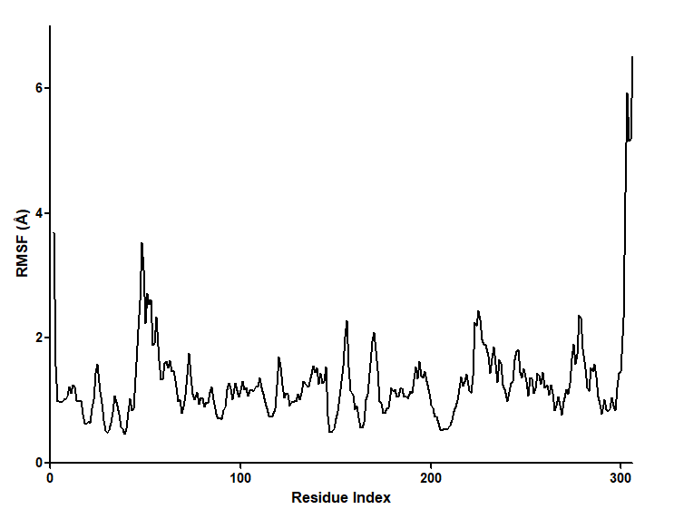
Supplementary figure 2B: Root mean square fluctuation plot of main protease and in the presence of theaflavin digallate. The simulation was carried out for 100 ns on GTX 1070 GPU with Amber 18 and Amber ff99SB force field. Left Y-axis represents the RMSF of main protease and X-axis represents the residue number of main protease.

Slide 8
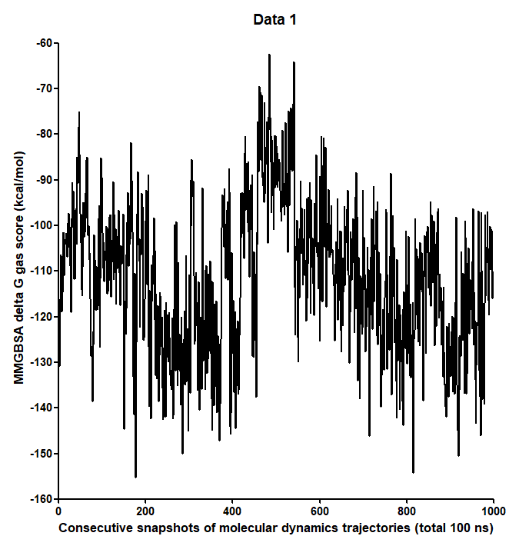
Supplementary figure 2C: MMGBSA delta G gas scores of theaflavin digallate with main protease during molecular dynamics simulation using Amber18 molecular dynamics package. The X-axis represents the 1000 consecutive snapshots of molecular dynamics trajectories in 100 ns simulation. Y-axis represents MMGBSA delta G gas scores of theaflavin-digallate complex.

Slide 9
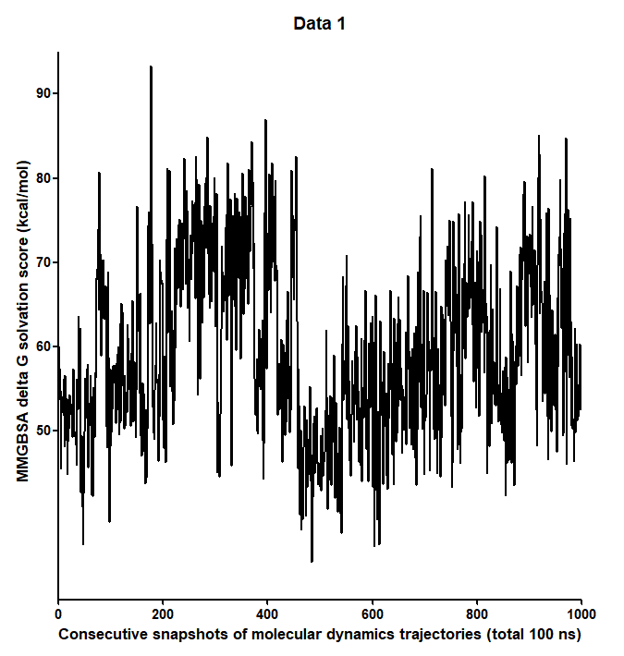
Supplementary Figure 2D: MMGBSA delta G solvation scores of theaflavin digallate with main protease during molecular dynamics simulation using Amber18 molecular dynamics package. X axis represents the 1000 consecutive snapshots of molecular dynamics trajectories in 100 ns simulation. Y-axis represent MMGBSA delta G solvation scores of theaflavin-digallate complex.

Slide 10
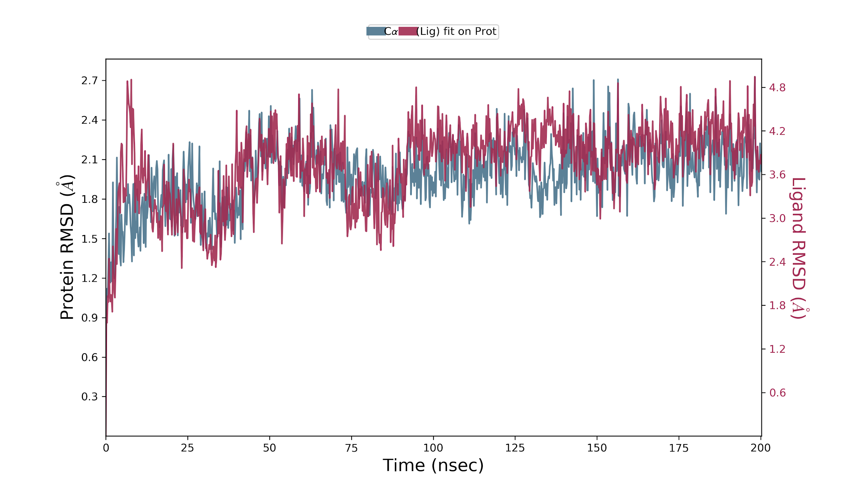
Supplementary Figure 3A: Root mean square deviation plot of main protease and theaflavin digallate (replicate 1). The simulation was carried out for 200 ns on GTX1070 GPU with Desmond 2019 and OPLS 2005 force field. The main protease RMSD is represented in pink line, whereas theaflavin digallate in dark line. Left Y-axis represents the RMSD of main protease, and Right Y-axis represents the RMSD of theaflavin digallate aligned on protein. X-axis represents the simulation time in nanoseconds.

Slide 11
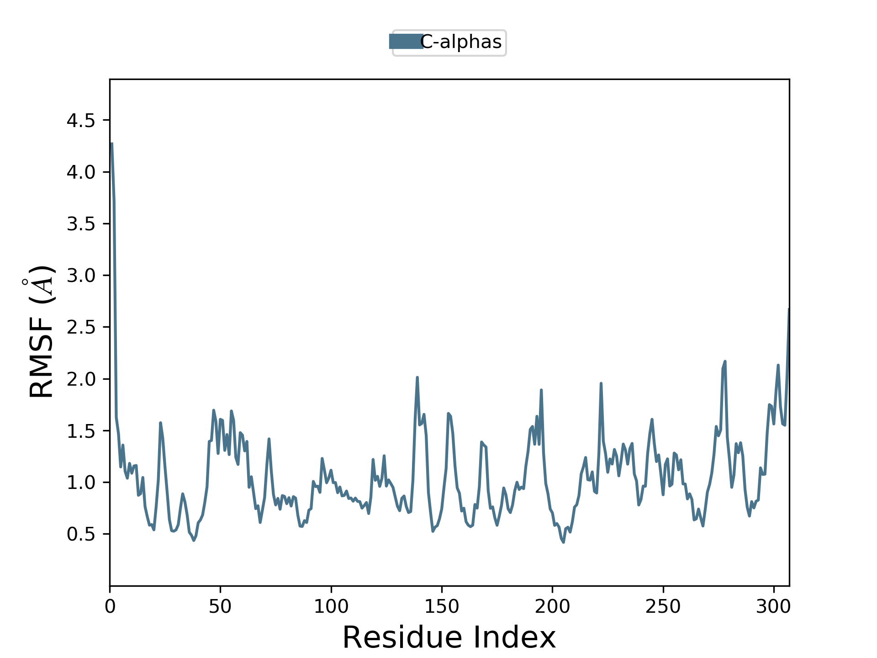
Supplementary Figure 3B: Root mean square fluctuation plot of main protease and in the presence of theaflavin digallate (Replicate 1). The simulation was carried out for 200 ns on GTX 1070 GPU with Desmond 2019 and OPLS 2005 force field. Left Y-axis represents the RMSF of main protease and X-axis represents the residue number of main protease.

Slide 12
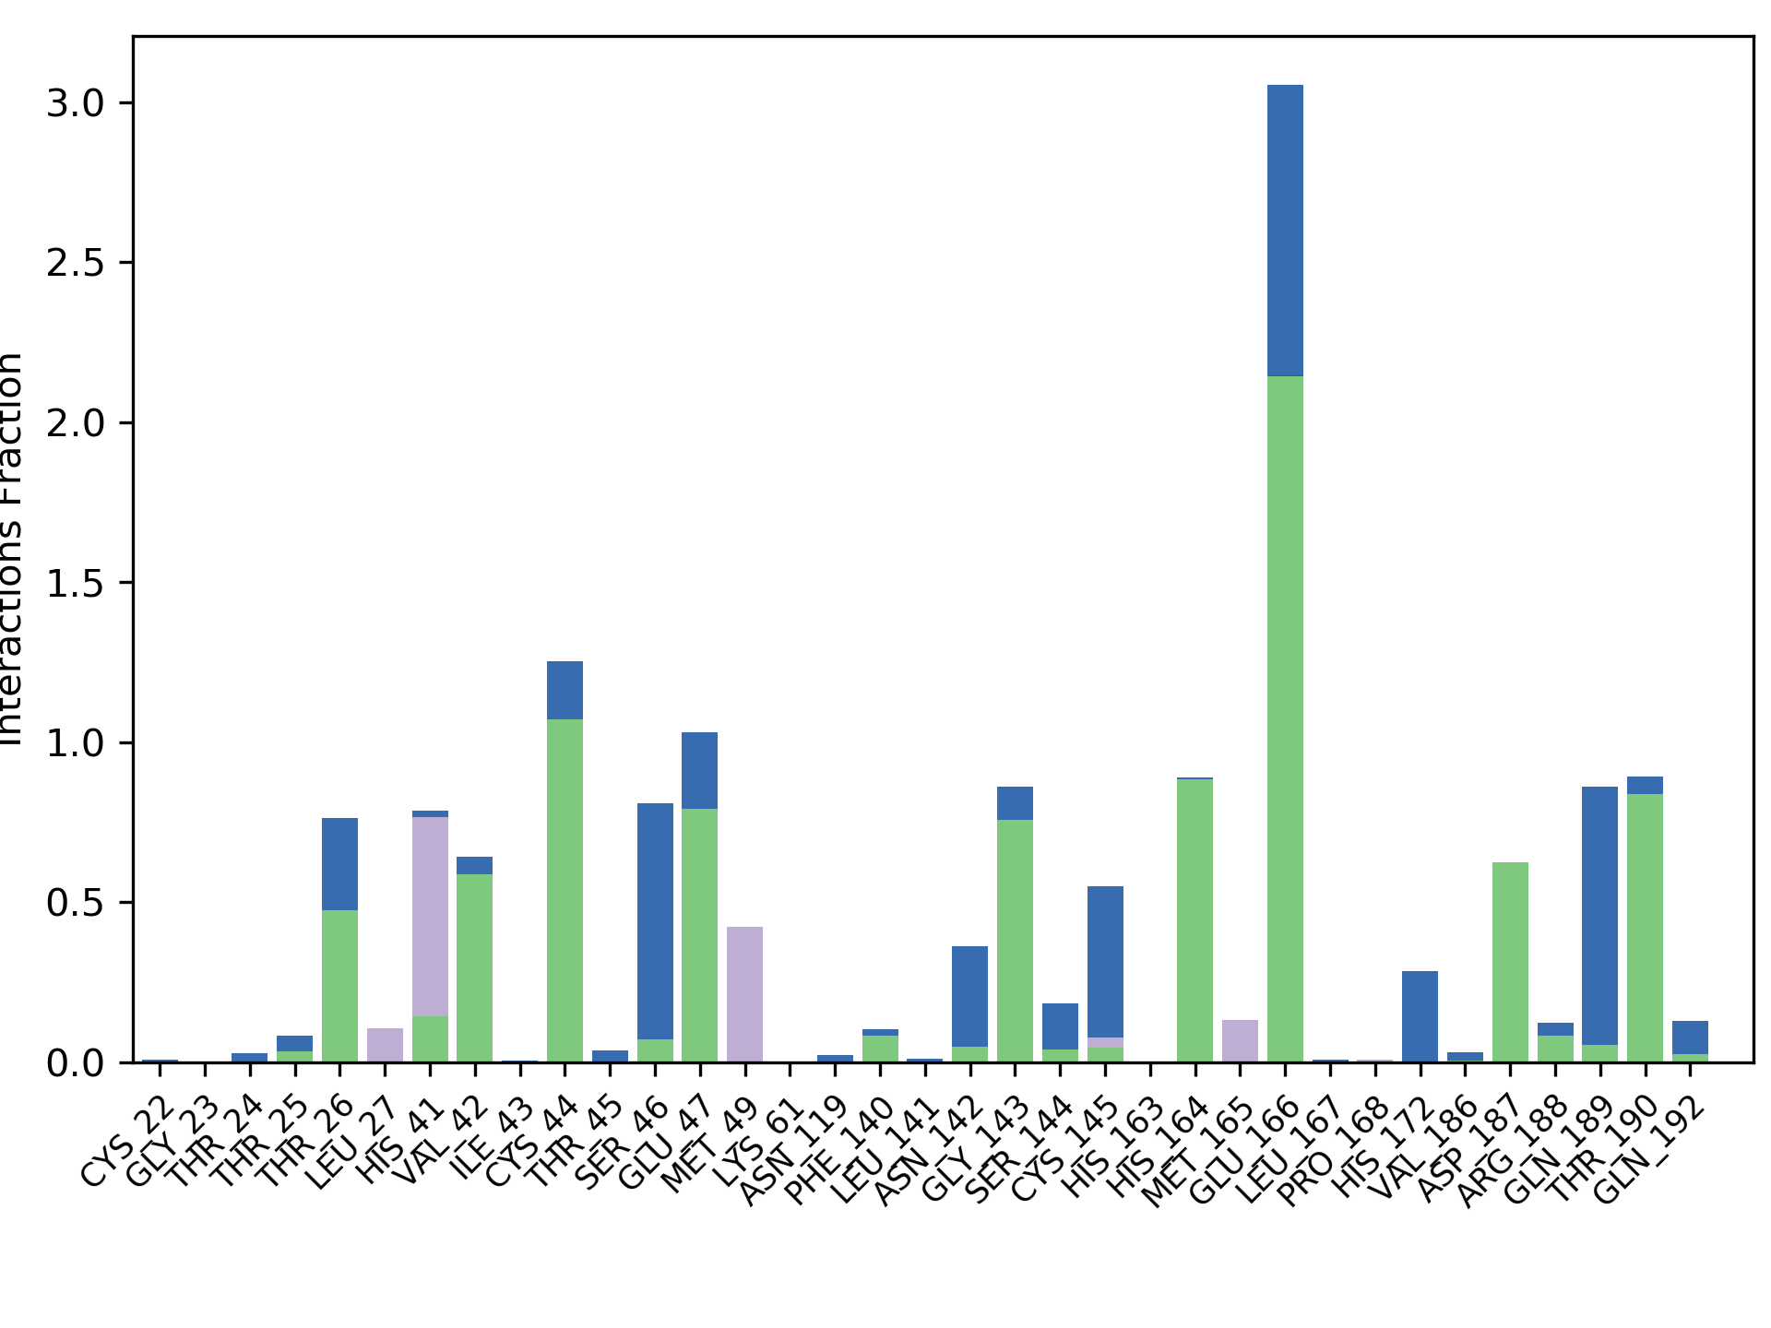

Interaction fraction
Supplementary Figure 3C: Interaction plot of main protease with theaflavin digallate (replicate 1). The simulation was carried out for 200 ns on GTX 1070 GPU with Desmond 2019, and OPLS 2005 force field. Y-axis represents the total number of contact fractions per residue per simulation time i.e., if the residue (presented on X-axis) has one contact during the whole simulation of 200 ns, it will have interaction fraction score of 1. Glu 166 has a score of ~3, which represents that Glu166 retains at least three total contacts during the whole simulation.

Slide 13
Supplementary Figure 4A: Root mean square deviation plot of C- alpha atoms of main protease and theaflavin digallate (replicate 2). The simulation was carried out for 200 ns on GTX1070 GPU with Desmond 2019 and OPLS 2005 force field. The main protease RMSD is represented in pink line whereas theaflavin digallate in dark line. Left Y-axis represent the RMSD of main protease and Right Y-axis represent the RMSD of theaflavin digallate aligned on protein. X axis represent the simulation time in nano second.

Slide 14
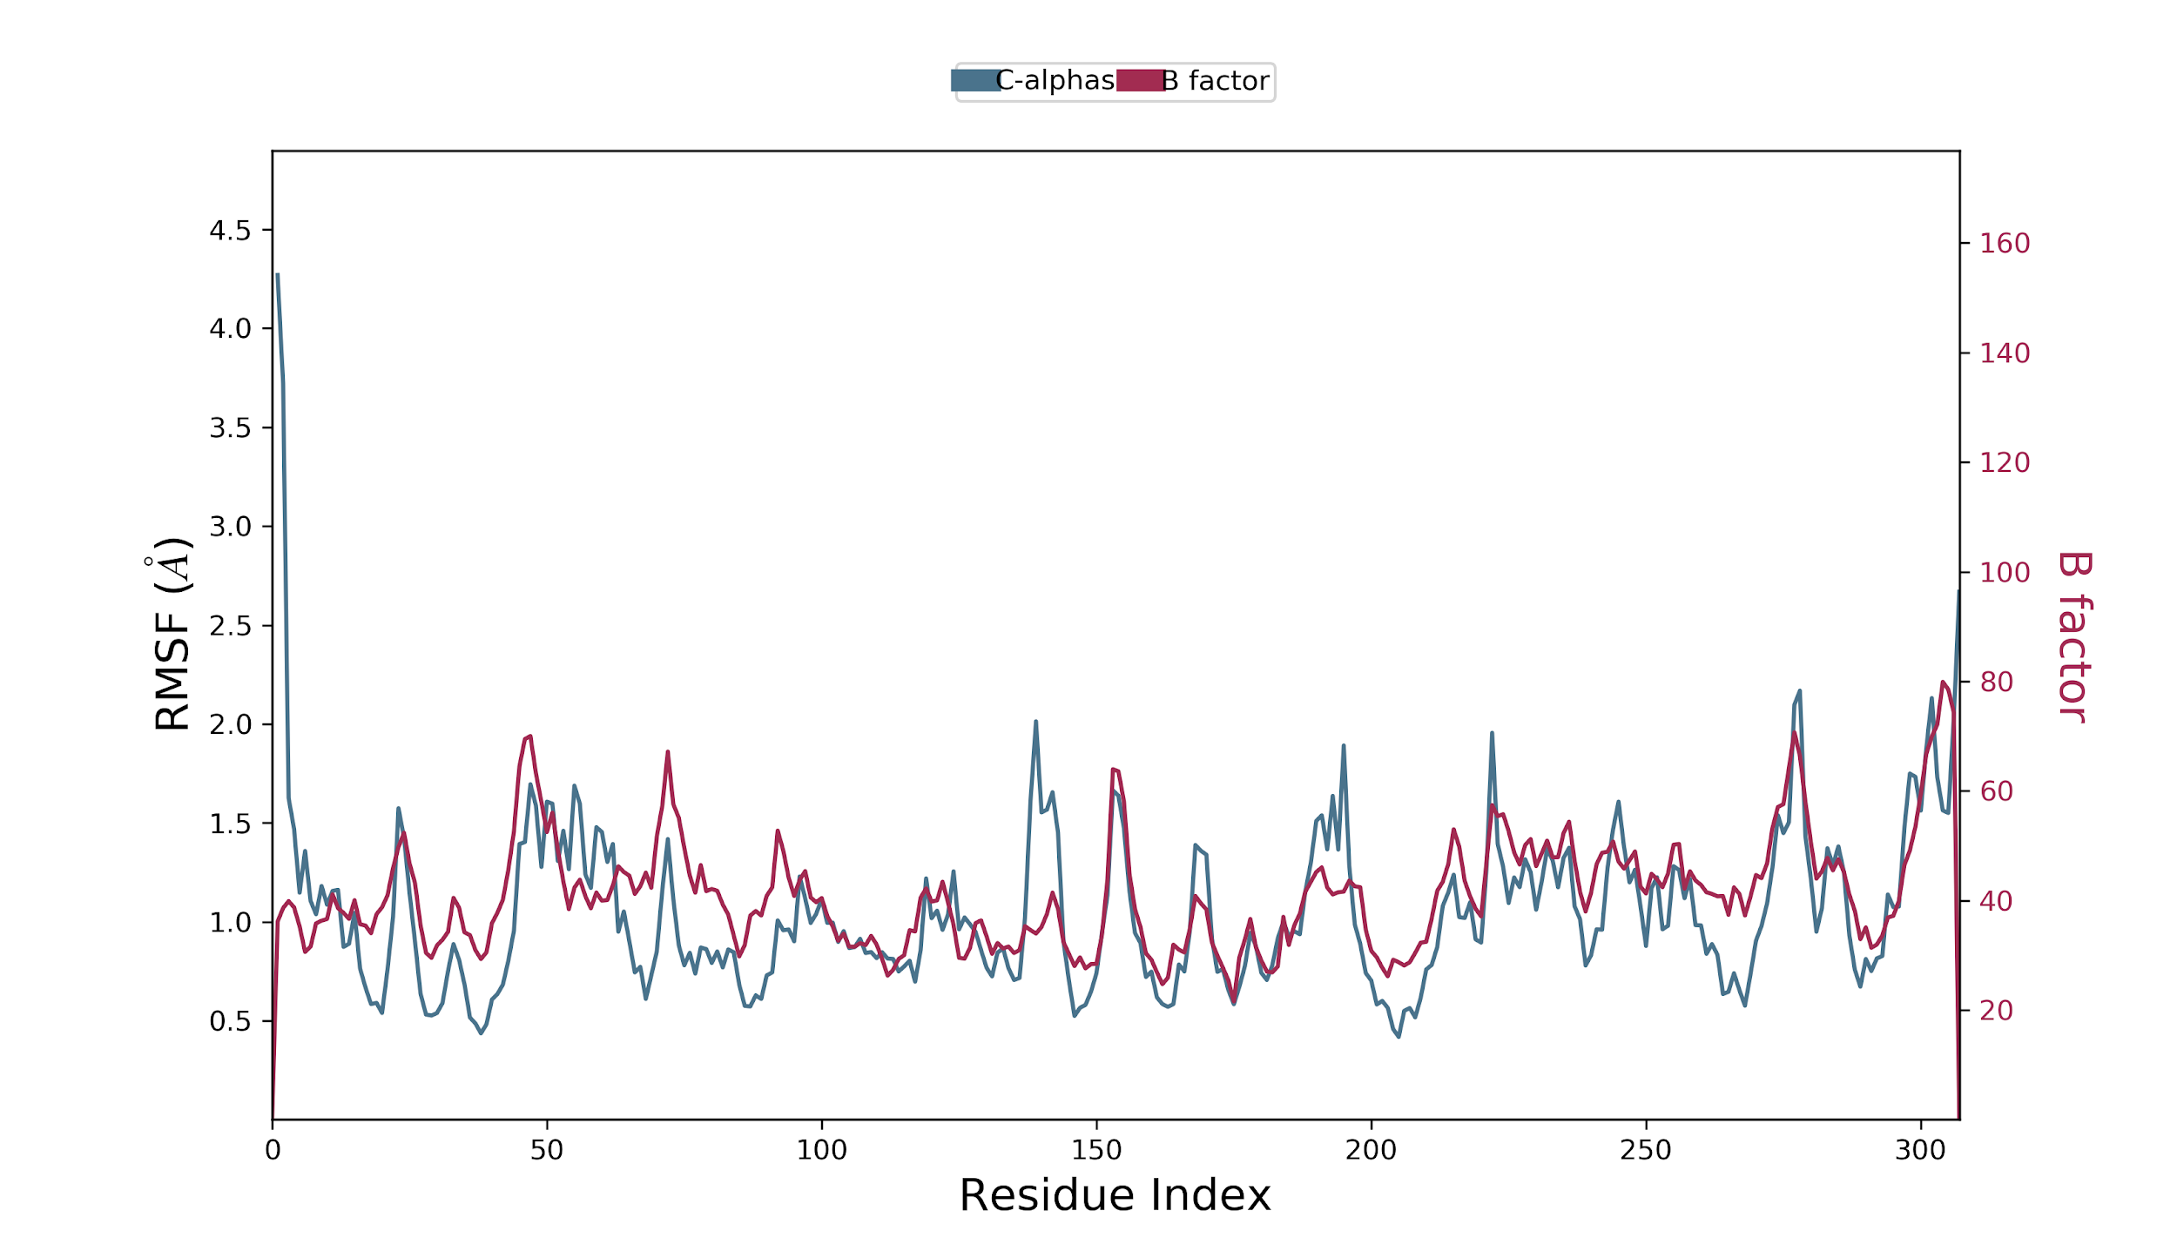
Interaction fraction
Supplementary Figure 4B: Root mean square fluctuation plot of main protease and in the presence of theaflavin digallate (Replicate 2). Pink line shows the variations in RMSF values wheresas the dark line show the B-factor from original X-ray crystallography experiments. The simulation was carried out for 200 ns on GTX 1070 GPU with Desmond 2019 and OPLS 2005 force field. Left Y-axis represent the RMSF of main protease and whereas right Y axis represent the B-factor of main protease from X-ray crystallography experiments. represent the residue number of main protease. The B factors values are aligned with RMSF values, which confirms the simulation mimics the native experimental conditions.

Slide 15
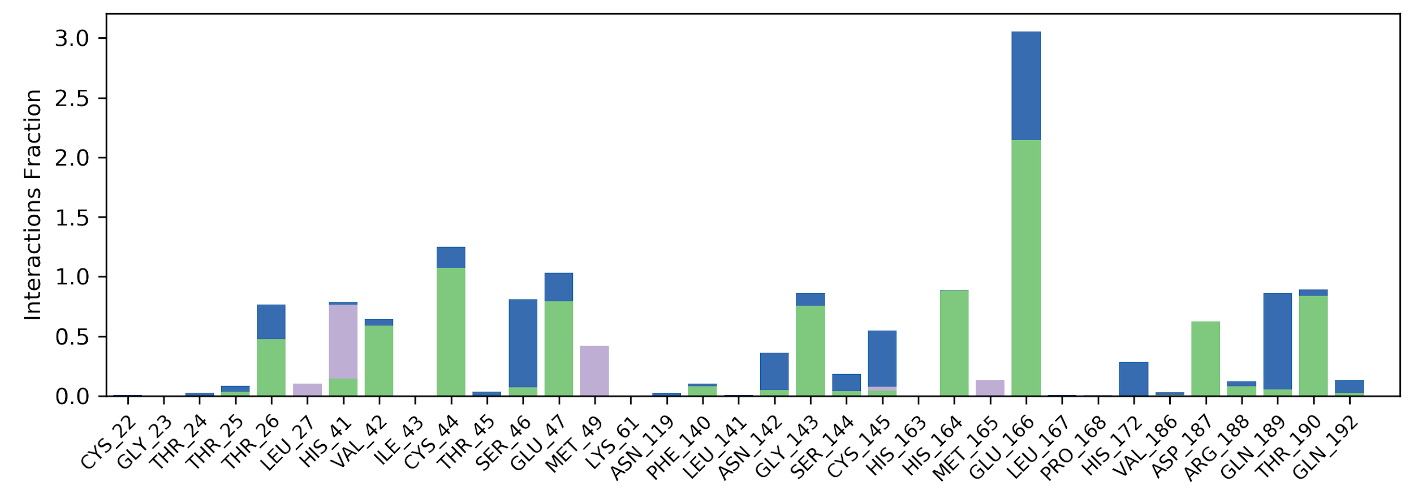
Interaction fraction
Supplementary Figure 6C: Interaction plot of main protease with theaflavin digallate (replicate 2). The simulation was carried out for 200 ns on GTX 1070 GPU with Desmond 2019 and OPLS 2005 force field Y axis represent the total number of contact fraction per residue per simulation time i.e. if the residue (presented on X-axis) has one contact during the whole simulation of 200 ns, it will have interaction fraction score of 1. Glu 166 has score ~3, which represents Glu 166 retain at least three total contacts during the whole simulation.

Slide 16
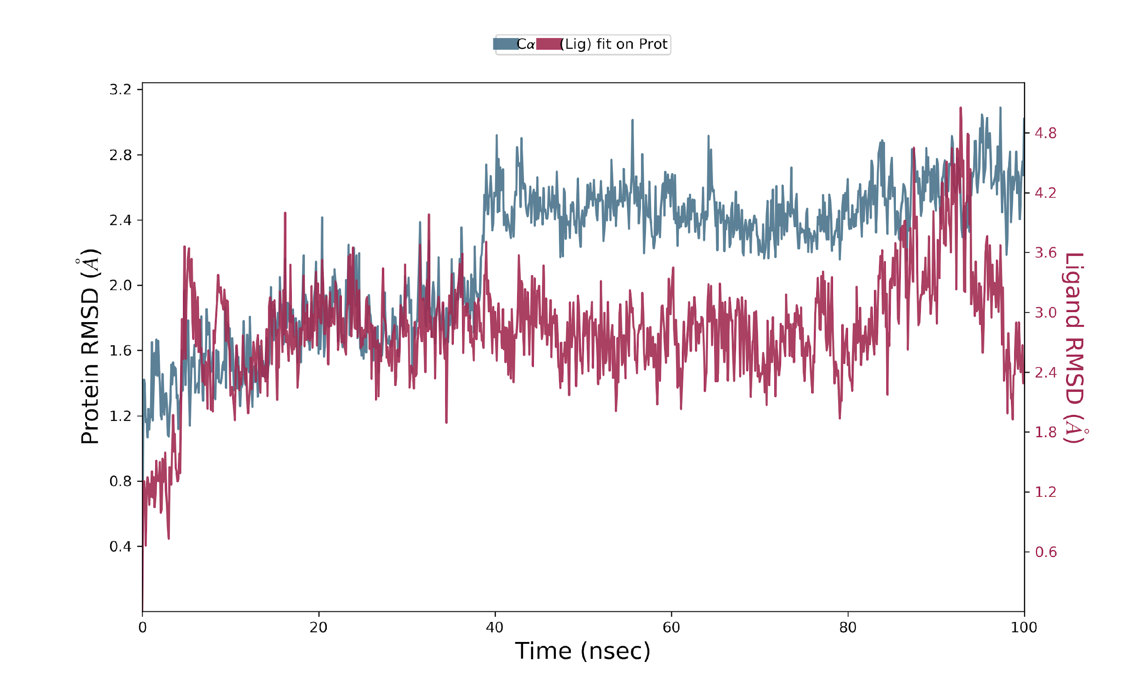
Supplementary Figure 5A: Root mean square deviation plot of C- alpha atoms of main protease and theaflavin digallate. The simulation was carried out for 100 ns on Tesla K40 GPU with Desmond 2019 and OPLS 2005 force field. The main protease RMSD is represented in pink line whereas theaflavin digallate in dark line. Left Y-axis represent the RMSD of main protease and Right Y-axis represent the RMSD of theaflavin digallate aligned on protein. X axis represent the simulation time in nano second.

Slide 17
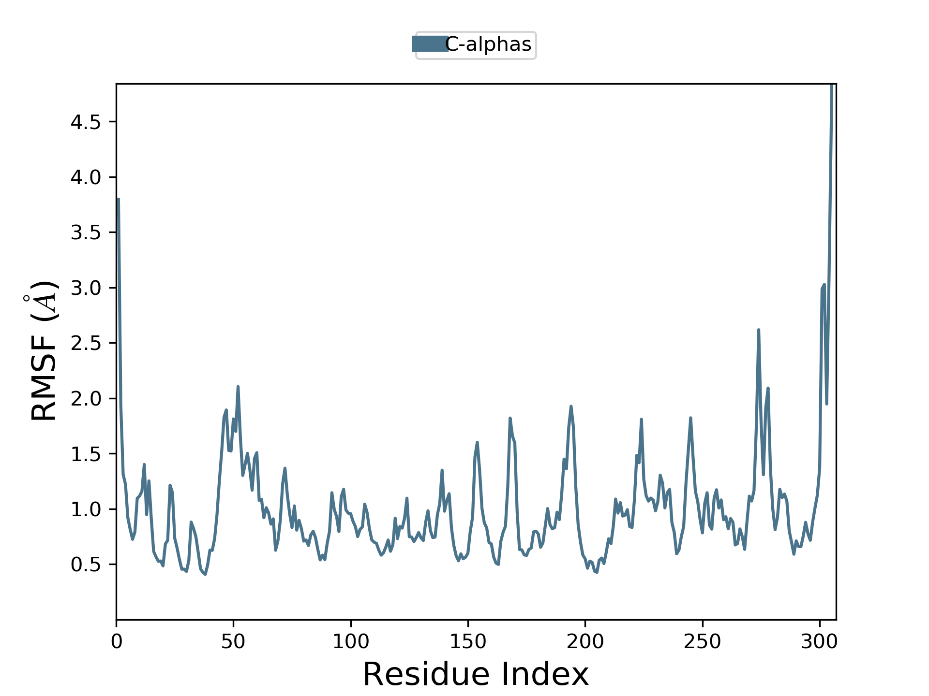
Supplementary Figure 5B: Root mean square fluctuation plot of main protease. The simulation was carried out for 100 ns on Tesla K40 GPU with Desmond 2019 and OPLS 2005 force field. Left Y-axis represent the RMSF of main protease and X axis represent the residue number of main protease.

Slide 18
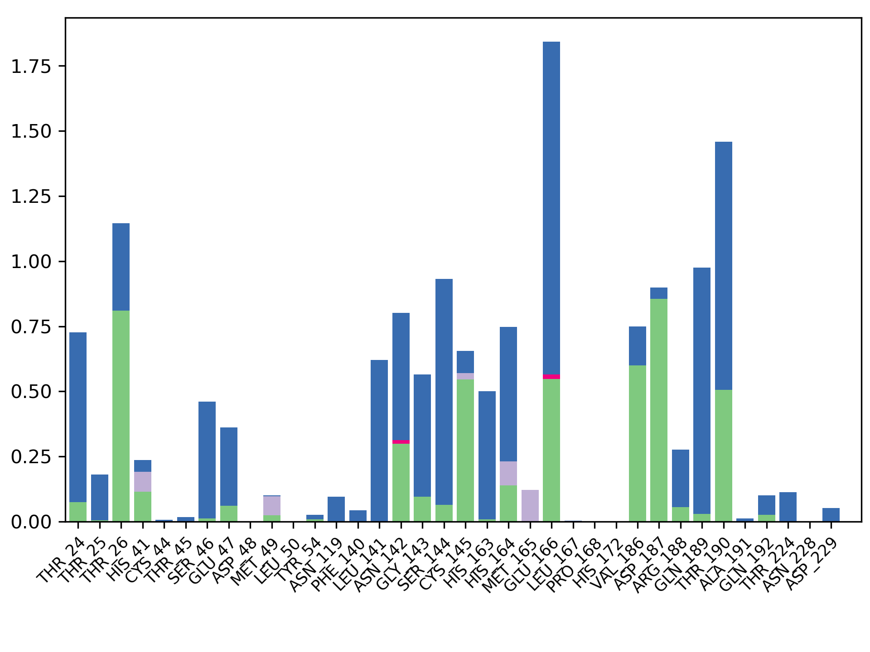
Interaction fraction
Supplementary Figure 5C: Interaction plot of main protease with theaflavin digallate. The simulation was carried out for 100 ns on Tesla K40 GPU with Desmond 2019 and OPLS 2005 force field. Y axis represent the total number of contact fraction per residue per simulation time i.e. if the residue (presented on X-axis) has one contact during the whole simulation of 100 ns, it will have interaction fraction score of 1. Figure shows the prominent interaction of theaflavin digallate with Glu 166 of main protease.

Slide 19
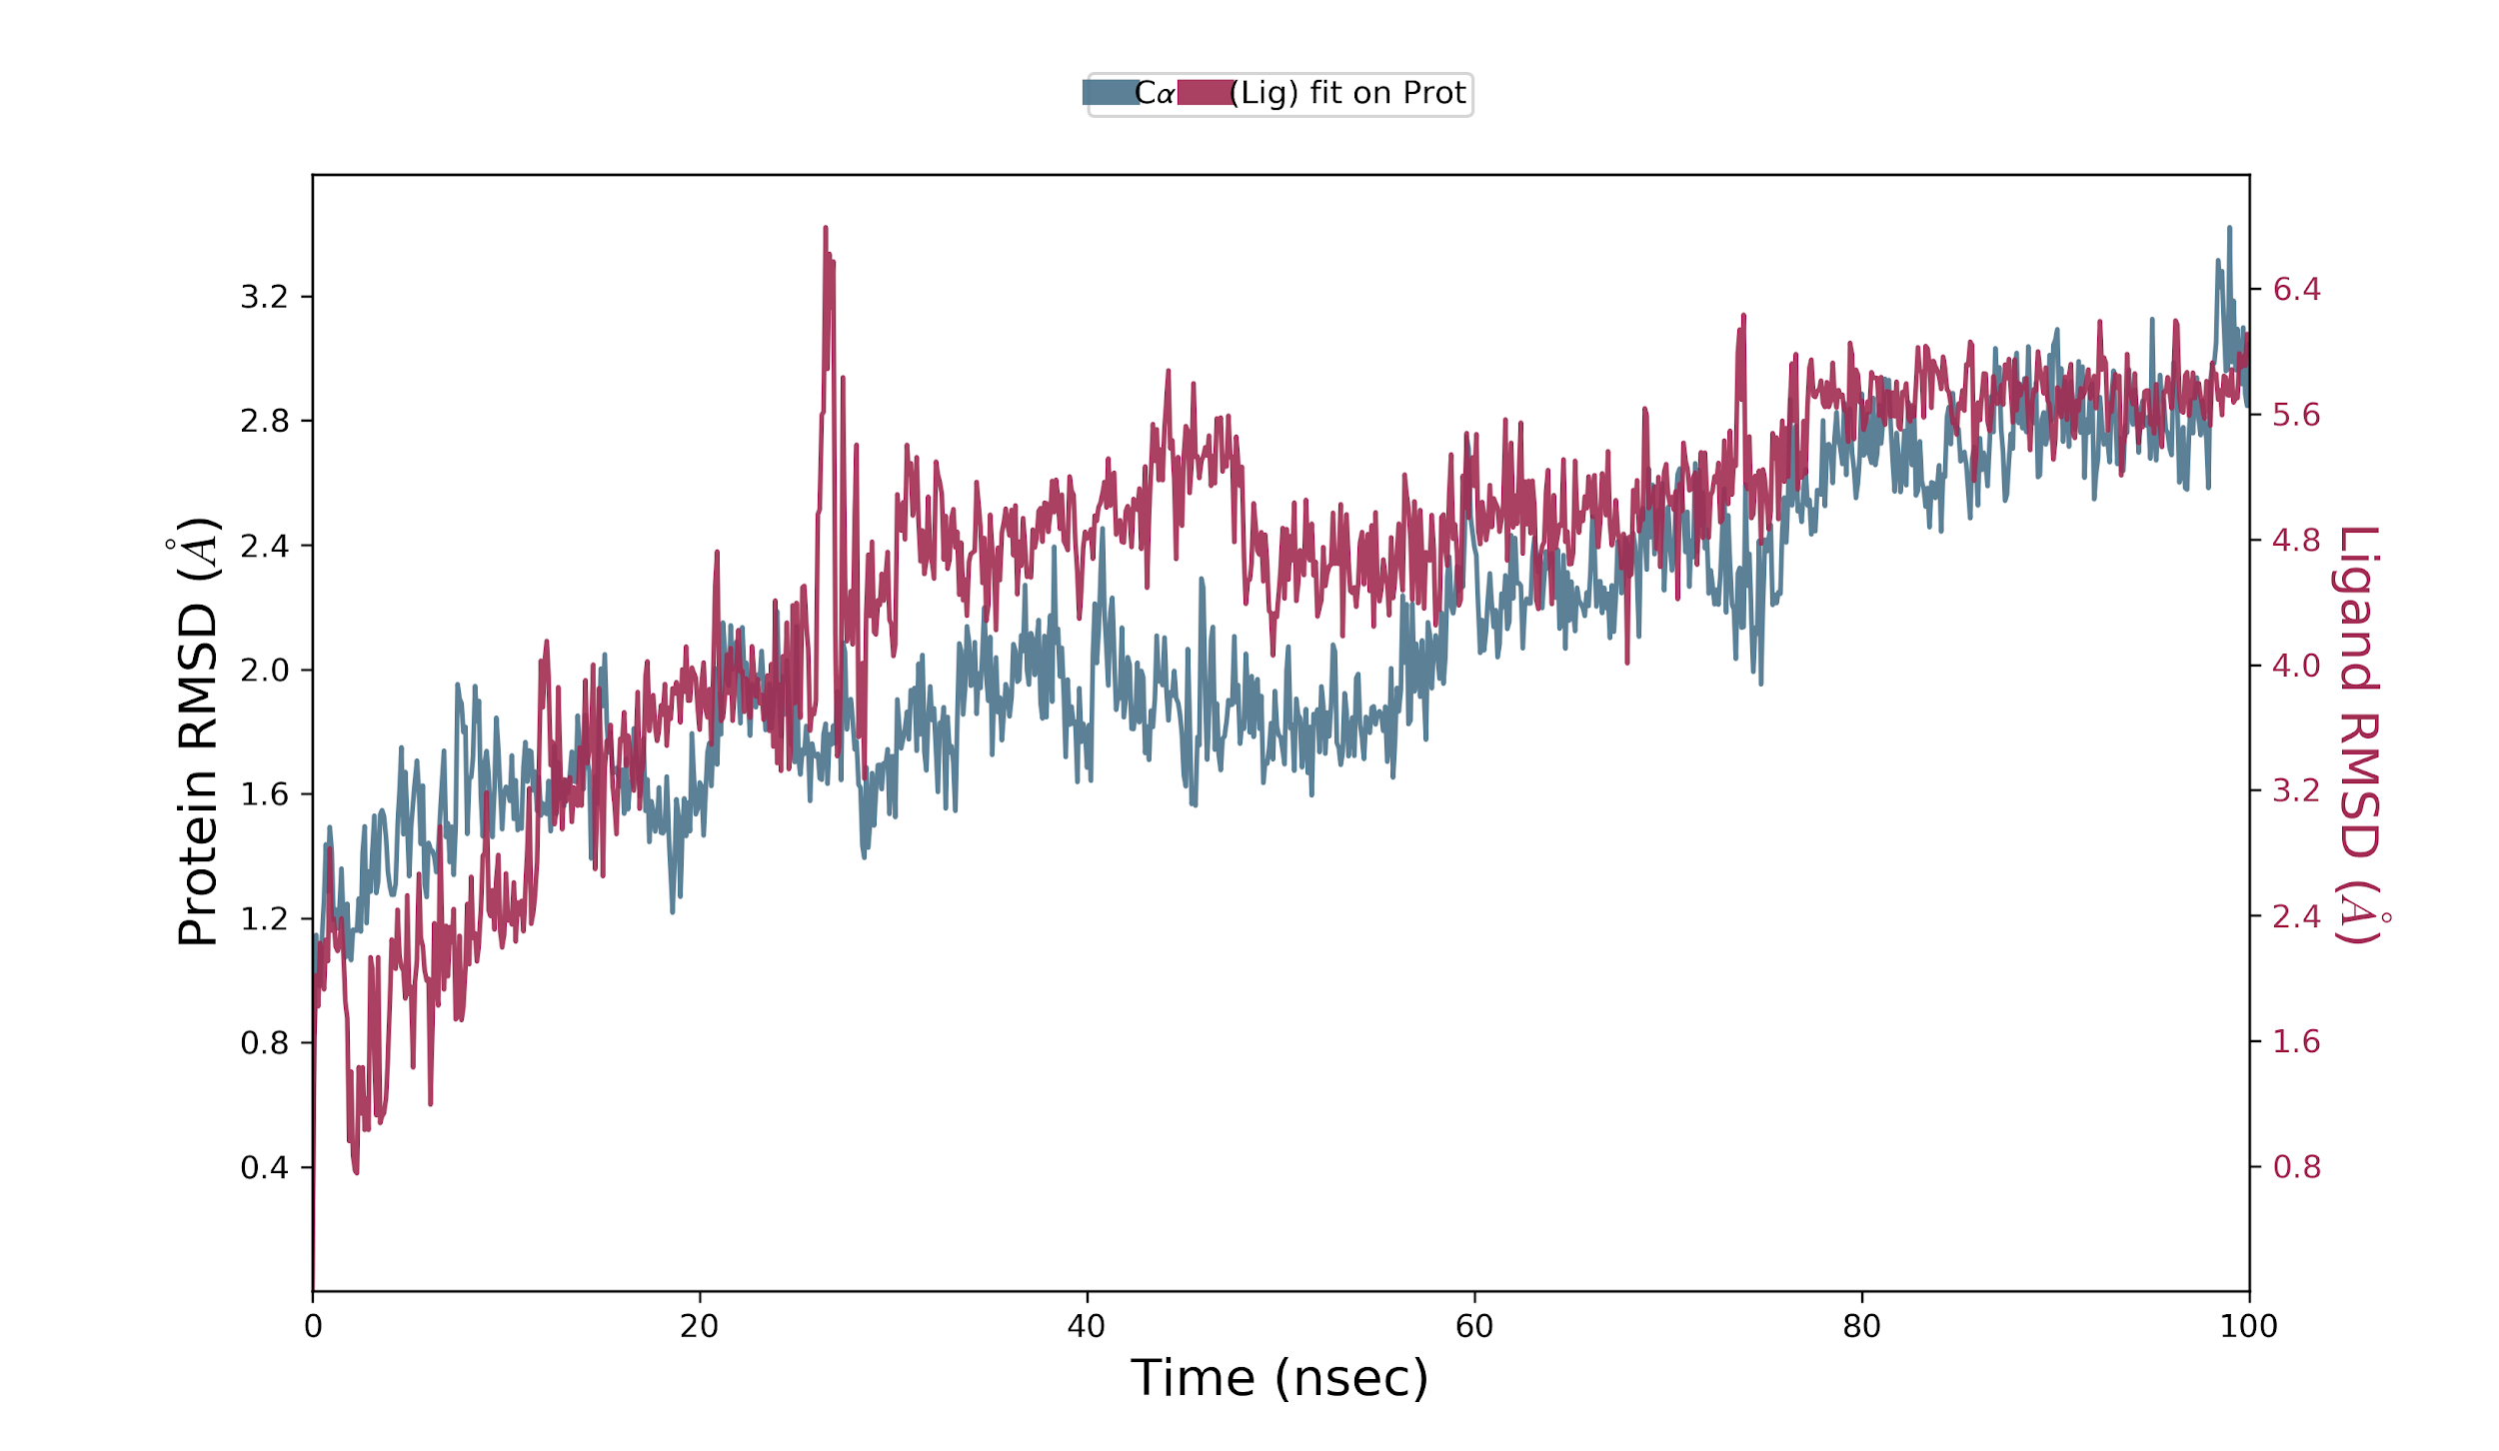
Supplementary Figure 6A: Root mean square deviation plot of C- alpha atoms of main protease and theaflavin digallate. The simulation was carried out for 100 ns on Tesla K40 GPU with Desmond 2019 and OPLS 2005 force field. The used input structure was after the simulation of 100 ns. The main protease RMSD is represented in pink line whereas theaflavin digallate in dark line. Left Y-axis represent the RMSD of main protease and Right Y-axis represent the RMSD of theaflavin digallate aligned on protein. X axis represent the simulation time in nano second.

Slide 20
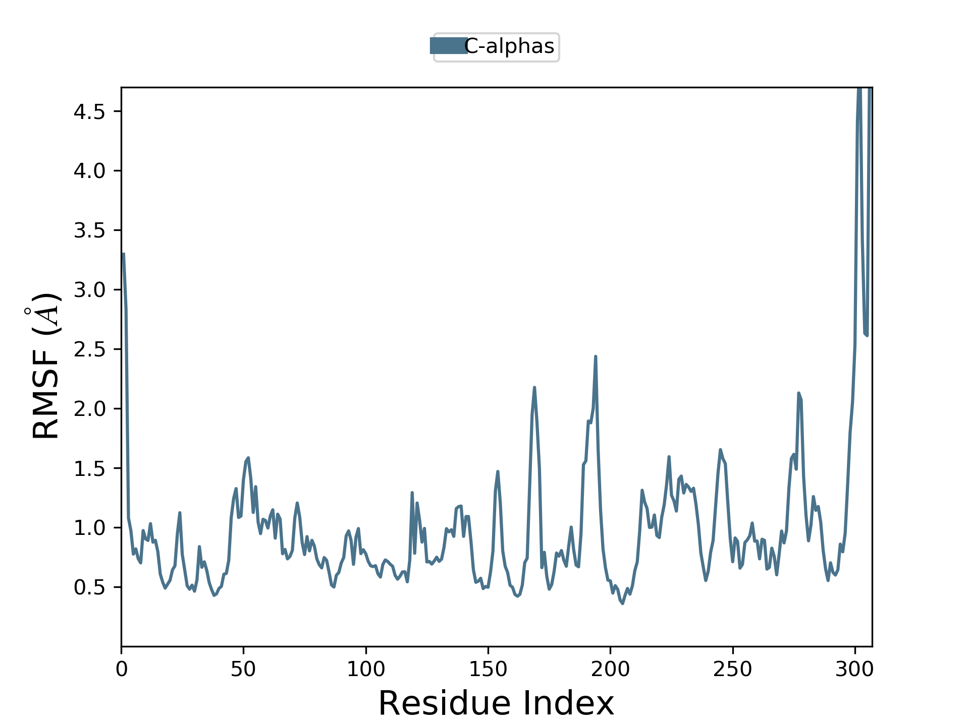
Supplementary Figure 6B: Root mean square fluctuation plot of main protease. The simulation was carried out for 100 ns on Tesla K40 GPU with Desmond 2019 and OPLS 2005 force field The used input structure was after the simulation of 100 ns. Left Y-axis represent the RMSF of main protease and X axis represent the residue number of main protease.

Slide 21
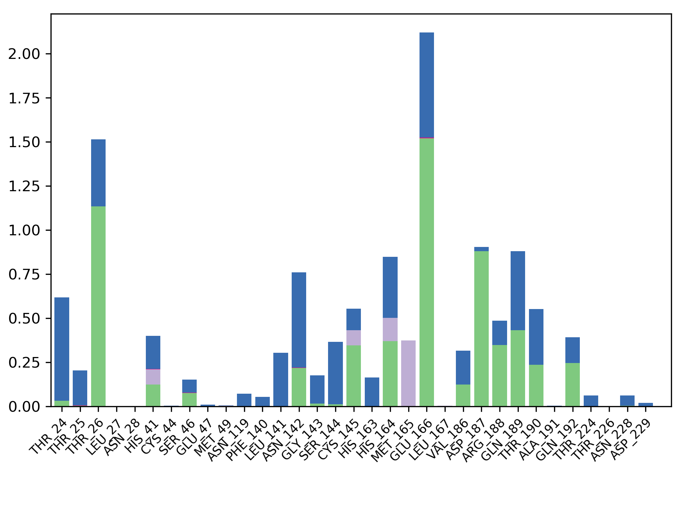
Supplementary Figure 6C: Interaction plot of main protease with theaflavin digallate. The simulation was carried out for 100 ns on Tesla K40 GPU with Desmond 2019 and OPLS 2005 force field. The used input structure was after the simulation of 100 ns. Y axis represent the total number of contact fraction per residue per simulation time i.e. if the residue (presented on X-axis) has one contact during the whole simulation of 100 ns, it will have interaction fraction score of 1. Figure shows the prominent interaction of theaflavin digallate with Glu 166 of main protease.

Slide 22
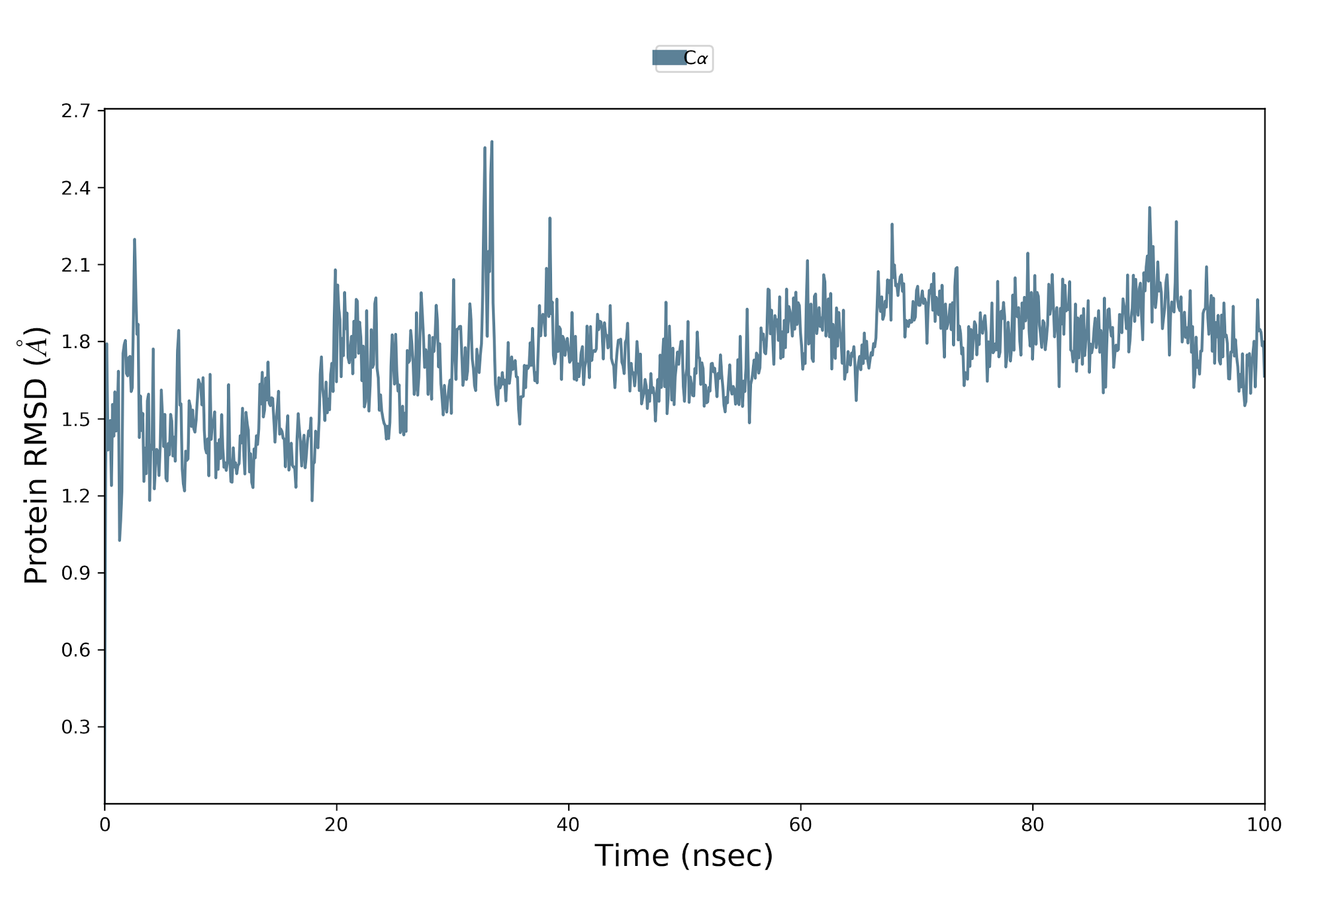
Supplementary Figure 7A: Root mean square deviation plot of C- alpha atoms of main protease and in the absence of theaflavin digallate. The simulation was carried out for 100 ns on Tesla K40 GPU with Desmond 2019 and OPLS 2005 force field. The main protease RMSD is represented in pink line. Left Y-axis represent the RMSD of main protease and X axis represent the simulation time in nano second

Slide 23
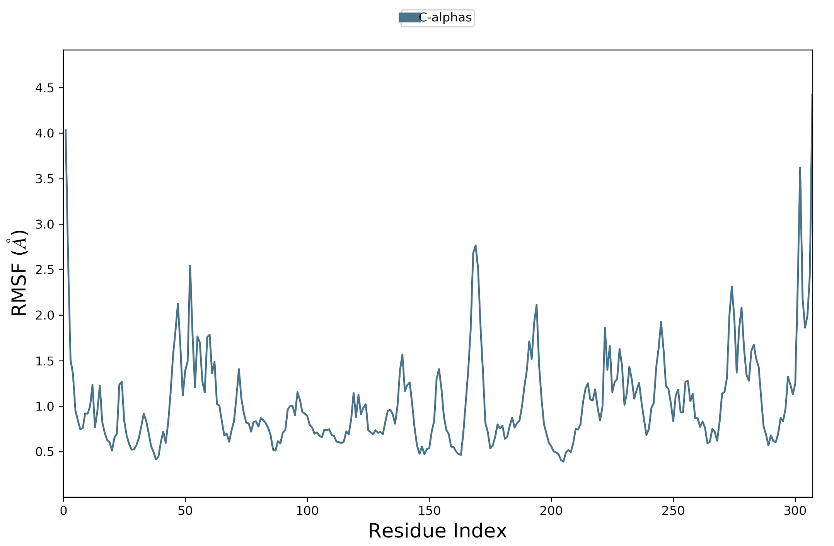
Supplementary Figure 7B: Root mean square fluctuation plot of main protease in the absence of theaflavin digallate. The simulation was carried out for 100 ns on Tesla K40 GPU with Desmond 2019 and OPLS 2005 force field. Left Y-axis represent the RMSF of main protease and X axis represent the residue number of main protease.

Slide 24
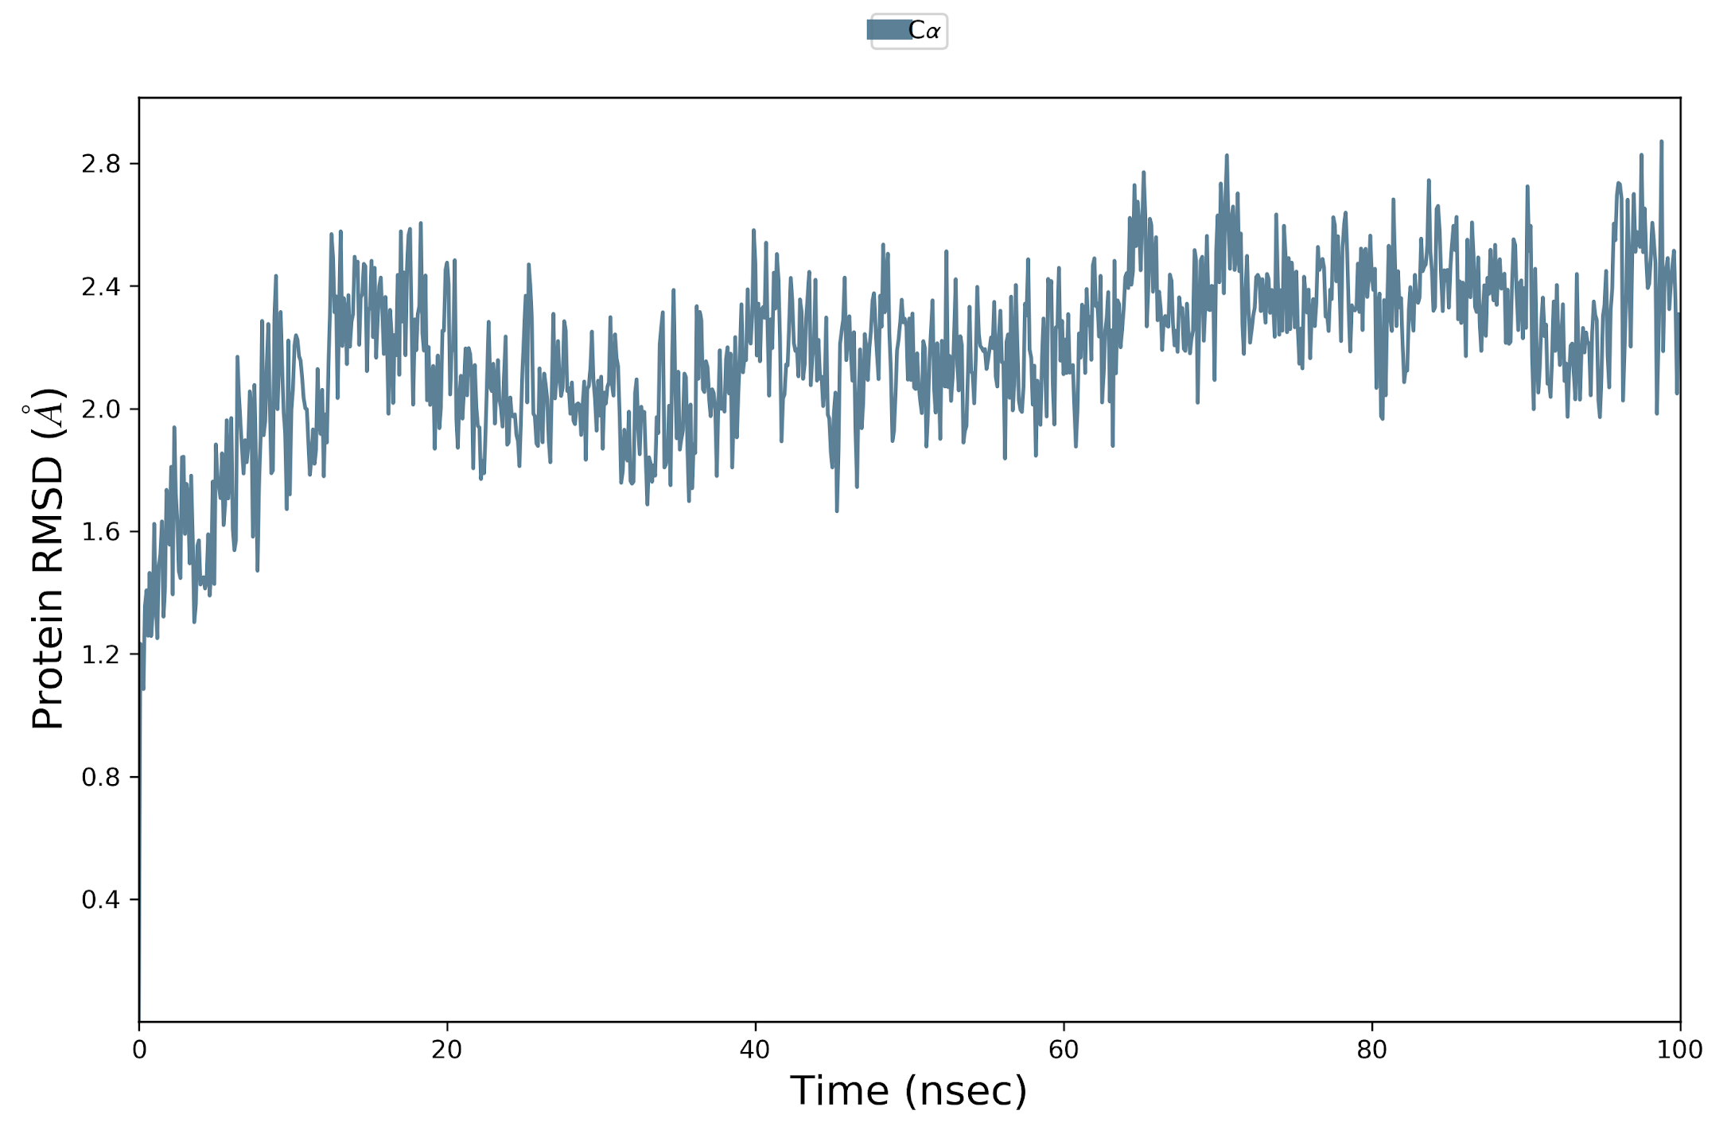
Supplementary Figure 8A: Root mean square deviation plot of C- alpha atoms of another template of main protease (PDB ID 6y84) and in the absence of theaflavin digallate. The simulation was carried out for 100 ns on Tesla K40 GPU with Desmond 2019 and OPLS 2005 force field. The main protease RMSD is represented in pink line. Left Y-axis represent the RMSD of main protease and X axis represent the simulation time in nano second

Slide 25
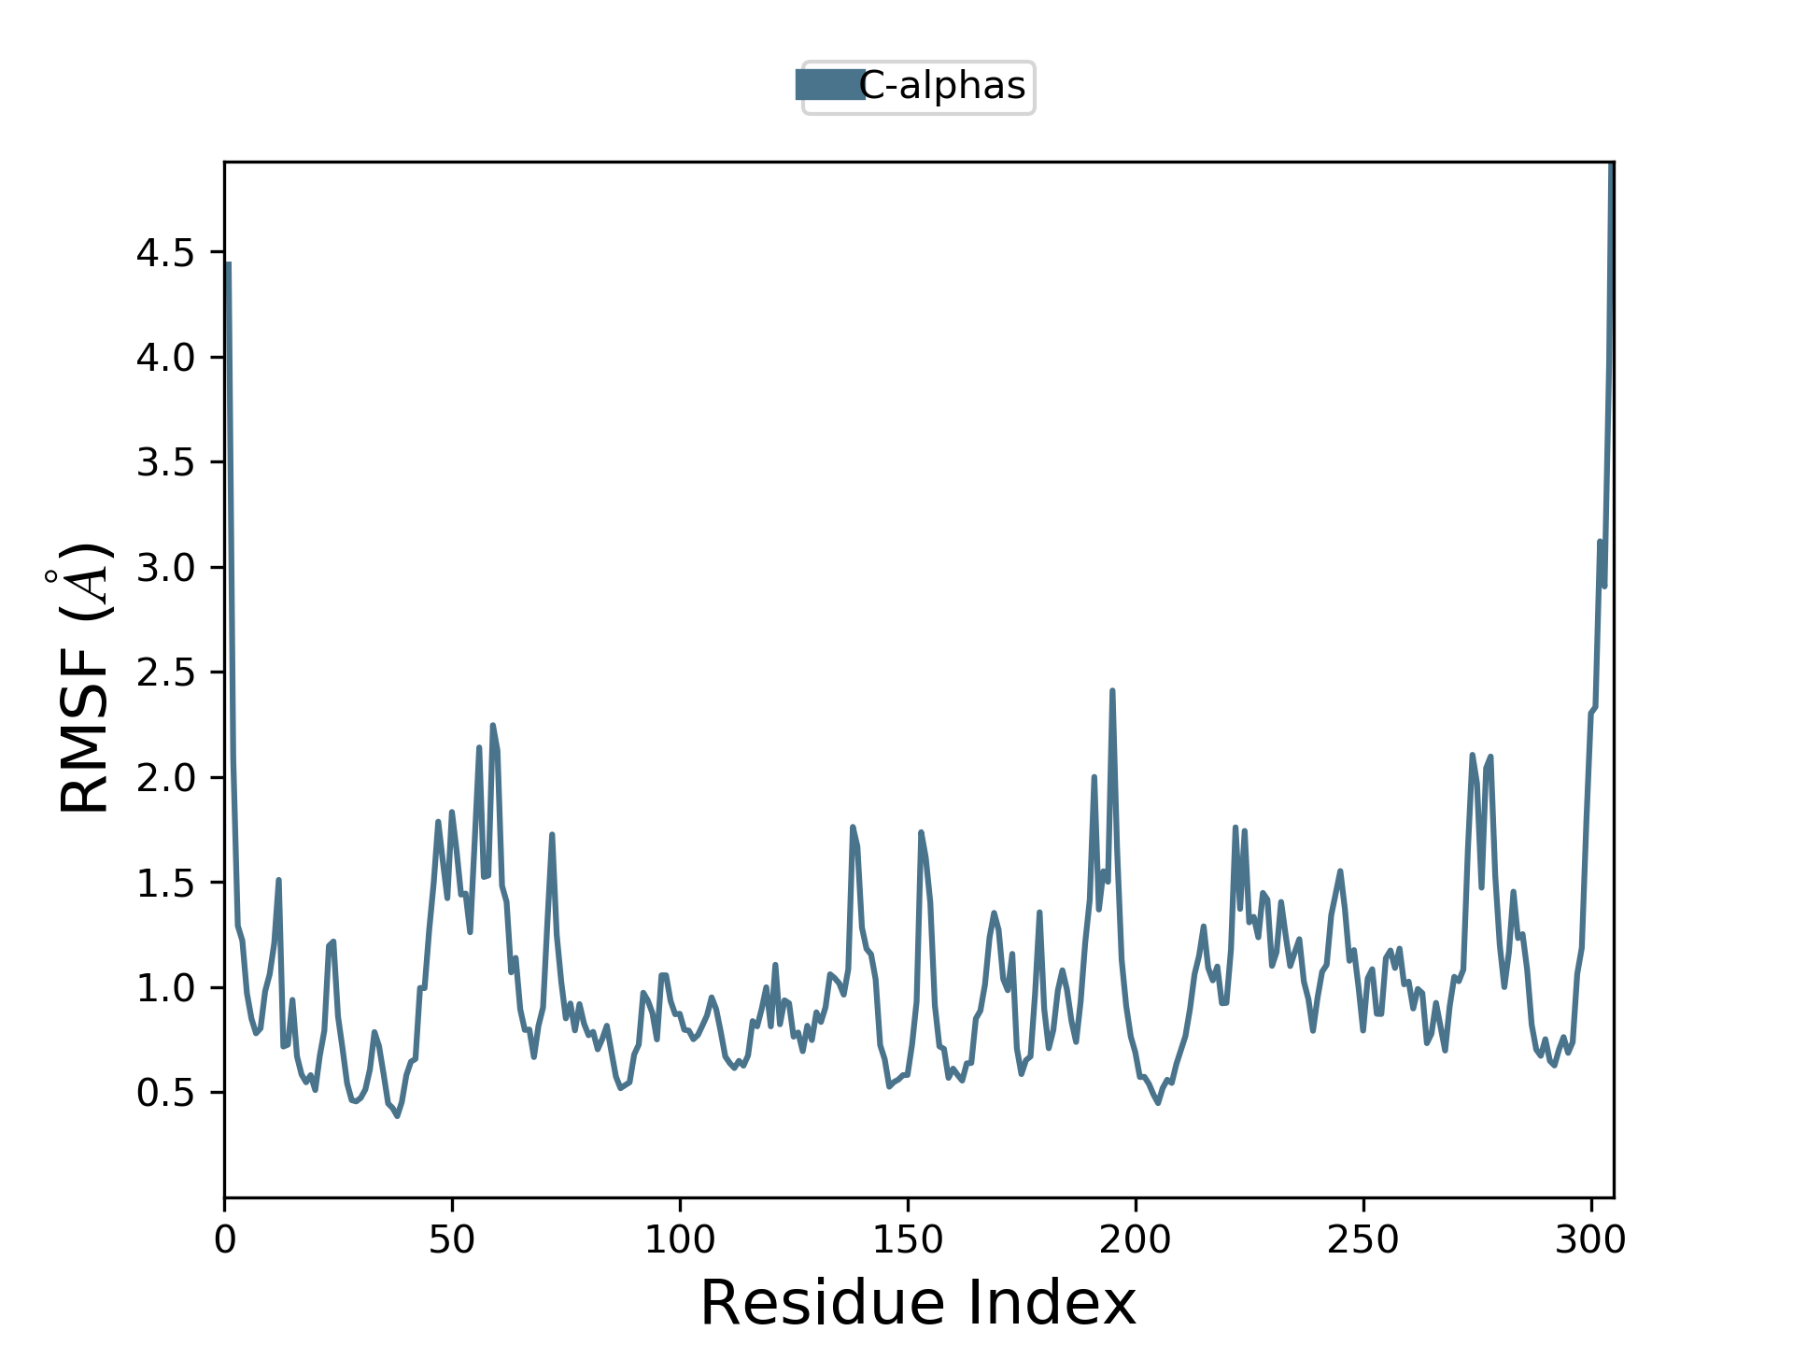
Supplementary Figure 8B: Root mean square fluctuation plot of another template of main protease (PDB ID 6y84) and in the absence of theaflavin digallate. The simulation was carried out for 100 ns on Tesla K40 GPU with Desmond 2019 and OPLS 2005 force field. Left Y-axis represent the RMSF of main protease and X axis represent the residue number of main protease.

Slide 26
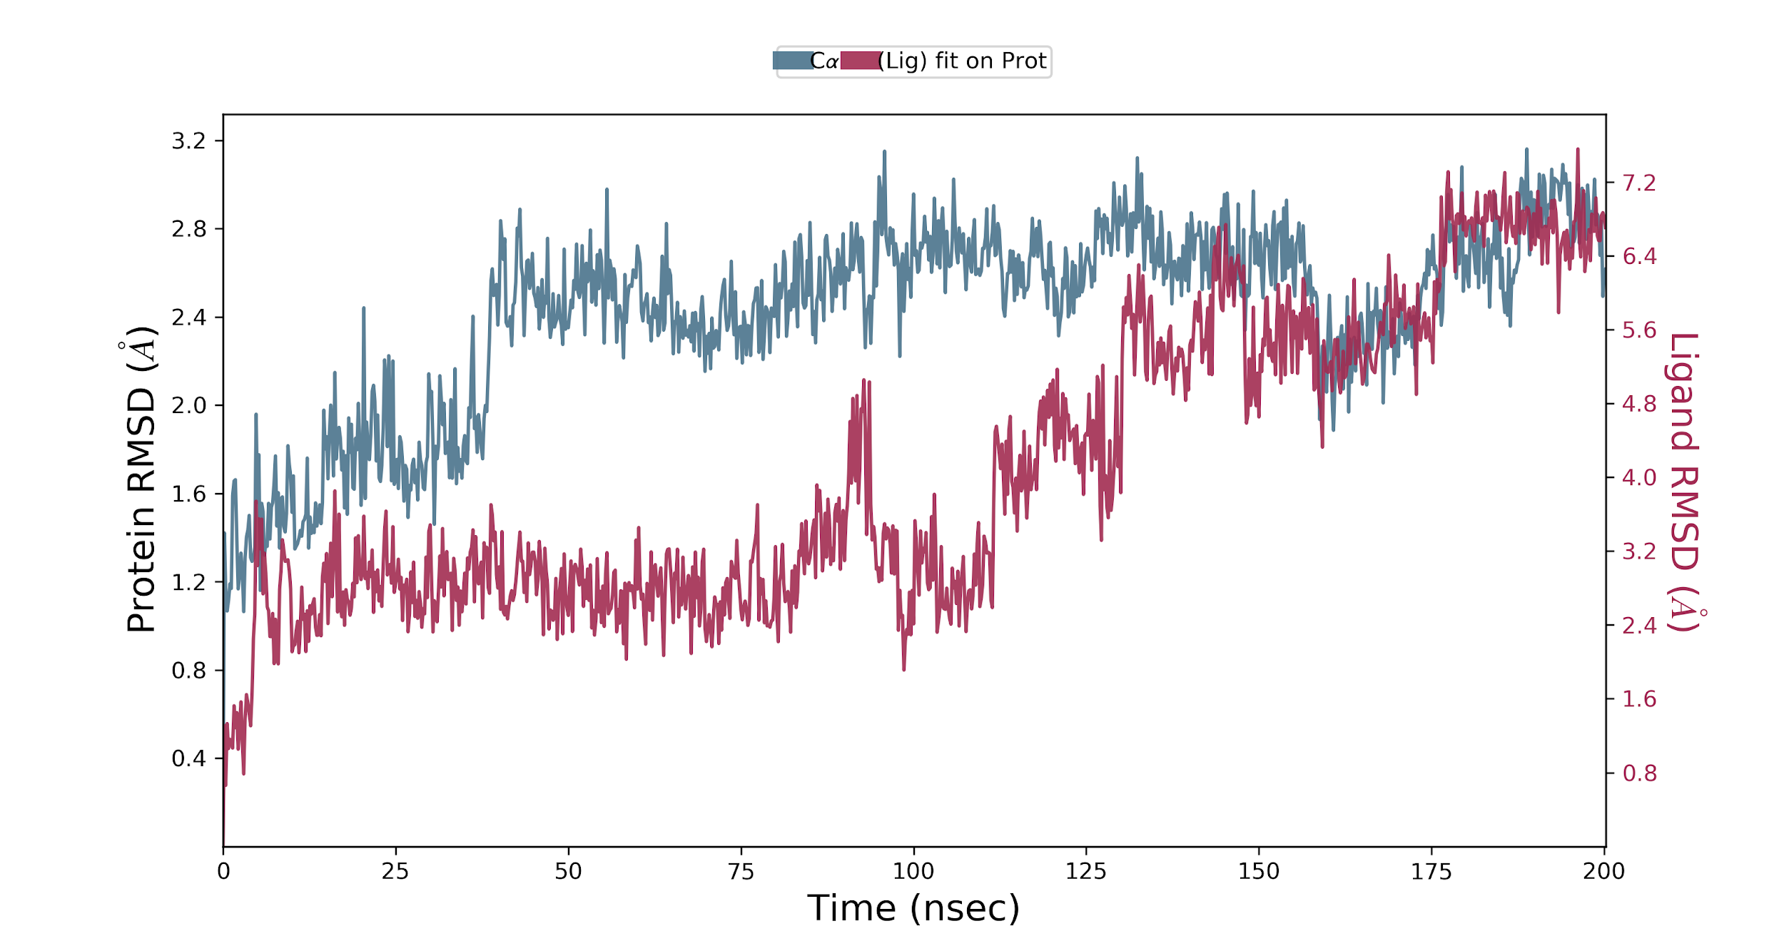
Supplementary Figure 9A: Root mean square deviation plot of C- alpha atoms of main protease and theaflavin digallate. The simulation was carried out for 200 ns on TESLA K40 GPU with Desmond 2019 and OPLS 2005 force field. The main protease RMSD is represented in pink line whereas theaflavin digallate in dark line. Left Y-axis represent the RMSD of main protease and Right Y-axis represent the RMSD of theaflavin digallate aligned on protein. X axis represent the simulation time in nano second.

Slide 27
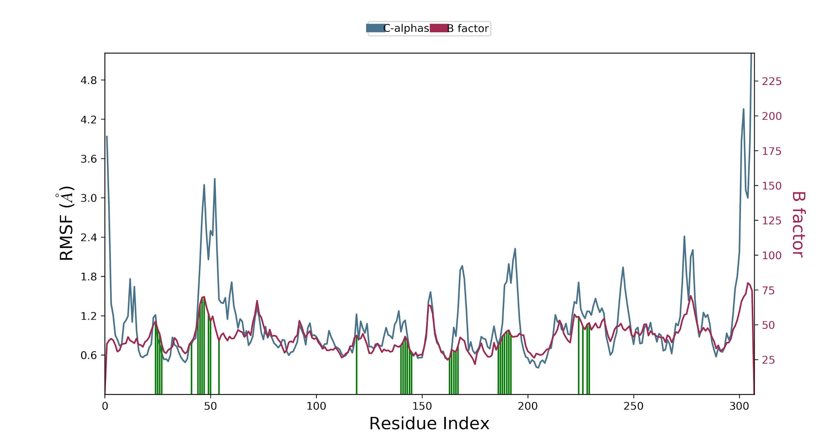
Supplementary Figure 9B: Root mean square fluctuation plot of main protease and in the presence of theaflavin digallate . Pink line shows the variations in RMSF values whereas the dark line show the B-factor from original X-ray crystallography experiments. The vertical red line denote the ligand interacting region. The simulation was carried out for 200 ns on Tesla K40 GPU with Desmond 2019 and OPLS 2005 force field. Left Y-axis represent the RMSF of main protease and whereas right Y axis represent the B-factor of main protease from X-ray crystallography experiments. represent the residue number of main protease.

Slide 28
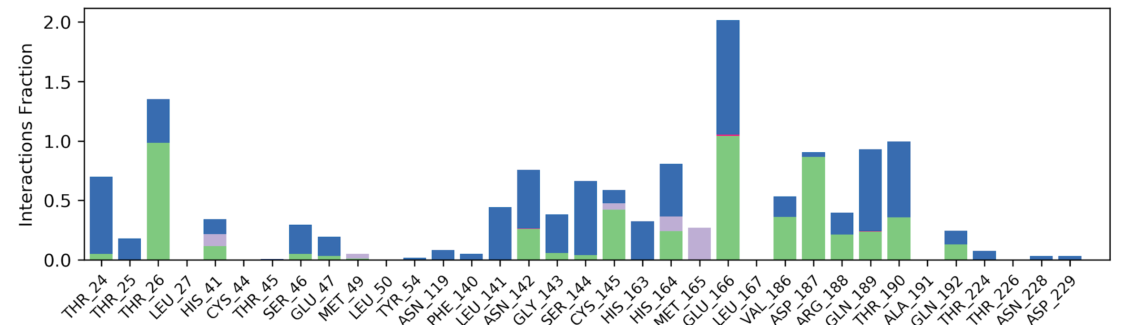
Interaction fraction
Supplementary Figure 9C: Interaction plot of main protease with theaflavin digallate (replicate 2). The simulation was carried out for 200 ns on Tesla K40 GPU with Desmond 2019 and OPLS 2005 force field Y axis represent the total number of contact fraction per residue per simulation time i.e. if the residue (presented on X-axis) has one contact during the whole simulation of 200 ns, it will have interaction fraction score of 1. Glu 166 has score ~2, which represents Glu 166 retain at least three two contacts during the whole simulation.

Slide 29
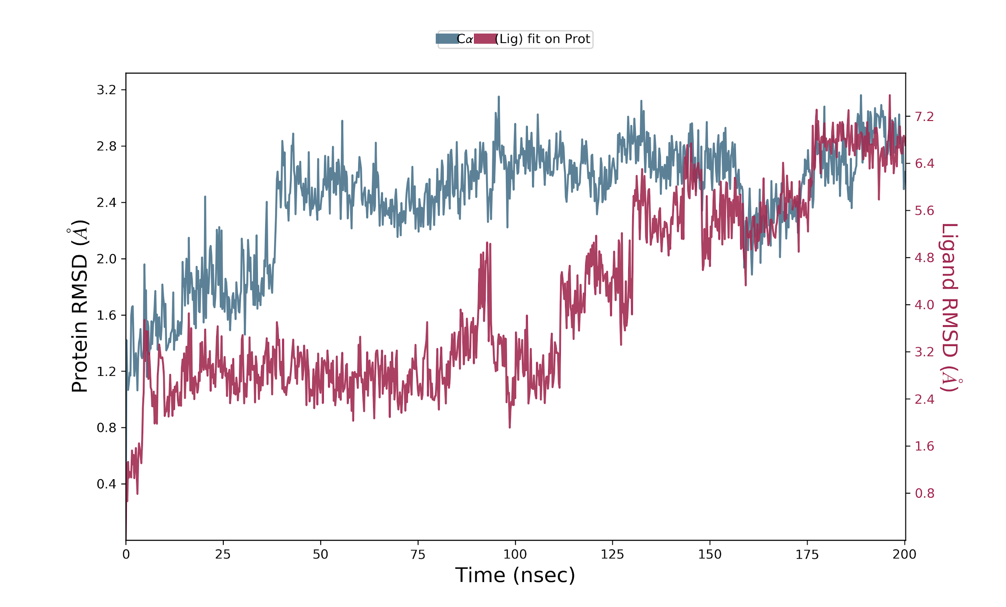
Supplementary Figure 10A: Root mean square deviation plot of C- alpha atoms of main protease and theaflavin digallate (replicate 1). The simulation was carried out for 200 ns on TESLA K40 GPU with Desmond 2019 and OPLS 2005 force field. The main protease RMSD is represented in pink line whereas theaflavin digallate in dark line. Left Y-axis represent the RMSD of main protease and Right Y-axis represent the RMSD of theaflavin digallate aligned on protein. X axis represent the simulation time in nano second.

Slide 30
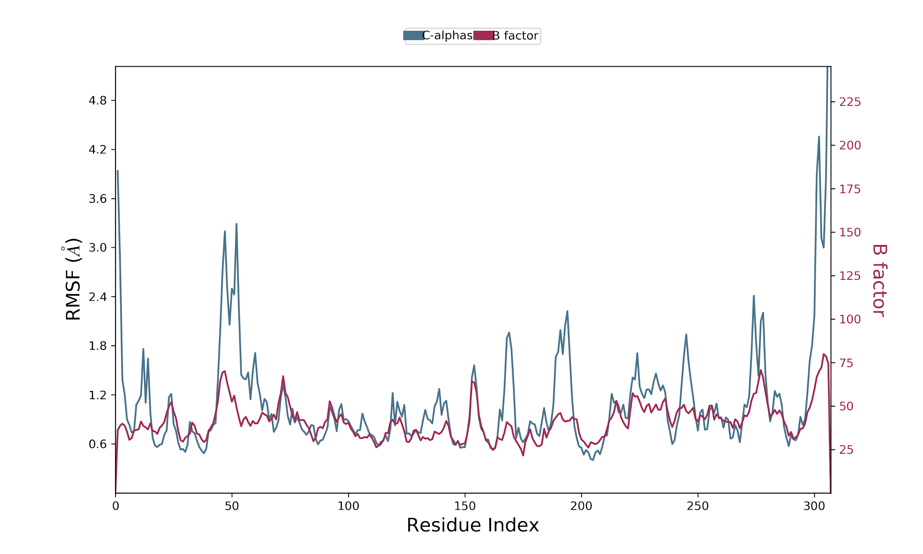
Supplementary Figure 10B: Root mean square fluctuation plot of main protease and in the presence of theaflavin digallate (replicate 1). Pink line shows the variations in RMSF values whereas the dark line show the B-factor from original X-ray crystallography experiments. The simulation was carried out for 200 ns on Tesla K40 GPU with Desmond 2019 and OPLS 2005 force field. Left Y-axis represent the RMSF of main protease and whereas right Y axis represent the B-factor of main protease from X-ray crystallography experiments. represent the residue number of main protease.

Slide 31
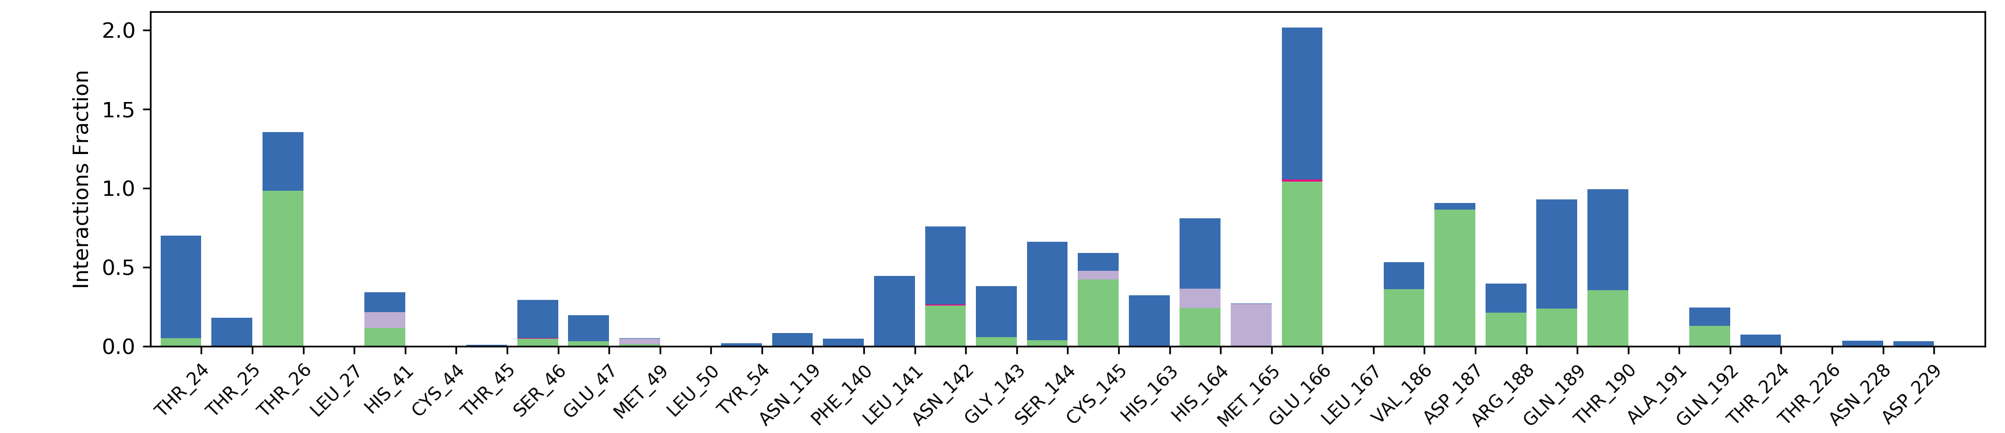
Interaction fraction
Supplementary Figure 10C: Interaction plot of main protease with theaflavin digallate (replicate 2). The simulation was carried out for 200 ns on Tesla K40 GPU with Desmond 2019 and OPLS 2005 force field Y axis represent the total number of contact fraction per residue per simulation time i.e. if the residue (presented on X-axis) has one contact during the whole simulation of 200 ns, it will have interaction fraction score of 1. Glu 166 has score ~2, which represents Glu 166 retain at least three two contacts during the whole simulation.

Slide 32
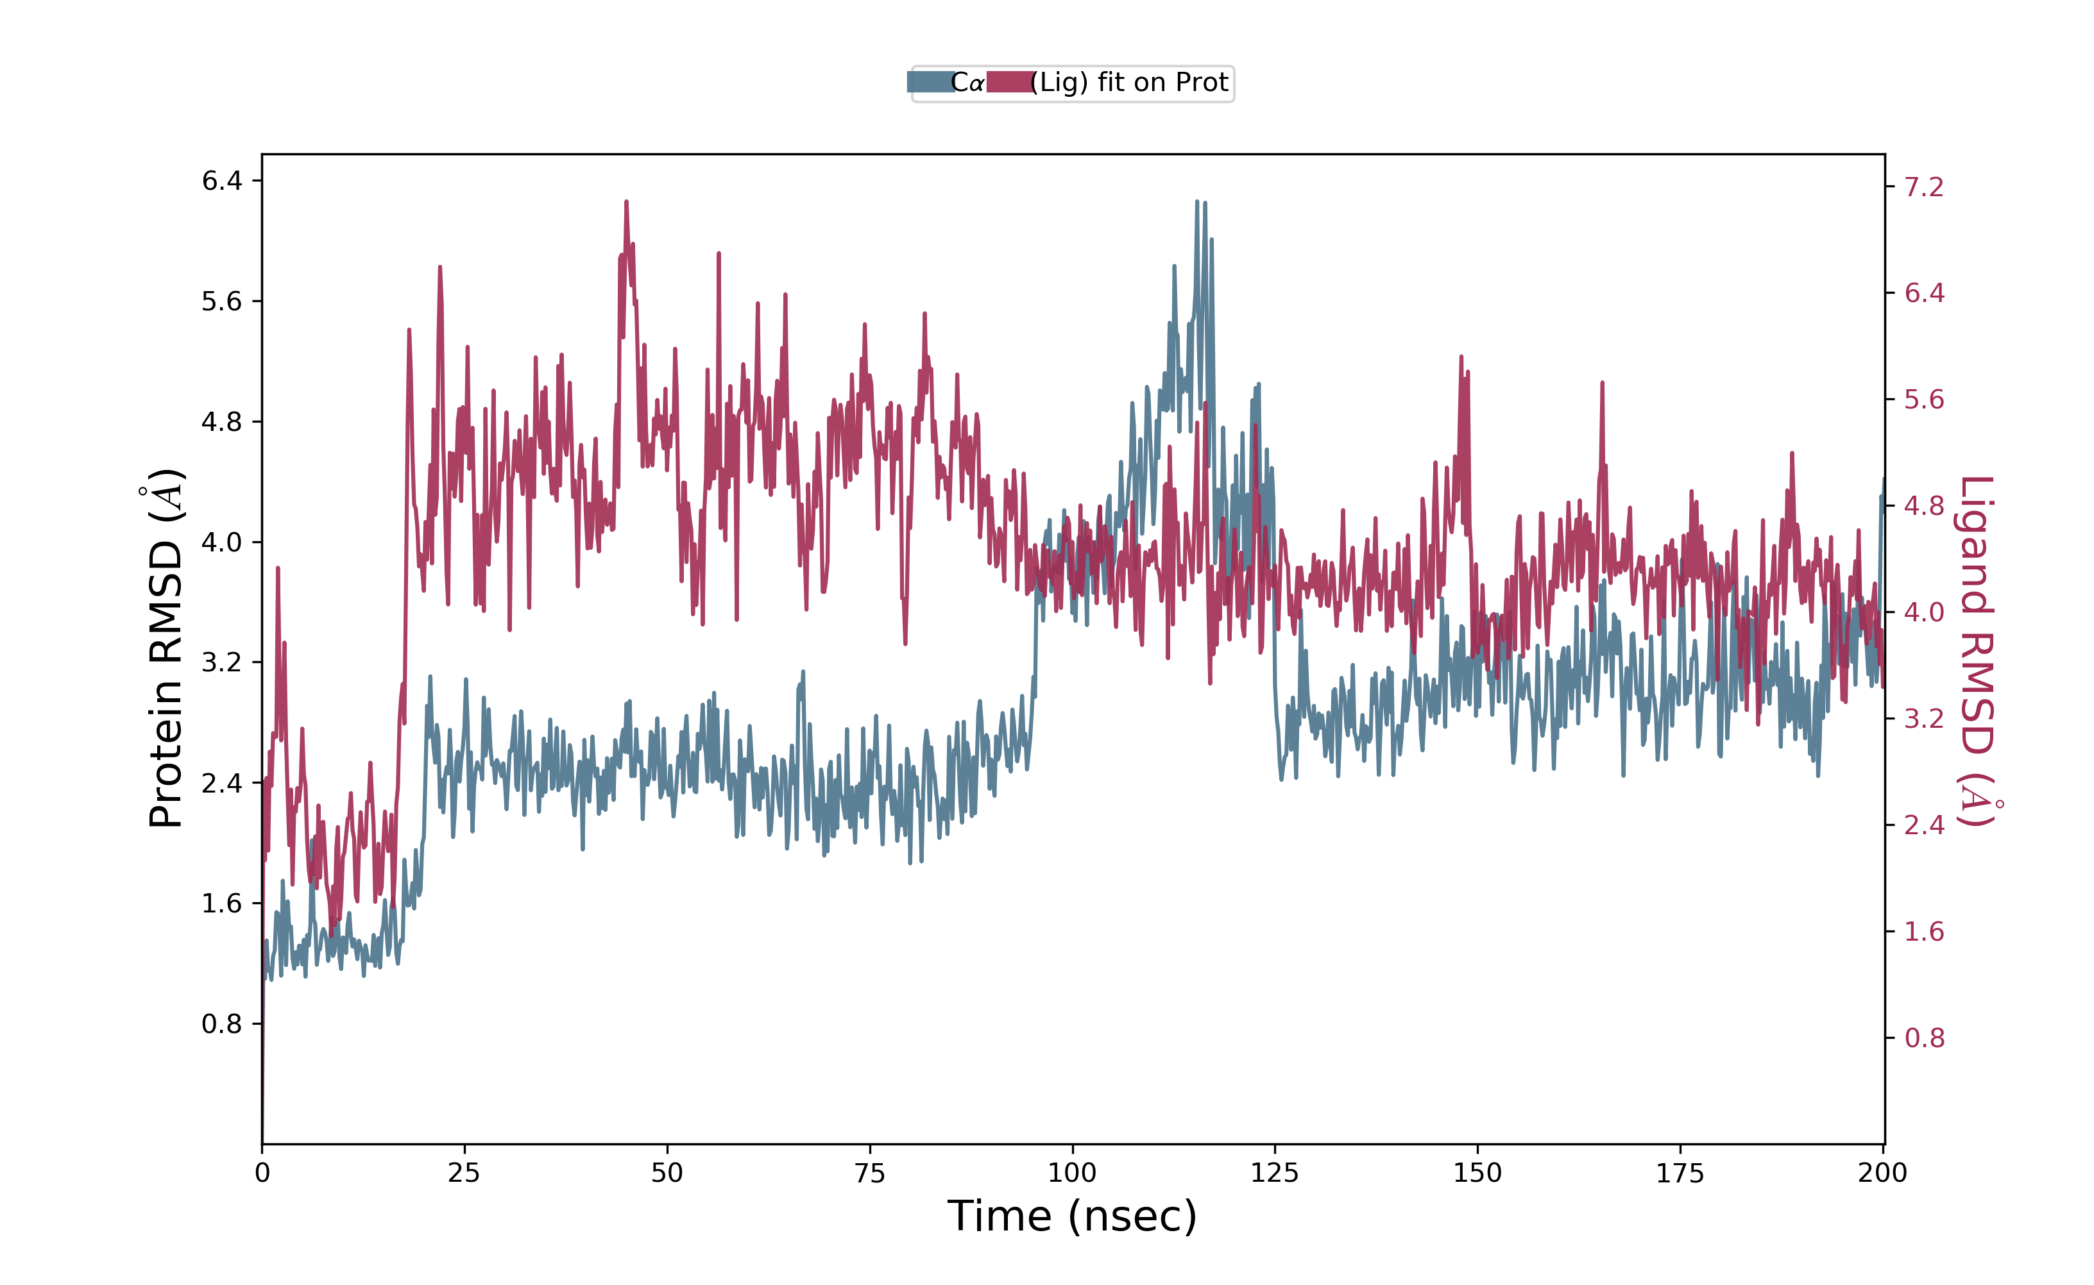
Supplementary Figure 11A: Root mean square deviation plot of C- alpha atoms of main protease and theaflavin digallate. The simulation was carried out for 200 ns on TESLA K40 GPU with Desmond 2019 and OPLS 2003 force field. The main protease RMSD is represented in pink line whereas theaflavin digallate in dark line. Left Y-axis represent the RMSD of main protease and Right Y-axis represent the RMSD of theaflavin digallate aligned on protein. X axis represent the simulation time in nano second.

Slide 33
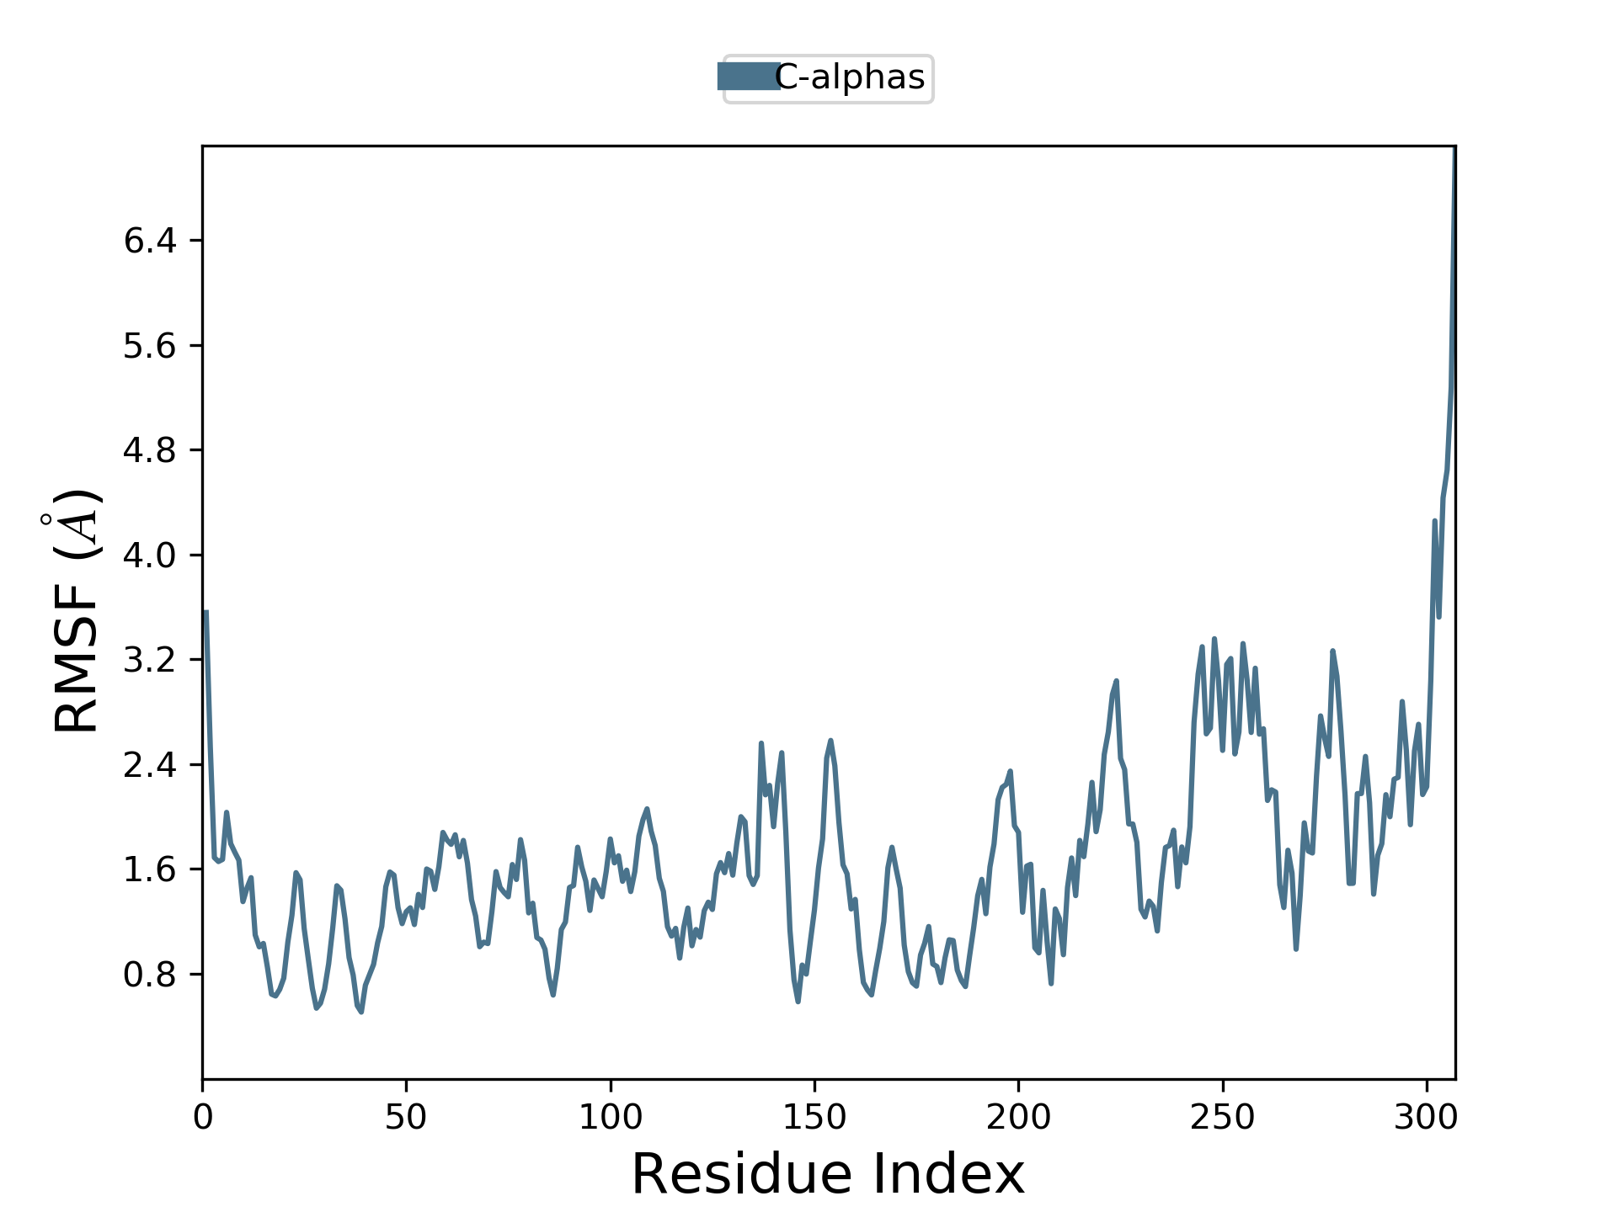
Supplementary Figure 11B: Root mean square fluctuation plot of main protease and in the presence of theaflavin digallate. The simulation was carried out for 200 ns on Tesla K40 GPU with Desmond 2019 and OPLS 2003 force field. Left Y-axis represent the RMSF of main protease and X axis represent the residue number of main protease.

Slide 34
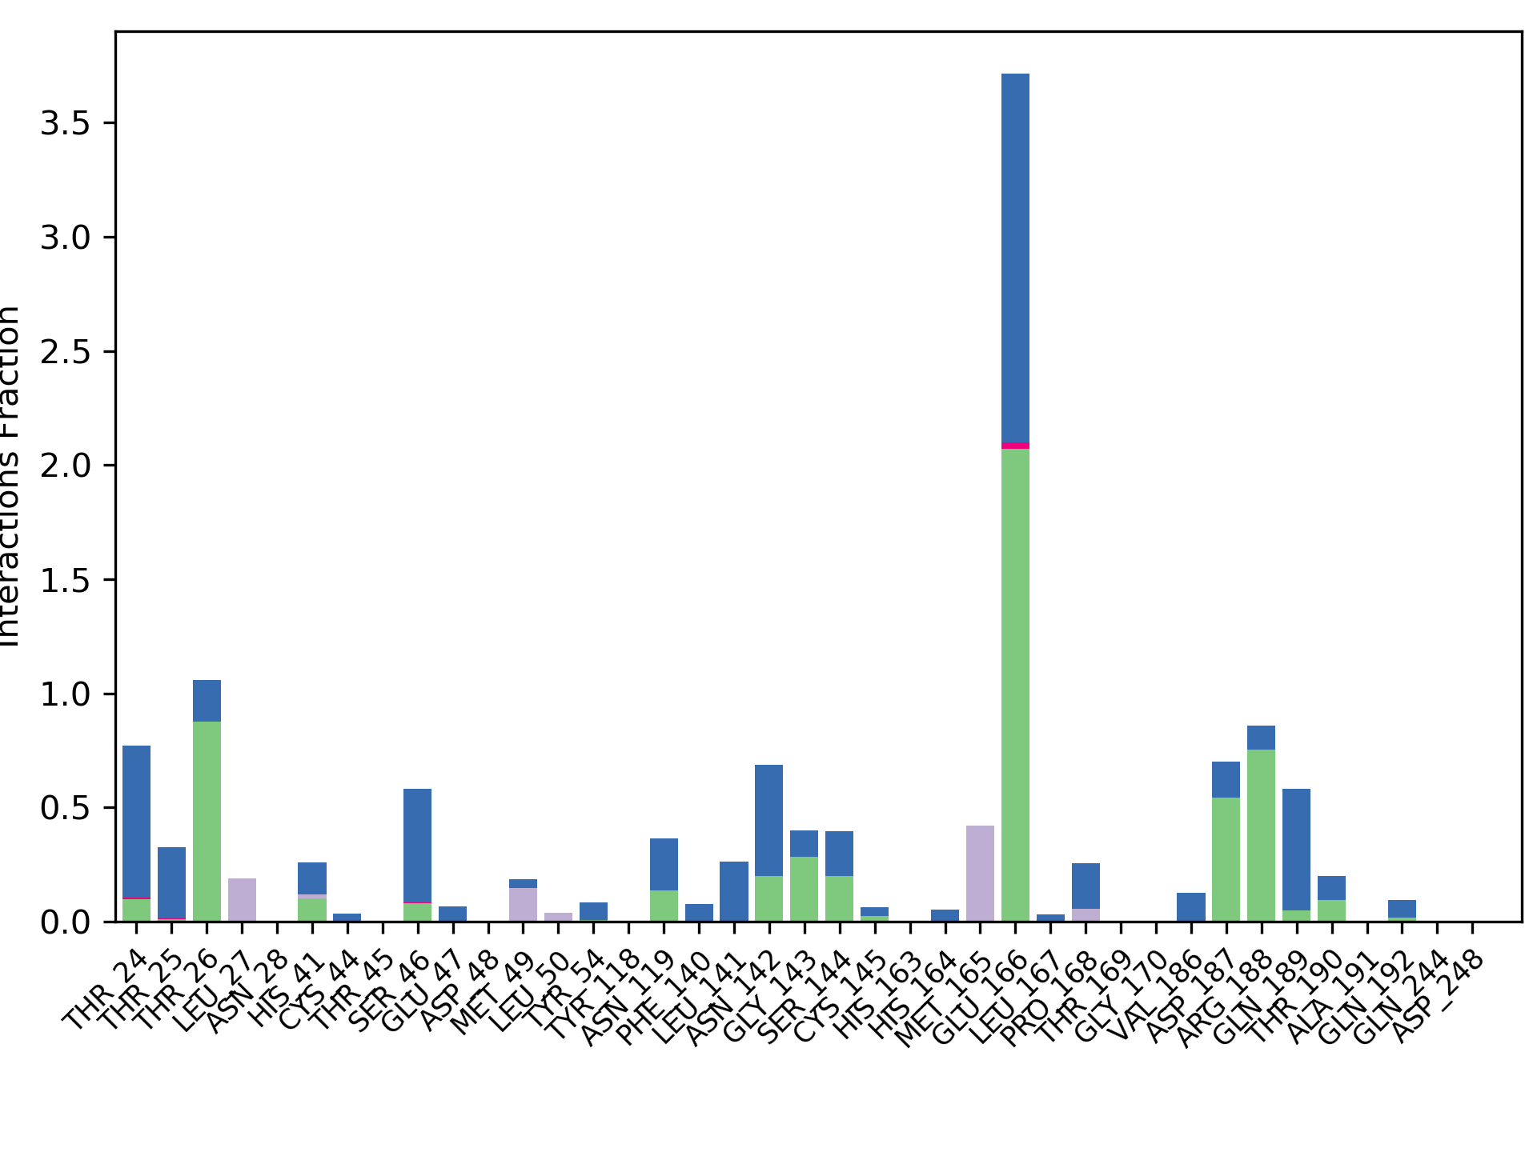
Interaction fraction
Supplementary Figure 11C: Interaction plot of main protease with theaflavin digallate. The simulation was carried out for 200 ns on Tesla K40 GPU with Desmond 2019 and OPLS 2003 force field. Y axis represent the total number of contact fraction per residue per simulation time i.e. if the residue (presented on X-axis) has one contact during the whole simulation of 200 ns, it will have interaction fraction score of 1. Glu 166 has score of ~3.5, which represents Glu 166 retain at least three 3.5 contacts during the whole simulation.

Slide 35
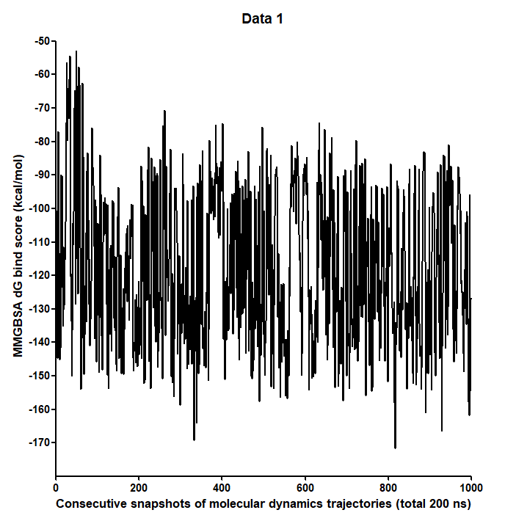
Supplementary Figure 12: MMGBSA dG bind scores of theaflavin digallate with main protease during molecular dynamics simulation using desmond molecular dynamics package. The water molecule around 5 Angstrom distance of ligand were considered explicitly. X axis represents the 1000 consecutive snapshots of molecular dynamics trajectories in 200 ns simulation. Y-axis represent MMGBSA dG bind score of theaflavin-digallate complex.

Slide 36
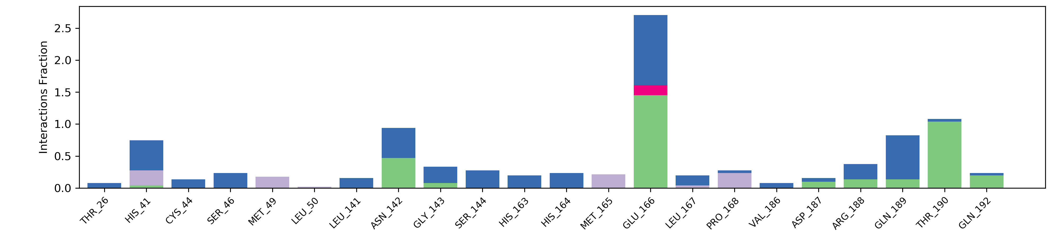
Supplementary Figure 13A: Interaction plot of main protease with theaflavin digallate in the first metadynamic run. The simulation was carried out for 10 ns on GTX 1070 with Desmond 2018 and OPLS 2003 force field. Y axis represent the total number of contact fraction per residue per simulation time i.e. if the residue (presented on X-axis) has one contact during the whole simulation of 10 ns, it will have interaction fraction score of 1.

Slide 37
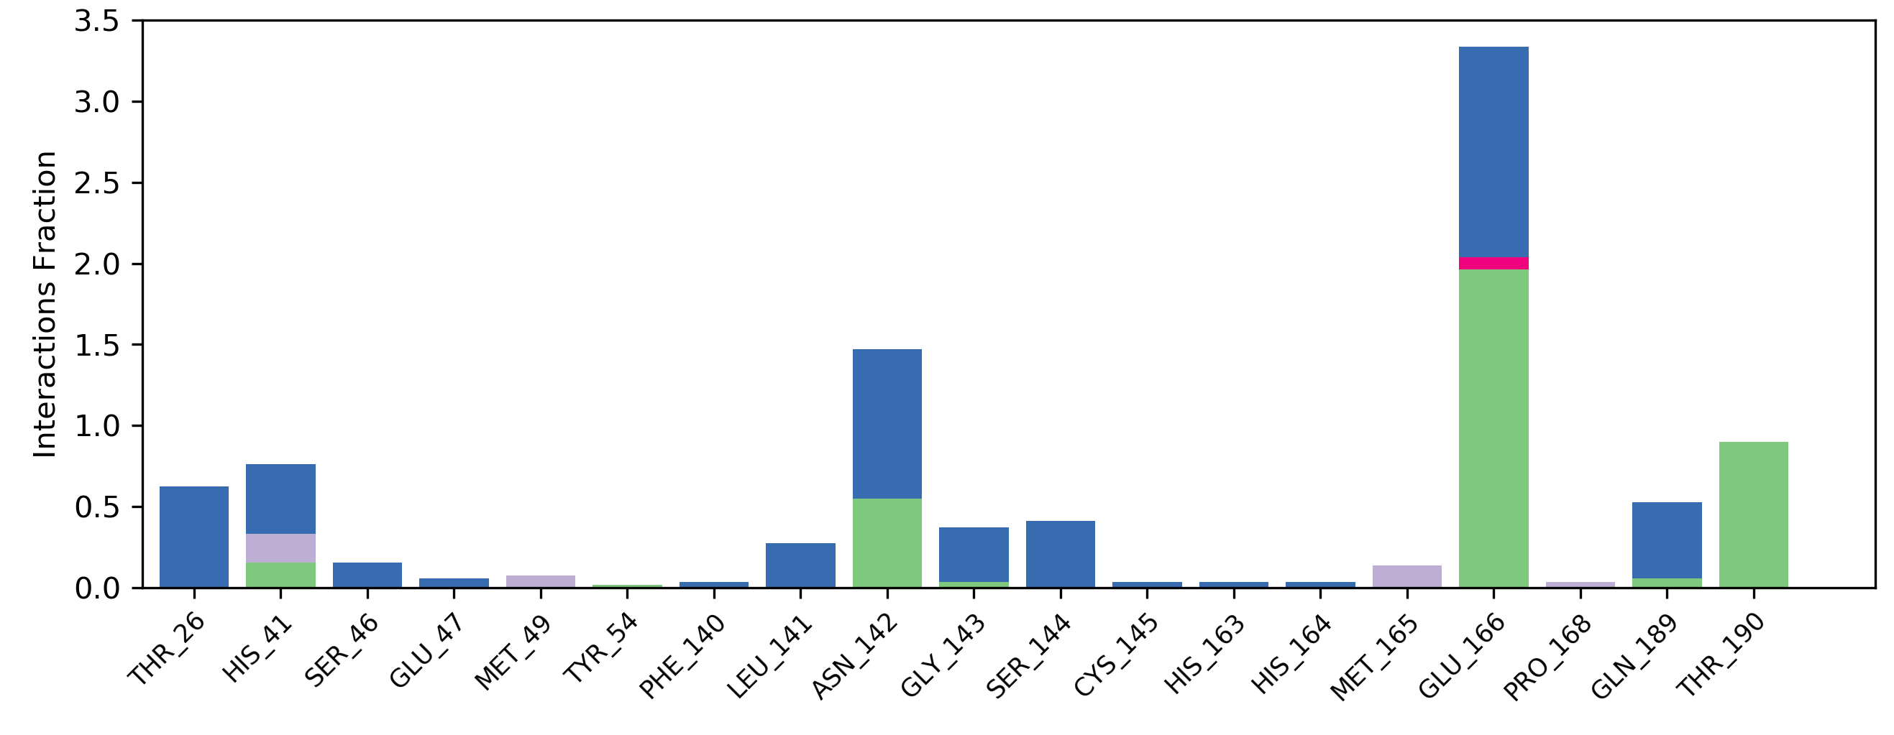
Supplementary Figure 13B: Interaction plot of main protease with theaflavin digallate in the first metadynamic run. The simulation was carried out for 10 ns on GTX 1070 with Desmond 2018 and OPLS 2003 force field. Y axis represent the total number of contact fraction per residue per simulation time i.e. if the residue (presented on X-axis) has one contact during the simulation of 10 ns, it will have interaction fraction score of 1.

Slide 38
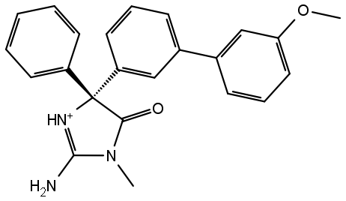
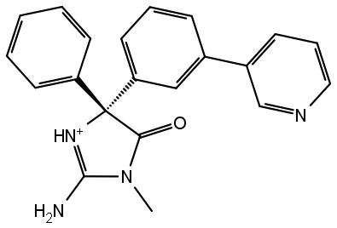
CAT-4b
CAT-4j
Supplementary Figure 14A: Two dimensional structure of method control ligands used in free energy perturbation calculations. The IUPAC name of CAT-4j is (2E,5R)-2-imino-3-methyl-5-phenyl-5-[3-(pyridin-3-yl) phenyl]imidazolidin-4-one. The IUPAC name of CAT-4b is ((2E,5R)-2-imino-5-(3'-methoxybiphenyl-3-yl)-3-methyl-5-phenylimidazolidin-4-one). The mutated regions was highlighted as yellow bracket.

Slide 39
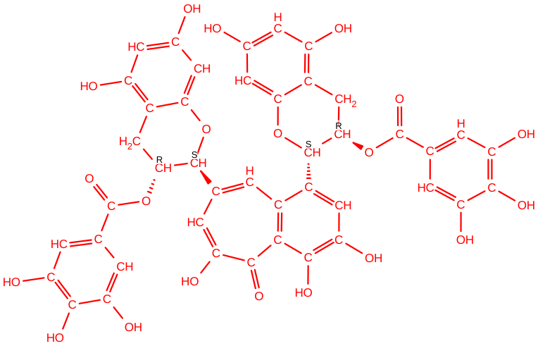
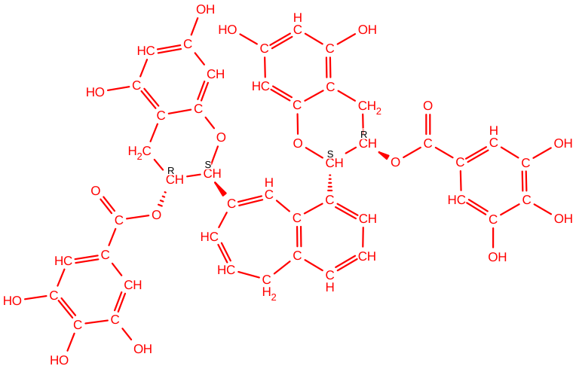
λ=0
Alchemical Transformation
λ=1
Supplementary Figure 14 B: Two Dimensional structure of experimental control ligand 1(FEP2, table 3) used in free energy perturbation calculation. The ligand structure was same as of FEP1 whereas only the core perturbed by 0.790 Angstrom. The relative binding free energy difference between TG (λ=0) and TG’ (λ=1) was 5.63+-0.78 kcal/mol which reflect the higher affinity of TG as compared to mutated residue TG’ was not a calculation artifact.

Slide 40
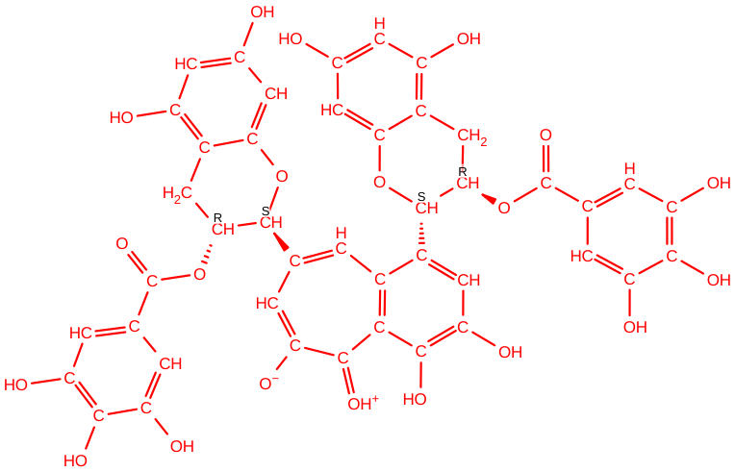

λ=0
Alchemical Transformation
λ=1
Supplementary Figure 14 C: Two Dimensional structure of experimental control ligand 2(FEP3, table 3) used in free energy perturbation calculation. The carbonyl oxygen atom was positively charged and hydroxyl oxygen was negatively charged in both native (TG) and mutated ligand (TG’). Hydroxyl group of O19 and O21 were deleted and replaced by methyl group in TG’. The relative binding free energy difference between TG (λ=0) and TG’ (λ=1) was 2.33+-1.11 kcal/mol.

Slide 41

λ=0
Alchemical Transformation
λ=1
Supplementary Figure 14 D: Two Dimensional structure of experimental control ligand 3 (FEP4, table 3) used in free energy perturbation calculation. The carbonyl oxygen atom was positively charged and hydroxyl oxygen was negatively charged in both native (TG) and mutated ligand (TG’). Hydroxyl group of O19 and O21 were deleted and the valency of carbon was satisfied by hydrogen atoms. The relative binding free energy difference between TG (λ=0) and TG’ (λ=1) was -0.58+-1.08 kcal/mol.

Slide 42
λ=0
Alchemical Transformation
λ=1
Supplementary Figure 14 E: Two Dimensional structure of experimental control ligand 4 (FEP5, table 3) used in free energy perturbation calculation. The carbonyl oxygen atom was positively charged and hydroxyl oxygen was negatively charged in native ligand (TG). Hydroxyl group of O19, O21, 052 and carbonyl group of O54 were deleted in mutated ligand (TG’). The relative binding free energy difference between TG (λ=0) and TG’ (λ=1) was 2.35+-1.02 kcal/mol.

Slide 43
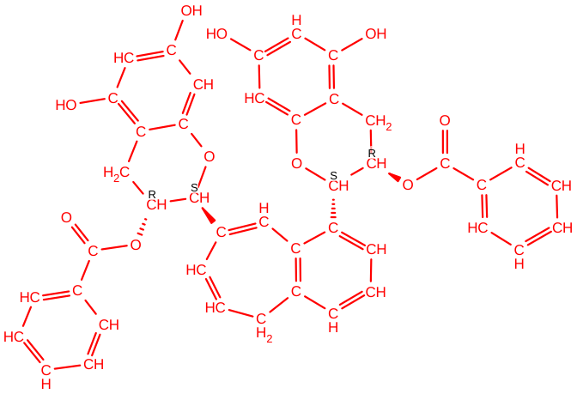
λ=0
Alchemical Transformation
λ=1
Supplementary Figure 14 F: Two Dimensional structure of experimental control ligand 5 (FEP6, table 3) used in free energy perturbation calculation. The carbonyl oxygen atom was positively charged and hydroxyl oxygen was negatively charged in native ligand (TG). Nine hydroxyl group and one carbonyl group were deleted in mutated ligand (TG’). The relative binding free energy difference between TG (λ=0) and TG’ (λ=1) was 3.89+-2.43
kcal/mol.

Slide 44
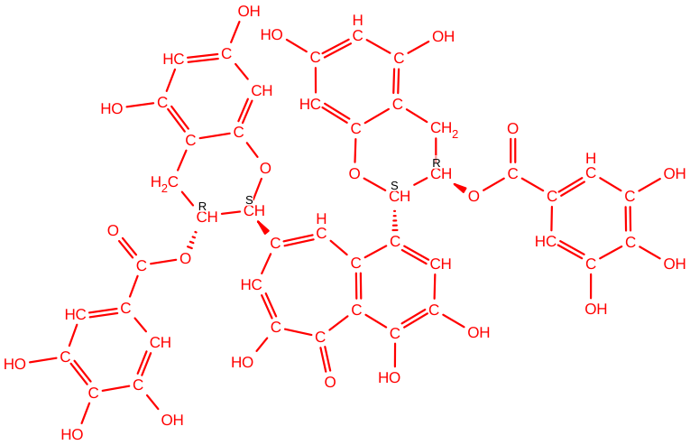

λ=0
Alchemical Transformation
λ=1
Supplementary Figure 14 G: Two Dimensional structure of experimental control ligand 6 (FEP7, table 3) used in free energy perturbation calculation. Native ligand (TG) was in non-ionized state as of FEP 1-2. In mutated ligand (TG’), the a hydroxyl oxygen atom not present in benzo (7) annulen-6-one was negative charged. The relative binding free energy difference between TG (λ=0) and TG’ (λ=1) was 4.22+-8.94 kcal/mol.

Slide 45
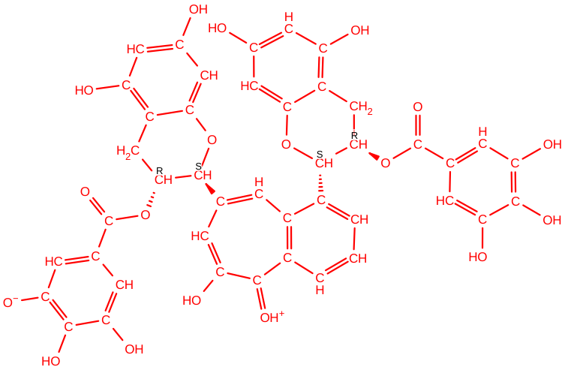
λ=0
Alchemical Transformation
λ=1
Supplementary Figure 14 H: Two Dimensional structure of experimental control ligand 7 (FEP8, table 3) used in free energy perturbation calculation. Native ligand (TG) was in non-ionized state as of FEP 1-2. In mutated ligand (TG’), the a hydroxyl oxygen atom not present in benzo (7) annulen-6-one was negative charged. The relative binding free energy difference between TG (λ=0) and TG’ (λ=1) was -2.05+-30.05 kcal/mol.

Slide 46

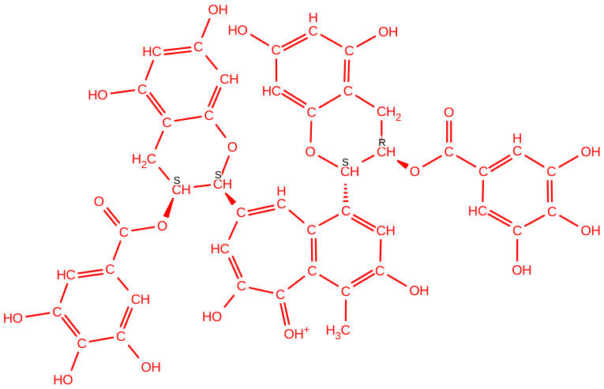
λ=0
Alchemical Transformation
λ=1
  Supplementary Figure 14 I: Two Dimensional structure of experimental control ligand 8 (FEP9, table 3) used in free energy perturbation calculation. Native ligand (TG) was in ionized state. The native and mutated ligand was not aligned. The relative binding free energy difference between TG (λ=0) and TG’ (λ=1) was -2.11+-7.63. kcal/mol

Slide 47
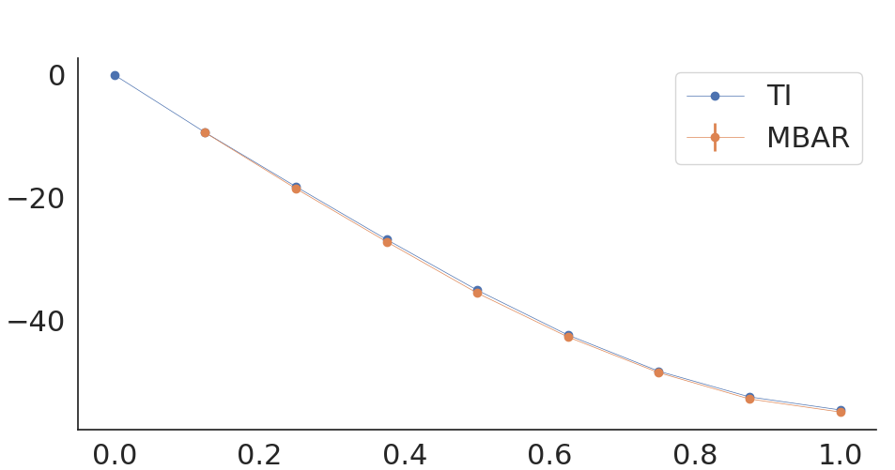
ΔG4 in kcal/mol
alchemical stepwise window(λ)
Supplementary Figure 15 A: Free energy difference in complex (bound) calculation for test set. Neutral TG molecule kept at λ=0, whereas the 3 hydroxyl and one carbonyl group of benzo(7) annulen-6-one of theaflavin digallate has been mutated for λ=1.

Slide 48
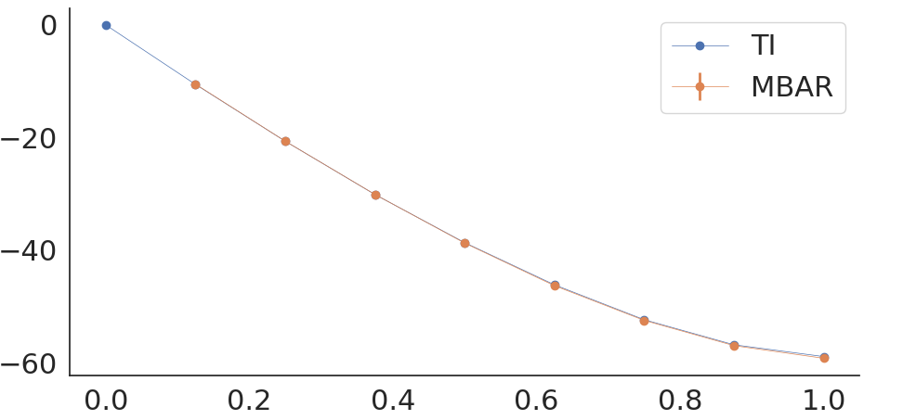
ΔG3 in kcal/mol
alchemical stepwise window(λ)
Supplementary Figure 15 B: Free energy difference in solution (free) calculation for test set. Neutral TG molecule kept at λ=0, whereas the 3 hydroxyl and one carbonyl group of benzo(7) annulen-6-one of theaflavin digallate has been mutated for λ=1.

