Slide 1
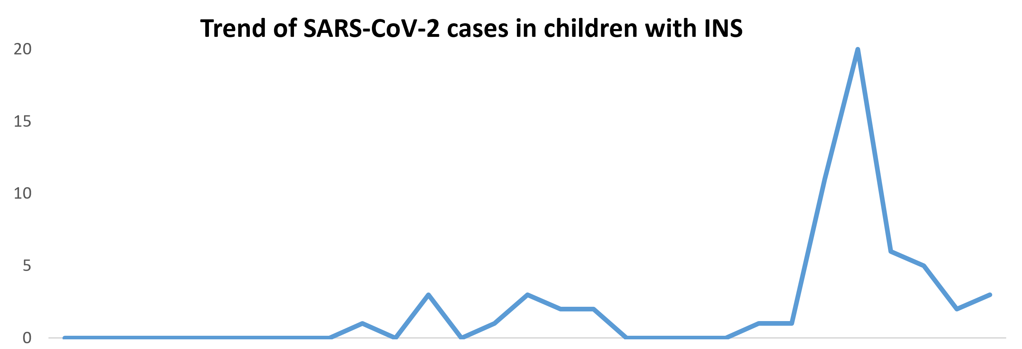
EPIDEMIOLOGY, SEVERITY AND RISK OF SARS-CoV-2 RELATED RELAPSE IN
CHILDREN AND YOUNG ADULTS AFFECTED BY IDIOPATHIC NEPHROTIC SYNDROME: A ​RETROSPECTIVE OBSERVATIONAL COHORT STUDY
HYPOTHESIS: Idiopathic nephrotic syndrome (INS) may impact the course of SARS-CoV-2 infection in children
DESIGN & OUTCOMES
SEVERITY
No hospitalization or deaths
Symptoms absent or mild in all children
IMMUNOSUPPRESSION
No impact on incidence or severity
Longer time to negativization
(13 vs 10 days)
RELAPSES & PROTEINURIA
Self-limiting proteinuria in 10.5%
Only one relapse (1.7%)
Retrospective monocentric study
61 INS patients with
SARS-CoV-2 infection
Incidence of 34.7%
PEAK
20
Incidence of SARS-CoV-2
over the months
176 children and young
adults with INS
SARS-CoV-2 CASES
10
ENDPOINTS
Incidence of SARS-CoV-2, severity and risk of relapse
Jan 2020
Jan 2021
Jan 2022
CONCLUSION: In this large cohort of children with INS and SARS-CoV-2 infection, symptoms were mild, even in immunosuppressed patients and those with proteinuria. Self-limiting proteinuria was common, with a low rate of relapses
Morello et al. 2022

