Slide 1
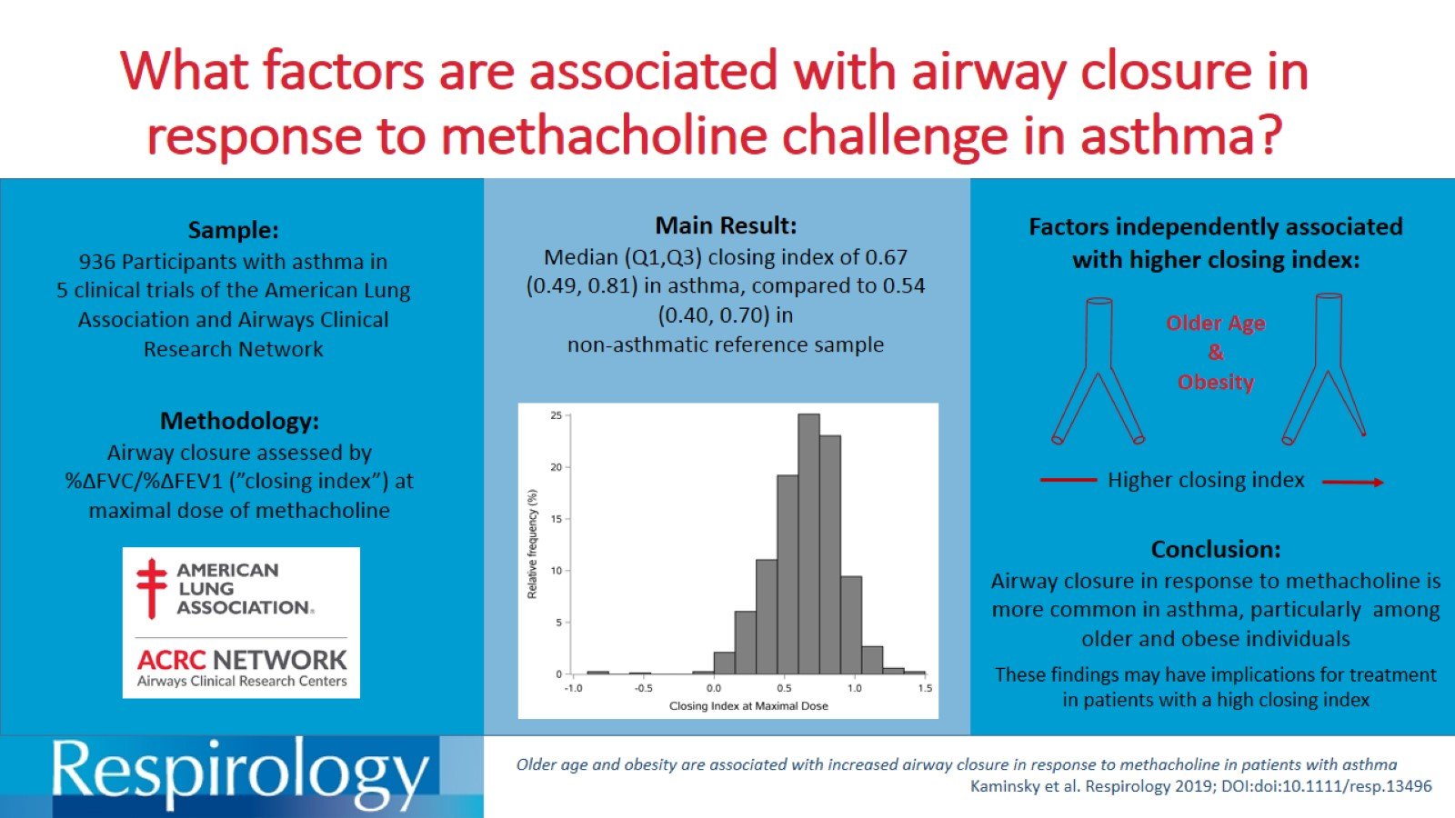
What factors are associated with airway closure in response to methacholine challenge in asthma?

