Slide 1
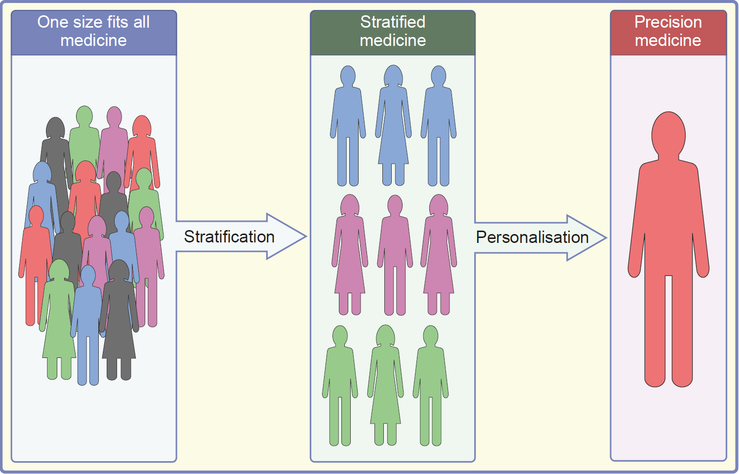
Stratified and precision medicine
Griffin (2022) Diabetologia DOI 10.1007/s00125-022-05782-7
©The Authors 2022. Distributed under the terms of the CC BY 4.0 Attribution License (http://creativecommons.org/licenses/by/4.0/)

Slide 2
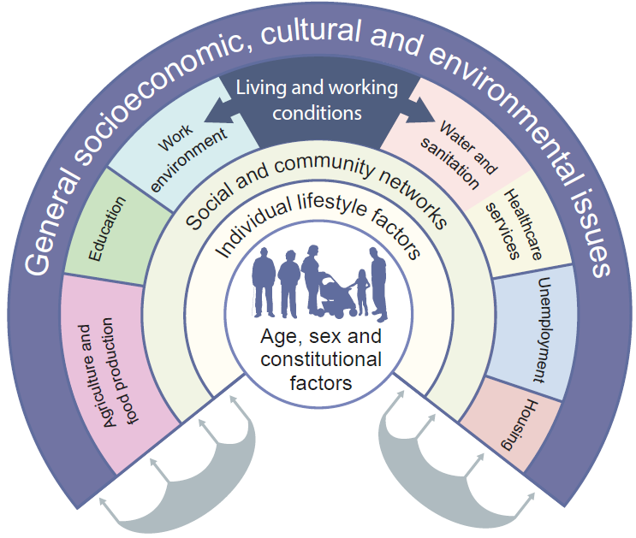
The main determinants of health. Adapted from Dahlgren G, Whitehead M, 2007
Griffin (2022) Diabetologia DOI 10.1007/s00125-022-05782-7
©The Authors 2022. Distributed under the terms of the CC BY 4.0 Attribution License (http://creativecommons.org/licenses/by/4.0/)

