Slide 1
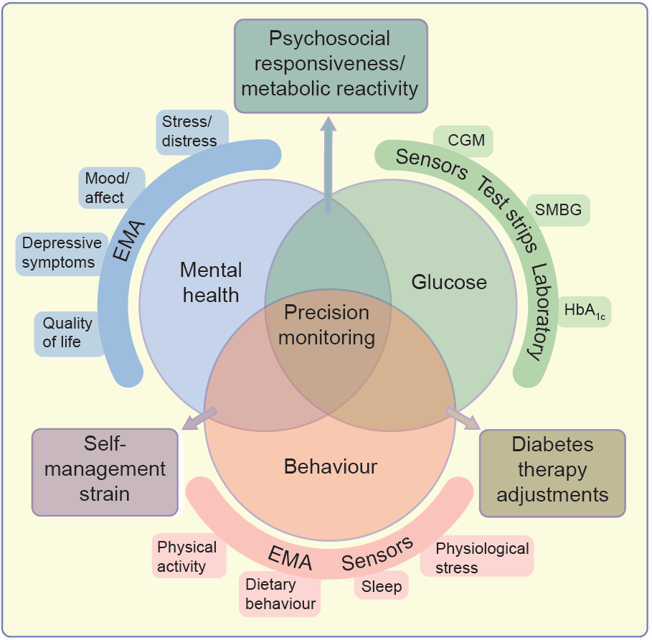
Conceptual model of multidimensional monitoring in diabetes (glucose, self-care behaviour, mental health)
Hermanns et al (2022) Diabetologia DOI 10.1007/s00125-022-05685-7
©The Authors 2022. Distributed under the terms of the CC BY 4.0 Attribution License (http://creativecommons.org/licenses/by/4.0/)

Slide 2
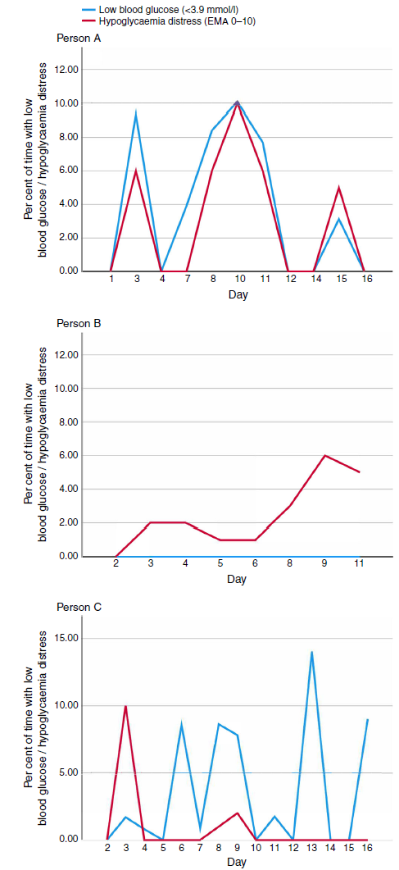
The association between perceived hypoglycaemia distress and exposure to low glucose values: data arising from three different case studies
Hermanns et al (2022) Diabetologia DOI 10.1007/s00125-022-05685-7
©The Authors 2022. Distributed under the terms of the CC BY 4.0 Attribution License (http://creativecommons.org/licenses/by/4.0/)

Slide 3
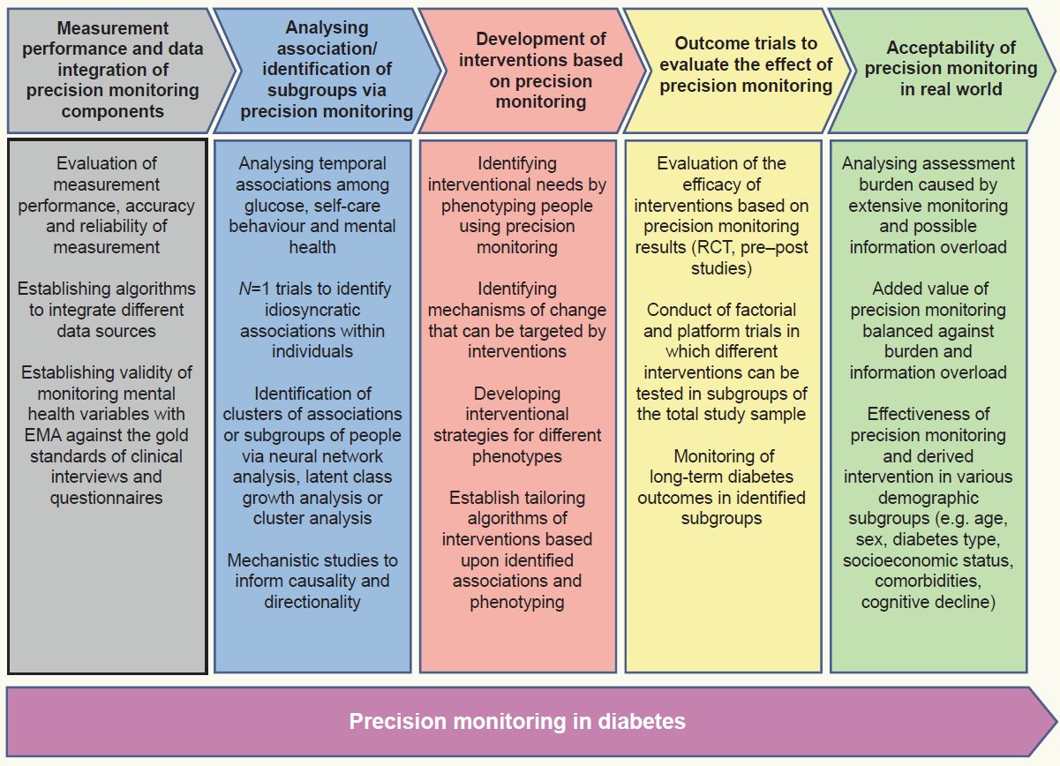
Roadmap suggesting studies necessary for achieving precision monitoring in diabetes
Hermanns et al (2022) Diabetologia DOI 10.1007/s00125-022-05685-7
©The Authors 2022. Distributed under the terms of the CC BY 4.0 Attribution License (http://creativecommons.org/licenses/by/4.0/)

