Slide 1
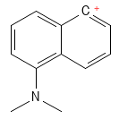
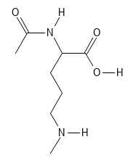
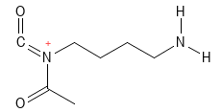
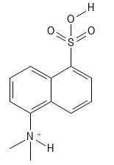
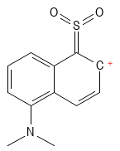


MS/MS Spectrum of Dansylated N-Acetyl-Ornithine (NAO)
100
170.0961
305.1319
- COOH
- CH₃CONH₂
Dansyl
80
234.0583
60
252.0690
MH⁺
Relative Abundance
40
408.1593
72.0814
157.0973
373.1854
20
129.10243
390.1478
0
60
80
100
120
140
160
180
200
220
240
260
280
300
320
340
360
380
400
420
m/z

