Slide 1
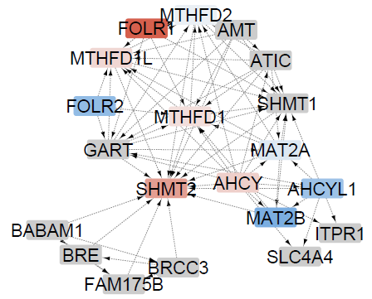
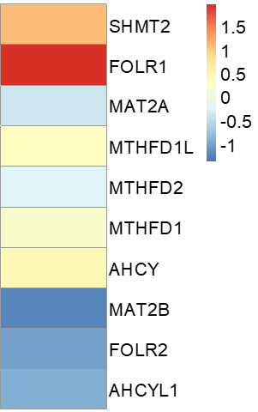
A
B
M2/M1
C
D
p = 0.0002
p = 0.026
E
F
*
3,3,2-²H-Ser
²H-Gly
SHMT2
***
T1C1CCA
*
MS
T1C1CCA
NO
**
²H-Met
B₁₂
MAT
²H-SAM
M0 M1 M2 M0 M1 M2
20% O₂ 2% O₂
²H-H3 K9me

