Slide 1
(a)
(b)
Collagen I heating at 100°C
(c)
Collagen I without heating
Collagen I heating at 50-60°C
(d)
(e)
(f)
Collagen IV without heating
Collagen IV heating at 100°C
Collagen IV heating at 50-60°C
Supplementary figure 1 : Optimisation of serum IgG response to collagen I and IV
Collagen I an IV are less soluble in native structure in carbonate and bicarbonate buffer and less protein-binding capacity to polystyrene ELISA plates. Therefore to maximize hydrophobic interactions between collagen I and IV and polystyrene residues on the solid phase, we performed the ELISA without heating the collagen and heating the collagen at 55-60°C for 5 mins and 100°C to 5 mins. There were no significant difference in absorbance between serum from rats injected with GAS rM5 (■), SDSE Stg480 (▲) and PBS (●) in the ELISA plates coated with collagen without heating and heating at 100°C to 5 mins. Whereas ELISA plates coated with collagen heated at 55-60°C for 5 mins showed a significant higher absorbance for serum from rats injected with GAS rM and SDSE Stg480 compared to PBS rats. Data are from one of the two sets of experiment with GAS rM5 (n = 5) and SDSE Stg480 (n = 6) age-matched rats. Error bars represent standard errors of the mean (SEM). *** P < 0.001, by One-way ANOVA with Tukey’s post hoc multiple comparison test.

Slide 2
(a)
Light entries
(b)
Light time
(c)
Light : latency to first entry time
Supplementary figure 2: Light/Dark box test to determine the anxiety level of rats exposed to GAS rM5 and SDSE Stg480. The effects of each group on behaviour using the light–dark box test include the number of entries into the light compartment (a) time spent in the light compartment (b) and Light-Latency to first entry (c). In the LDB test no significant difference were observed in any of the rats (GAS rM5 (■), SDSE Stg480 (▲) and PBS (●)) in latency to first entry to light compartment, number of entries to light compartment and time spent in light compartment, which indicated that any of the rats had anxiety-like behaviours or changes exploratory behaviour on the LDB test. Data are from one of the two sets of experiment with GAS rM5 (n = 5) and SDSE Stg480 (n = 6) age-matched rats. Error bars represent standard errors of the mean (SEM) by One-way ANOVA with Tukey’s post hoc multiple comparison test.

Slide 3

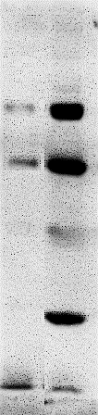
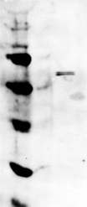

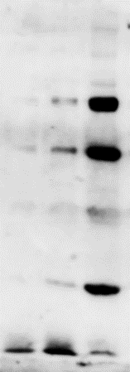
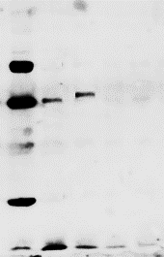
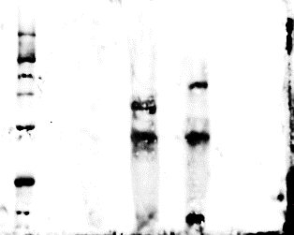
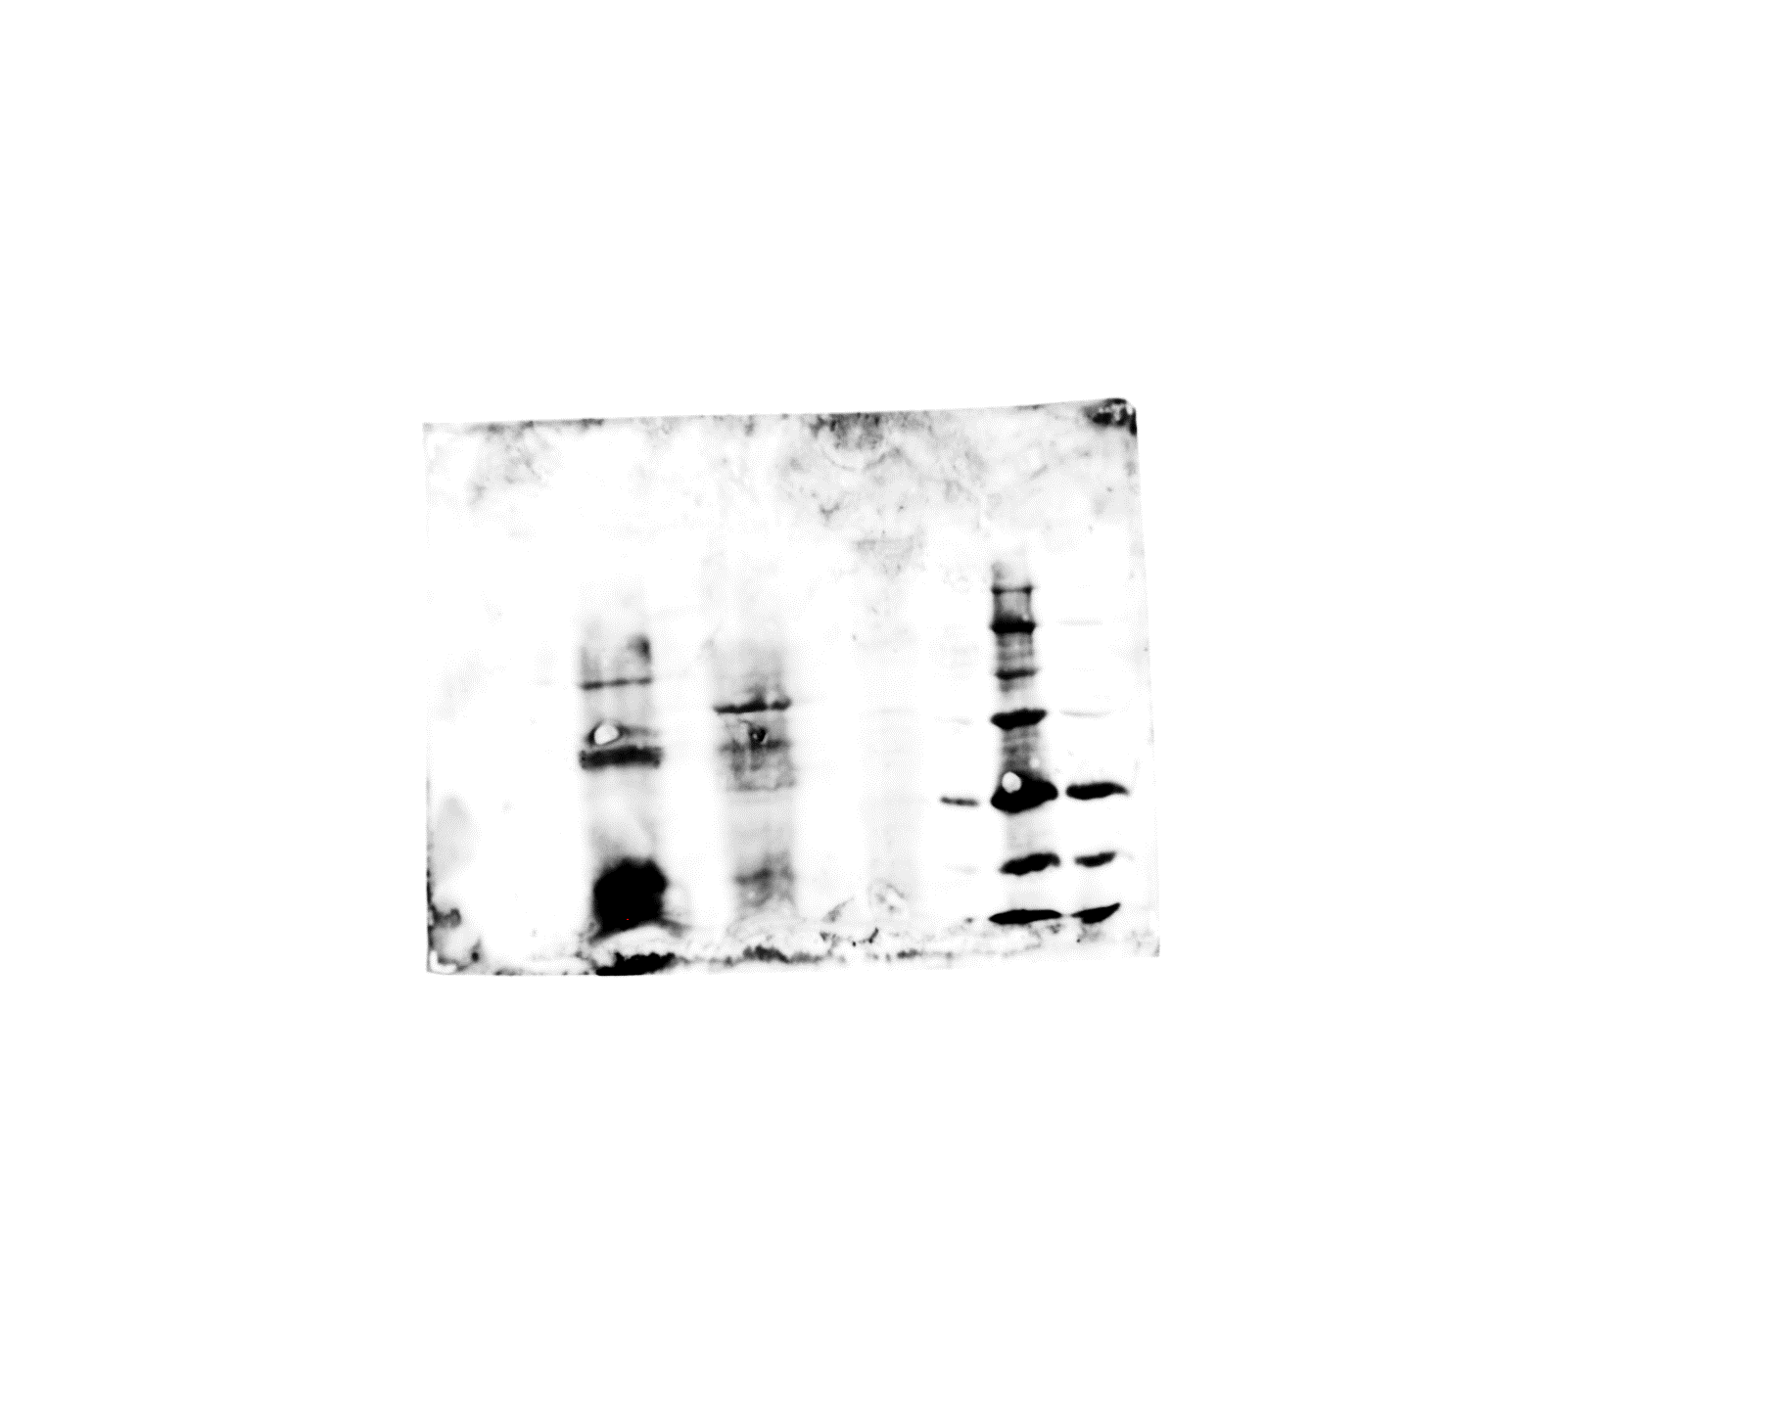
(a)
(c)
GAS rM5 sera
SDSE Stg480 sera
GAS rM5 sera
(b)
SDSE Stg480 sera
(d)
D1 D2 LG β-Tubulin
D1 D2 LG β-Tubulin
Ladder Kidney Cerebellum Striatum
250
150
100
75
50
37
25
Ladder Kidney Cerebellum Striatum
250
150
100
75
50
37
25
250
150
100
75
50
37
25
250
150
100
75
50
37
25
(f)
(e)
SDSE Stg480 sera
GAS rM5 sera
Ladder Kidney Cerebellum Striatum
Ladder Kidney Cerebellum Striatum
250
150
100
75
50
37
250
150
100
75
50
37
GAPDH
37kDa
GAPDH
37kDa
Supplementary figure 3: Original full blots with markers.
Representative Western blot images illustrate the binding pattern of the IgG from pooled sera of rats injected with GAS rM5 (a) and SDSE Stg480 (b) with purified DR1 and DR2, tubulin and lysogangliosideGM1. Pooled sera from rats injected with GAS rM5 (c) and SDSE Stg480 (d) also bounds to lysates of striatum and cerebellum from naïve rats. Bands on these blots were observed at ~55 kDa, and ~70 kDa which is consistent with the known molecular weights of DR1, DR2, lysogangliosideGM1 and tubulin respectively. Moreover, these sera did not recognise proteins in kidney lysates used as non-neuronal control. GAPDH Rabbit monoclonal antibody were used to determine the expression of housekeeping proteins in the lysates of striatum, cerebellum and kidney (e, f). Data are from one of the two sets of experiment with GAS rM5 (n = 5) and SDSE Stg480 (n = 6) age-matched rats.

