Slide 1
Dietary-derived Vitamin B12 Protects Caenorhabditis elegans from Thiol Reducing Agents
Additional File 1 for:
Alan D. Winter, Elissa Tjahjono, Leonardo J. Beltrán, Iain L. Johnstone, Neil J. Bulleid, Antony P. Page§
§ Corresponding author tony.page@glasgow.ac.uk
This file includes Figure S1-S9

Slide 2
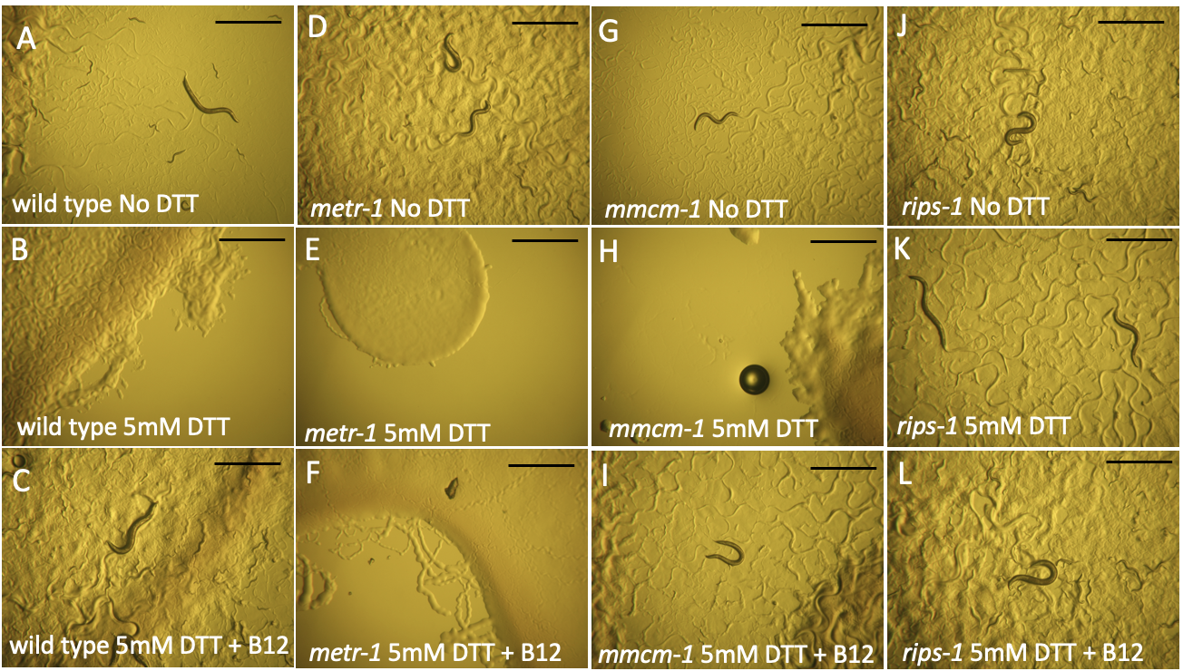
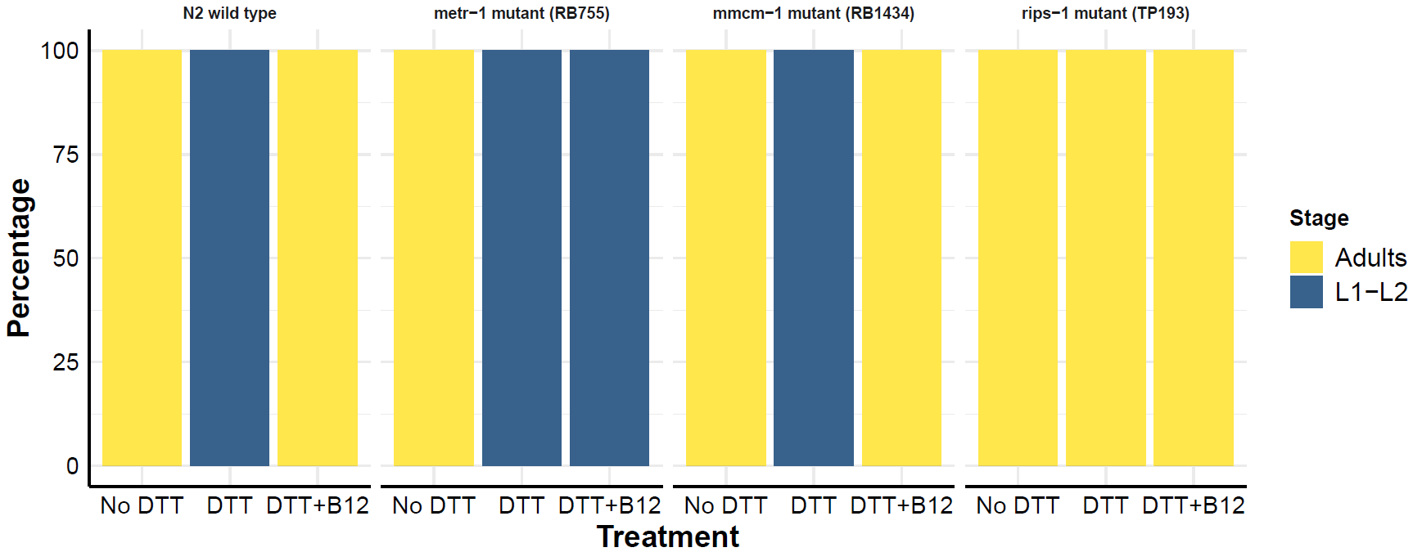
M
N2 wild type
metr-1 mutant
mmcm-1 mutant
rips-1 mutant
NS
NS
NS
***
NS
NS
NS
NS
***
NS
***
***
***
***
NS
NS
NS
Figure S1

Slide 3
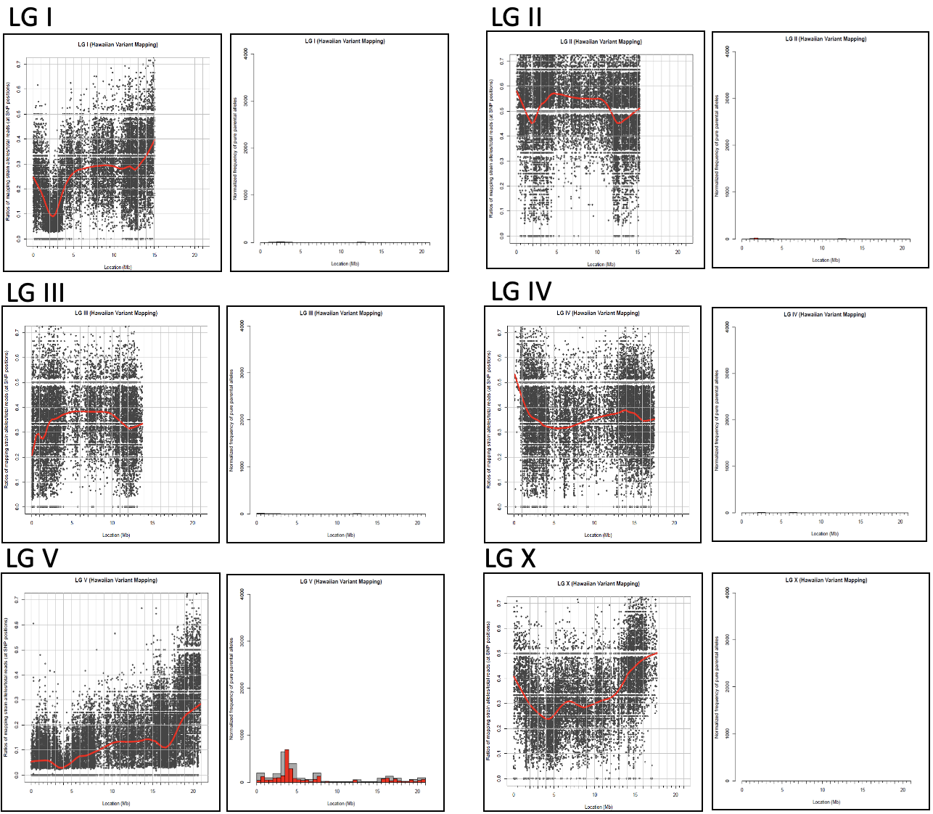
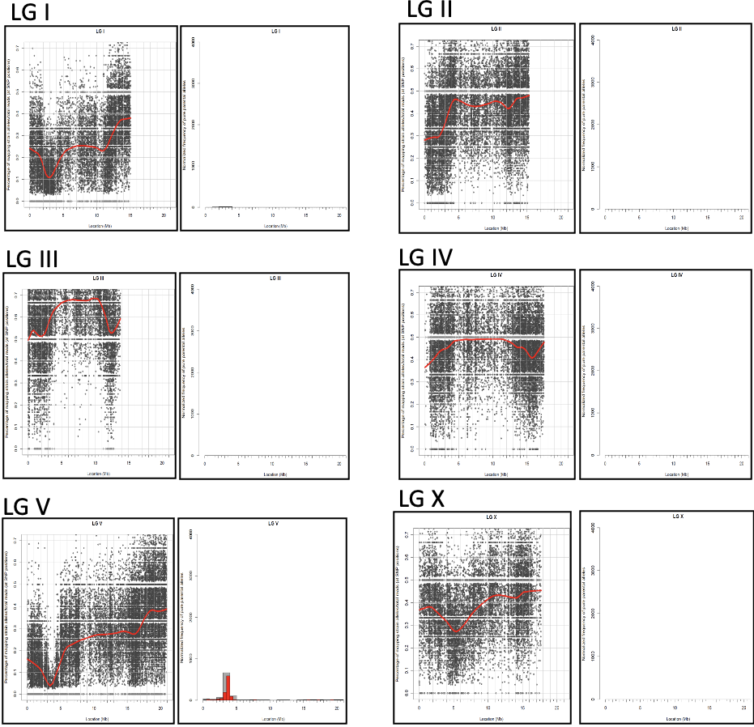
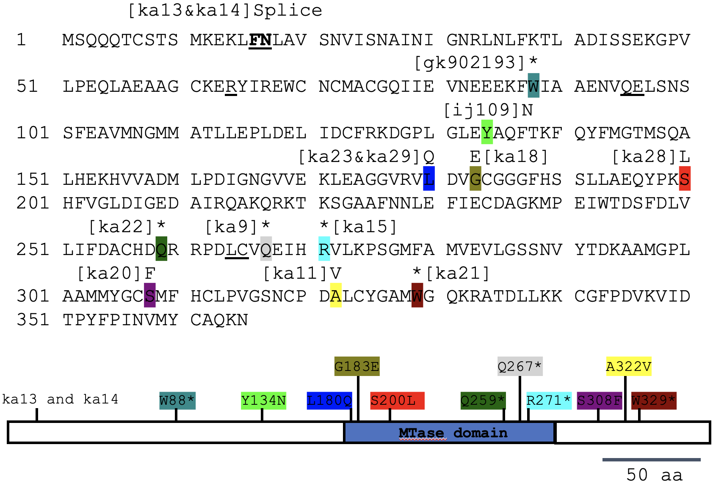
Figure S2
A
B
C

Slide 4
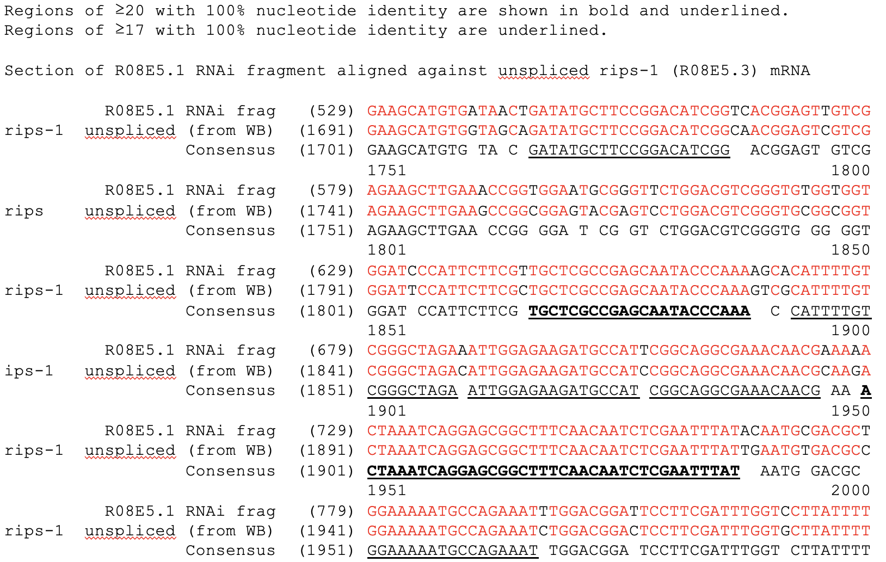
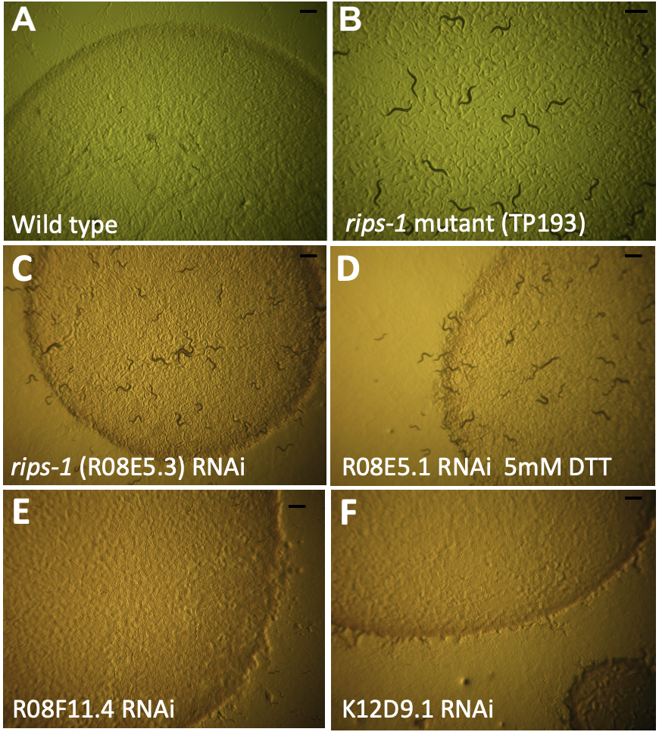
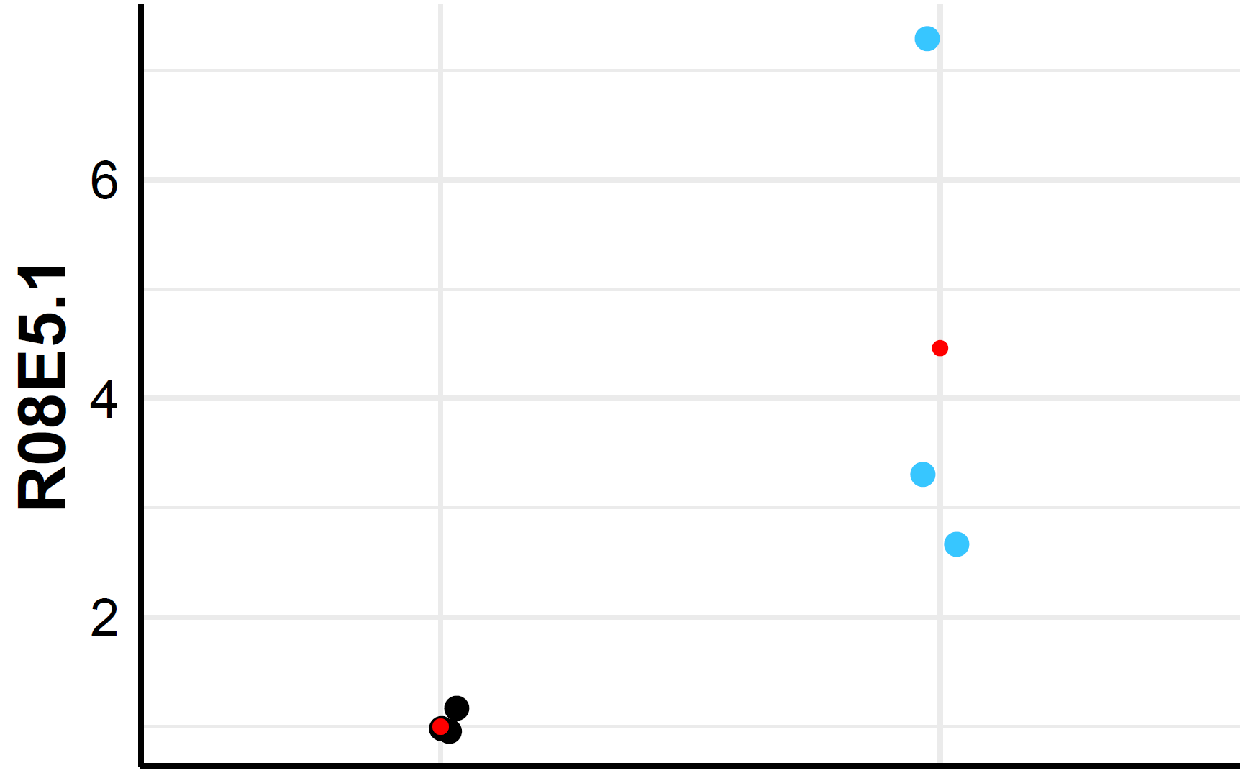
Figure S3
A
B
a
b
C
R08E5.1
Fold Upregulation
c
d
Untreated
5 mM DTT
e
f

Slide 5
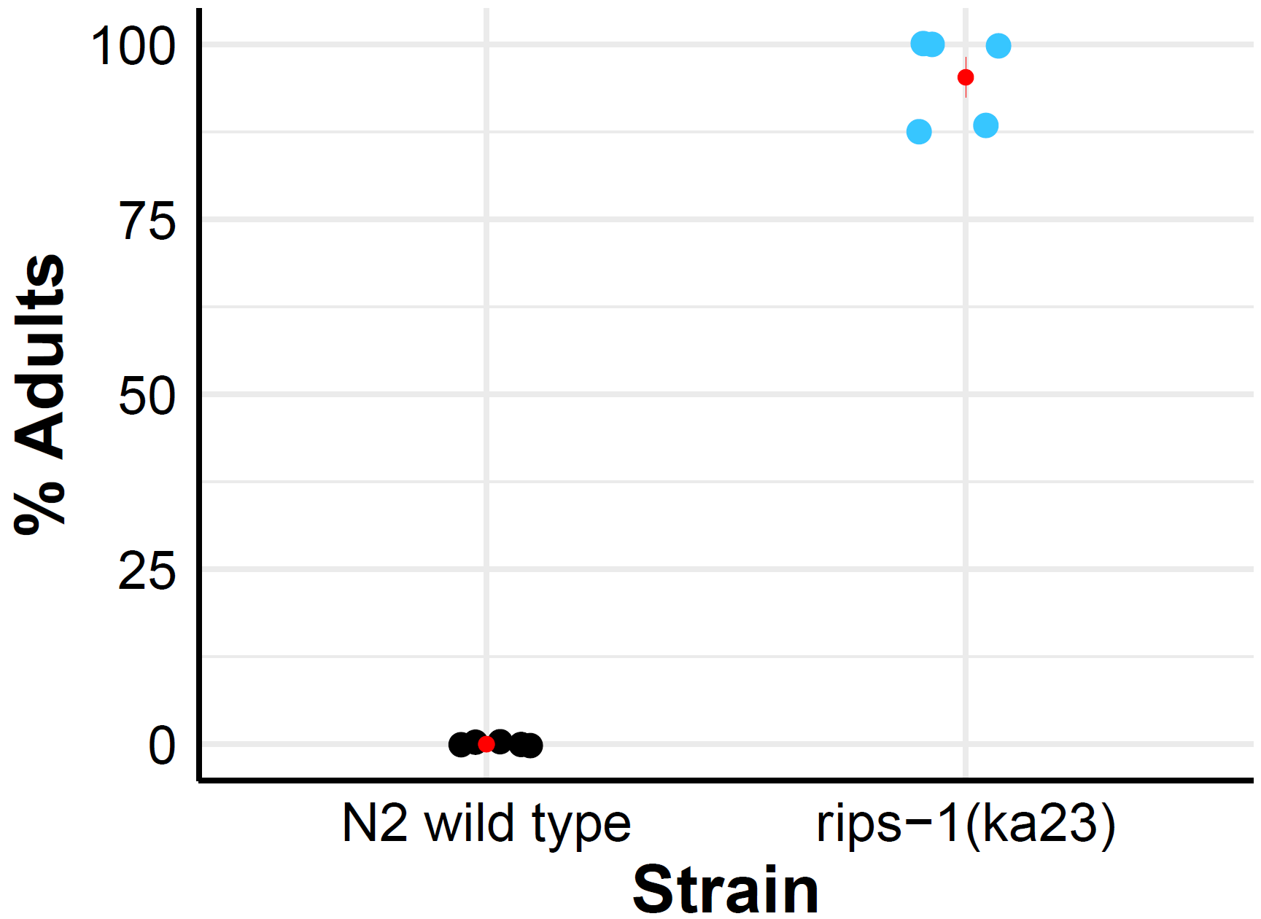
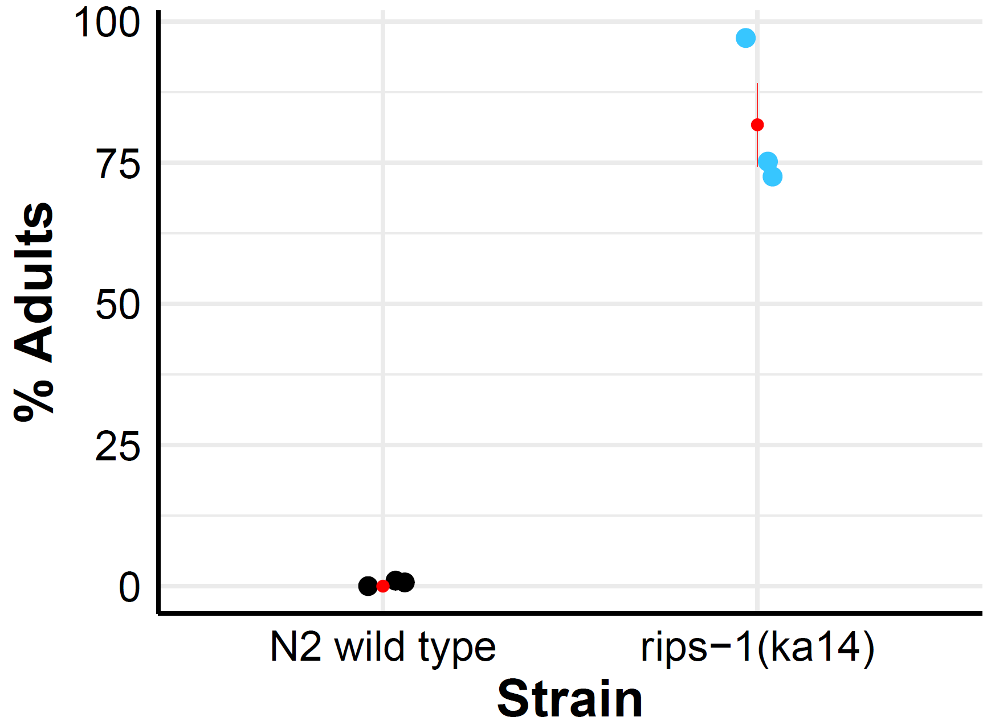
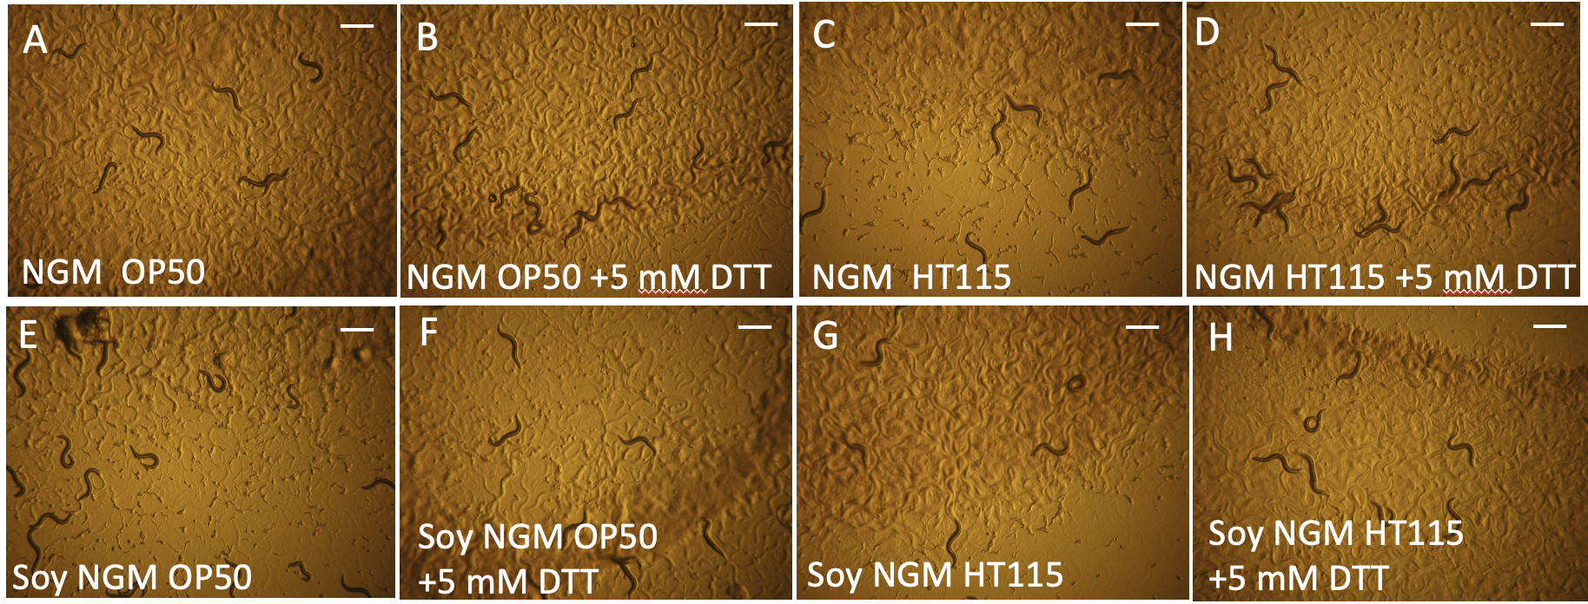
Figure S4
A
B
***
**
rips-1(ka23)
rips-1(ka14)
C

Slide 6
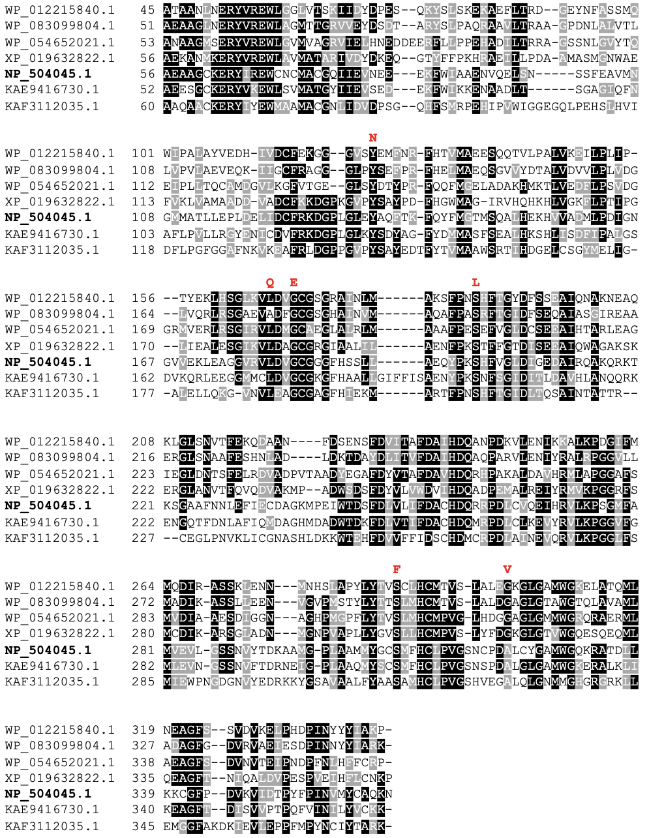
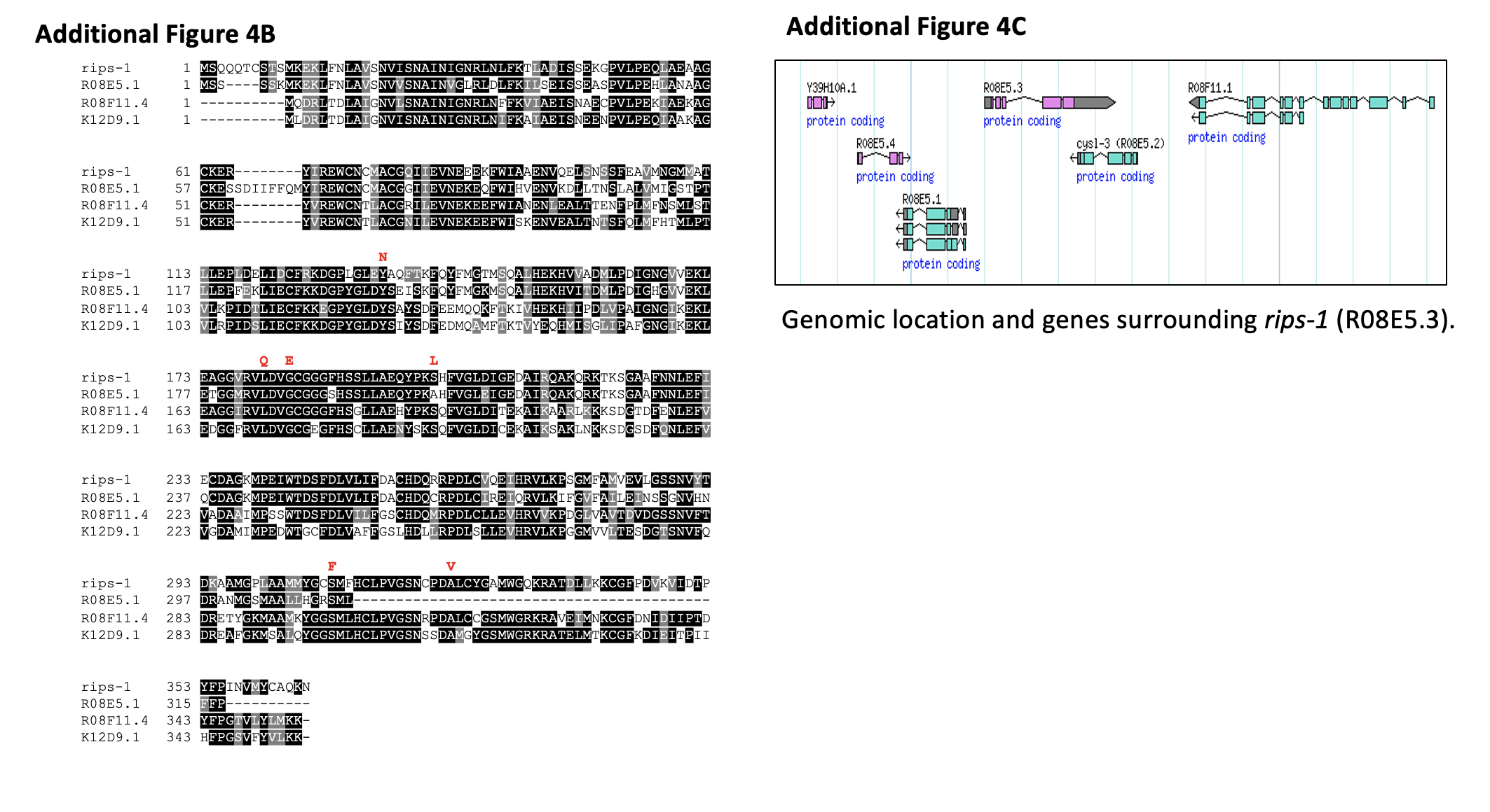
Figure S5
A
B
C

Slide 7
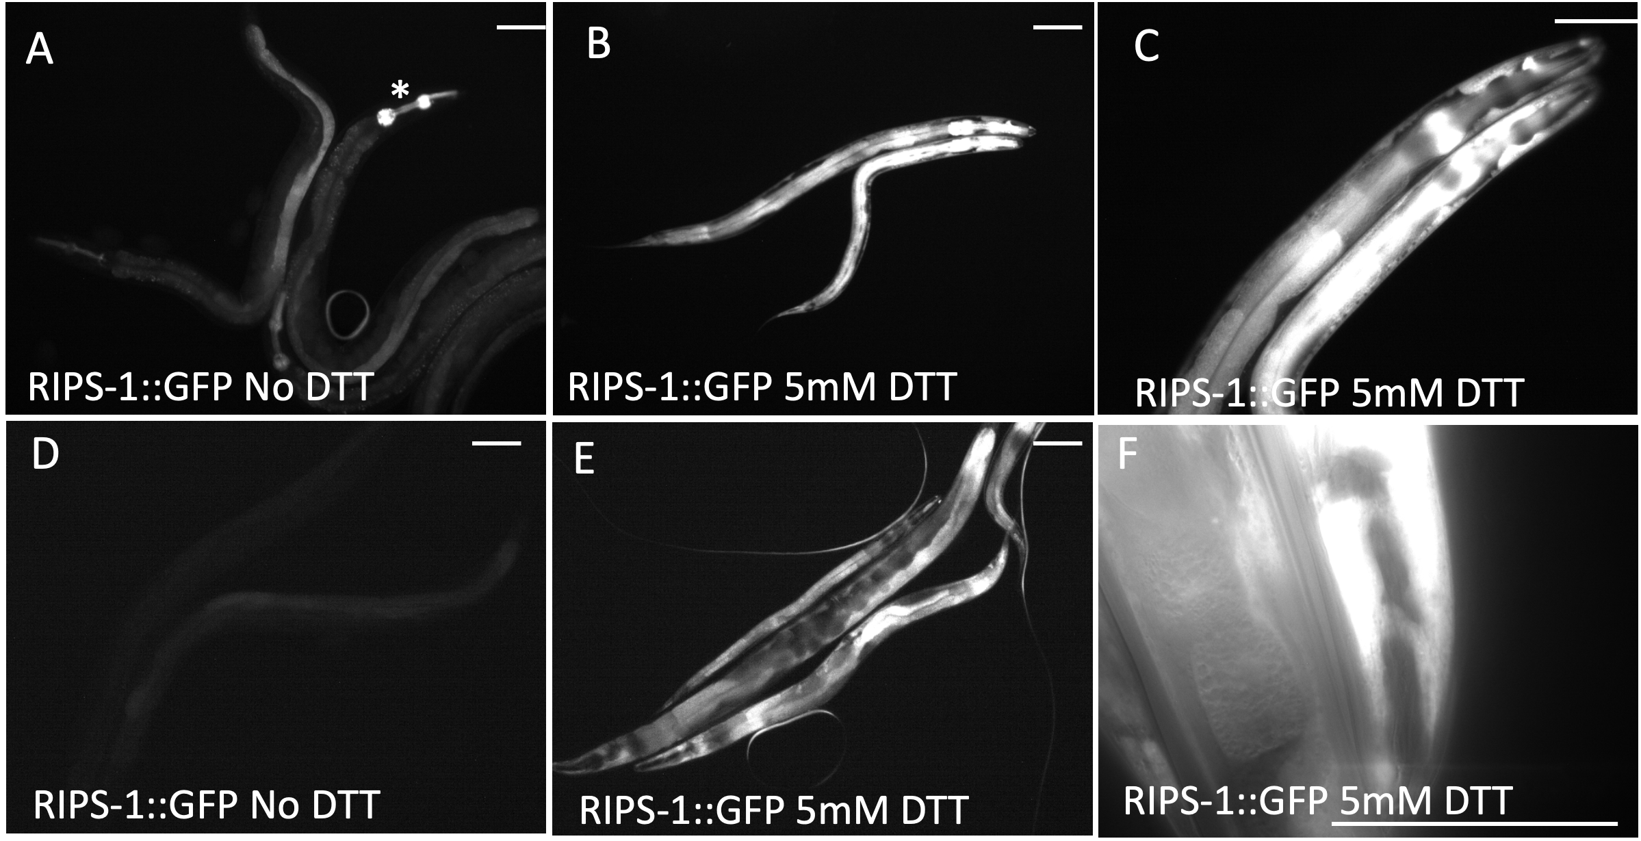
Figure S6

Slide 8
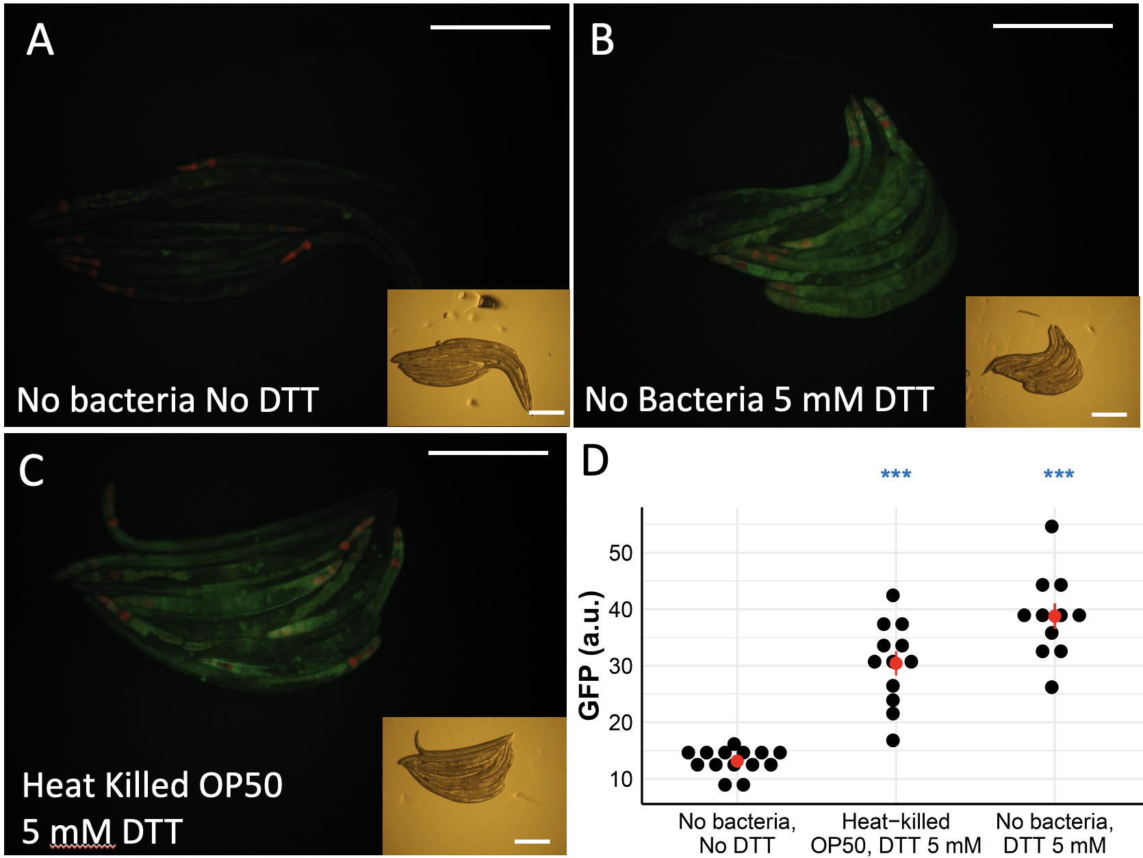
Figure S7

Slide 9
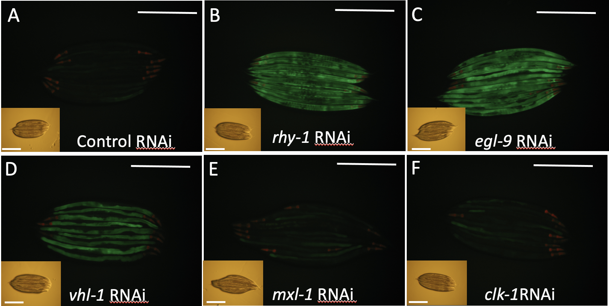
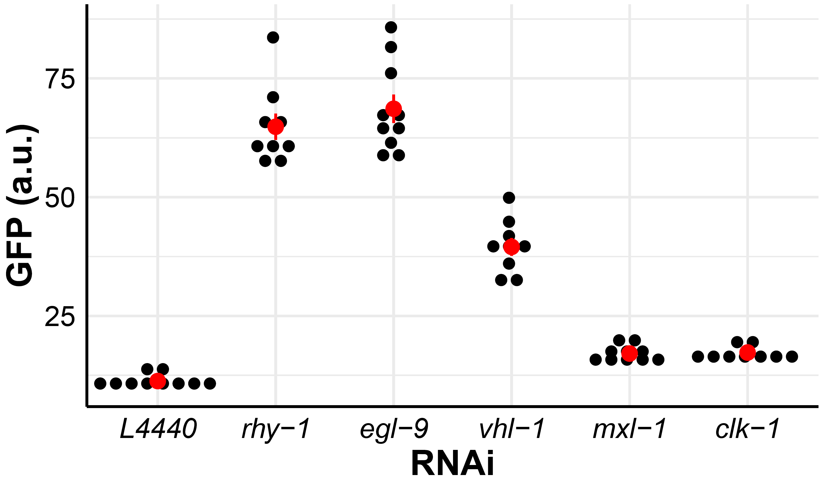
control RNAi
rhy-1 RNAi
egl-9 RNAi
vhl-1 RNAi
mxl-3 RNAi
clk-1 RNAi
G
***
***
***
NS
NS
mxl–3
Figure S8

Slide 10
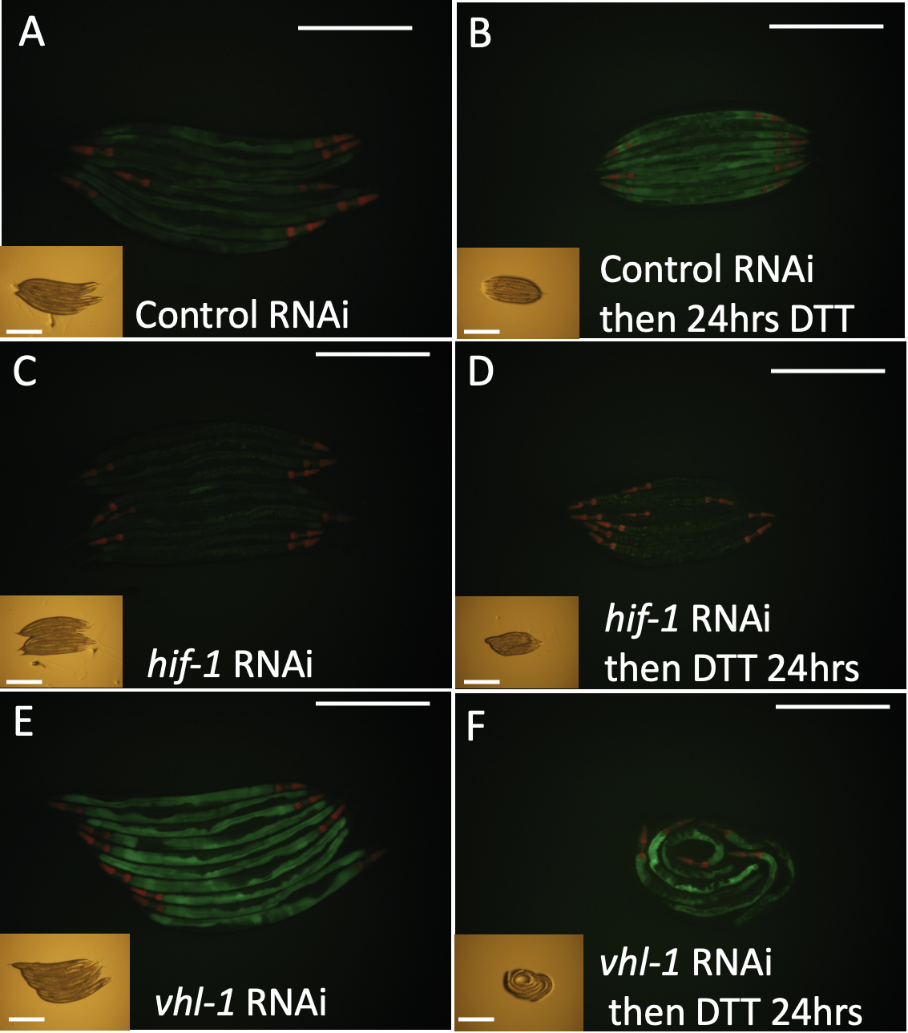
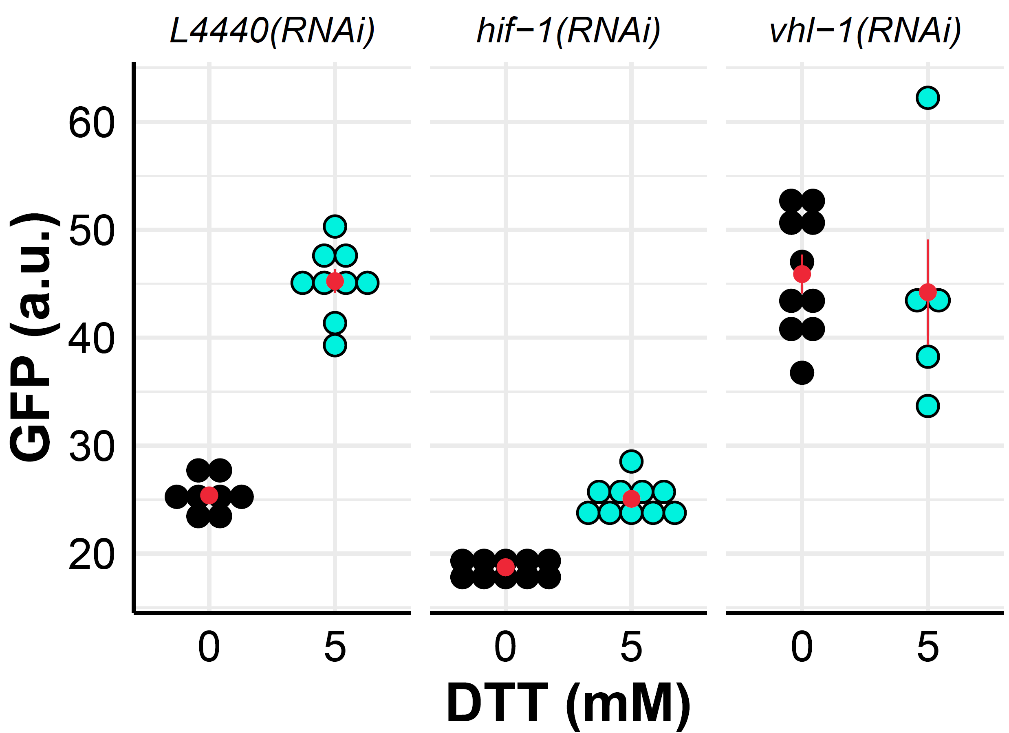
Figure S9
G
***
***
NS
NS
***
*
*

