Slide 1
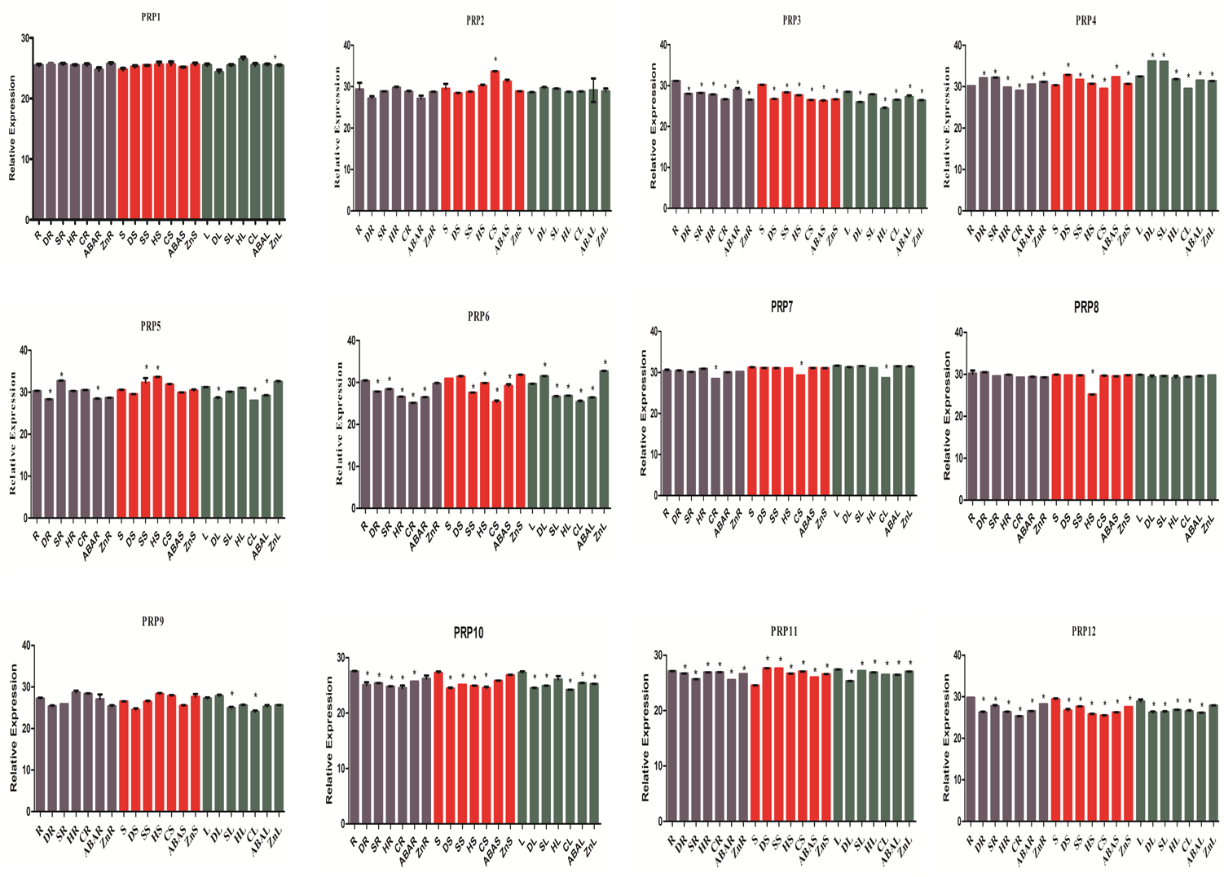

Slide 2
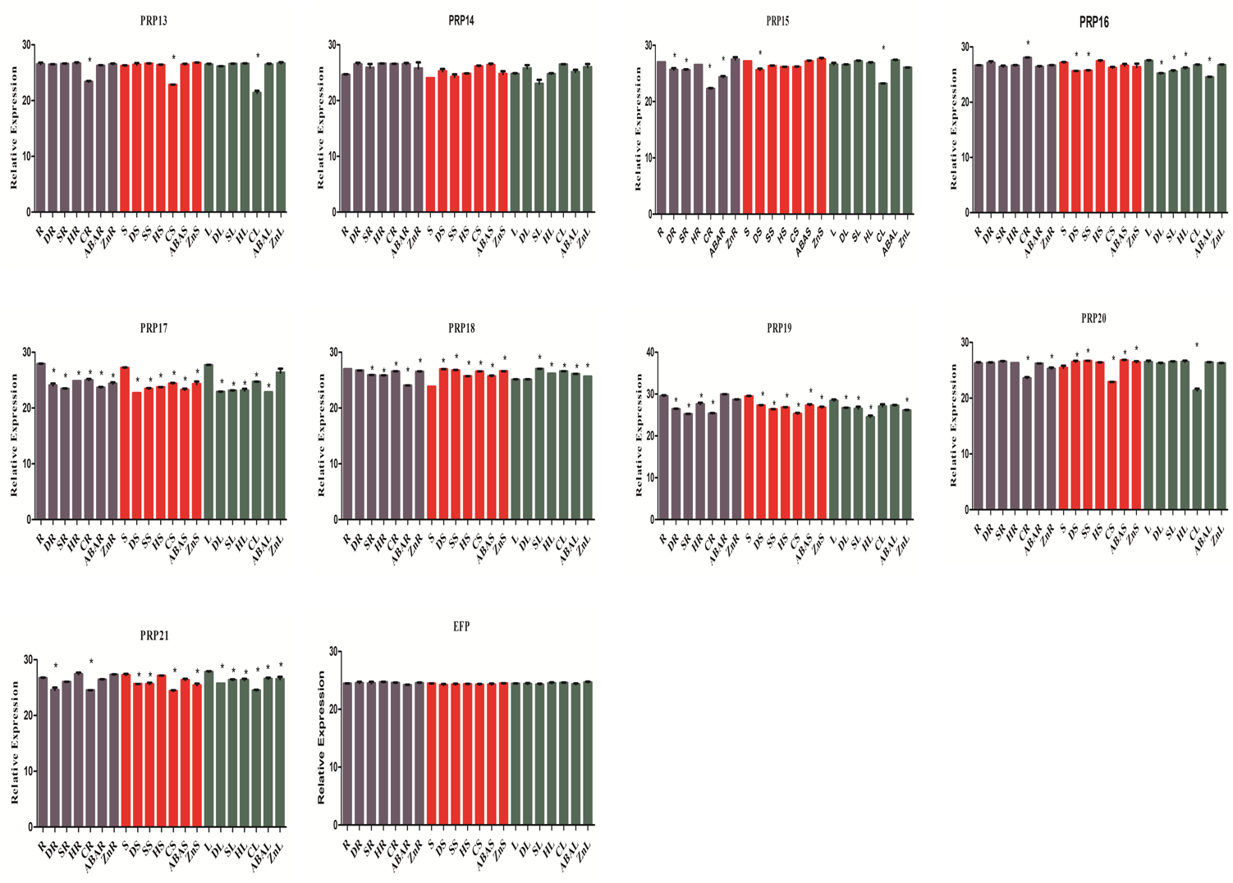
Figure S11 The relative expression values of SbPRPs in roots, stems and leaf tissues under drought, salt, heat and cold stress. Error bars indicate ± SD. *Indicate significant differences calculated by t-test (*P ≤ 0.05).

