Slide 1
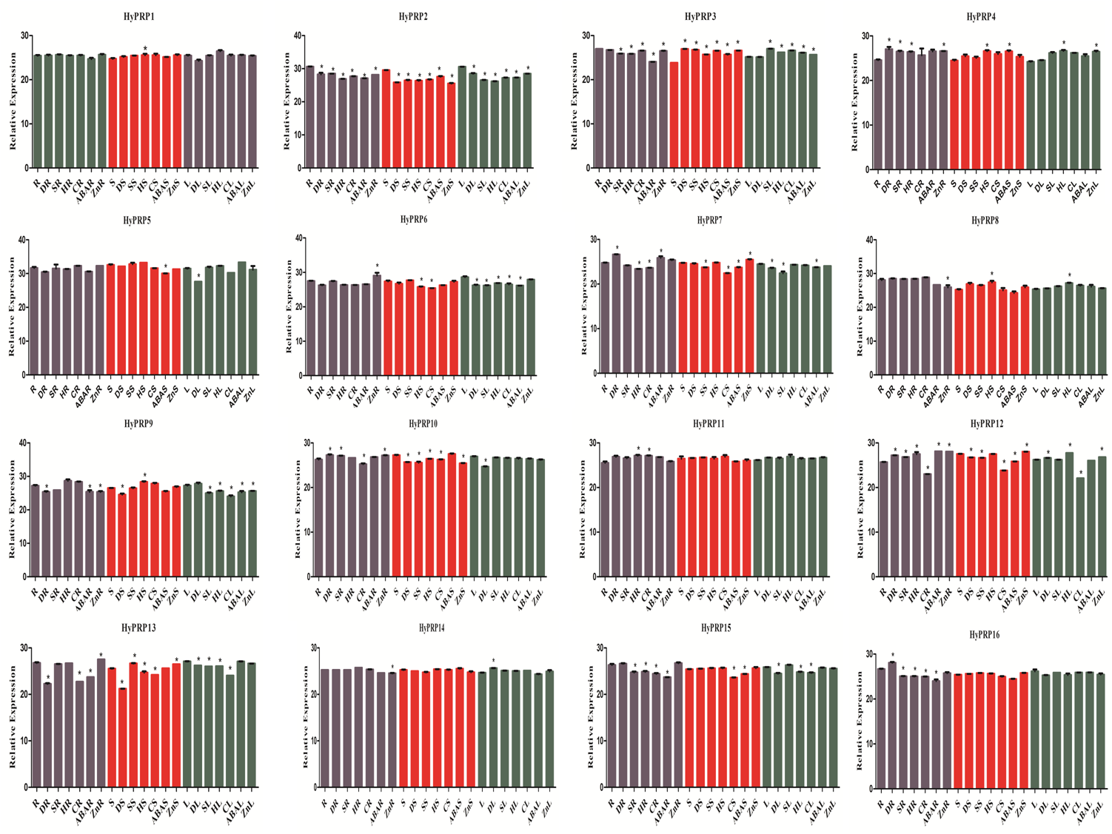

Slide 2
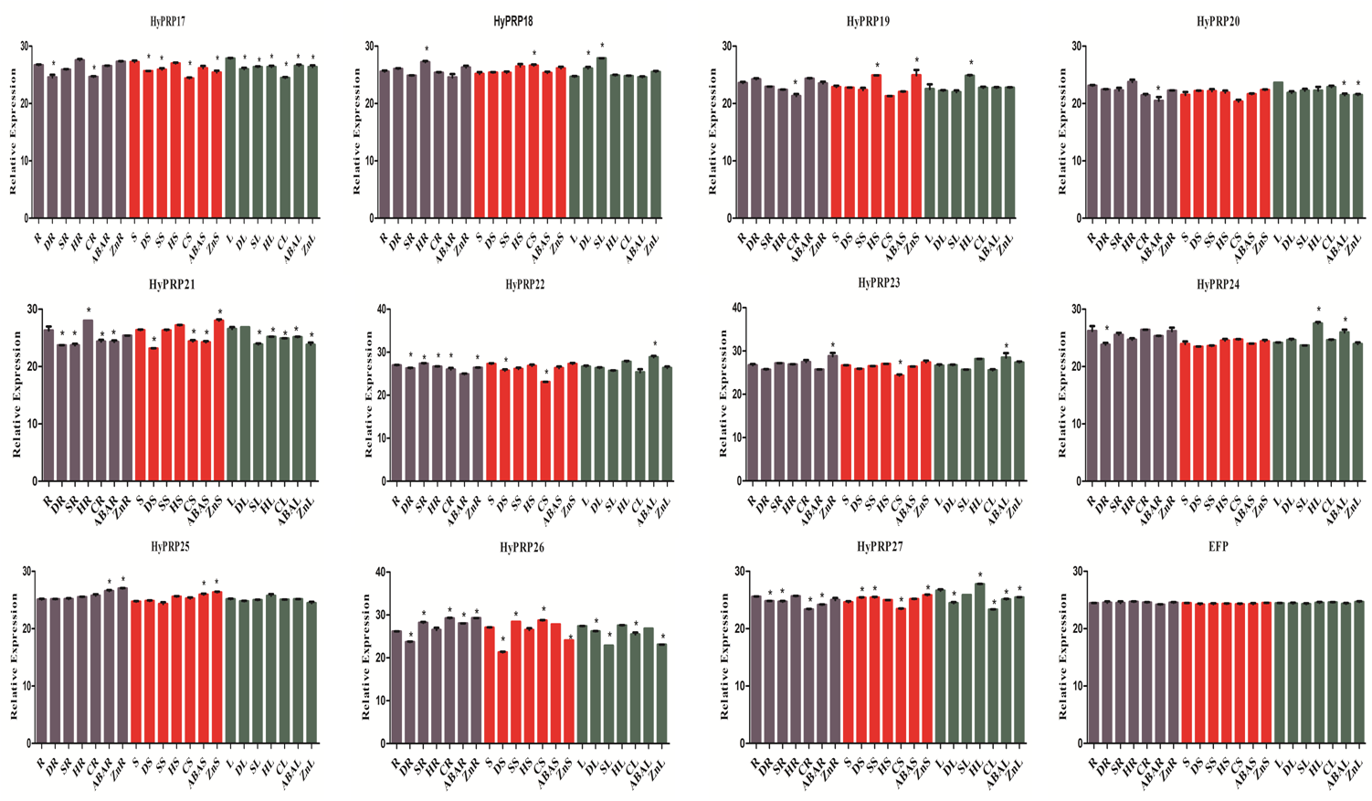
Figure S12 The relative expression values of SbHyPRPs in roots, stems and leaf tissues under abiotic Stresses, ABA and Zinc. Error bars indicate ± SD. *Indicate significant differences calculated by t-test (*P ≤ 0.05).

