Slide 1
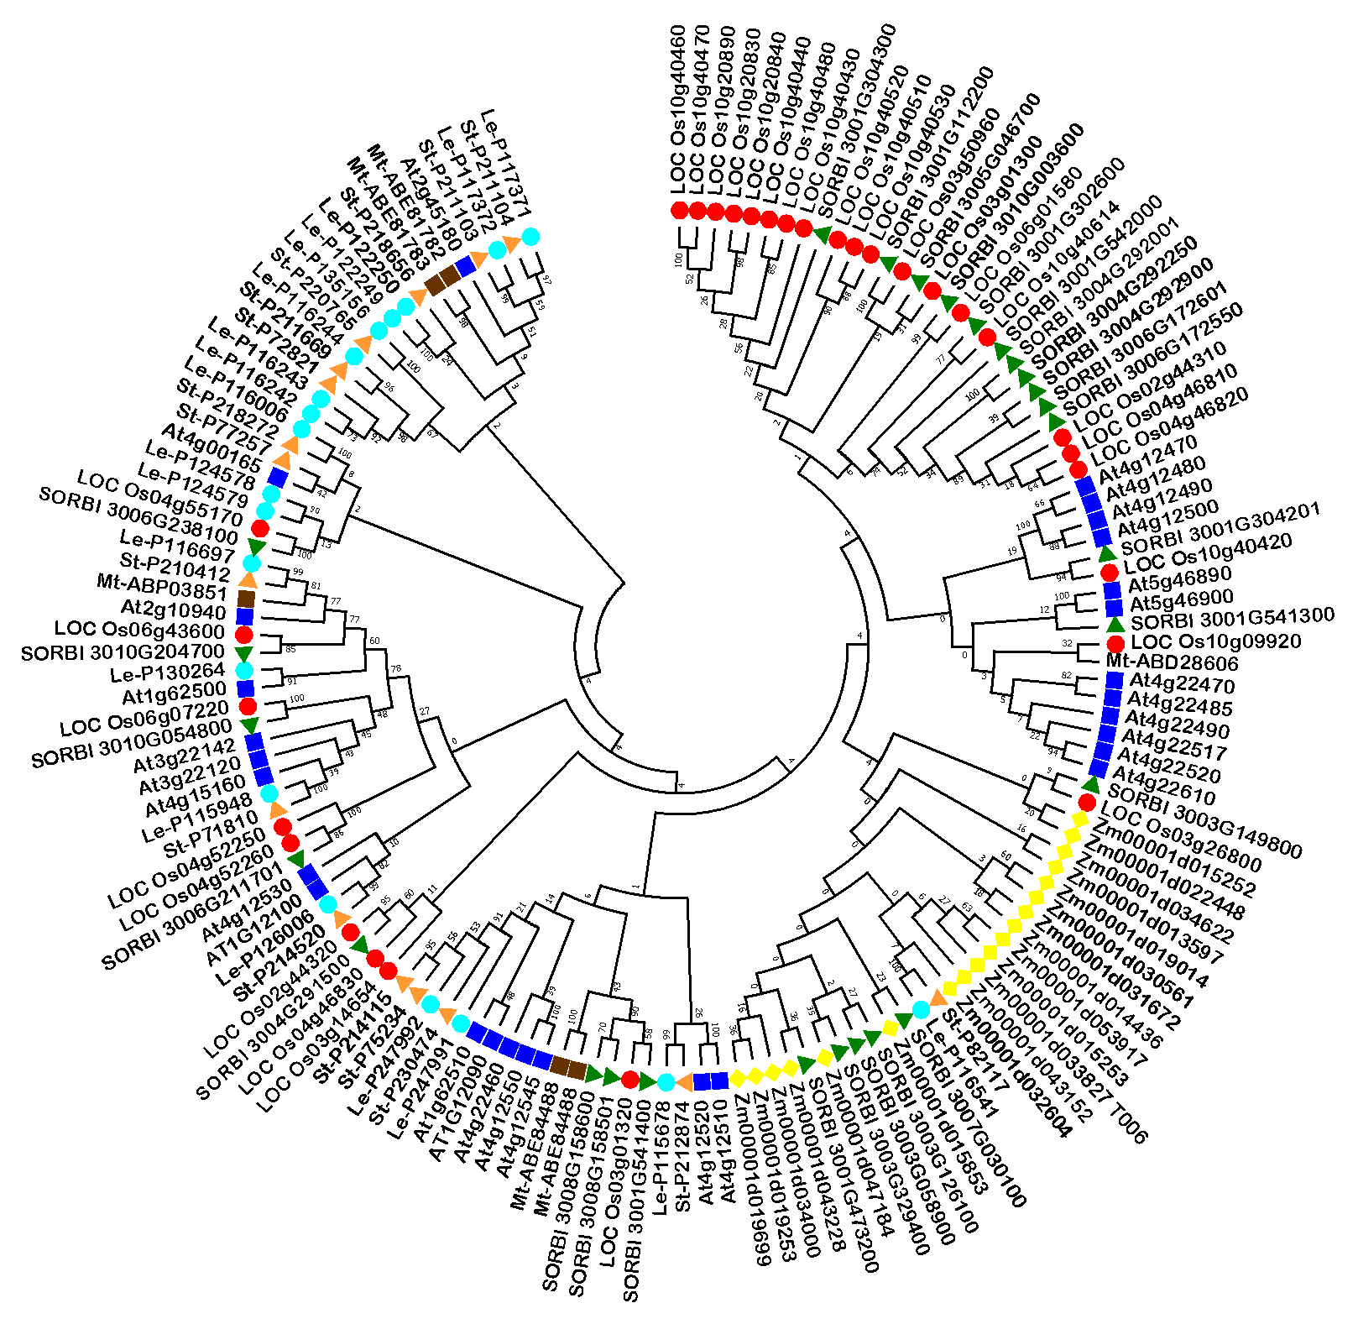
Figure S4 Comprehensive phylogenetic tree of HyPRPs of Sorghum, Oryza, Arabidopsis, Zea, Solanum, Lycopersicum, Medicago, Hordeum, Beta vulgaris, and Setaria. Various crops represented with different colors

