Slide 1
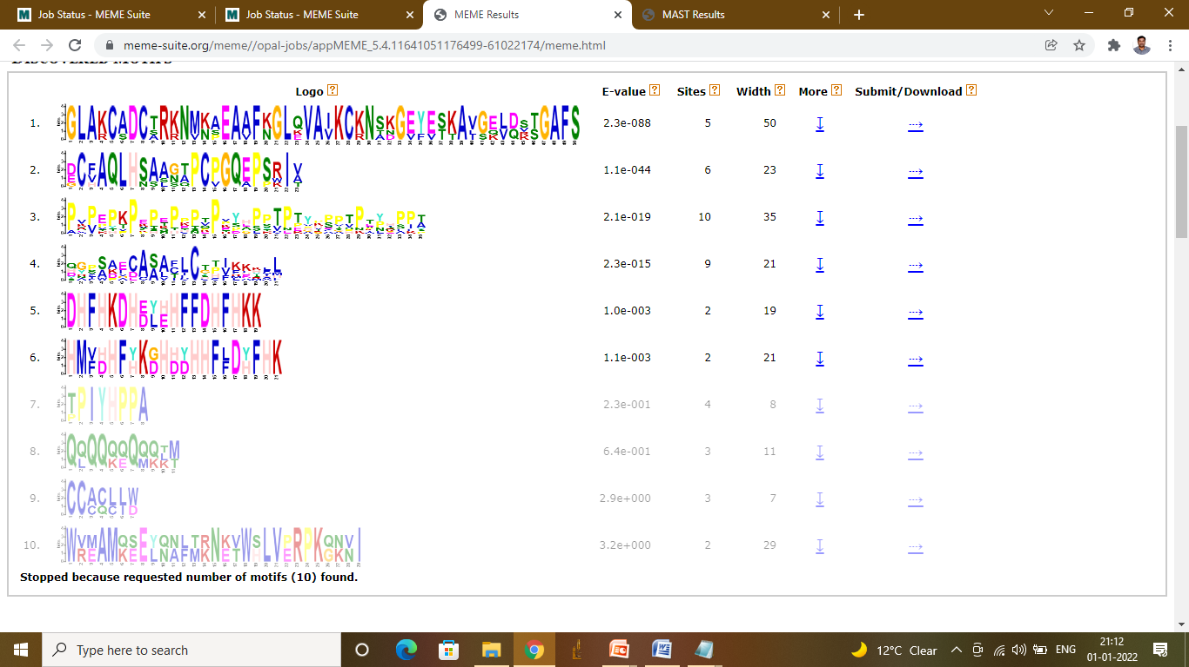
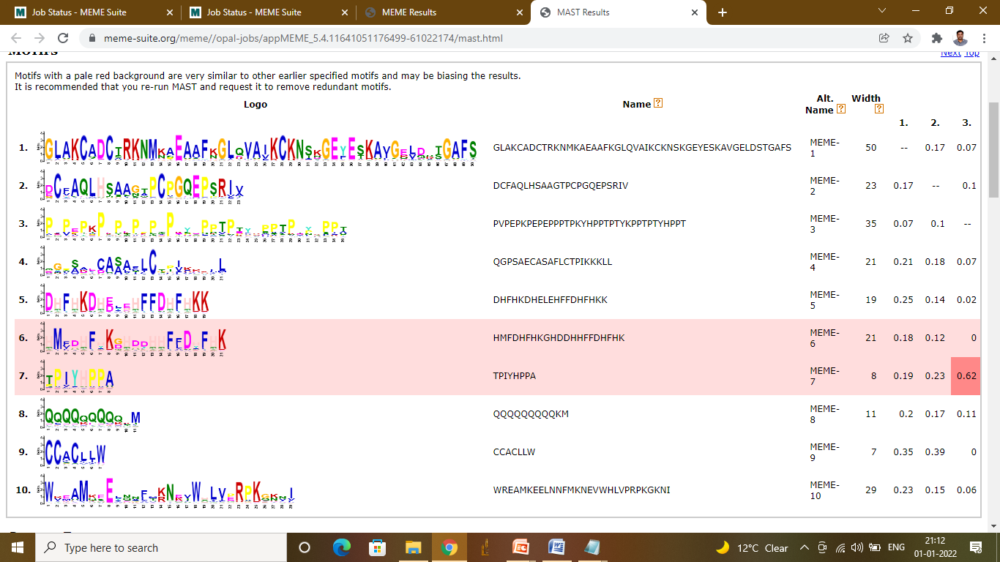
Figure S2 MEME identified 10 motif sequences in SbPRPs

