Slide 1
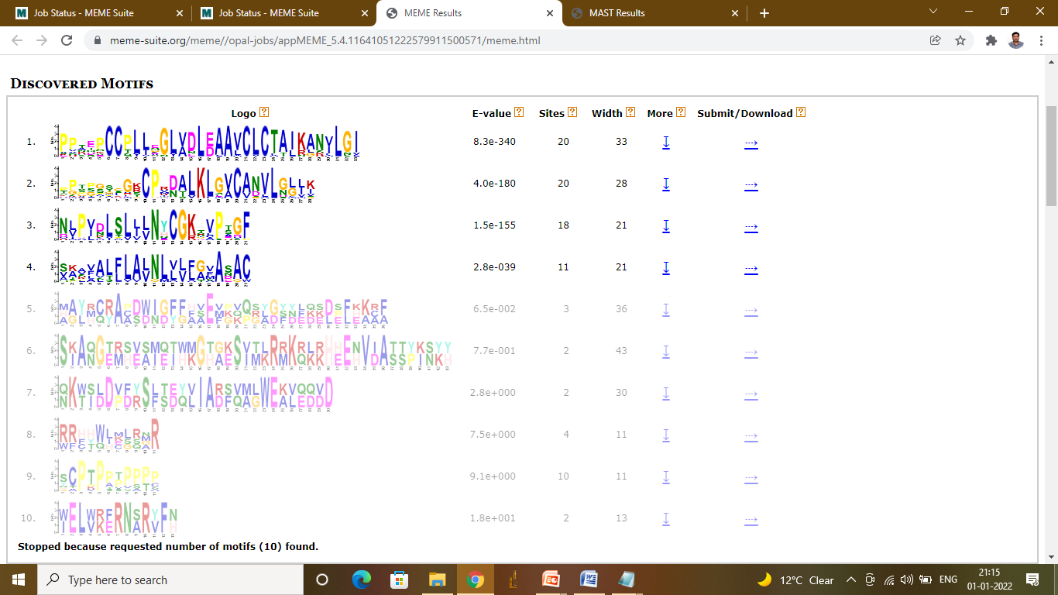
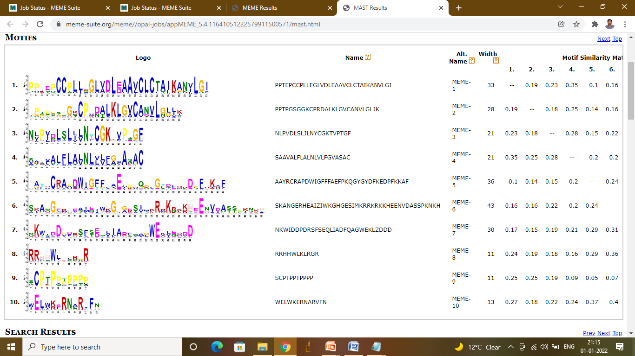
Figure S8 MEME identified 10 motif sequences in SbHyPRPs

