Slide 1
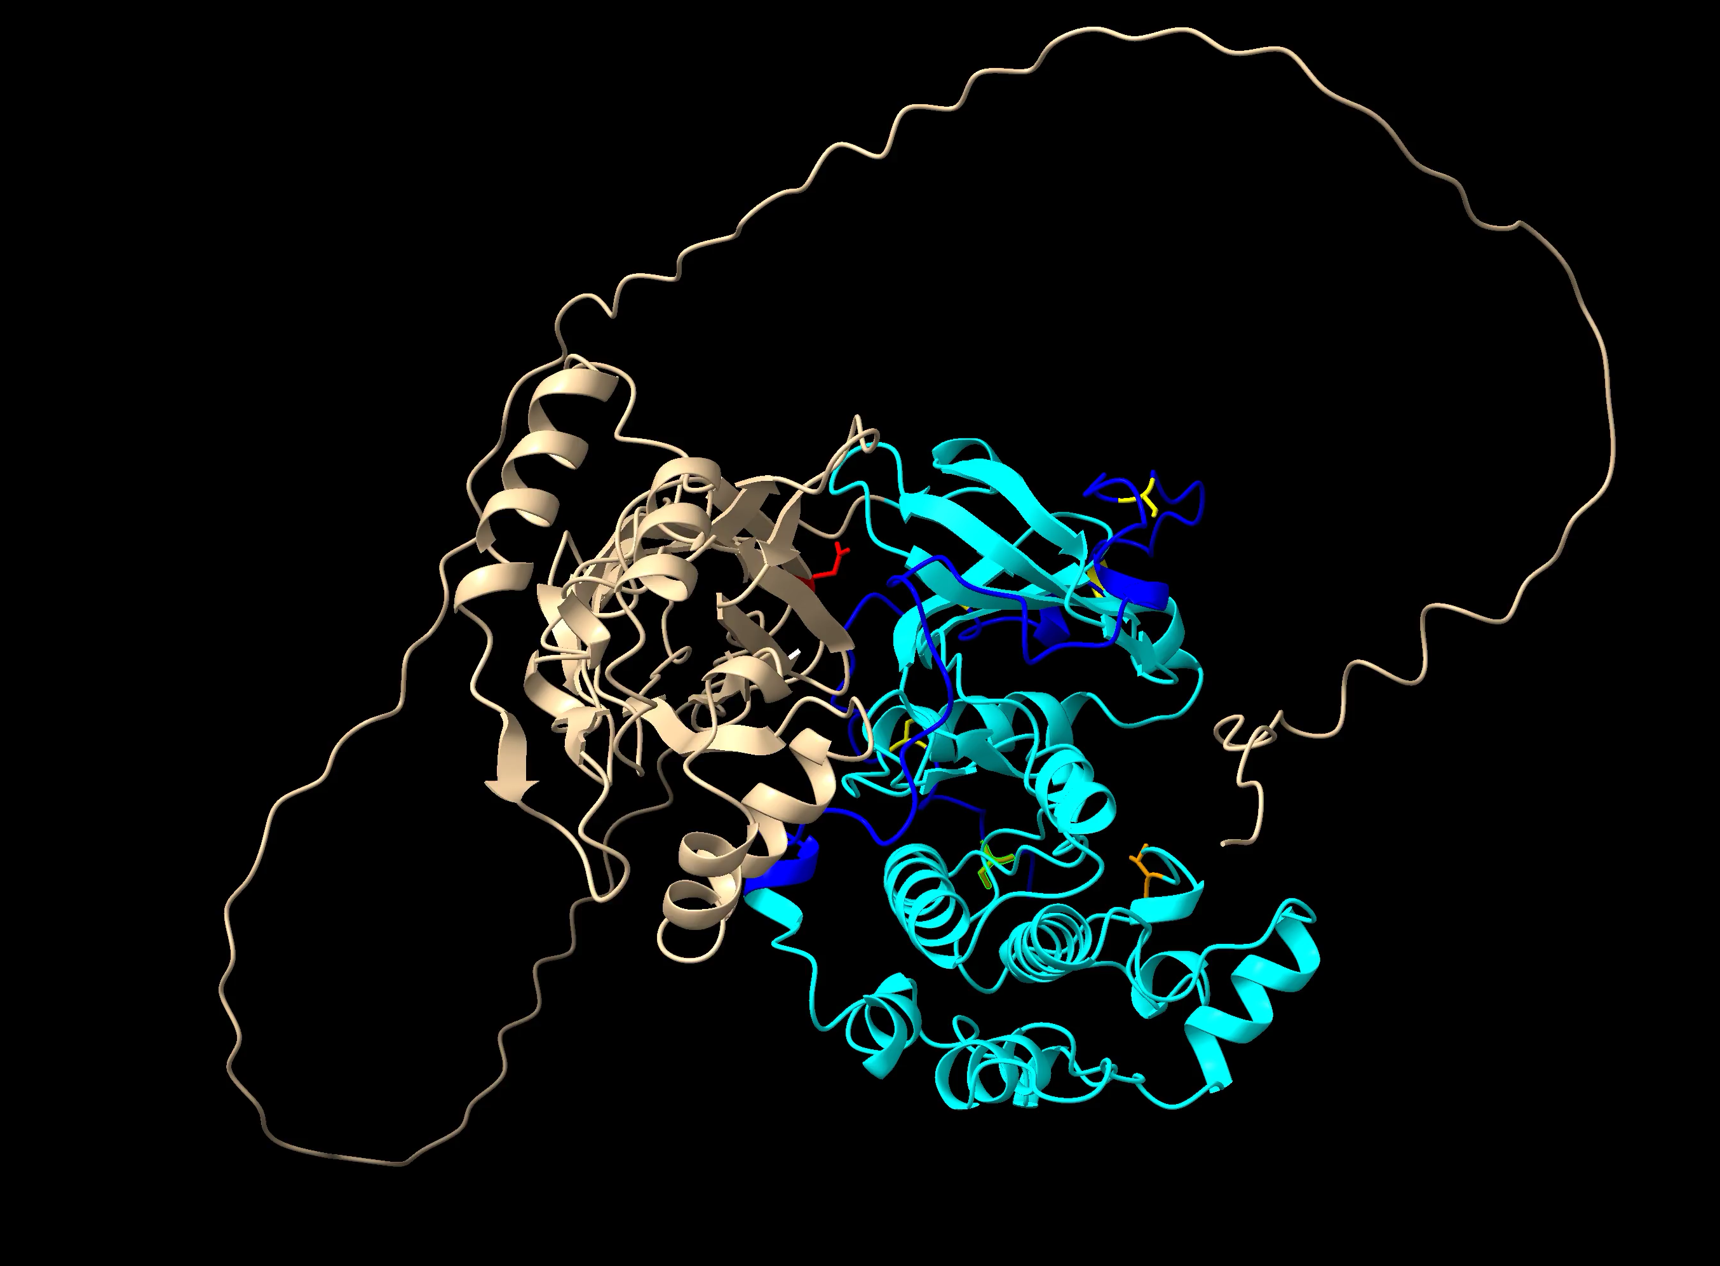
AlphaFold2 Prediction
[AF-P12688-F1-model_v2.pdb]
Catalytic domain
C2 domain (with helical insert)
Pkh1 site (Thr504)
Asp242 (D242A mutant constitutively-active)
C-terminal tail
TORC2 sites (S644, S653, T662, S672, S678)

