Slide 1



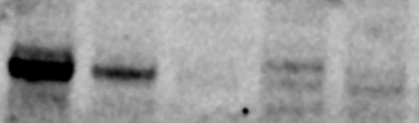

Figure S1
A
HCT116
LKB1 WT
A549
LKB1 MUT
IgG Control
(in HCT116)
PDX60
(0)
PDX102
(1)
PDX197
(2.25)
B
C
MCF10A p53 –/– Rb–/– clone 2
RB1 -/- Clone 1
RB1 -/- Clone 2
RB1 shRNA
TP53 -/-
NS shRNA
WT
TP53 homozygous deletion:
-
+
+
+
-
-
RB1 homozygous deletion:
-
-
+
+
-
-
RB1 shRNA:
-
-
-
-
+
-
RB1
TP53
Actin
D
LKB1#1
LKB1 pool
Mock
siCON
LKB1#2
CCNE1 CN-ampl/gain
LKB1
Vinculin
Cell line | AZD1775 GI50 (µM) | CCNE1 CN
HCC1806 | 0.120 | gain
HCC1569 | 0.152 | amp
MDA-MB-157 | 0.268 | gain
BT-20 | 0.238 | normal
MDA-MB-231 | 0.277 | normal
MDA-MB-436 | 0.406 | normal
MDA-MB-468 | 0.628 | normal

Slide 2
Figure S2
A
B
C

Slide 3
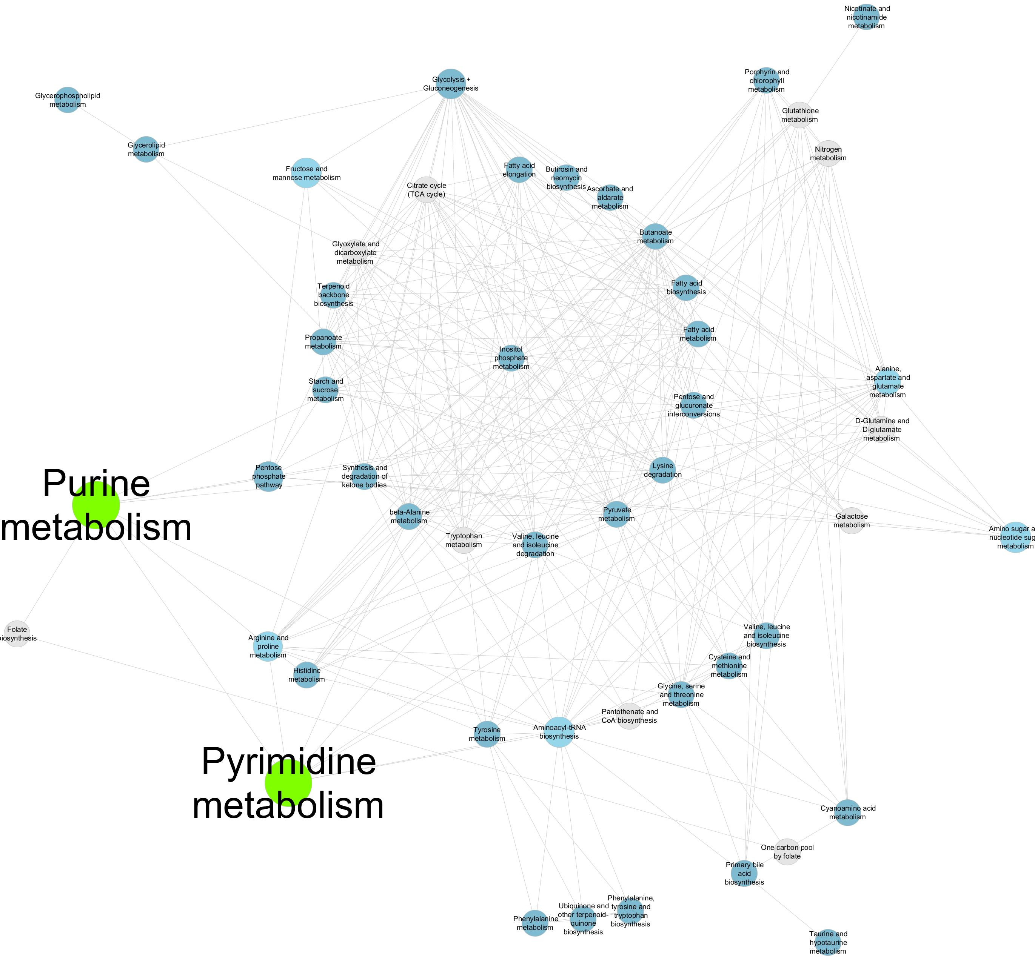
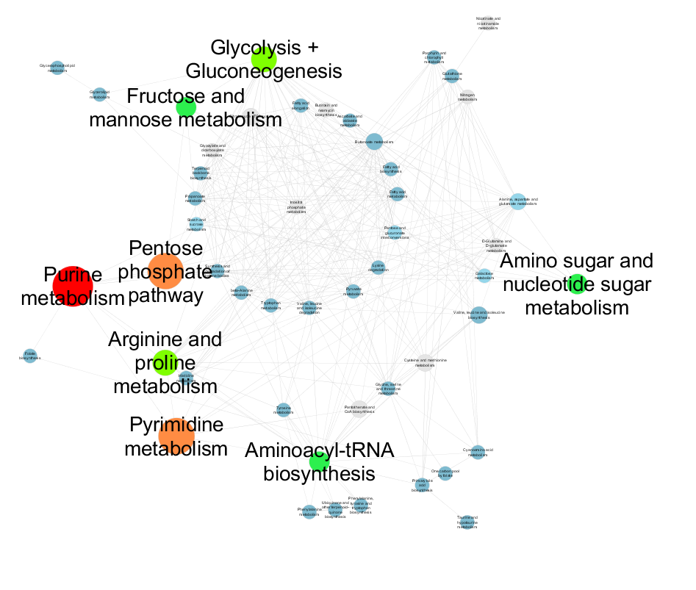
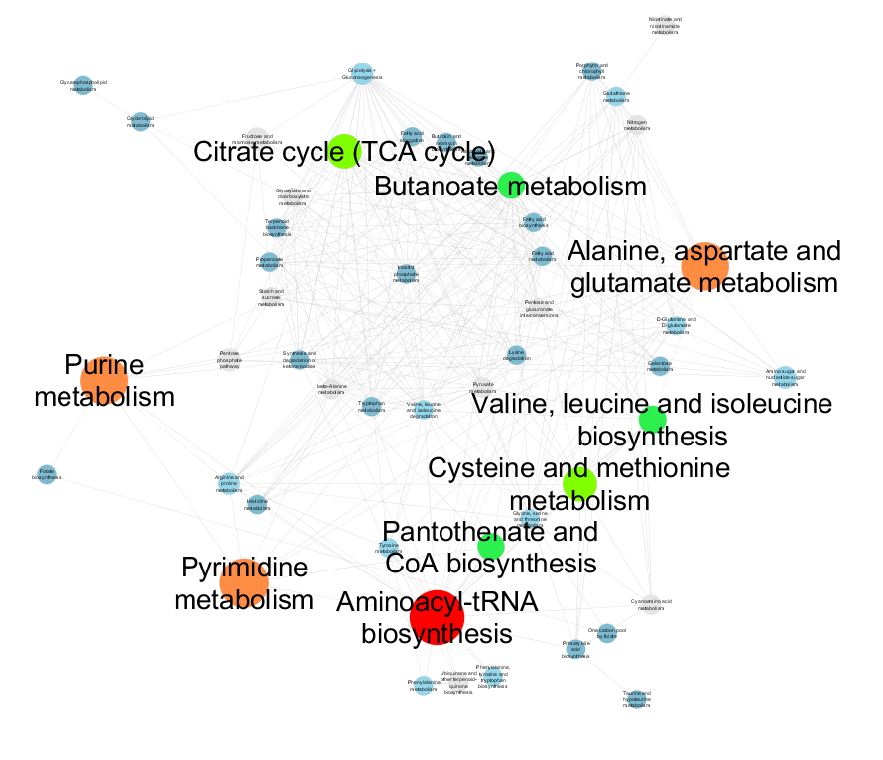
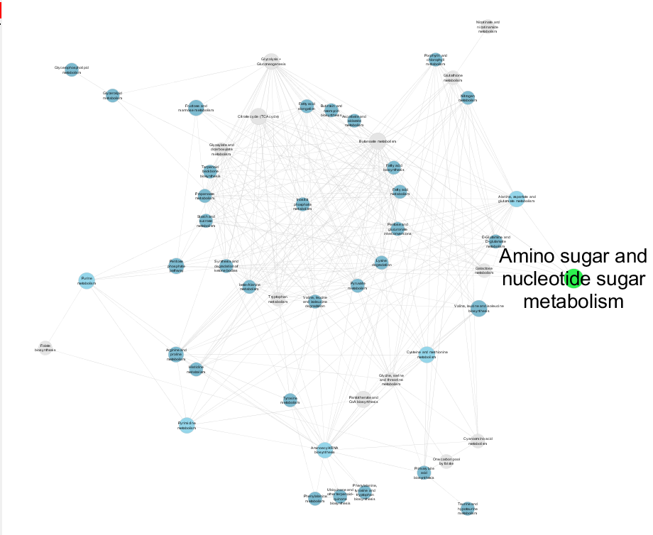
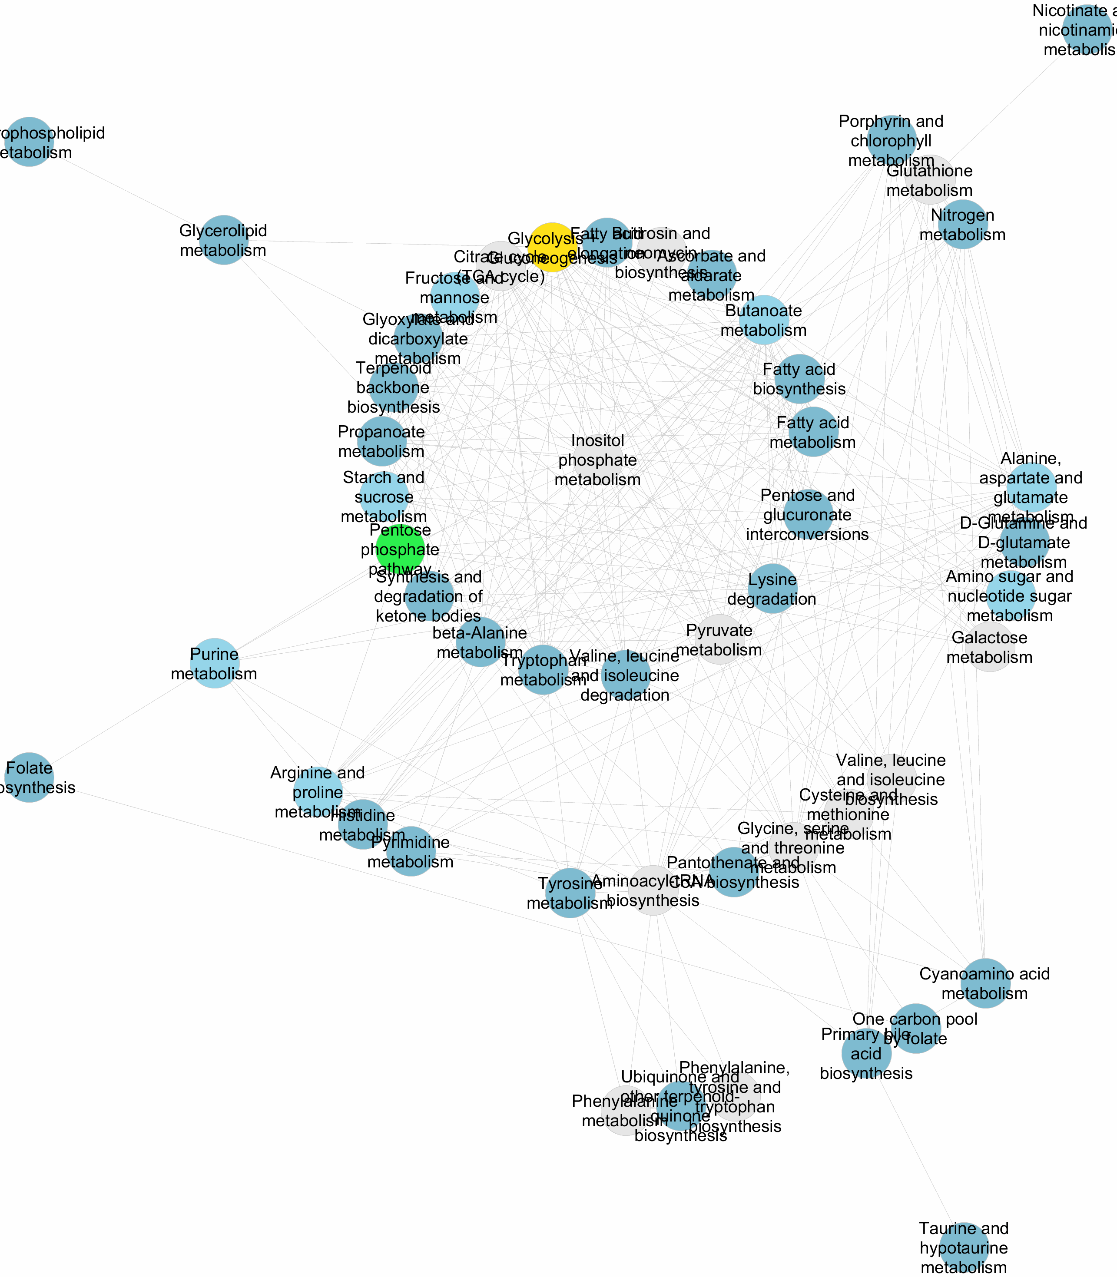
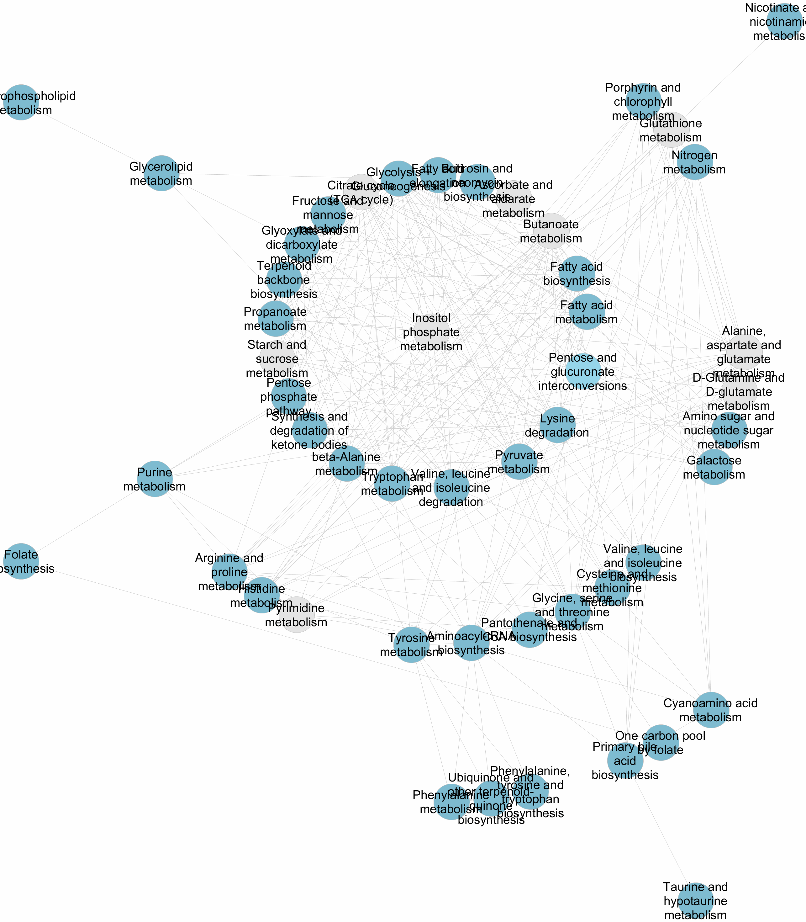
Figure S3
8 hours
24 hours
PDX098
PDX060
PDX102

Slide 4
Figure S4
A
C
B

Slide 5
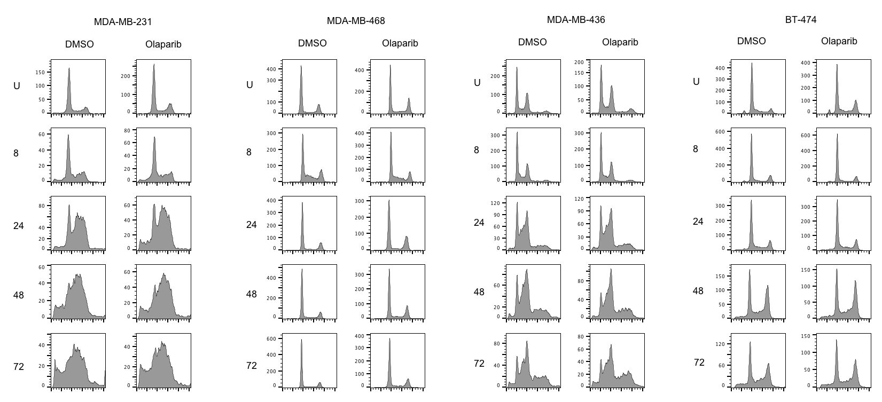
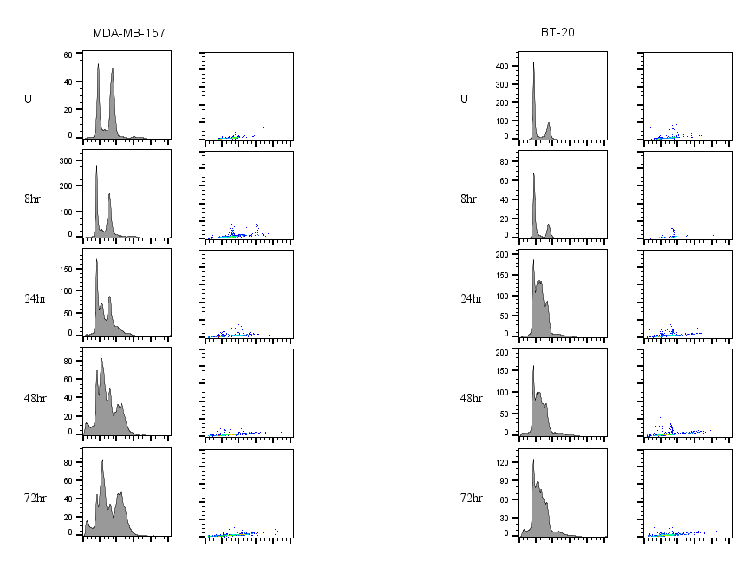
Figure S5
A
MDA-MB-231
MDA-MB-436
MDA-MB-157
BT-20
Count
Count
Count
Count
Count
B
Notes:
To point out:
-Narrow range of sensitivities (IC50)
-No single component correlates with sensitivity (CCNE1 ampl/gain, trend towards sensitivity p=0.136, t-test)
-CDKN2A, myc and BRCA1/2 important in DLBCL

Slide 6
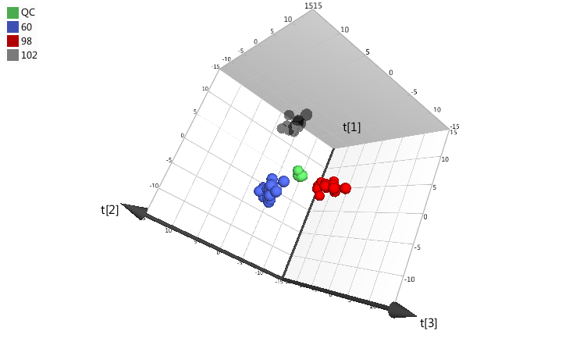
Figure S6
A
B

Slide 7
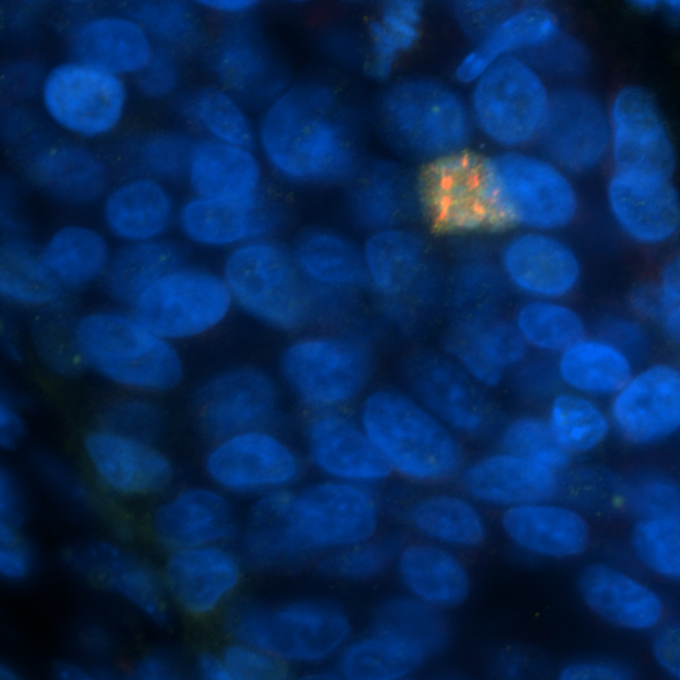
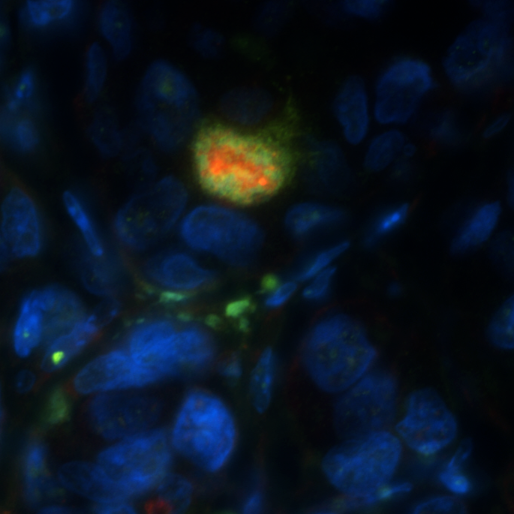
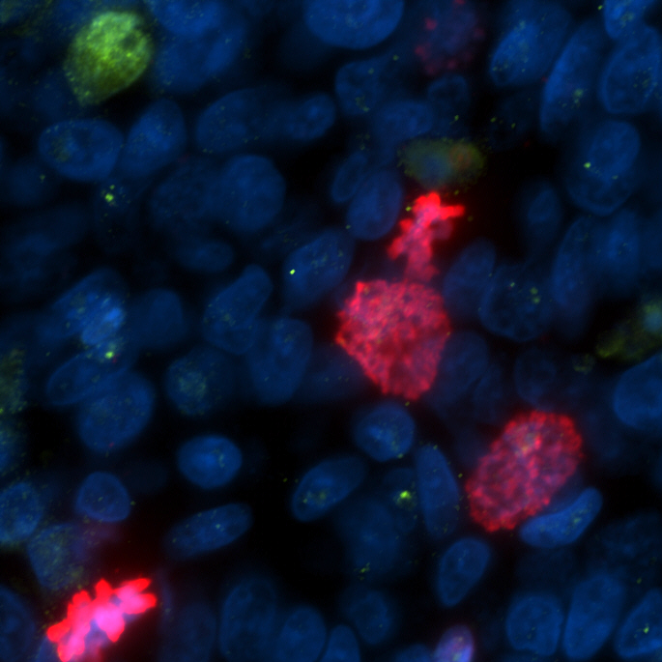
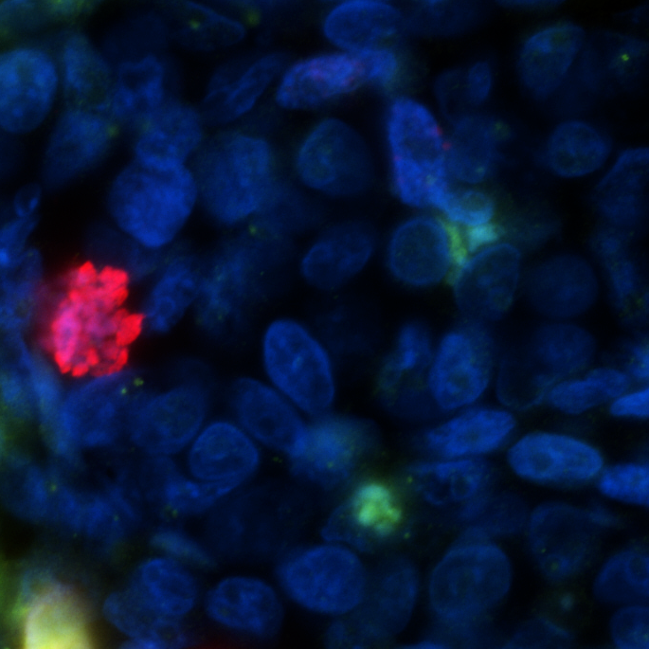
Figure S7
A
PDX098
PDX236
Vehicle
AZD1775
Vehicle
AZD1775
pRPA
γH2AX
DAPI
pRPA
γH2AX
DAPI
pDNAPK
γH2AX
DAPI
pDNAPK
γH2AX
DAPI
pHH3
γH2AX
DAPI
pHH3
γH2AX
DAPI
B

Slide 8
Figure S8
C
A
D
B
E
F
H
GI50 (µM) | A549 | A549 ATM KO #2 | A549 ATM KO #3 | FaDu | FaDu ATM KO
Olaparib | 8.183 | 0.042 | 0.158 | 1.259 | 0.020
AZD1775 | 0.761 | 0.384 | 0.468 | 0.133 | NA
AZD6738 | 1.370 | 0.351 | 0.314 | 0.875 | 0.235
G
I

Slide 9
Figure S9

Slide 10



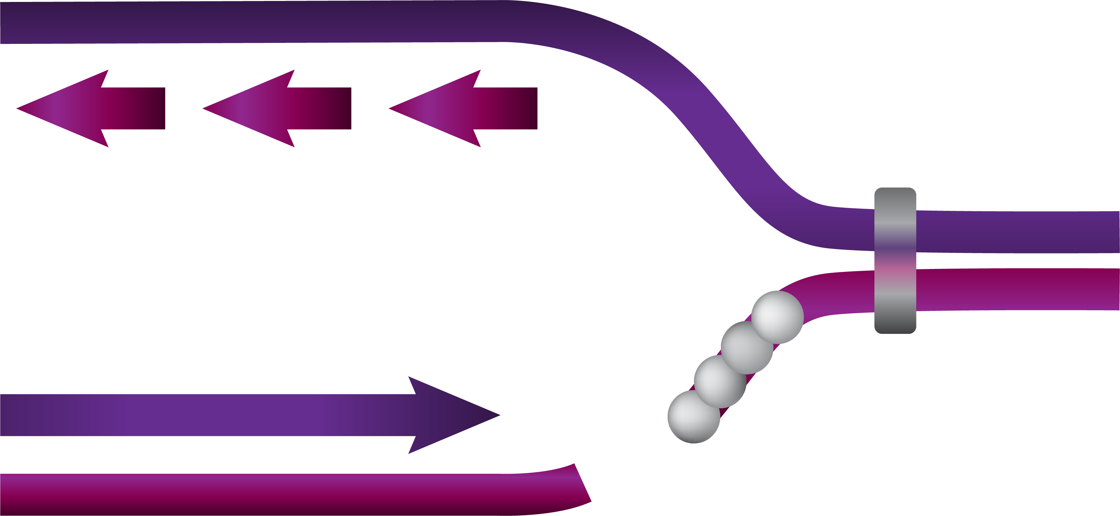








Figure S10
A
Early entry into S-phase
+
Increased replication stress
and/or
Abrogated replication stress response
TP53
MYC
CCNE1
SETD2
BRCA1
INK4A
KRAS
KDM4A
BRCA2
ARF
STK11
PALB2
RB1
TSC2
CCND1
RSP6KA6
Loss of function
CDK4
Phenotypic markers of RS
e.g. pRPA, pan-γH2AX, pDNAPK
CDK6
Gain of function
B
Replication Stress Response (WEE1, ATR, CHK1, DNAPK)
PARP
PALB2
BRCA2
BRCA1
RAD51
Replication Fork stabilization and re-start
Stalled Replication Fork
Nucleases
Collapsed Replication Fork
Pol
pRPA
WEE1
ATR
Double strand break (DSB)
DNAPK
Replication Stress
ATM
Stalled polymerase
CHK1
ATR
PARP
BRCA1
BRCA2
Physical block
dNTP shortage
KRASm
pRB
p53
Cyclin E
SETD2
MYC
PARP
INK4A
CDK6
LKB1
Topo I
ARF
CDK4
TSC2
10

