Slide 1

Efficacy and safety of mepolizumab in hypereosinophilic syndrome: A phase III, randomized, placebo-controlled trial
Florence Roufosse, MD, Jean-Emmanuel Kahn, MD, Marc E. Rothenberg, MD, Andrew J. Wardlaw, MD, Amy D. Klion, MD, Suyong Yun Kirby, PhD, Martyn J. Gilson, MSc, Jane H. Bentley, MSc, Eric S. Bradford, MD, Steven W. Yancey, MSc, Jonathan Steinfeld, MD, Gerald J. Gleich, MD
Journal of Allergy and Clinical Immunology
Volume 146 Issue 6 Pages 1397-1405 (December 2020)
DOI: 10.1016/j.jaci.2020.08.037
Copyright © 2020 The Authors Terms and Conditions

Slide 2
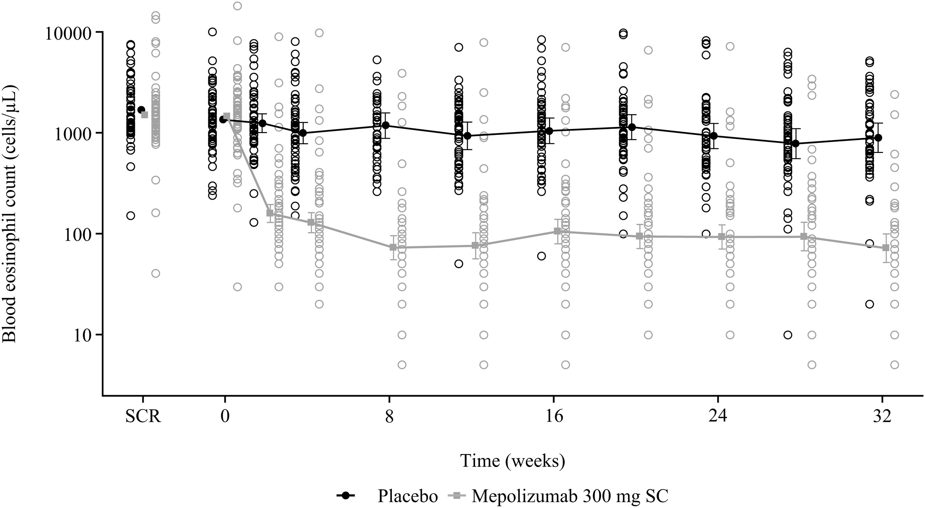
Fig E3
Journal of Allergy and Clinical Immunology 2020 1461397-1405DOI: (10.1016/j.jaci.2020.08.037)
Copyright © 2020 The Authors Terms and Conditions

