Slide 1
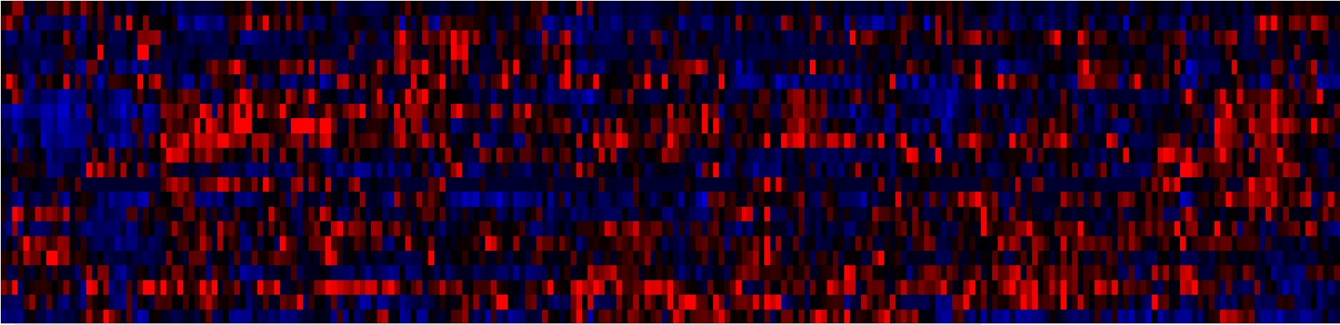
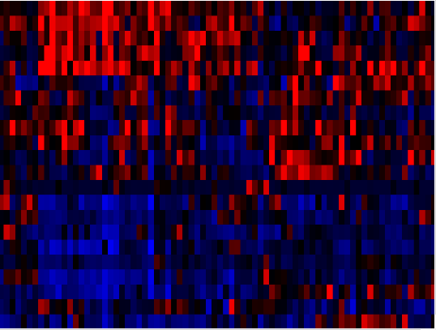
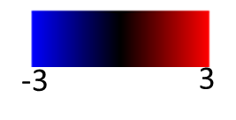
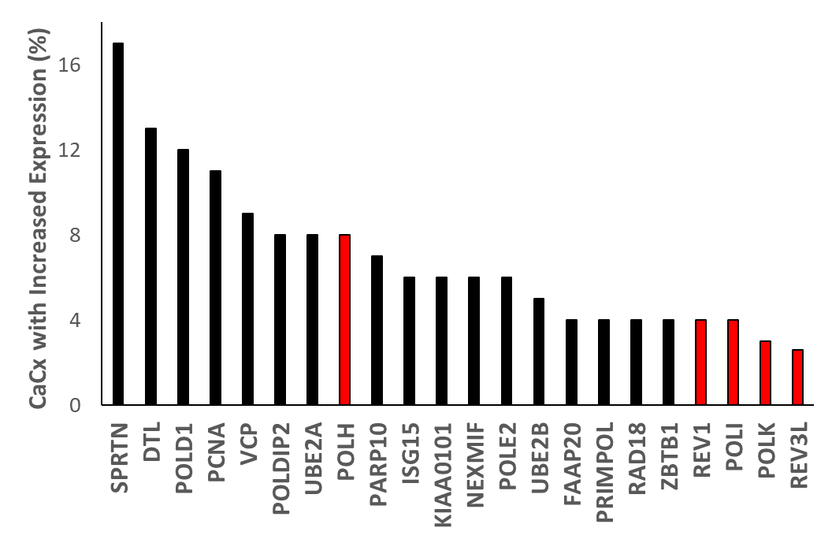
A
Translesion Synthesis Genes
B
POLDIP2
KIAA0101
PRIMPOL
FAAP20
PARP10
POLD1
UBE2A
NEXMIF
RAD18
POLE2
UBE2B
ZBTB1
SPRTN
ISG15
PCNA
REV3L
POLH
REV1
POLK
VCP
DTL
POLI
Cervical Cancer Samples
C

Slide 2
