Slide 1
Supporting Information 2 for
Spatial Control of Microbial Pesticide Degradation in Soil: A model-based Scenario Analysis
Erik Schwarz*^{,1,2,3}, Swamini Khurana^{1,4}, Arjun Chakrawal^{1,2}, Luciana Chavez Rodriguez^{3,5}, Johannes Wirsching⁶, Thilo Streck³, Stefano Manzoni^{1,2}, Martin Thullner^{4,7} and Holger Pagel³
¹Department of Physical Geography, Stockholm University, 10691 Stockholm, Sweden
²Bolin Centre for Climate Research, Stockholm University, 10691 Stockholm, Sweden
³Institute for Soil Science and Land Evaluation, Biogeophysics, University of Hohenheim, 70599 Stuttgart, Germany
⁴Department of Environmental Microbiology, Helmholtz Centre for Environmental Research (UFZ), 04318 Leipzig, Germany
⁵Department of Ecology and Evolutionary Biology, University of California Irvine, Irvine, CA 92697, USA
⁶Institute for Soil Science and Land Evaluation, Soil Biology, University of Hohenheim, 70599 Stuttgart, Germany
⁷Federal Institute for Geosciences and Natural Resources (BGR), 30655 Hannover, Germany
*Corresponding author: erik.schwarz@natgeo.su.se
7 Pages
0 Tables
4 Figures

Slide 2
Table of Contents
Example Simulations……………………………………………………………………………………………………………………………… S3
List of Figures
Figure S9 Example simulation of MCPA reactive transport in HOM ……………………………………………………………. S4
Figure S10 Example simulation of MCPA reactive transport in LOW …………………………………………………………… S5
Figure S11 Example simulation of MCPA reactive transport in HIGH ………………………………………………………….. S6
Figure S12 Example simulation of MCPA reactive transport in EXTR ….………………………………………………………. S7

Slide 3
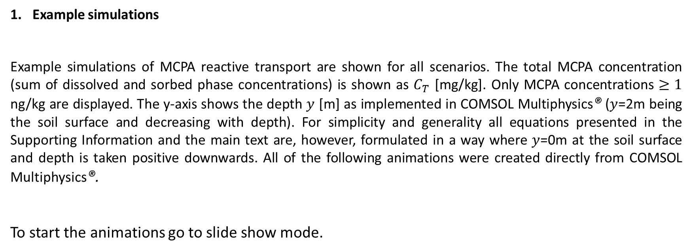
Example simulations
Example simulations of MCPA reactive transport are shown for all scenarios. The total MCPA concentration (sum of dissolved and sorbed phase concentrations) is shown as $C_{T}$ [mg/kg]. Only MCPA concentrations $≥1$ ng/kg are displayed. The y-axis shows the depth $y$ [m] as implemented in COMSOL Multiphysics® ($y$=2m being the soil surface and decreasing with depth). For simplicity and generality all equations presented in the Supporting Information and the main text are, however, formulated in a way where $y$=0m at the soil surface and depth is taken positive downwards. All of the following animations were created directly from COMSOL Multiphysics®.
To start the animations go to slide show mode.

Slide 4
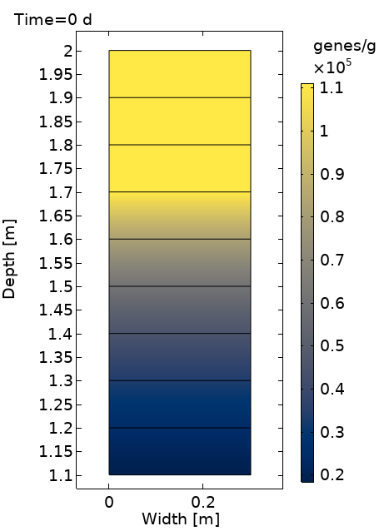
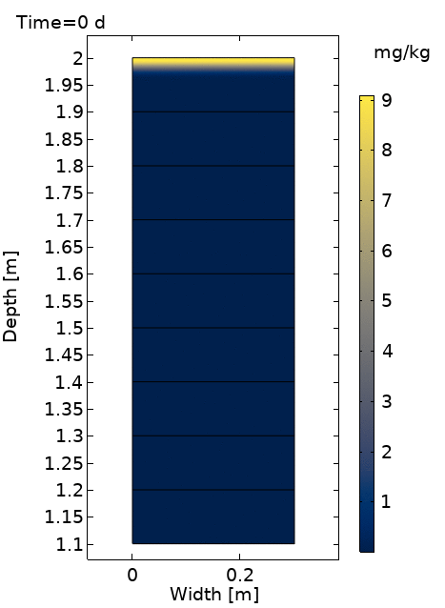
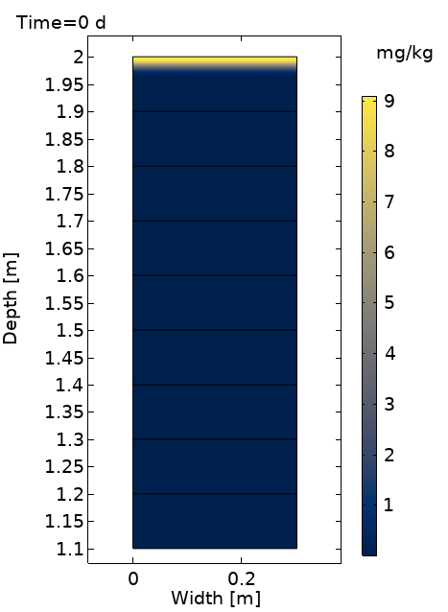
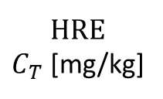
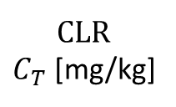

HOM
CLR
$C_{T}$ [mg/kg]
HRE
$C_{T}$ [mg/kg]
$B$ [genes/g]
Figure S9 Example simulation of MCPA reactive transport with a homogeneous spatial degrader distribution (HOM) in continuous light rain (CLR) and heavy rain events (HRE) scenarios. The left panel shows the degrader distribution B, the middle an animation of MCPA reactive transport under CLR, and the right under HRE.

Slide 5
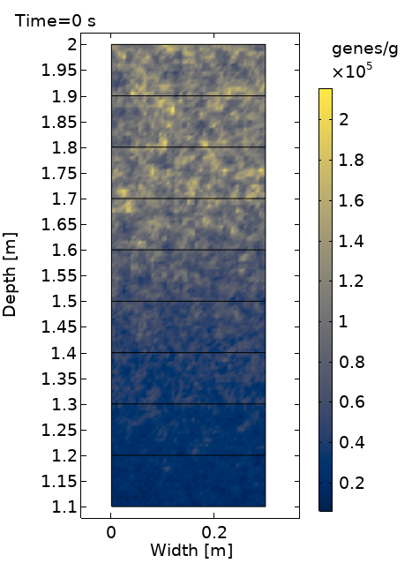
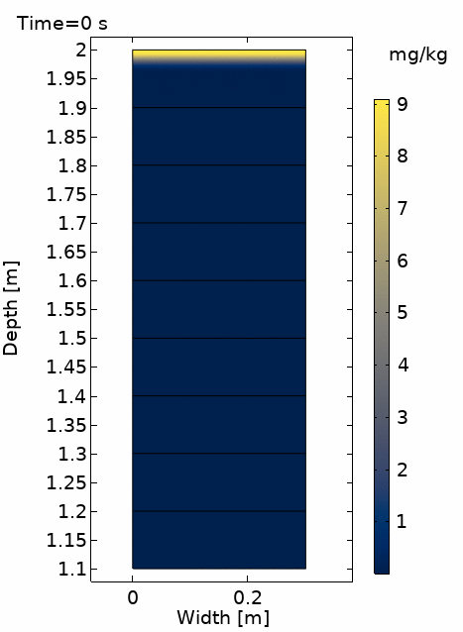
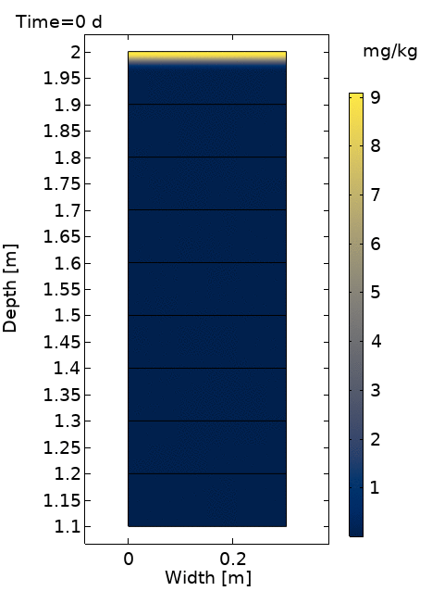
LOW
CLR
$C_{T}$ [mg/kg]
HRE
$C_{T}$ [mg/kg]
$B$ [genes/g]
Figure S10 Example simulation of MCPA reactive transport with low heterogeneity in the spatial degrader distribution (LOW) in continuous light rain (CLR) and heavy rain events (HRE) scenarios. The left panel shows the degrader distribution B, the middle an animation of MCPA reactive transport under CLR, and the right under HRE.

Slide 6
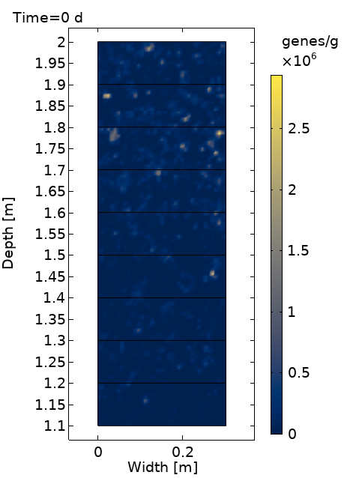


HIGH
CLR
$C_{T}$ [mg/kg]
HRE
$C_{T}$ [mg/kg]
$B$ [genes/g]
Figure S11 Example simulation of MCPA reactive transport with high heterogeneity in the spatial degrader distribution (HIGH) in continuous light rain (CLR) and heavy rain events (HRE) scenarios. The left panel shows the degrader distribution B, the middle an animation of MCPA reactive transport under CLR, and the right under HRE.

Slide 7
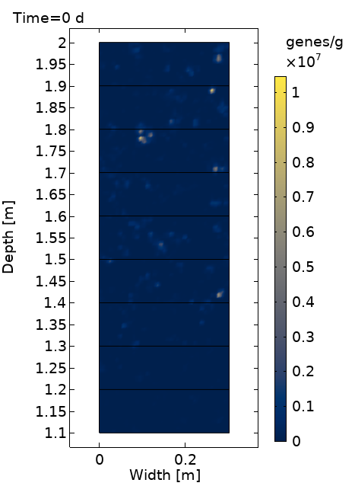


EXTR
CLR
$C_{T}$ [mg/kg]
HRE
$C_{T}$ [mg/kg]
$B$ [genes/g]
Figure S12 Example simulation of MCPA reactive transport with extreme heterogeneity in the spatial degrader distribution (EXTR) in continuous light rain (CLR) and heavy rain events (HRE) scenarios. The left panel shows the degrader distribution B, the middle an animation of MCPA reactive transport under CLR, and the right under HRE.

