Slide 1
Supplemental Figure S1. GSEA of 247 genes linked by GREAT with 351 human-specific LTR7 and LTR5_Hs using the Enrichr bioinformatics platform (A; F) and targeted interrogations of 17 (B; C) human-specific LTR7 and LTR5_Hs loci and 14 (D; E) human-specific LTR7 and LTR5_Hs loci employing the GREAT algorithm (B - E).
Related to Figure 5. Inference of putative phenotypic impacts of human-specific LTR7 & LTR5_Hs loci based on GREAT algorithm-guided functional annotations of proximity placement-linked genes.

Slide 2
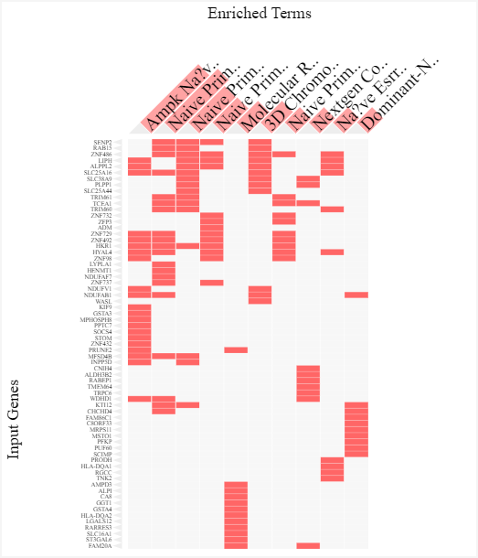
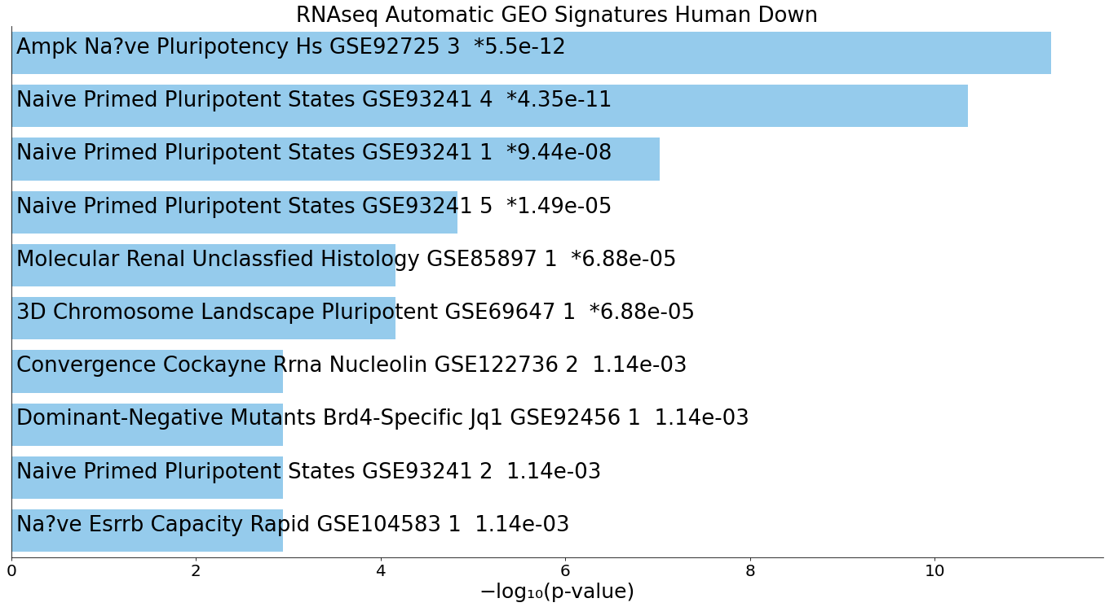
A
351 human-specific LTR7 & LTR5_Hs loci
247 genes
Naïve Primed Pluripotent States Genes

Slide 3
B
17 human-specific LTR7 & LTR5_Hs loci
17 human-specific LTR7 & LTR5_Hs loci

Slide 4
C
17 human-specific LTR7 & LTR5_Hs loci

Slide 5
D
14 human-specific LTR7 & LTR5_Hs loci
14 human-specific LTR7 & LTR5_Hs loci

Slide 6
E
14 human-specific LTR7 & LTR5_Hs loci

Slide 7
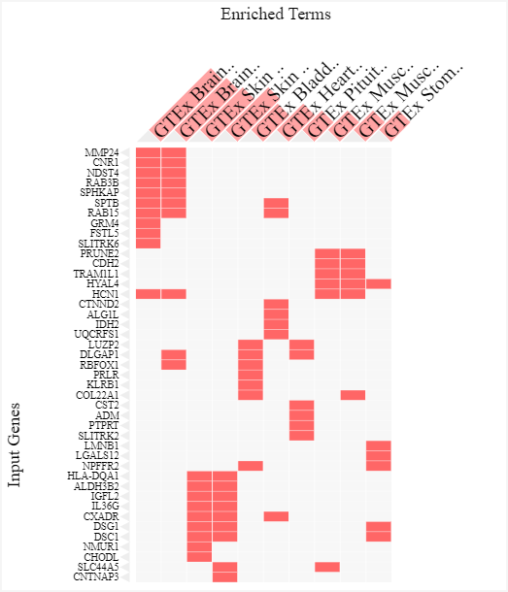
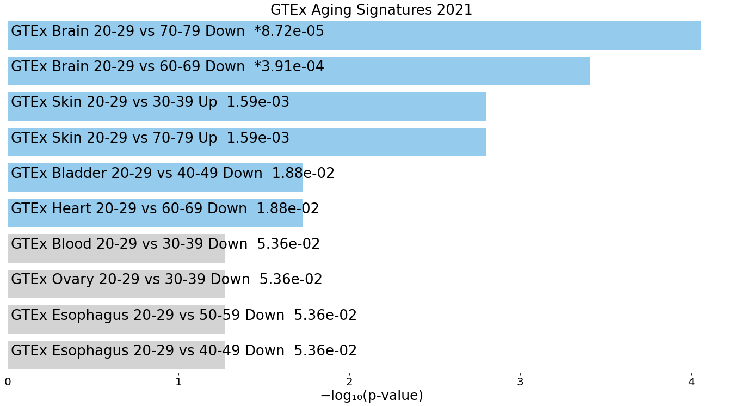
F
351 human-specific LTR7 & LTR5_Hs loci
215 LTR-regulated genes

