Slide 1
Supplementary Figure S3. GSEA of 377 genes comprising putative down-stream regulatory targets of both LTR7 and LTR5_Hs loci. Related to Table 8.

Slide 2
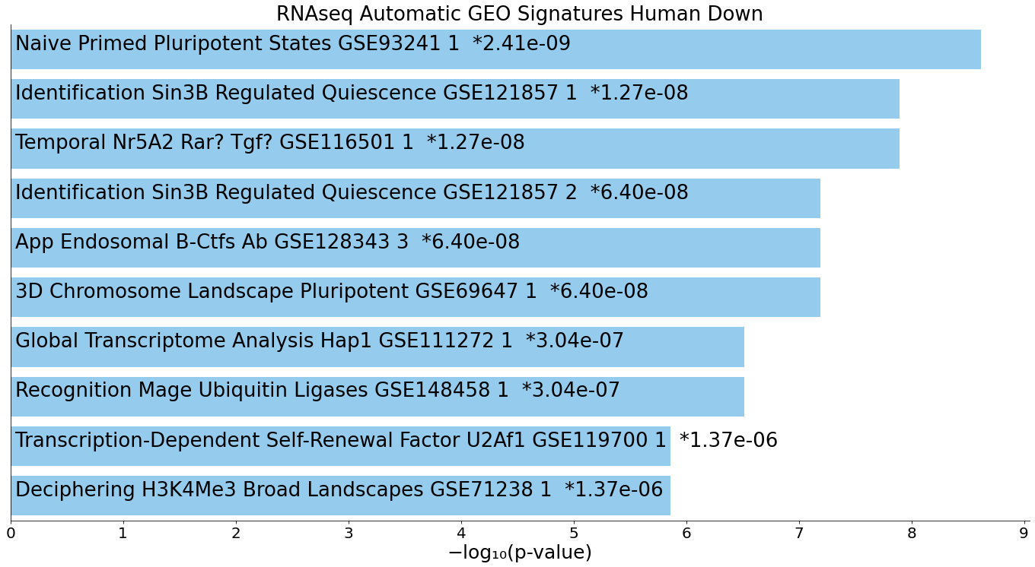
A
377 genes linked by GREAT with both LTR7 and LTR5_Hs loci

Slide 3
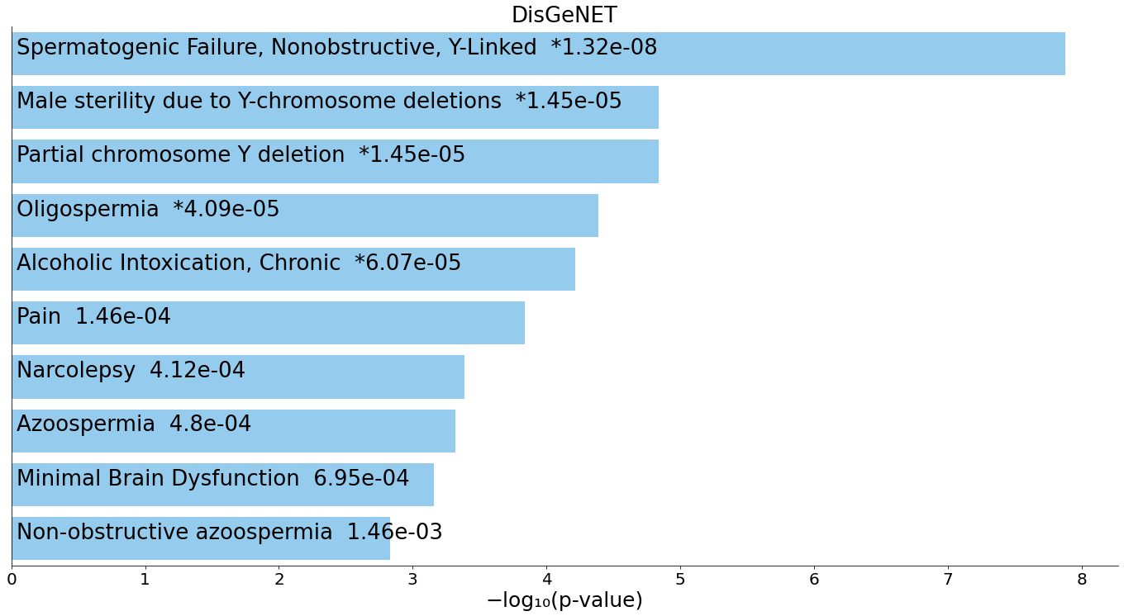
B
377 genes linked by GREAT with both LTR7 and LTR5_Hs loci

Slide 4
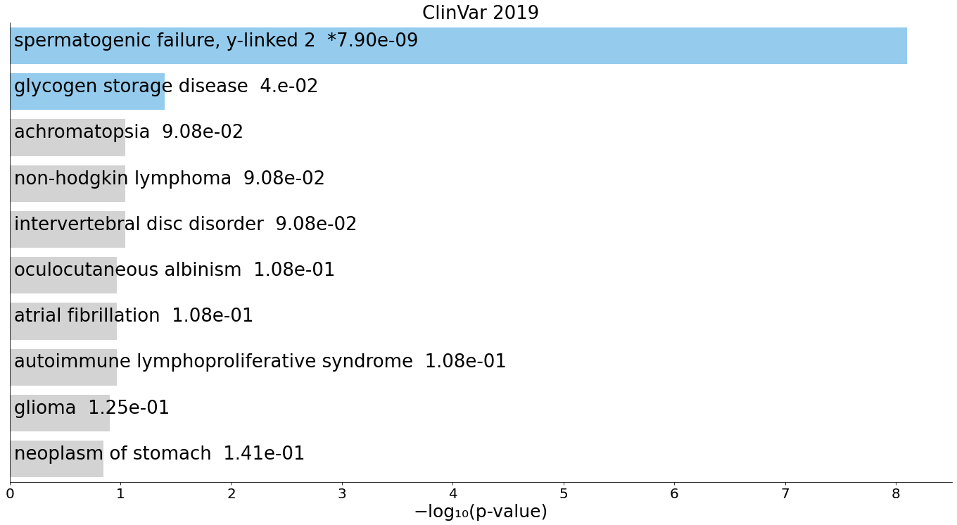
C
377 genes linked by GREAT with both LTR7 and LTR5_Hs loci

Slide 5
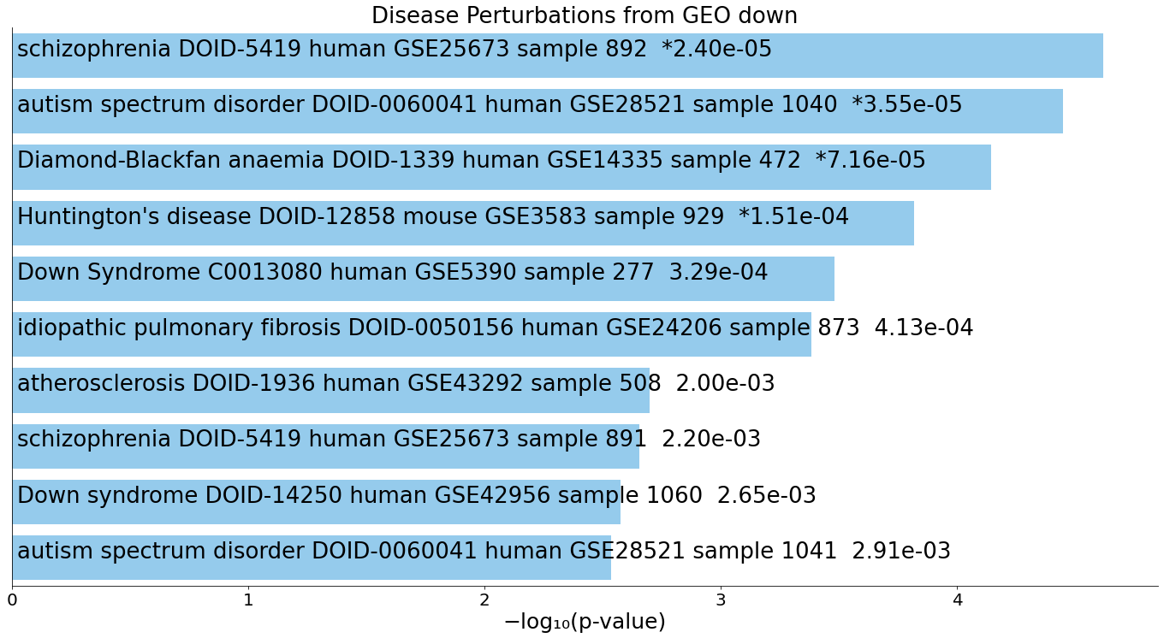
D
377 genes linked by GREAT with both LTR7 and LTR5_Hs loci

