Slide 1
Supplemental Figure S4. GSEA of 16 transcription factors (TF) - coding genes regulating expression of 377 LTR7- and LTR5_Hs-linked genes. Related to Table 8.

Slide 2
A
GSEA of 377 LTR7- and LTR5_Hs-linked genes
TF perturbations followed by expression database
16 TF-coding genes regulating expression LTR7- and LTR5_Hs-linked genes
BACH2
BCL11B
DNMT1
EOMES
HMGA2
MYC
NKX25
REST
SATB1
SOX2
SOX3
TET1
TET2
TET3
TWIST1
VDR

Slide 3
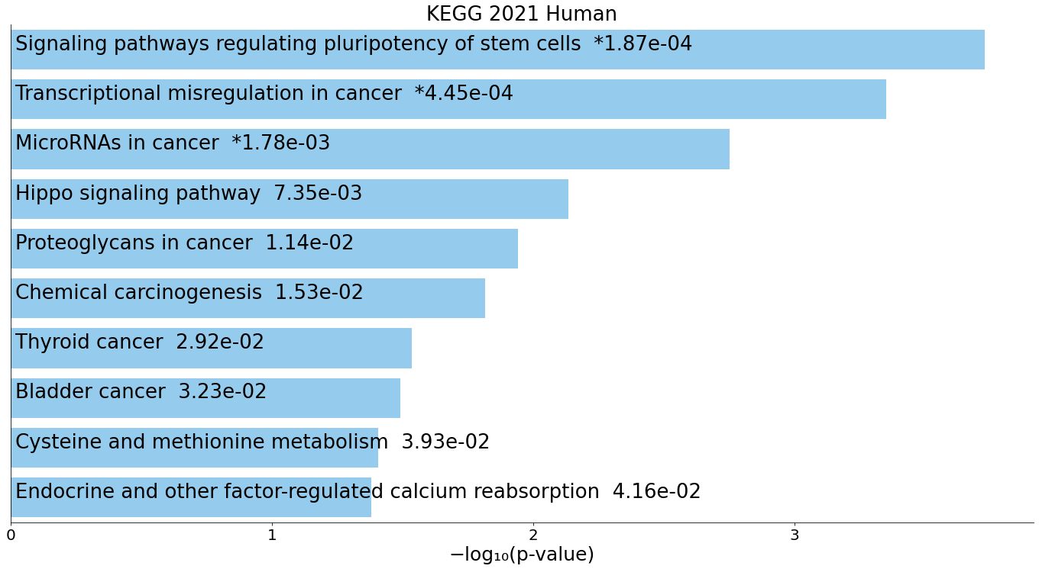
B
GSEA of 16 TF coding genes regulating expression of
377 LTR7- and LTR5_Hs-linked genes

Slide 4
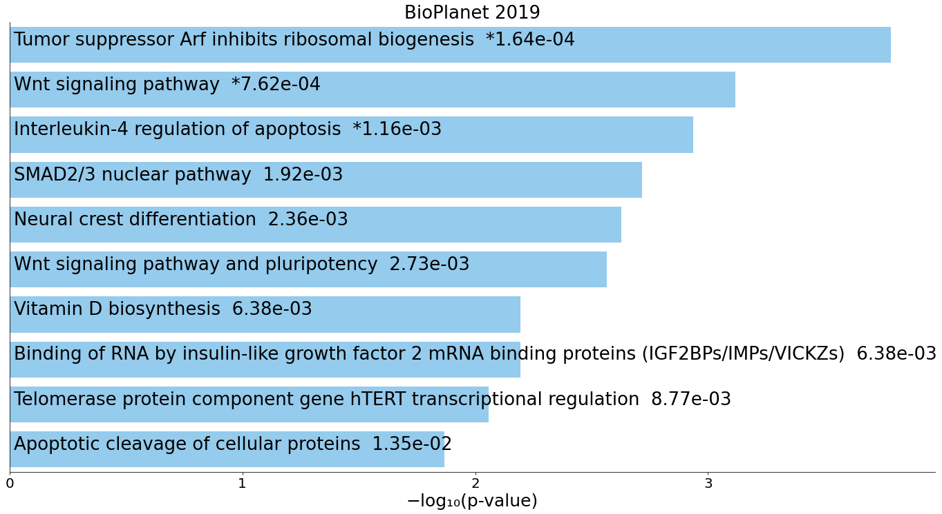
C
GSEA of 16 TF coding genes regulating expression of
377 LTR7- and LTR5_Hs-linked genes

Slide 5
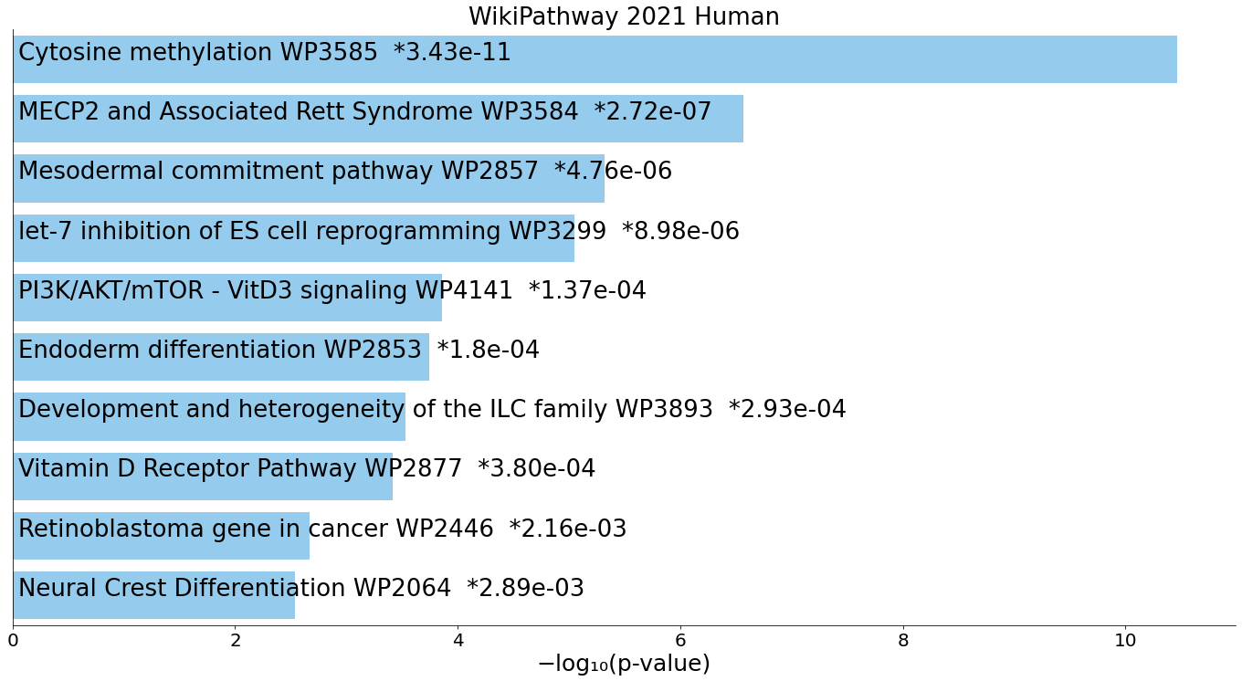
D
GSEA of 16 TF coding genes regulating expression of
377 LTR7- and LTR5_Hs-linked genes

Slide 6
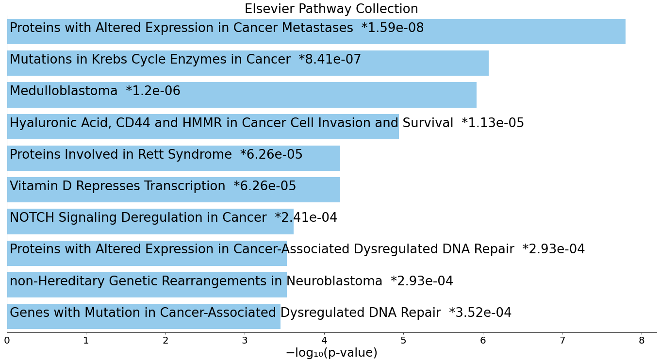
E
GSEA of 16 TF coding genes regulating expression of
377 LTR7- and LTR5_Hs-linked genes

Slide 7
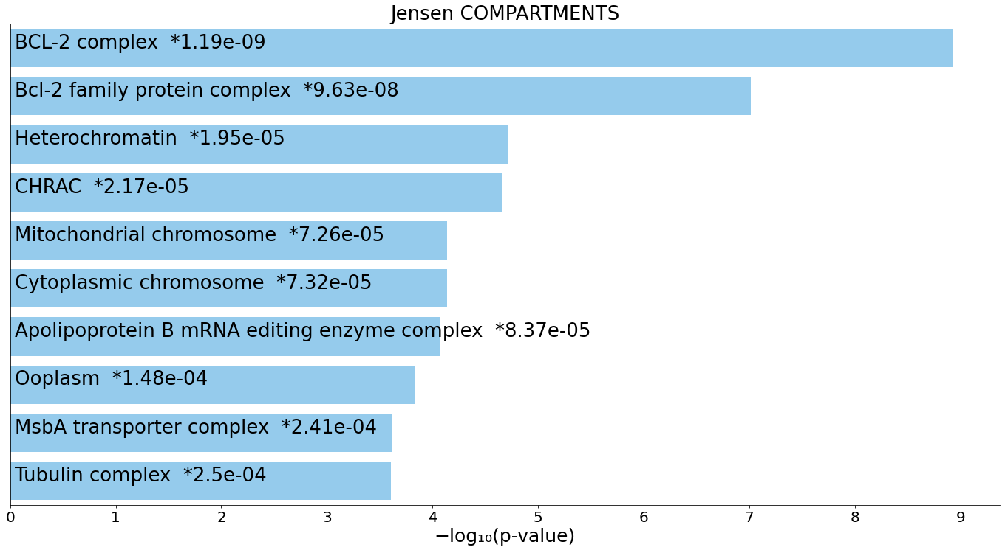
F
GSEA of 16 TF coding genes regulating expression of
377 LTR7- and LTR5_Hs-linked genes

Slide 8
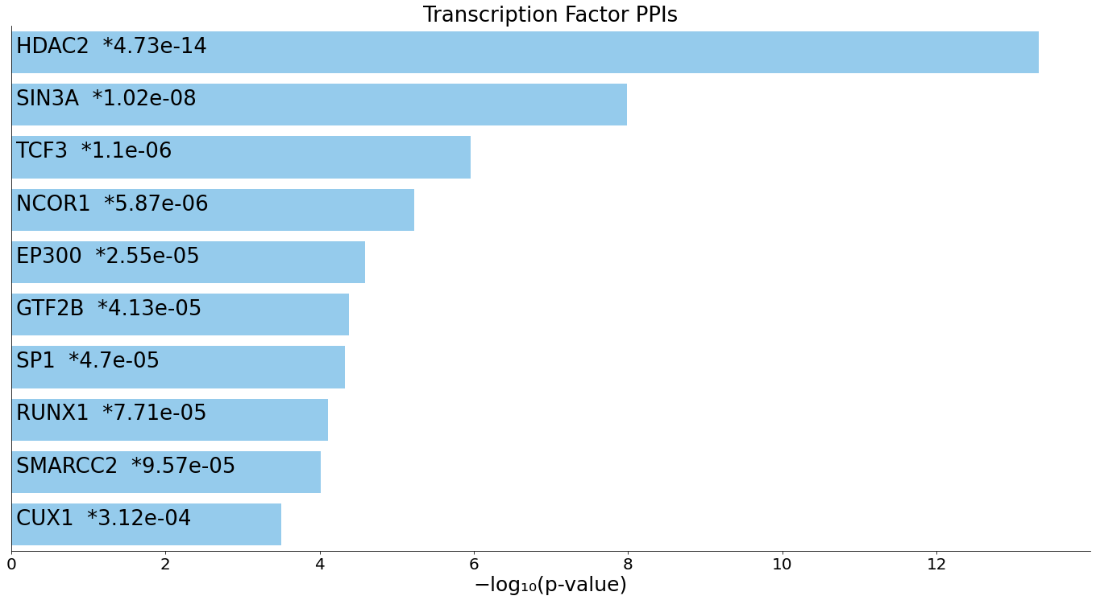
G
GSEA of 16 TF coding genes regulating expression of
377 LTR7- and LTR5_Hs-linked genes

Slide 9
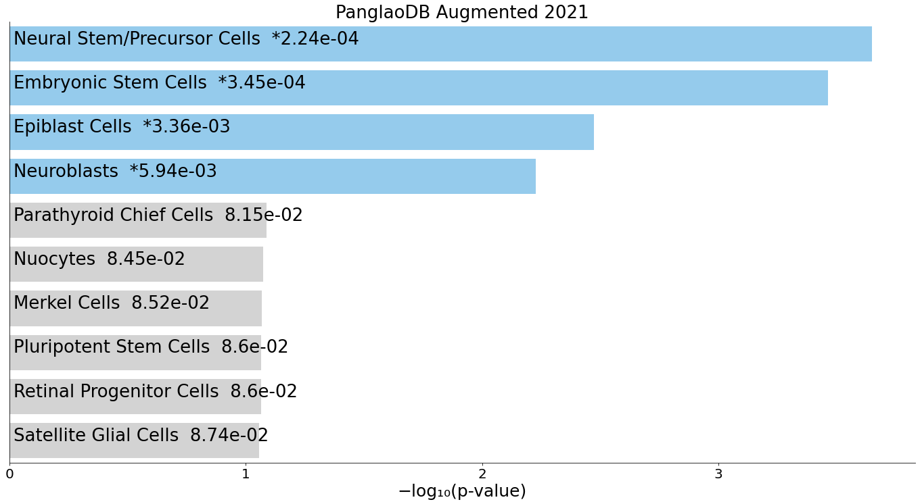
H
GSEA of 16 TF coding genes regulating expression of
377 LTR7- and LTR5_Hs-linked genes

Slide 10
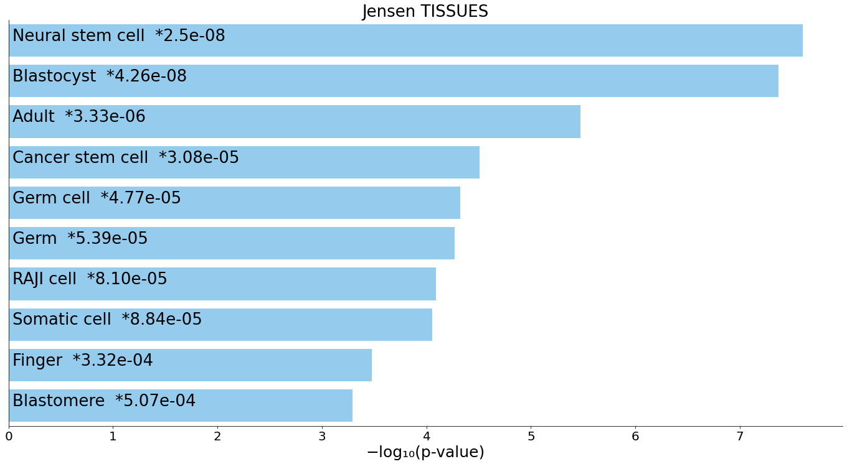
I
GSEA of 16 TF coding genes regulating expression of
377 LTR7- and LTR5_Hs-linked genes

Slide 11
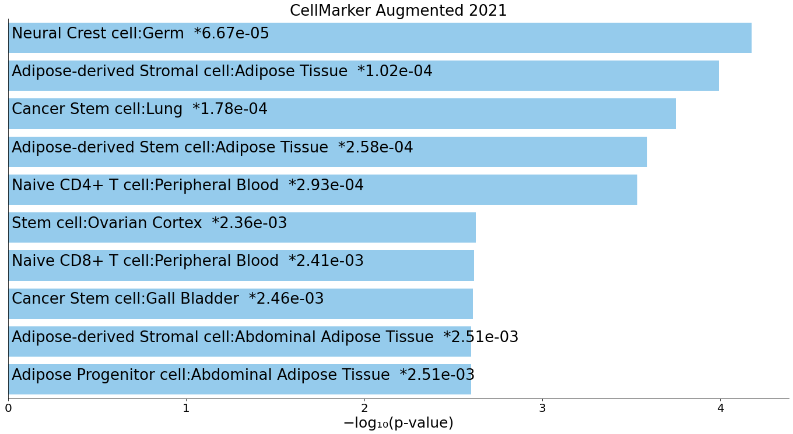
J
GSEA of 16 TF coding genes regulating expression of
377 LTR7- and LTR5_Hs-linked genes

Slide 12
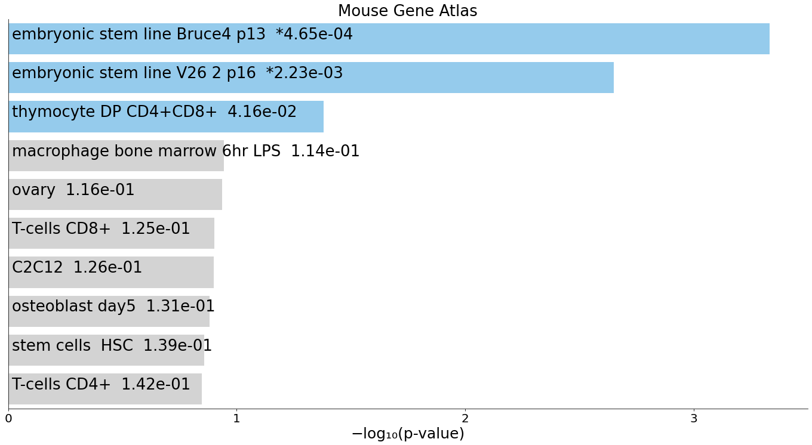
K
GSEA of 16 TF coding genes regulating expression of
377 LTR7- and LTR5_Hs-linked genes

Slide 13
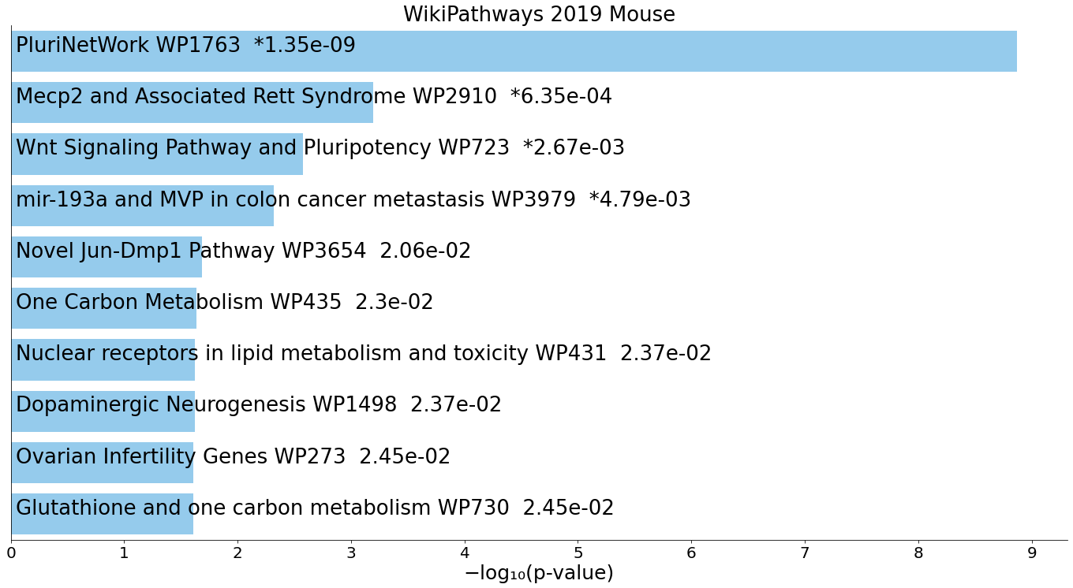
L
GSEA of 16 TF coding genes regulating expression of
377 LTR7- and LTR5_Hs-linked genes

Slide 14
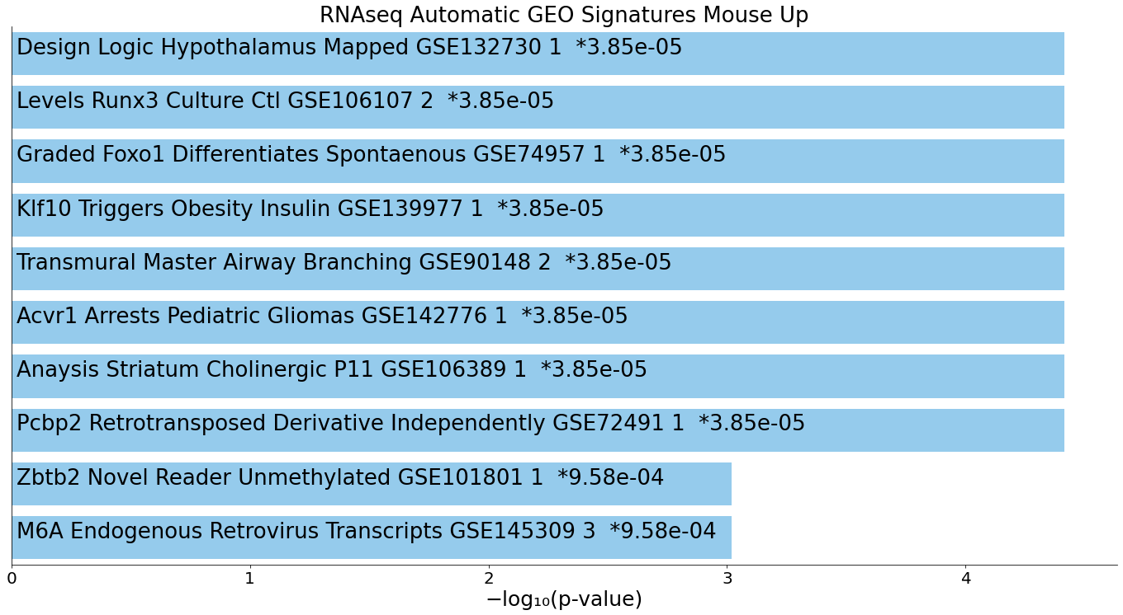
M
GSEA of 16 TF coding genes regulating expression of
377 LTR7- and LTR5_Hs-linked genes

