Slide 1
Supplementary Figure 1
OKI-005 (uM)
Supplementary Figure 1: Effects of OKI-005 in vitro in TNBC cell lines. Anti-proliferative effects were assessed using the SRB assay. Cells were treated with OKI-005 (0-5 uM) and proliferation was assessed at 72 hours.

Slide 2
Supplementary Figure 2
% (Proliferation)
OKI-005 (uM)
Supplementary Figure 2: Effects of OKI-005 in vitro in CRC cell lines. Anti-proliferative effects were assessed using the SRB assay. Cells were treated with OKI-005 (0-5 uM) and proliferation was assessed at 72 hours.

Slide 3
B
Supplementary Figure 3
A
Vehicle
OKI-005 10 mg/kg PO
OKI-005 30 mg/kg PO
OKI-005 100 mg/kg PO
OKI-005 5 mg/kg IP
Entinostat 20 mg/kg PO
Vehicle
OKI-005 10 mg/kg PO
OKI-005 30 mg/kg PO
OKI-005 100 mg/kg PO
OKI-005 5 mg/kg IP
Entinostat 20 mg/kg PO

Slide 4
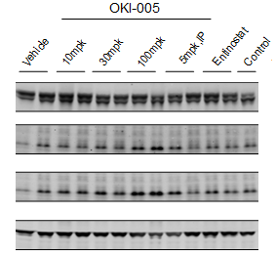
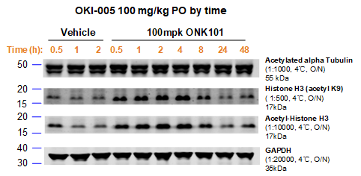
Supplementary Figure 4
A
C
Effect of OKI-005 on Histone H3 (Acetyl K9) in HCT-116 Xenograft at 1 hour
Acetylated α-Tubulin
Histone H3 (acetyl K9)
Acetylated H3
GAPDH
Vehicle
OKI-005
10 mpk
OKI-005
30 mpk
OKI-005
100 mpk
OKI-005
5 mpk IP
Entinostat
20 mpk
B
D
Effect of OKI-005 on Acetyl-Histone H3 in HCT-116 Xenograft at 1 hour
Vehicle
OKI-005
10 mpk
OKI-005
30 mpk
OKI-005
100 mpk
OKI-005
5 mpk IP
Entinostat
20 mpk

