Slide 1
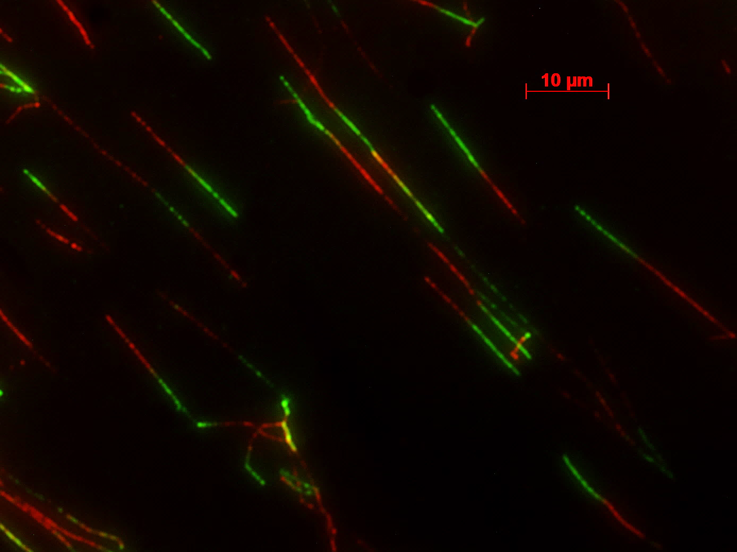
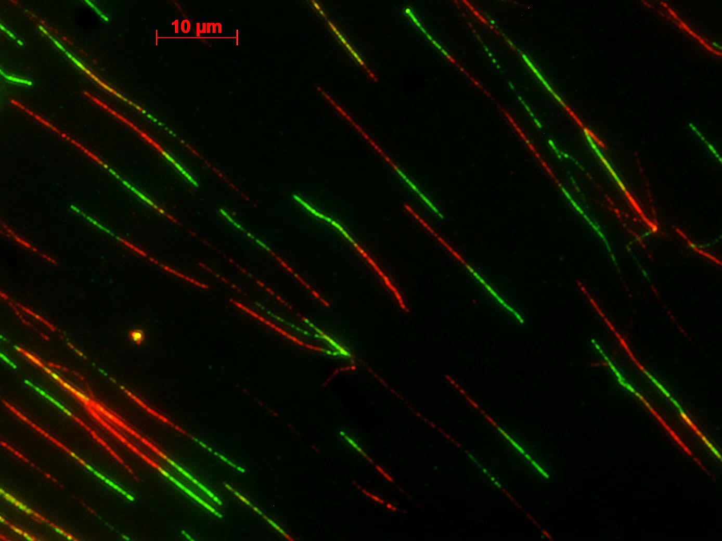
A
IdU 30 min
CldU 30 min
B
NS
NS
POLDIP3-WT
WT
KO
WT
KO
POLDIP3-KO
IdU, 30 min
CldU, 30 min
Figure S2. Knockout of POLDIP3 in A549 cells has no pronounced effects on the genome-wide DNA synthesis. POLDIP3-WT and POLDIP3-KO A549 cells were sequentially pulse-labeled with IdU and CldU for 30 minutes and then used for the DNA fiber assay. Green color showed the IdU tracks. Red color showed the CldU tracks. Representative images of DNA fibers are shown in (A). The length of around 150 fibers from each sample were measured and plotted in (B). Standard two-tailed Student’s t-test: NS – not significant.
Notes:
Mann Whitney test, NS is not significant, Sample > 350A549 Idu30mins : 10.12+0.1378 N=365
PDIP46KO Idu 30mins: 10.62 + 0.3734 N=453
A549 Cldu30mins: 9.935+ 0.1294 N=365
PDIP46KO Cldu 30mins: 10.39 + 0.3593 N=453

