Slide 1

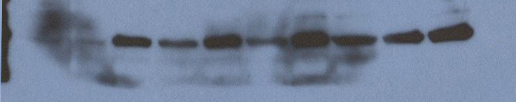
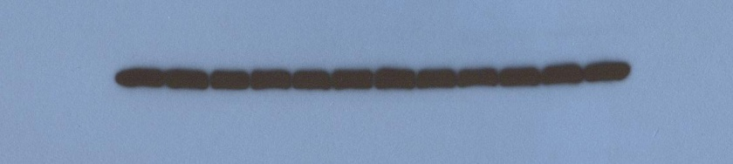
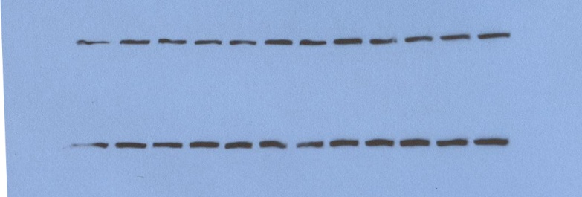
UVC, J/m²
0
5
10
20
30
Control-shRNA
+
-
+
-
+
-
+
-
+
-
POLDIP3-shRNA
-
+
-
+
-
+
-
+
-
+
POLDIP3
pChk1
Actin
p125
Figure S3. Depletion of POLDIP3 using shRNA attenuates UVC induced DNA damage checkpoint activation.
A549 cells were stable infected with either control-shRNA or POLDIP3-shRNA, and then treated with different doses of UVC. Cell lysates were immunblotted with different antibodies as indicated on the right.

