Slide 1
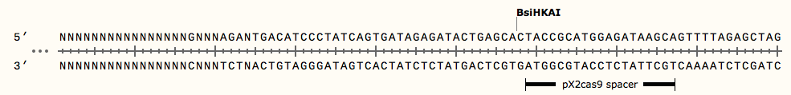
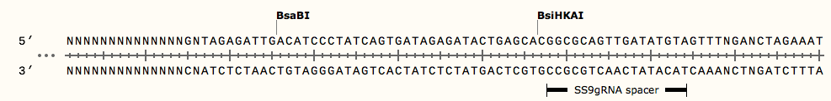
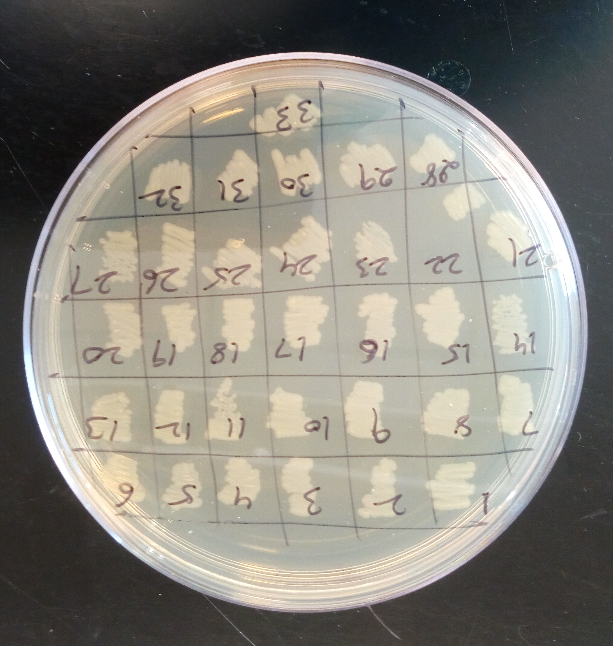
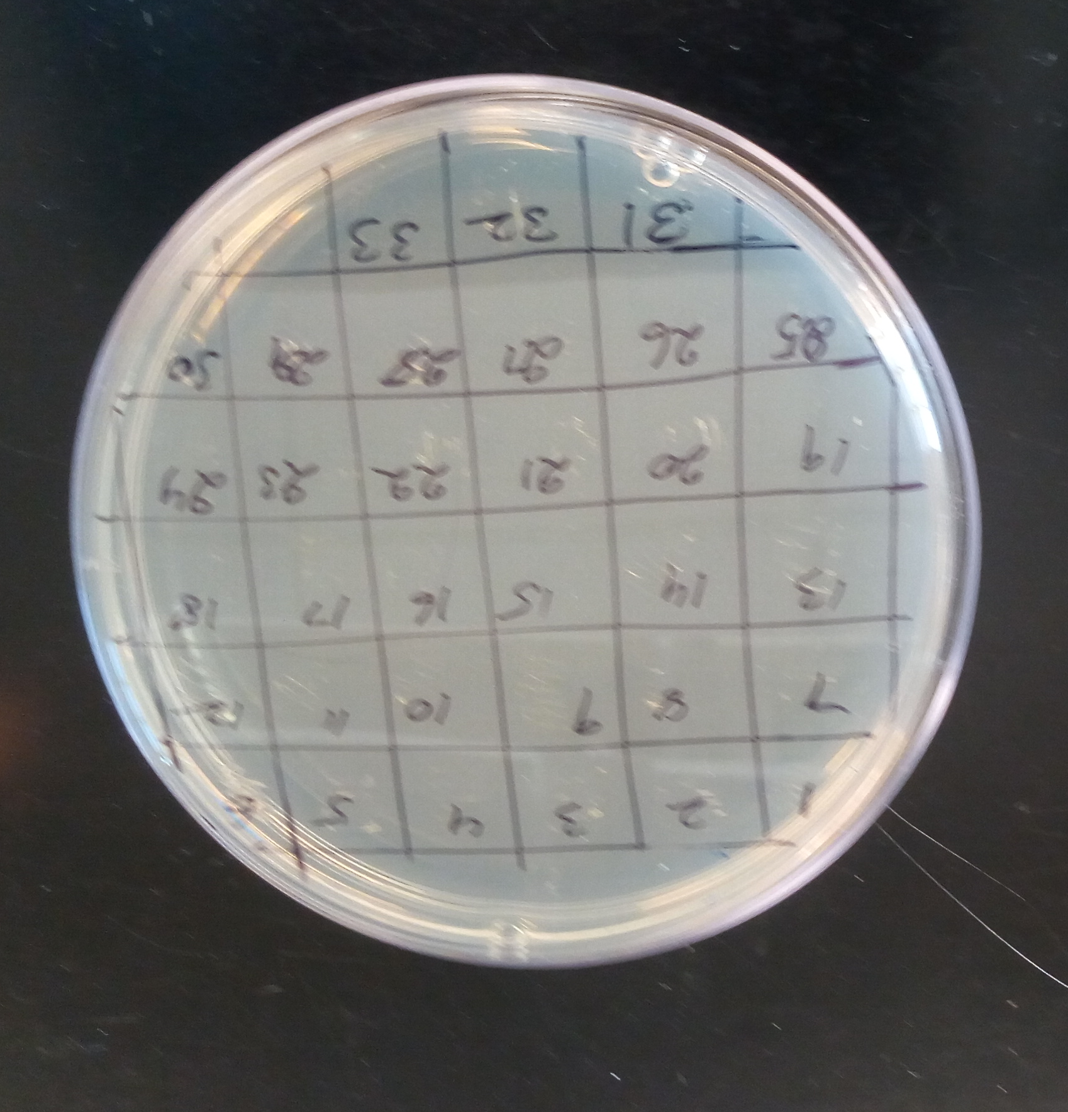
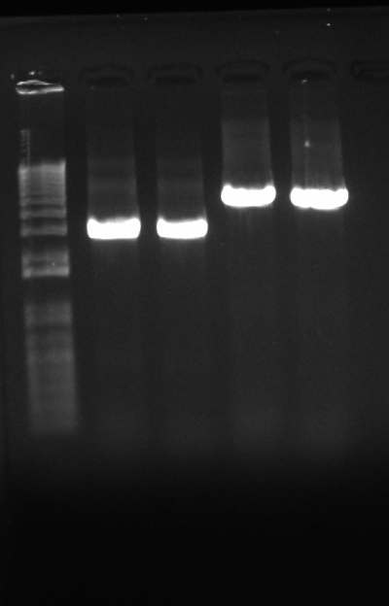
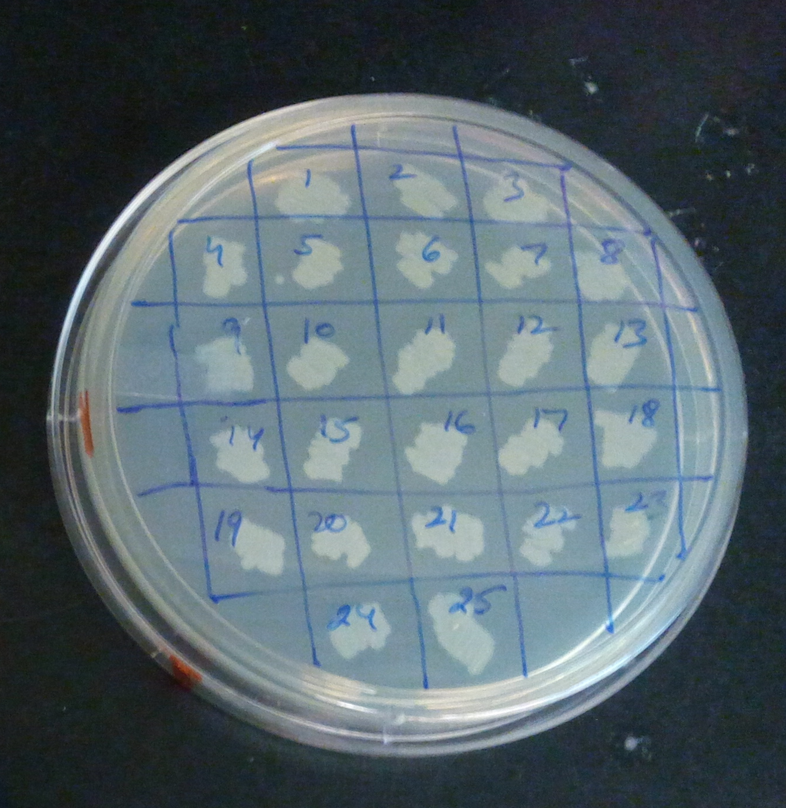
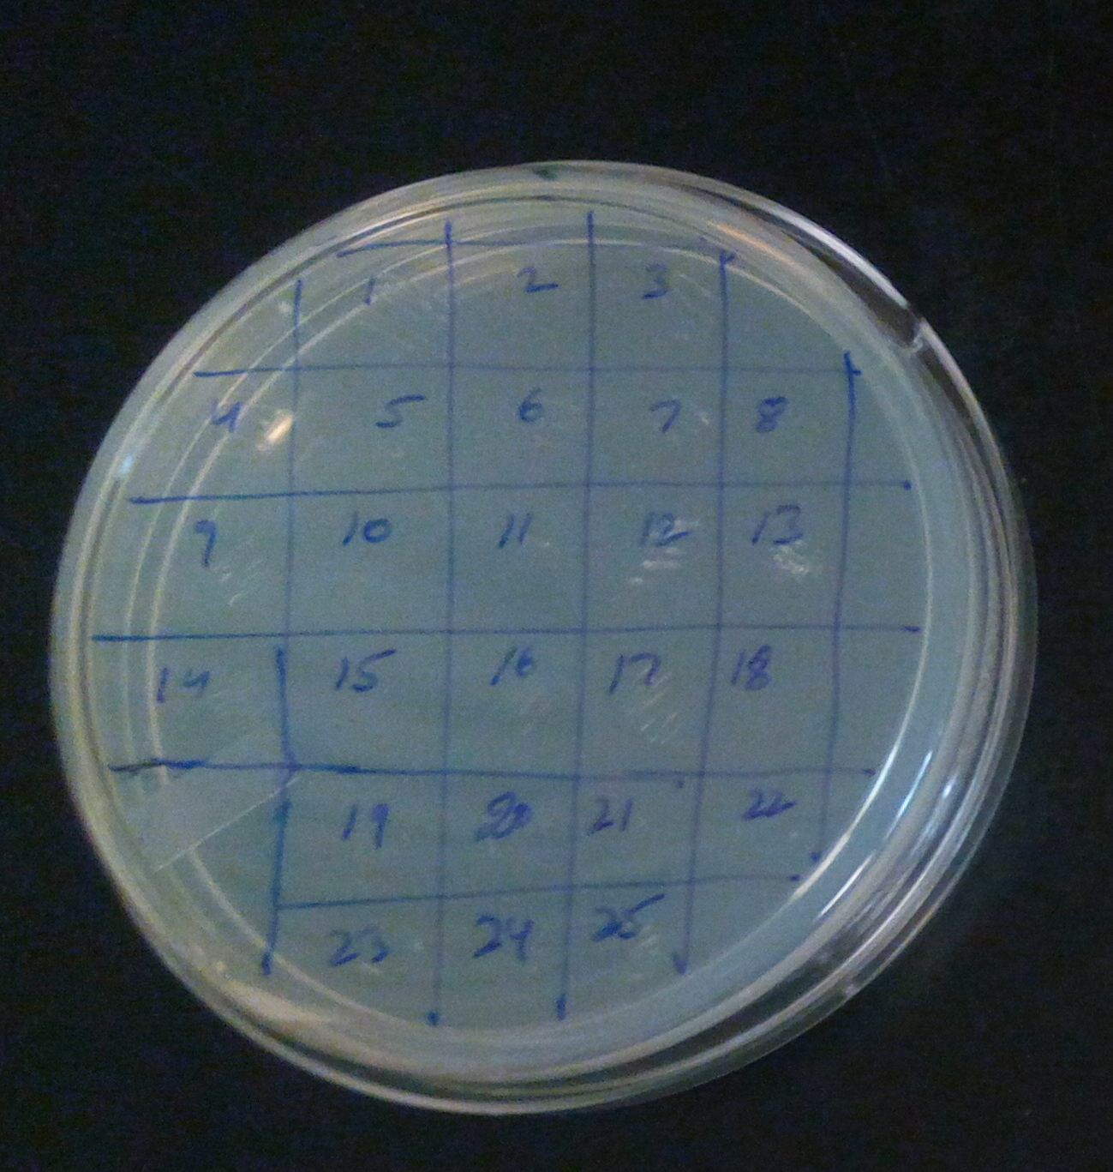
A
Supplementary Fig. 2 Inserting spacer for curing SS9gRNA and pX2Cas9 plasmids (A) Confirmation of spacer integration to pKDsgRNA ack after sequencing. (B) PCR amplification of pKDsgRNA ack using primer set 1 (lane1) and 2 (lane 3) for inserting spacers for SS9gRNA and pX2Cas9 plasmids (lane 2 and 4 respectively). (c) Cultures recovered on LB agar supplemented with aTC (100ng ml-1) and with and without ampicillin and kanamycin.
C
aTc
aTc+Amp
B
L 1 2 3 4
4414bp
2845bp
aTc
aTc+Kan

Slide 2
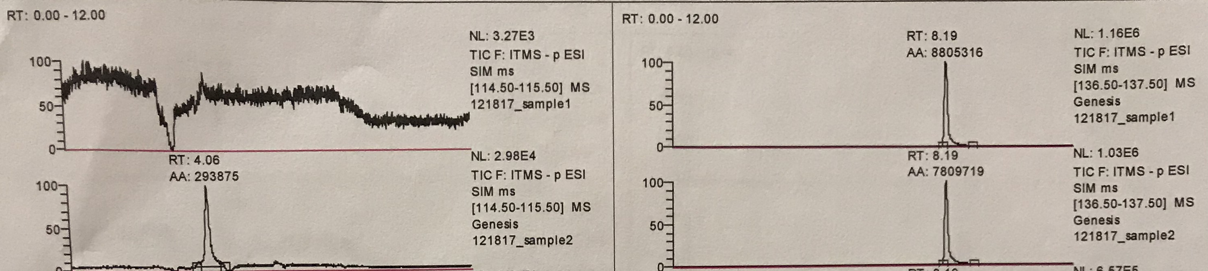
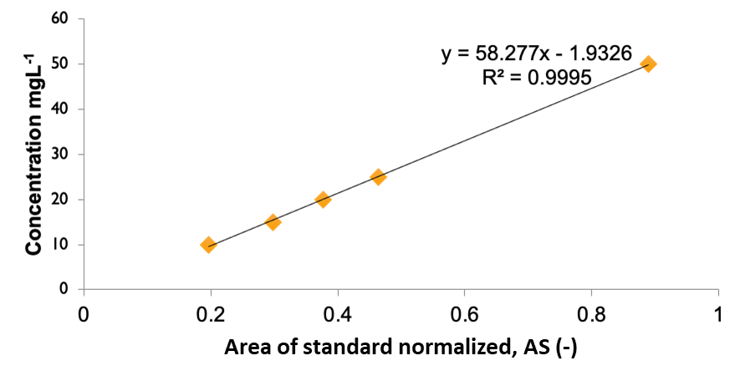
A
B
Supplementary Fig. 3 LCMS analysis of Ketoisovalerate (A) LCMS graphs showing peaks for KIV at RT 4.06, and internal standard salicylic acid at RT 8.19. Strain with integrated KIV pathway showed no KIV peak before downregulation of ilvE gene but after downregulation KIV peak appeared at RT 4.06. (B) Graph showing standard curve of KIV production after normalization with internal standard.

Slide 3
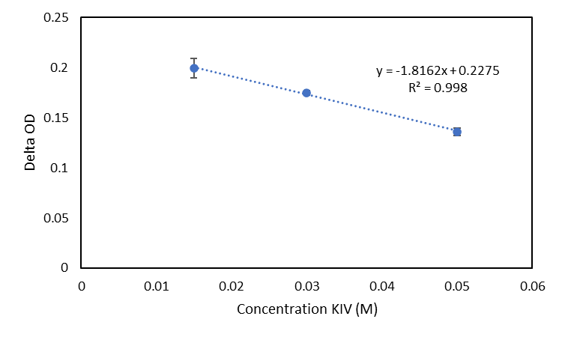
Supplementary Fig. 4 Delta OD600 vs concentration of KIV. The linear fit corresponds to a minimum inhibitory concentration of 14.7 g L⁻¹

