Slide 1

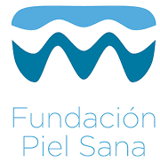

Classification of the cutaneous manifestations of COVID-19: a rapid prospective nationwide consensus study in Spain with 375 cases.
C. Galván Casas, A. Català, G. Carretero Hernández , P. Rodríguez-Jiménez, D. Fernández Nieto , A. Rodríguez-Villa Lario, I. Navarro Fernández, R. Ruiz-Villaverde, D. Falkenhain, M. Llamas Velasco, J. García-Gavín, O. Baniandrés, C. González-Cruz, V. Morillas-Lahuerta, X. Cubiró, I. Figueras Nart, G. Selda-Enriquez, J. Romaní, X. Fustà-Novell, A. Melian-Olivera, M. Roncero Riesco, P. Burgos-Blasco, J. Sola Ortigosa, M. Feito Rodriguez, I. García-Doval
Academia Española de Dermatología y Venereología, Madrid, Spain
Fundación Piel Sana, Madrid, Spain
British Journal of Dermatology 2020. DOI: 10.111/bjd.19163

Slide 2

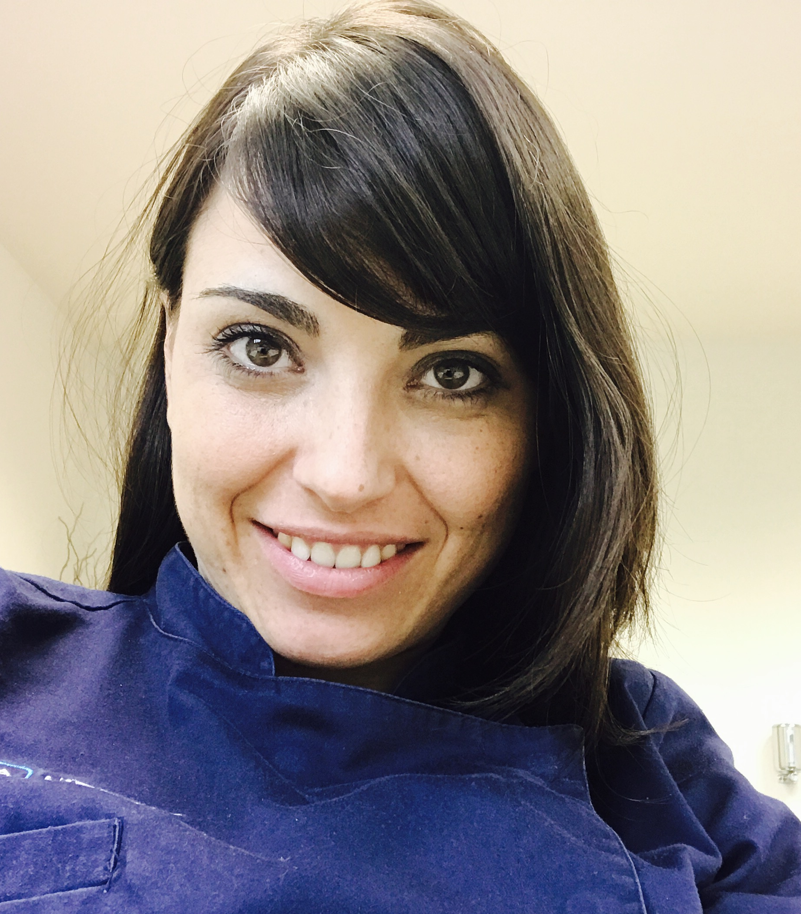

Lead Researcher
C. Galván Casas A. Català G. Carretero Hernández
British Journal of Dermatology. DOI: 10.111/bjd.19163

Slide 3
Introduction
What’s already known?
Previous descriptions of cutaneous manifestations of COVID-19 were case reports and mostly lacked illustrations.
There is no previous detailed classification nor description of the cutaneous manifestations of COVID-19.
British Journal of Dermatology. DOI: 10.111/bjd.19163

Slide 4
Objective
To describe the cutaneous manifestations of COVID-19 disease.
To relate the cutaneous manifestations to other clinical findings.
British Journal of Dermatology. DOI: 10.111/bjd.19163

Slide 5
Methods
Skin lesions +
COVID-19 suspected/confirmed
Excluded (n= 54)
Not meeting inclusion criteria (n=31 )
Other specific diagnosis (n=5) Missing information (n=18)
Assessed for eligibility
(n=429 )
Inclusion
(n=375)
Cross-sectional descriptive study.
Nationwide case collection survey of images and clinical data.
Support from the Spanish Academy of Dermatology.
Inclusion criteria: Patients with an eruption of recent onset (previous 2 weeks) and no clear explanation, plus suspected or confirmed COVID-19 were included.
Enrollment
British Journal of Dermatology. DOI: 10.111/bjd.19163

Slide 6
Suspected and Confirmed cases
Aiming to describe the lesions in less severe cases, we accepted both confirmed and suspected cases¹, as testing was not done in this period in most cases of mild disease.
Suspected: Patient with acute respiratory tract infection (at least one of the following: cough, fever, shortness of breath) with no other aetiology in a country/area reporting local or community transmission.
Confirmed: A person with laboratory confirmation of virus causing COVID-19 infection, irrespective of clinical signs and symptoms.
¹ Case definition and European surveillance for COVID-19, as of 2 March 2020.
British Journal of Dermatology. DOI: 10.111/bjd.19163

Slide 7
Methods
A standardized questionnaire was used, and pictures taken for most of them.
Using a consensus, we described 5 clinical patterns.
We later described the association of these patterns with patient demographics, timing in relationship with symptoms of the disease, severity, and prognosis.
The study was authorized by an ethics committee (HUGCDN: 2020-172-1- COVID-19), the Spanish Drug Agency (ACG-CLO-2020-01) and included in EnCEPP (EUPAS34469).
All patients (or their next of kin in case of minors) gave their informed consent to participate and an explicit consent to use their pictures in publications.

Slide 8
Analysis
Analysis of the data and distribution tests were done using Stata 16 (Statacorp, 2019).
Due to low sensitivity of some diagnostic tests and their scarcity, we accepted cases with clinical diagnosis of the disease (suspected cases) but performed a sensitivity analysis to check that the results do not change if done only on confirmed patients

Slide 9
Results
Pseudo-chilblains
Vesicular eruptions
Urticarial lesions
Livedo or necrosis
Maculo-papular eruptions
Final sample included 375 patients.
Consensus after reviewing the pictures led to the description of five main clinical patterns
British Journal of Dermatology. DOI: 10.111/bjd.19163

Slide 10
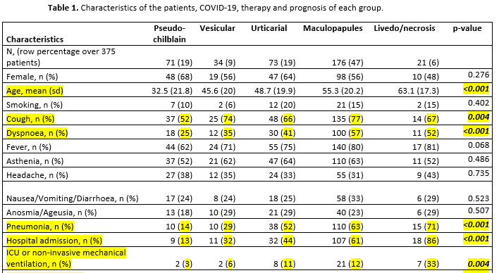
Characteristics associated with each clinical pattern
The different clinical patterns were associated with differences in demographics and in other clinical manifestations

Slide 11
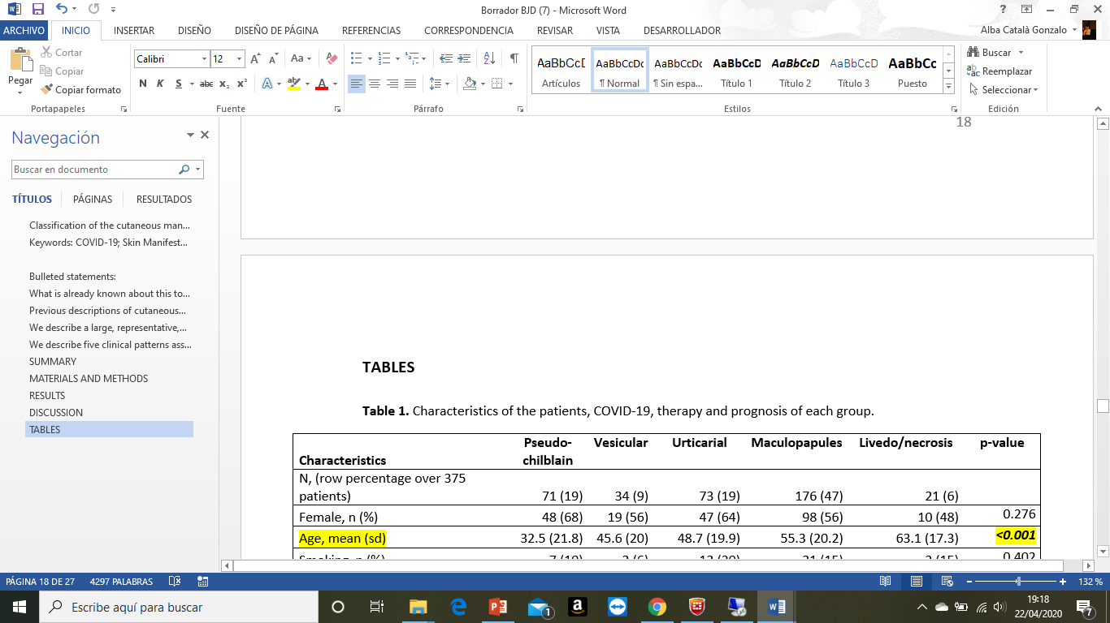
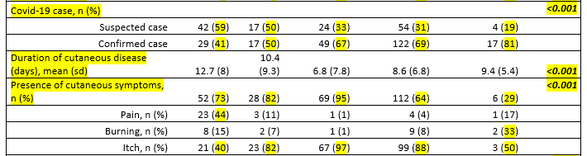
Characteristics associated with each clinical pattern

Slide 12
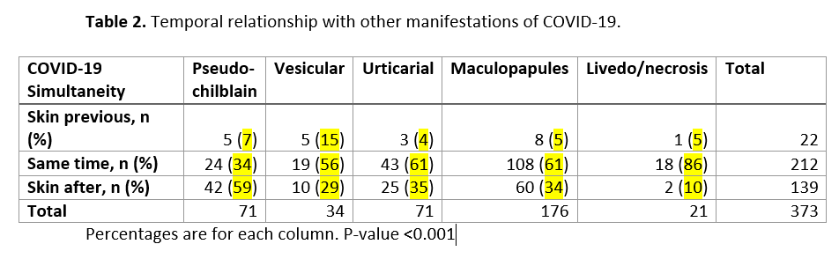
Characteristics associated with each clinical pattern

Slide 13
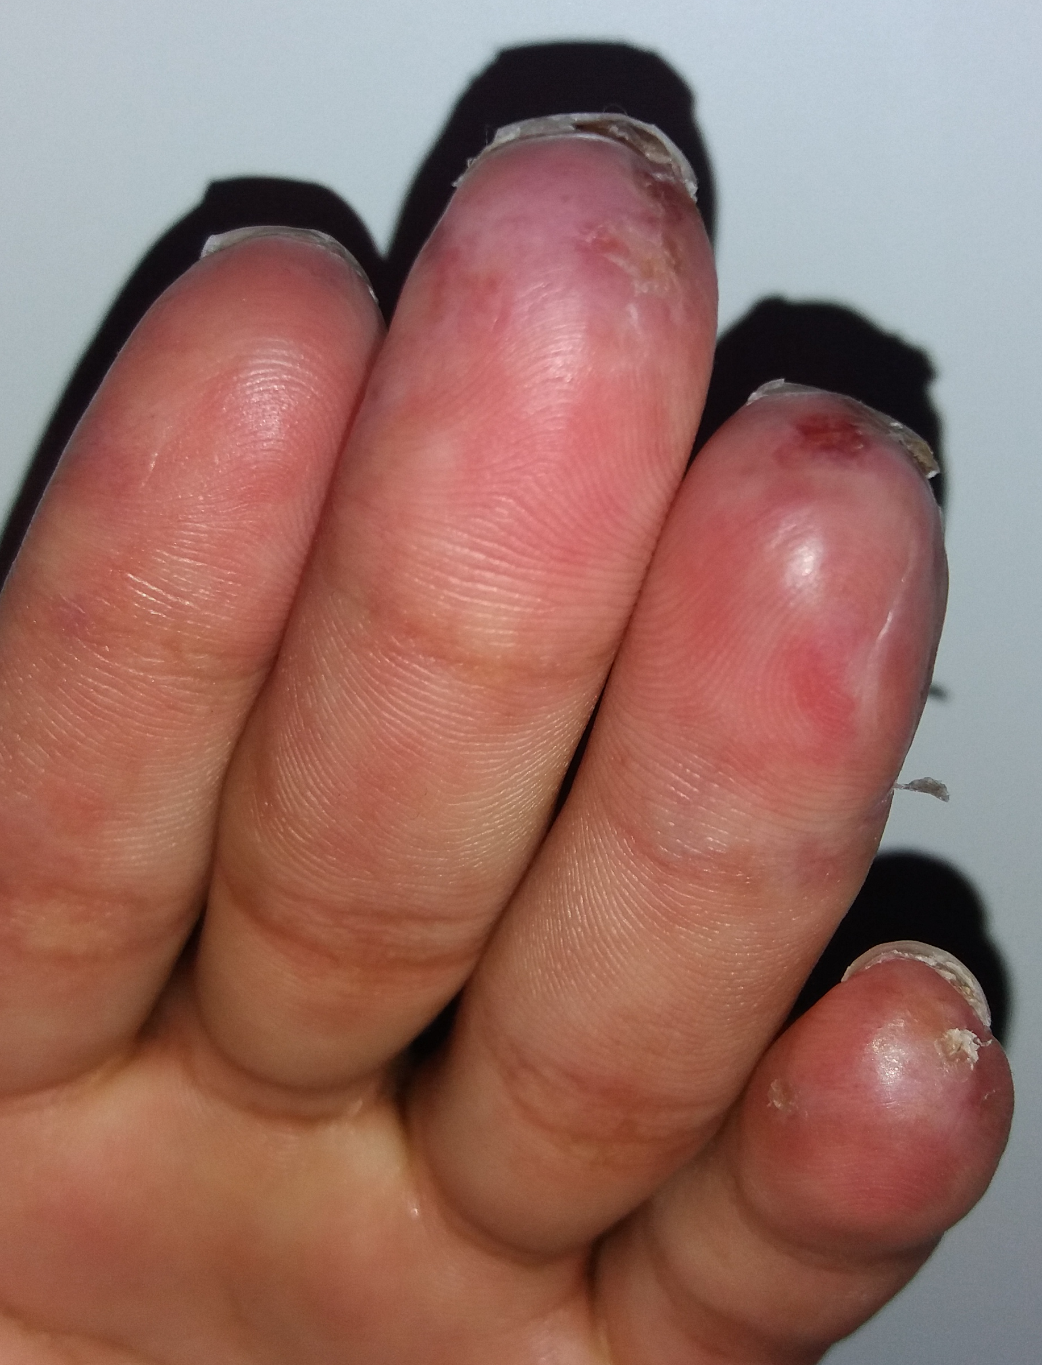
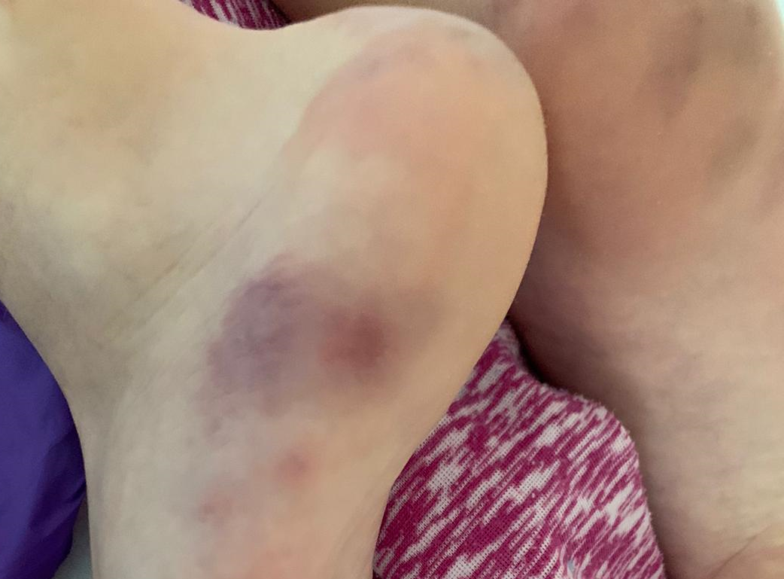
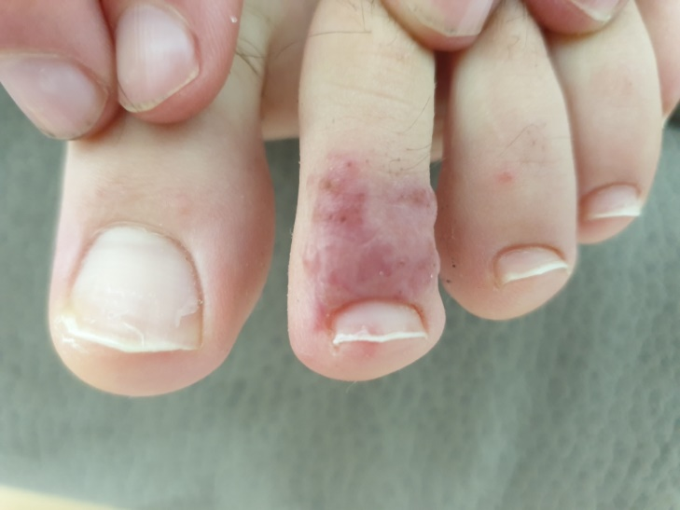
1.-Acral areas of erythema-edema with some vesicles or pustules (pseudo-chilblains).
Can resemble chilblains.
Have purpuric areas.
Affect hands and feet.
Usually asymmetrical.
Affect younger patients.
Last for a mean of 12.7 days.
Take place later in the course of the COVID-19.
Are associated with less severe disease.
Only 1/71 previous history of perniosis.
41% had confirmed presence of SARS-Cov-2

Slide 14
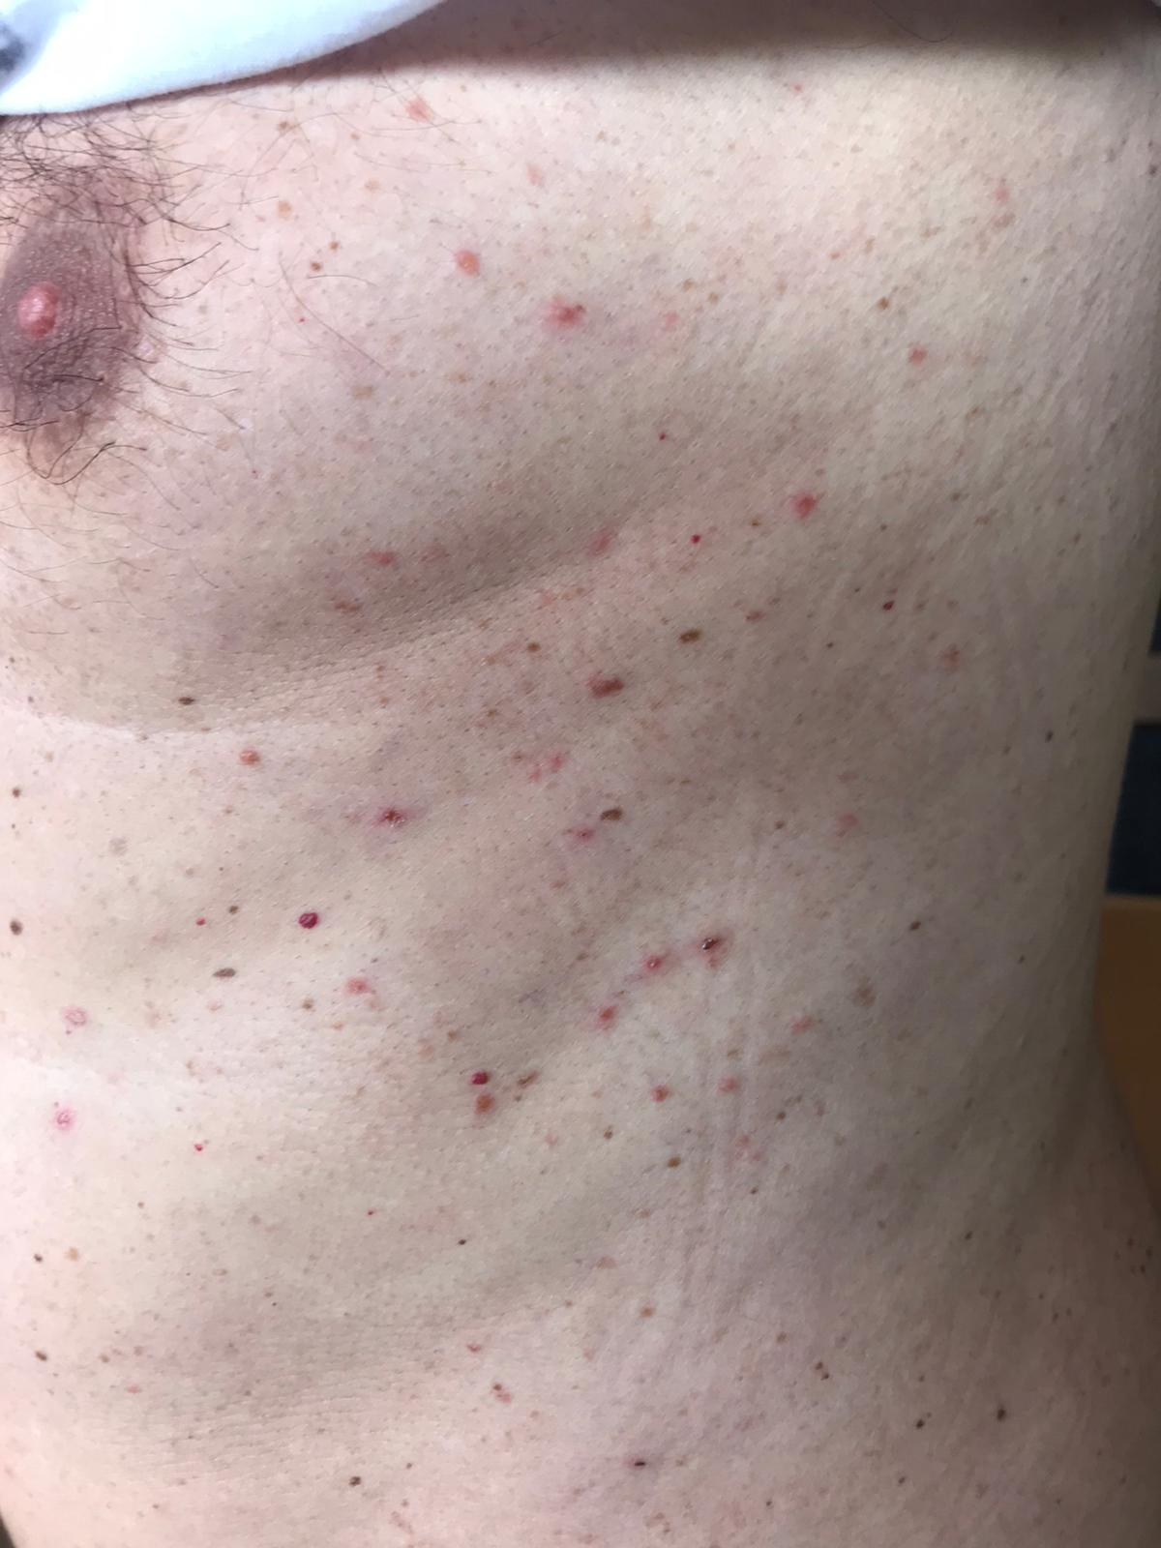
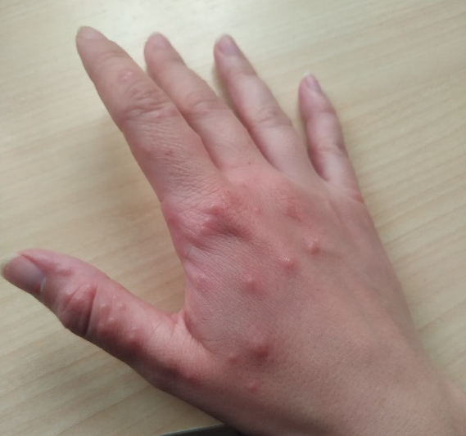
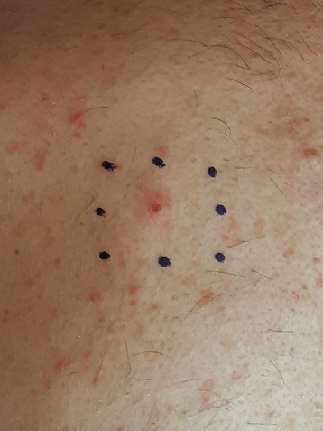
2.-Other vesicular eruptions.
Small monomorphic vesicles (unlike polymorphic vesicles in chickenpox)
Can become larger or diffuse.
Usually affect the trunk, also the limbs.
Typically arise in middle-aged patients.
Last for a mean of 10.4 days.
Appear commonly (15%) before other COVID-19 symptoms.
Are associated with intermediate COVID-19 disease severity.

Slide 15
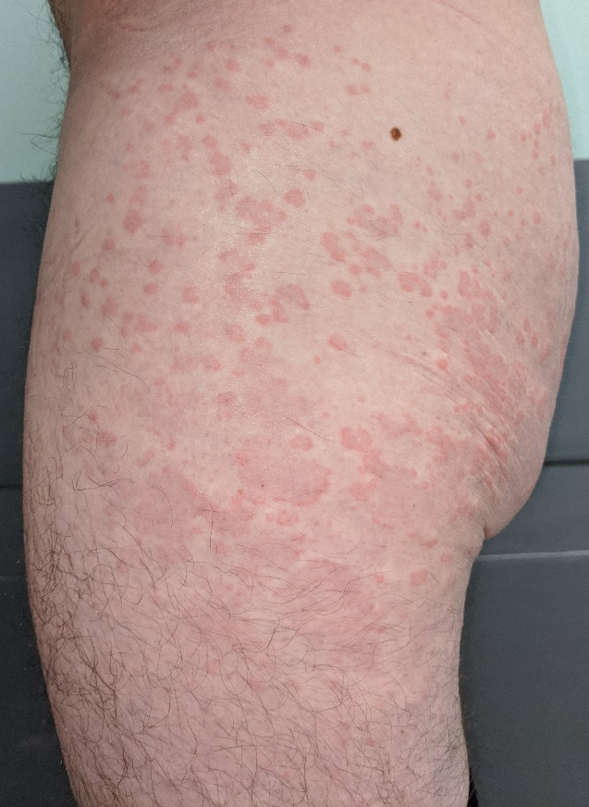
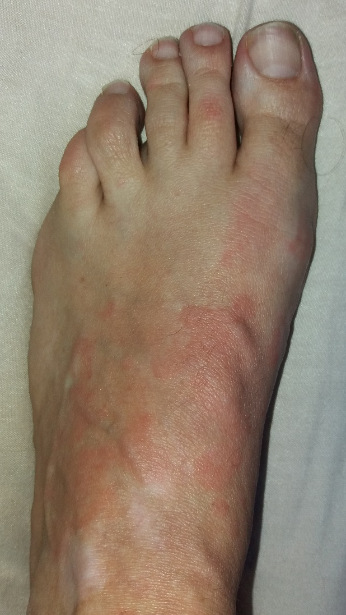
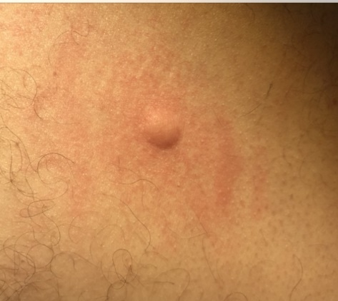
3.- Urticarial lesions
Mostly distributed on the trunk or diffusely.
Few cases palmar.
Last for a shorter period.
Usually appear at the same time as other symptoms.
Last for a mean of 8 days.
Are associated with more severe COVID-19 disease.

Slide 16
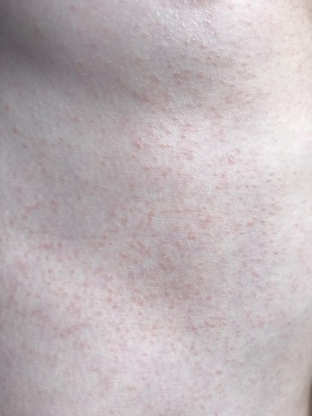
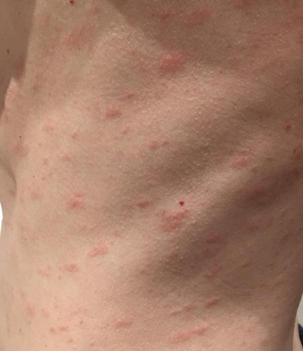
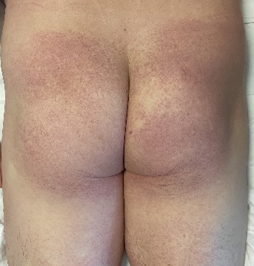
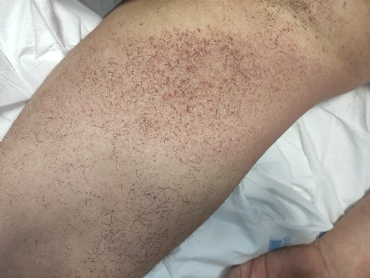
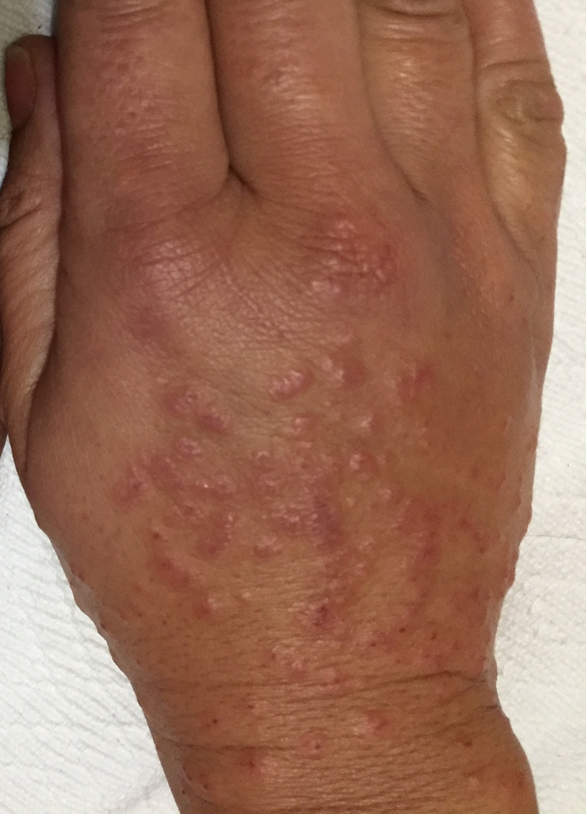
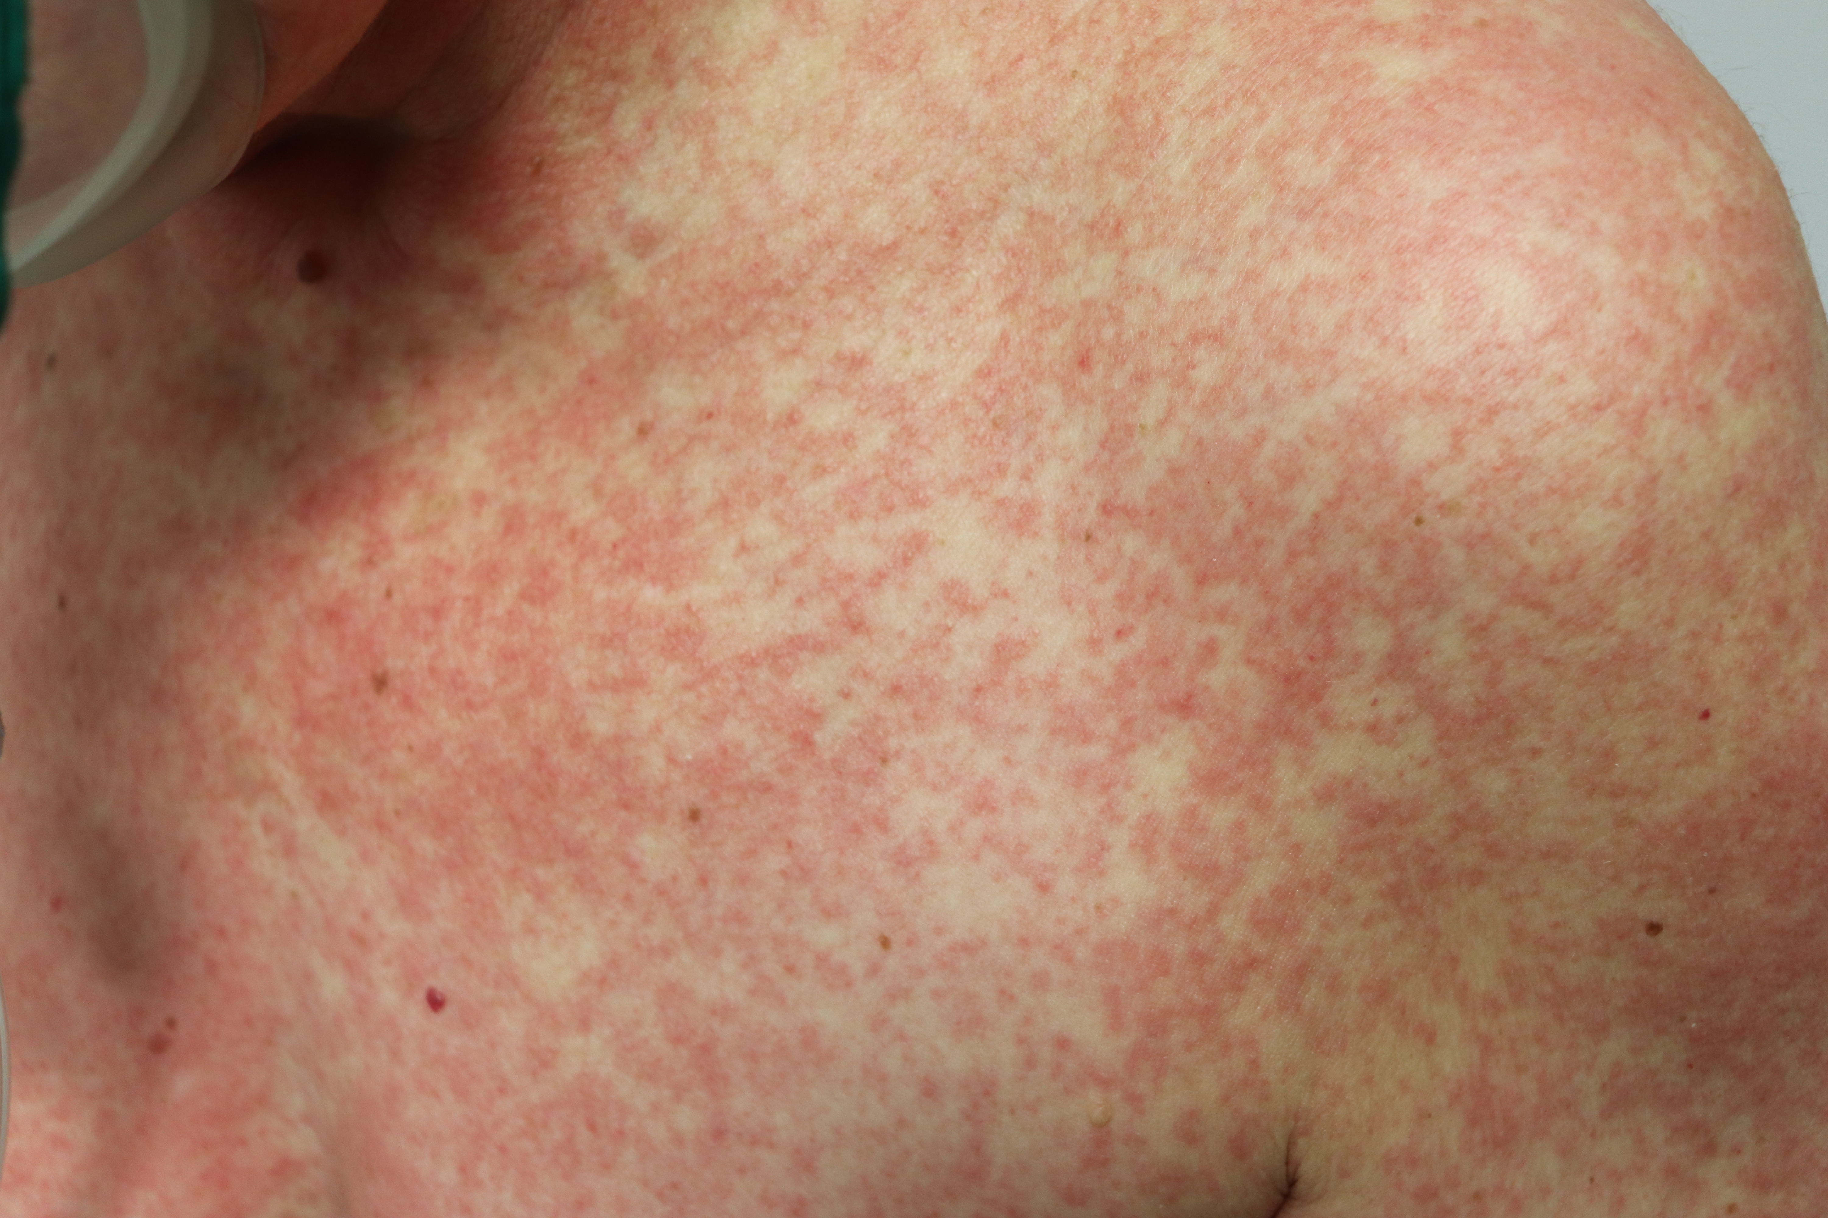
4.- Maculopapular eruptions
The manifestations of COVID-19 in this group are more variable:
Perifollicular distribution and varying degrees of scaling.
Similar to pityriasis rosea.
Purpura punctiform or on larger areas.
Infiltrated papules in the extremities (dorsum of the hands, that look pseudovesicular or resemble EED or EM).
A few cases showed purpuric flexural lesions.
The percentage of patients receiving drugs other than paracetamol was higher than for pseudo-chilblain or vesicular lesions.

Slide 17
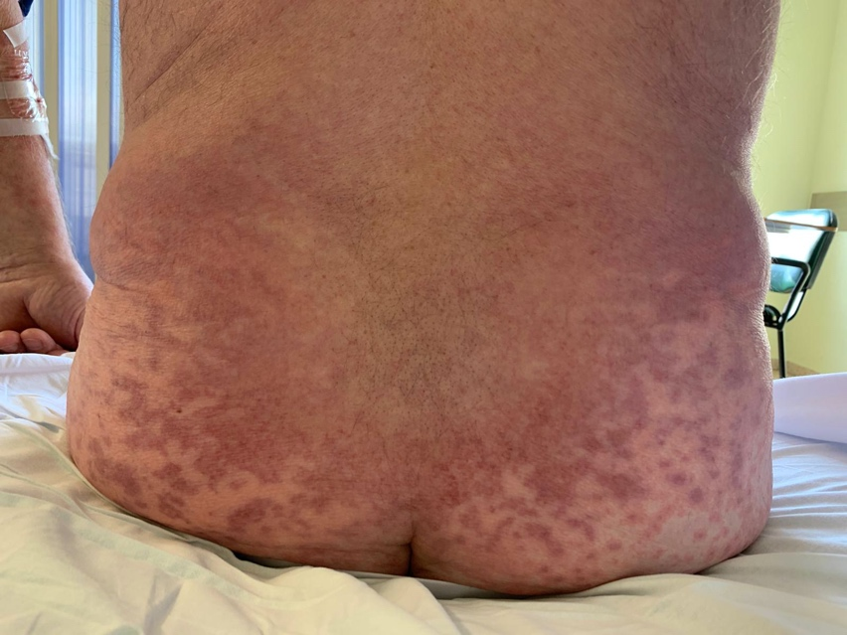
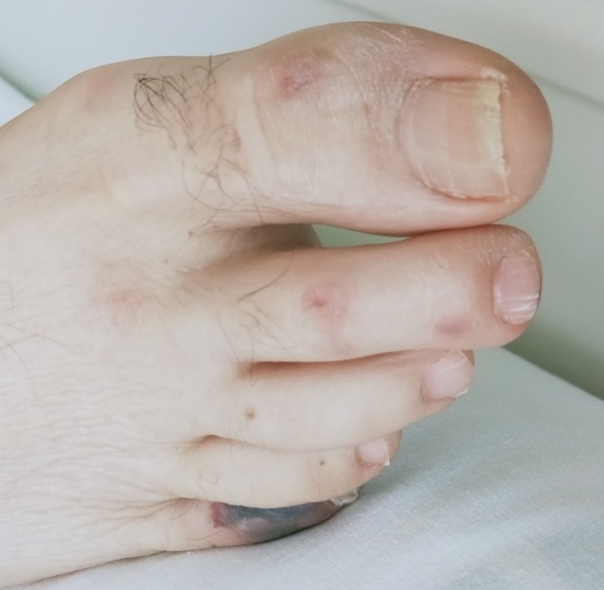
5.- Livedo or necrosis
Different degrees of lesions suggesting occlusive vascular disease.
Areas of ischemia in the trunk or acral.
Took place in older patients with more severe disease.
Also, we included transient livedo, with some suffering COVID-19 that did not require hospitalization.

Slide 18
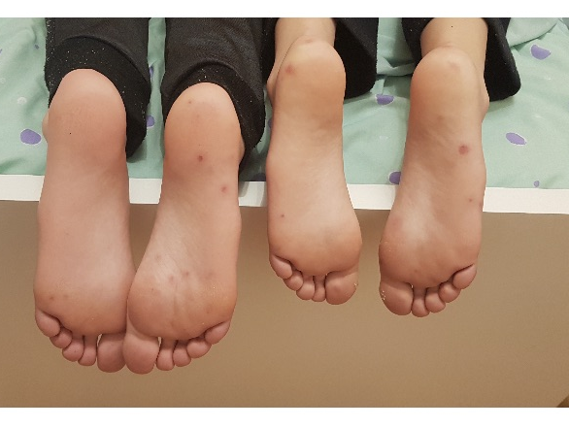
Familiar clusters
We could describe 3 familiar clusters with lesions.
One family had 2 children with pseudo-chilblain and other showing a generalized vesicular eruption with suspected COVID-19.
Another 2 families showed clusters of lesions but did not have symptoms of respiratory COVID-19 and did not enter the study: each of the two families had two children, that simultaneously developed pseudo-chilblains.

Slide 19
Severity
Severity of associated disease follows a gradient, from less severe disease in pseudo-chilblains to most severe disease in patients with livedoid presentations, as shown by the increasing percentages of pneumonia, admission, and intensive care needs.
Pseudo-chilblains
Vesicular eruptions
Urticarial lesions
Maculopapular eruptions
Livedo or necrosis
Severity
<
<
<

Slide 20
Sensitivity analysis
We have reproduced the same analysis using only confirmed cases of COVID-19, and the results are similar.

Slide 21
Conclusions
What does this study add?
We describe a large, representative, sample of patients with unexplained skin manifestations and a diagnosis of COVID-19; using a consensus method to define morphological patterns associated with COVID-19.
We describe five clinical patterns associated with different patient demographics, timing, and prognosis and provide illustrations of these patterns to allow for easy recognition.
British Journal of Dermatology. DOI: 10.111/bjd.19163

Slide 22
Call for correspondence
Why not join the debate on this article through our correspondence section?
Rapid responses should not exceed 350 words, four references and one figure
Further details can be found on the BJD website

