Slide 1

Cutaneous manifestations in patients with COVID-19: A preliminary review of an emerging issue
A.V. Marzano^{1,2}, N. CASSANO³, G. Genovese^{1,2}, C. MOLTRASIO¹, G.A. VENA³
1) Dermatology Unit, Fondazione IRCCS Ca’ Granda Ospedale Maggiore Policlinico, Milan, Italy
2) Department of pathoPHYSIOlogy and Transplantation, Università degli Studi di Milano, Milan, Italy
3) Dermatology and Venereology Private Practice, Bari and Barletta, Italy
British Journal of Dermatology. DOI: 10.111/bjd.19264

Slide 2

Lead Researcher
Angelo Valerio Marzano
British Journal of Dermatology. DOI: 10.111/bjd.19264

Slide 3
Introduction
What’s already known?
The infection caused by the Severe Acute Respiratory Syndrome Coronavirus 2 (SARS-CoV-2), called CoronaVirus Disease-19 (COVID-19), has rapidly spread throughout the world, becoming a pandemic.
The heterogeneous spectrum of COVID-19-associated cutaneous manifestations is based on preliminary reports of different types of skin lesions, leading to a need for clarity.
British Journal of Dermatology. DOI: 10.111/bjd.19264

Slide 4
Objective
To provide an overview of COVID-19-associated cutaneous lesions
British Journal of Dermatology. DOI: 10.111/bjd.19264

Slide 5
Methods
A literature search in electronic databases PubMed, Scopus and Web of Science was conducted up to the 30th of April 2020, using the term “COVID-19” in combination with “skin”, “cutaneous manifestations”, “eruption”, “rash”, “exanthem”, “urticarial”, “chilblain”, “livedo”, and “purpura” in order to collect reports of skin manifestations described in patients with COVID-19.
Articles were selected based on title and abstract. Full texts were then carefully read to evaluate the article content. Articles from the references cited in the retrieved papers were also manually searched as appropriate.
British Journal of Dermatology. DOI: 10.111/bjd.19264

Slide 6
Results
Literature reports showed a great heterogeneity in COVID-19-associated cutaneous manifestations, as well as in their latency periods and associated extracutaneous symptoms.
Pathogenic mechanisms are unknown, although the roles of hyperactive immune response, complement activation and microvascular injury have been hypothesized.
British Journal of Dermatology. DOI: 10.111/bjd.19264

Slide 7
Results
Based on our experience and the literature data, we subdivided the reported cutaneous lesions into six main clinical patterns:
  i) urticarial rash
  ii) confluent erythematous/maculo-papular/morbilliform rash
  iii) papulovesicular exanthem
  iv) chilblain-like acral pattern
  v) livedo reticularis/racemosa-like pattern
  vi) purpuric “vasculitic” pattern
These six patterns can be grouped into two. Patterns i-iii are inflammatory/exanthematous, and patterns iii-vi are vasculopathic/vasculitic
British Journal of Dermatology. DOI: 10.111/bjd.19264

Slide 8
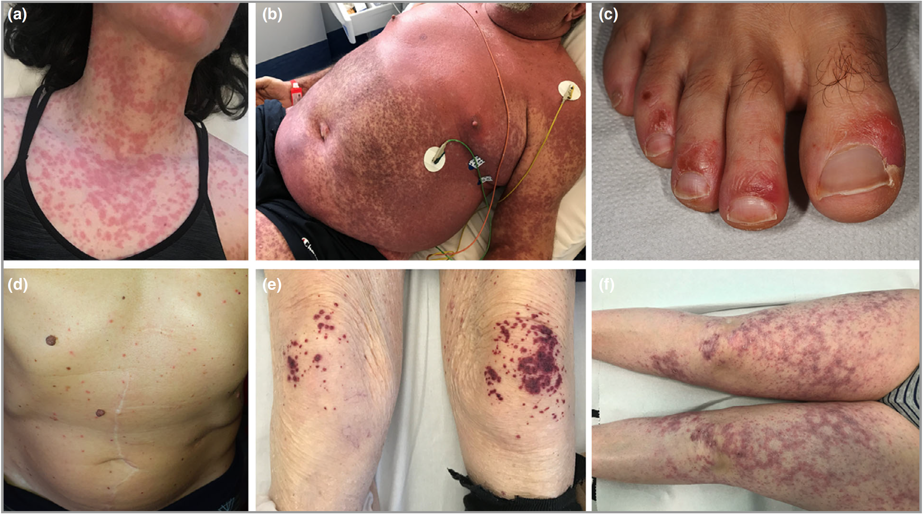
Results
British Journal of Dermatology. DOI: 10.111/bjd.19264

Slide 9
Conclusions
What does this study add?
A summary of the clinical and histological features of COVID-19-associated skin manifestations has been provided
Six main clinical patterns can be identified: i) urticarial rash, ii) confluent erythematous/maculopapular/morbilliform rash, iii) papulovesicular exanthem, iv) chilblain-like acral pattern, v) livedo reticularis/racemosa-like pattern, vi) purpuric “vasculitic” pattern
British Journal of Dermatology. DOI: 10.111/bjd.19264

Slide 10




The Team
Angelo Valerio Marzano Nicoletta Cassano Gino Antonio Vena Giovanni Genovese Chiara Moltrasio
British Journal of Dermatology. DOI: 10.111/bjd.19264

Slide 11
Call for correspondence
Why not join the debate on this article through our correspondence section?
Rapid responses should not exceed 350 words, four references and one figure
Further details can be found on the BJD website

