Slide 1
Point of care ultrasound
Knobology & physics

Slide 2
Objectives
Basic US physics
Obtaining an Image
Optimizing the Image
Additional Modes of US
Artefacts
Saving Images, Videos & Interpretation

Slide 3
BASIC US PHYSICS

Slide 4
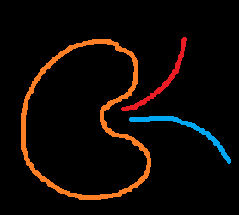

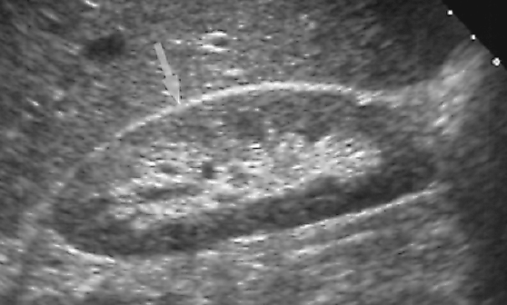
Piezoelectric Effect on Ultrasound
3. Image formed on ultrasound screen
1. Piezoelectric crystal emits sounds
2. Organ reflects sounds back
Notes:
Discuss about piezoelectric effect and principles of SONAR

Slide 5
Frequency of Sound
< 20 Hz
20 Hz - < 1 MHz
1 MHz – 25 MHz
> 50 MHz
Infrasonic
Sonic
Hypersonic
Ultrasonic

Slide 6
Sound waves
Energy is transferred to matter as sound moves through
01
Sound traveling through dense matter loses more energy
02
Low frequency sound waves lose less energy and travel further
03
High frequency sound waves lose more energy and travel less distance
04
Notes:
Discuss lose of energy as it passes through different tissues. Why frequency of probe determines the depth.

Slide 7
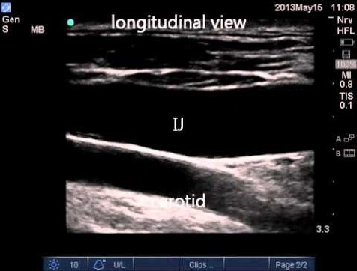
How is an image formed by ultrasound?
Notes:
As ultrasound beam emits through the probe and travels through various structures, it loses energy. Based on how much is absorbed and how much is reflected back determines the echogenicity. The superficial structures are the ones where sound takes the least time to come back to probe and so the image is formed at the top of the screen. The deeper structures reflect sound waves after a delay and hence the image formed is at the bottom of the screen.

Slide 8
How is depth perceived by ultrasound?
Less time = Less depth
More time = More depth

Slide 9
Echogenicity of structures
Depends on 3 factors largely:
1. Acoustic impendence (Interface between various structures)
2. Specular reflector
3. Angle of insonation

Slide 10
Acoustic impedance
Two materials with same impedance – No echo (ex: blood, fluid)
Two materials with minor mismatch – Weak echo (ex: liver, kidney)
Two materials with major mismatch – Strong echo (ex: bone, air)
HYPERECHOIC | ANECHOIC
Structure reflects most sound waves | Structures allow most sound waves to pass through
Structures appears white on the screen | Structures appear black on the screen
Notes:
Acoustic impedance (Z) is a physical property of tissue. It describes how much resistance an ultrasound beam encounters as it passes through a tissue. Acoustic impedance depends on: the density of the tissue (d, in kg/m³) the speed of the sound wave (c, in m/s)

Slide 11
Angle of Insonation
90°
< 90°
90°
> 90°
Weak Echo
Strong Echo
Strong Echo
Weak Echo

Slide 12
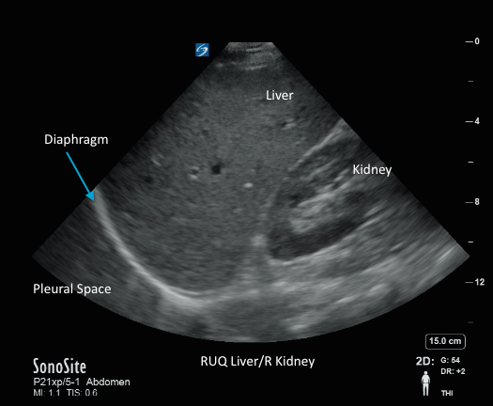
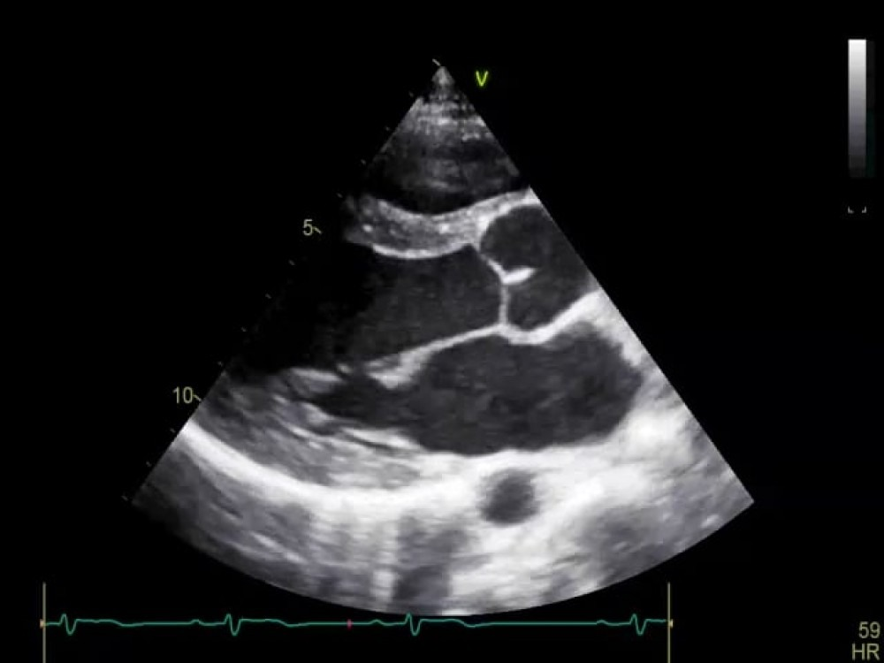
Specular reflector
Notes:
Diaphragm and pericardial sac are strong reflectors. They reflect sound waves almost completely and hence appear bright white/echogenic. These structures act to create mirror image artefact which is discussed later.

Slide 13
OBTAINING AN IMAGE

Slide 14
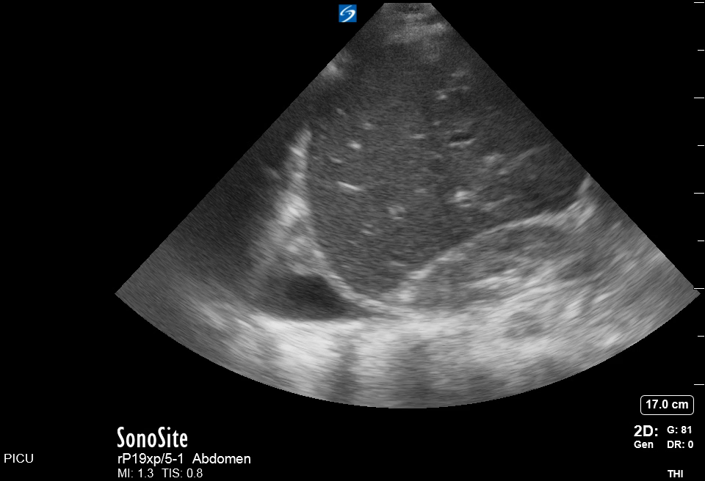
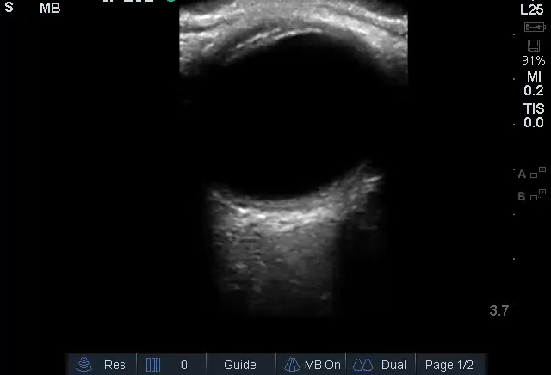
Probe Orientation
Head
Feet
Ultrasound probe orientation:
Sagittal plane: The probe marker is always towards the patients head
Transverse plane: The probe marker is always towards the patient’s right
Exception: Cardiac, procedural US
Right
Left

Slide 15
Probe Movement
The probe can be moved in different planes to optimize the image
Tilting: The probe is moved from side to side on the same axis
Sliding: The probe is slid up and down along the organ of interest.
Fanning: Similar to tilting but here the probe is tilted from one side to the other.
Please watch the YouTube video for further explanation of these movements.
https://youtu.be/RskrEsAGzec?t=120
Notes:
https://youtu.be/RskrEsAGzec?t=120

Slide 16
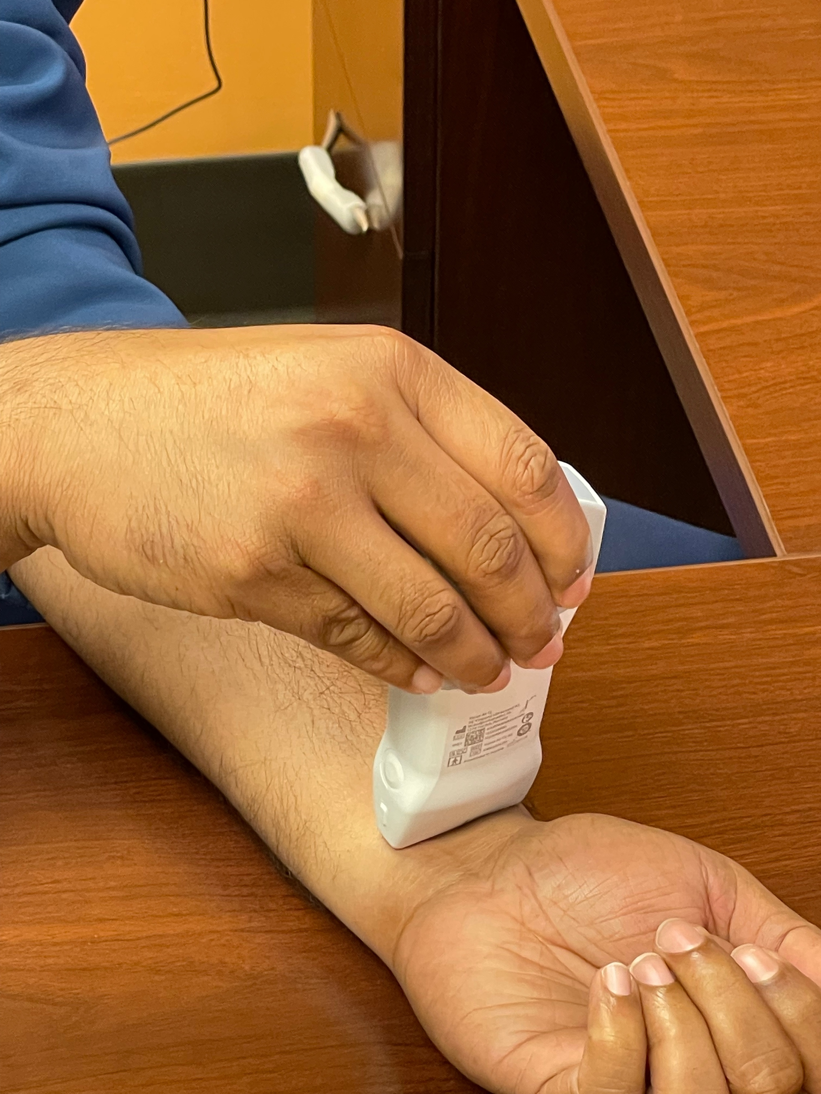
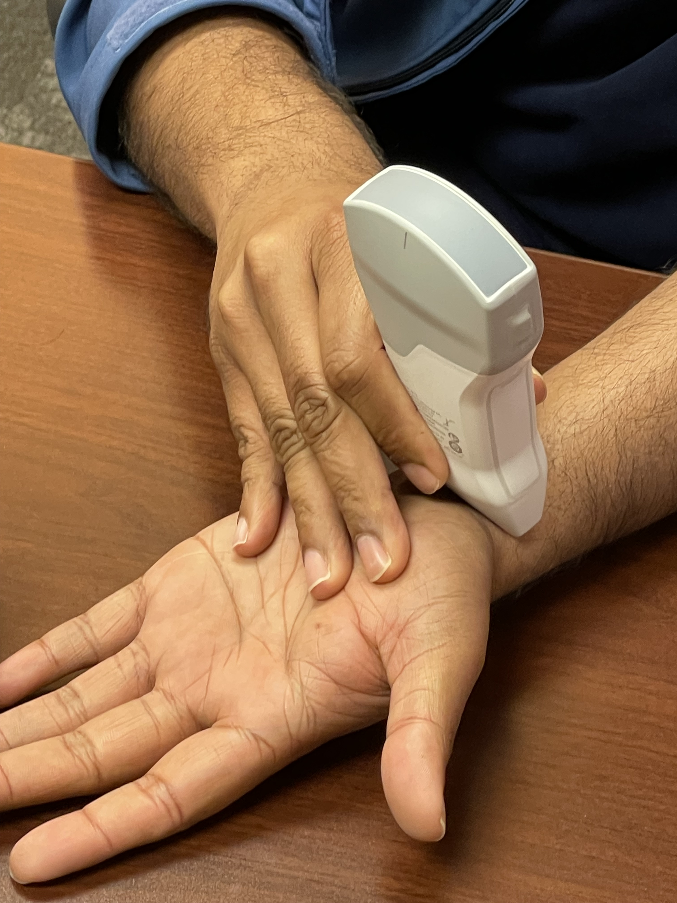
Holding the probe
Incorrect
Correct

Slide 17
IMAGE OPTIMIZATION

Slide 18
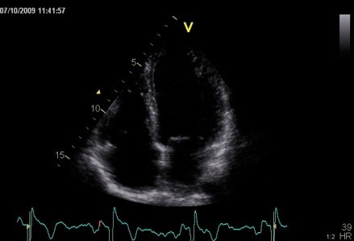
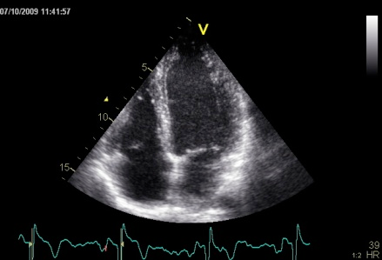
Gain
Notes:
Gain in the amount of digital enhancement that is provided to an image to compensate for the loss of energy as the sound waves travel through tissue. The further the structure of interest, the higher is the gain required. Most new machines are smart enough to optimize the gain in an image automatically.

Slide 19
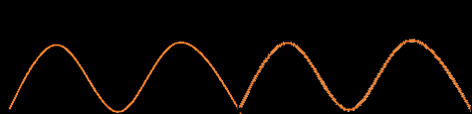
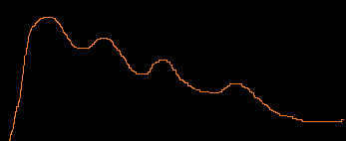
Near and Far Gain
US beam through tissues
Near field strong signal
Return signal without gain correction
Far field weak signal
Adjustment of gain signal
Ga I n
Corrected return signal
Notes:
Demonstrates how far and near gain processing is handled
A way to overcome ultrasound attenuation is time gain compensation (TGC), in which signal gain is increased as time passes from the emitted wave pulse. This correction makes equally echogenic tissues look the same even if they are located in different depths.
The basis of this is that of returned ultrasound echoes from tissues. It is known that early echoes represent wave reflections in superficial layers, while late echoes come from deeper layers. This is the base of axial localisation in ultrasound.
It is also known that the emitted ultrasound wave amplitude gets smaller as it penetrates tissue, a phenomenon called attenuation. So, one might expect late echoes (from deep layers) to have smaller amplitudes than early (superficial) echoes even if those layers have the same echogenicity.
If the ultrasound image was formed directly by the raw returned echoes, image would appear lighter in superficial layers and darker in deep layers but TGC is used to overcome this artifact.

Slide 20
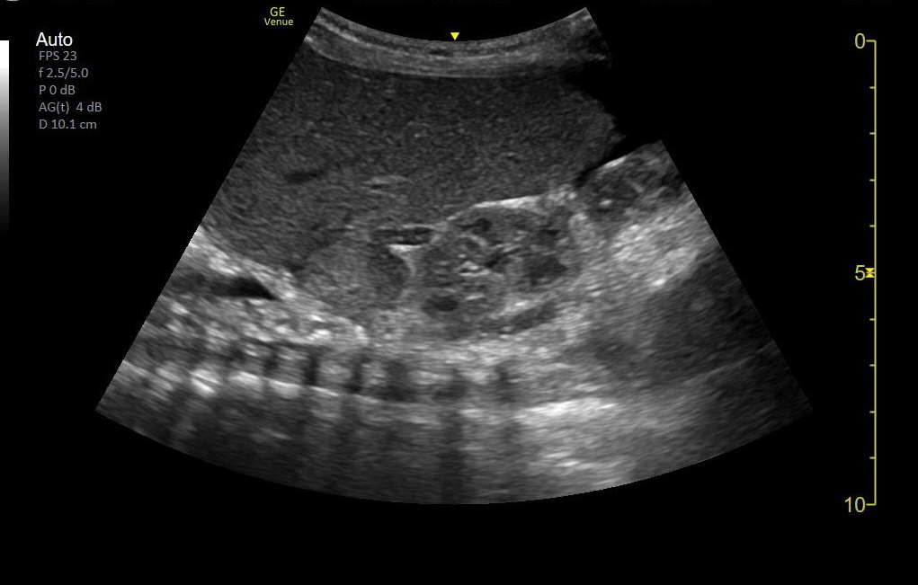
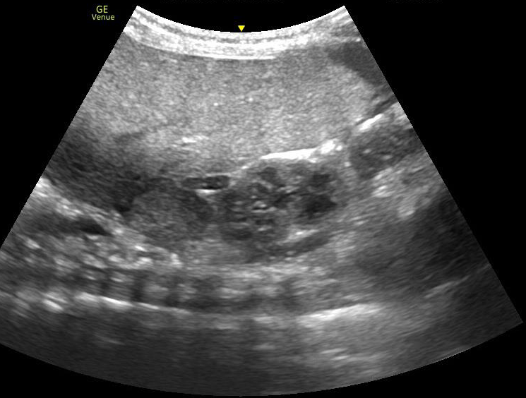
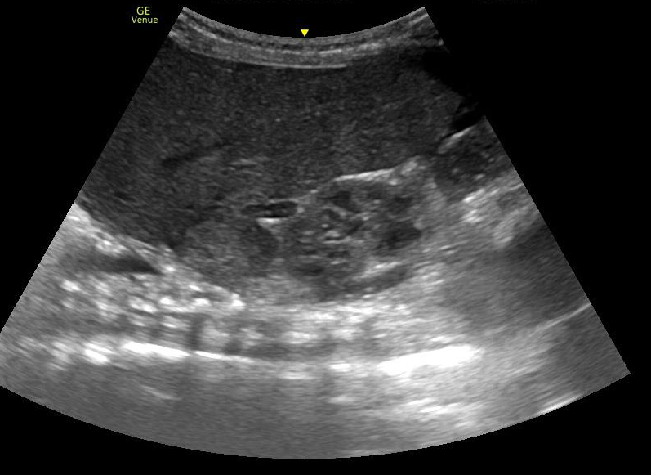
Near and Far Gain
Optimum Gain
Excess Near Field Gain
Excess Far Field Gain

Slide 21
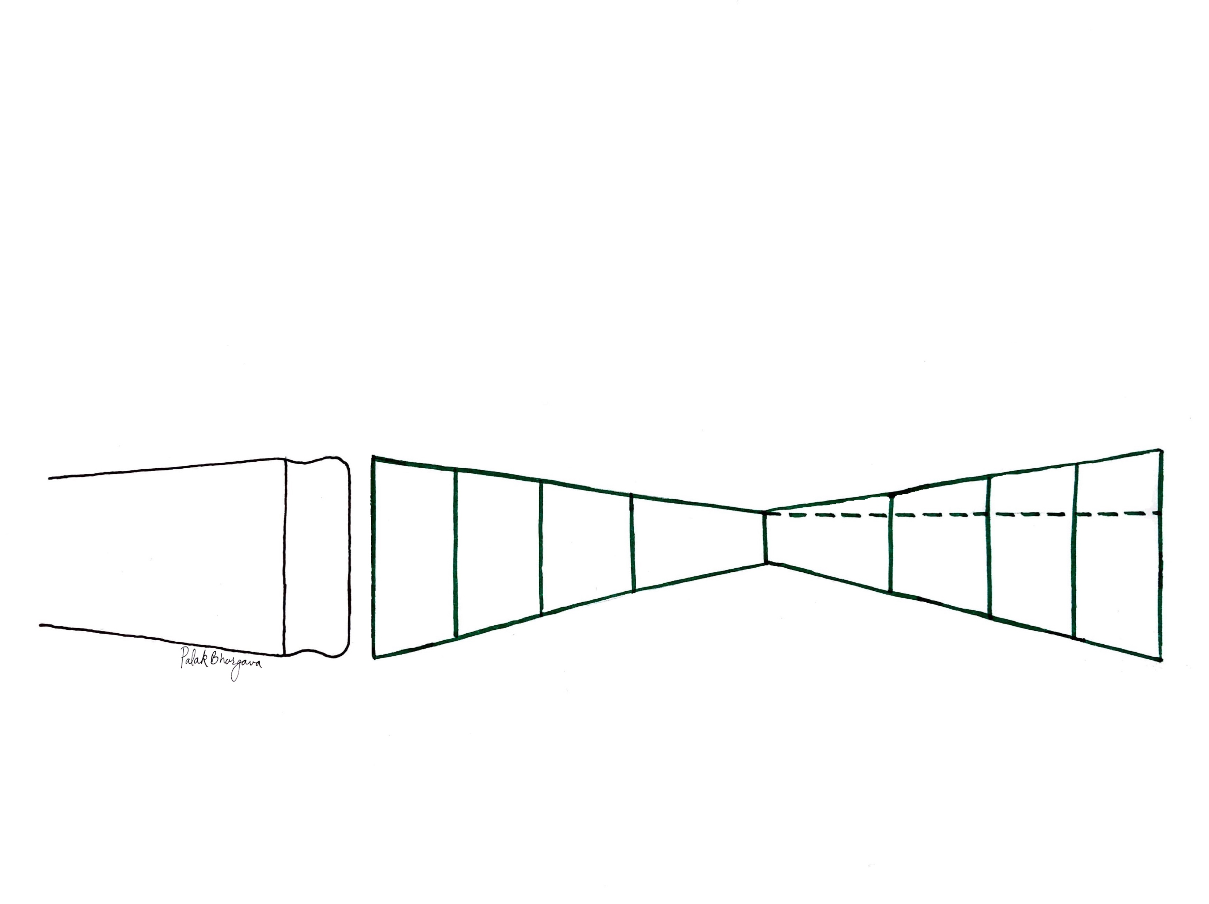
Improve Image Resolution (Focal Zone)
Near Field
Far Field
Focal Zone
Focal Distance
Notes:
Focal point is the point of the convergence of us beam. Due to this convergence, the images formed at this point have the highest lateral resolution.

Slide 22
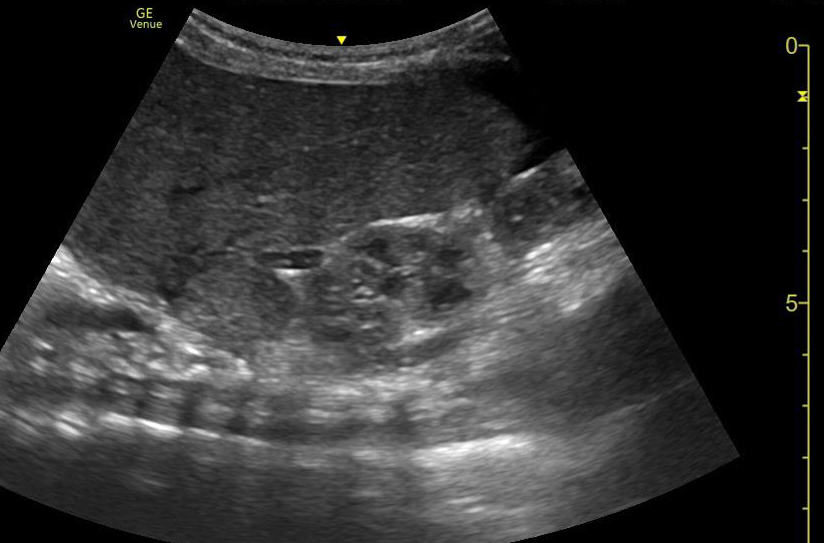
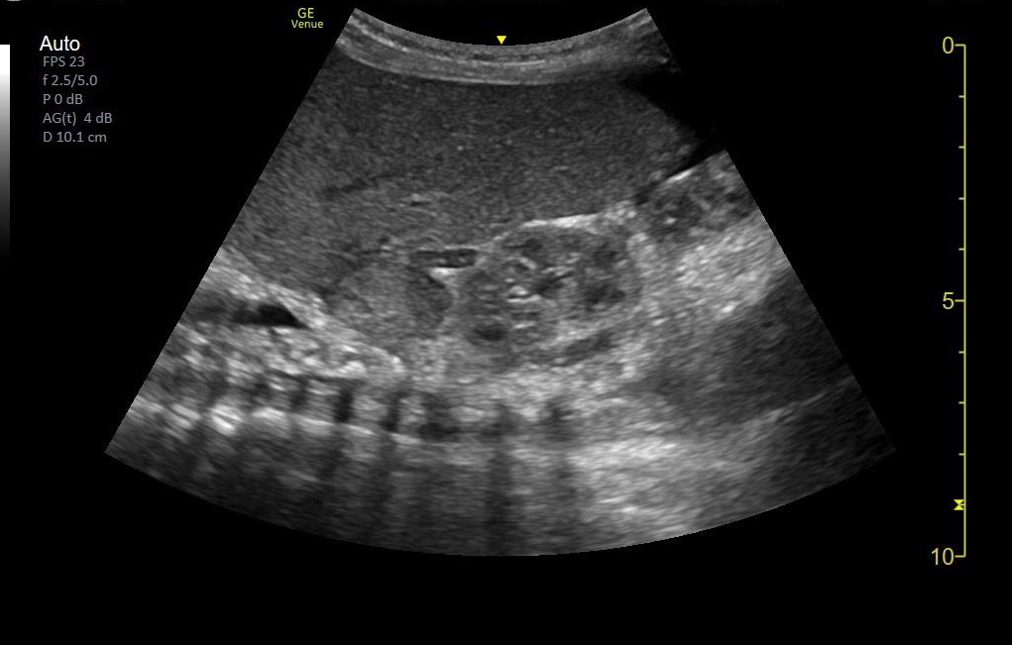
Improve Image Resolution (Focal Zone)
Observe subtle change in image quality with change in focal zone

Slide 23
OTHER MODES OF US

Slide 24
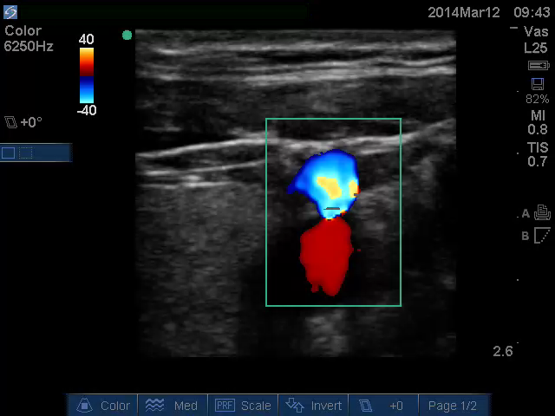
Doppler
Blood flow
BLUE – AWAY RED - TOWARDS

Slide 25
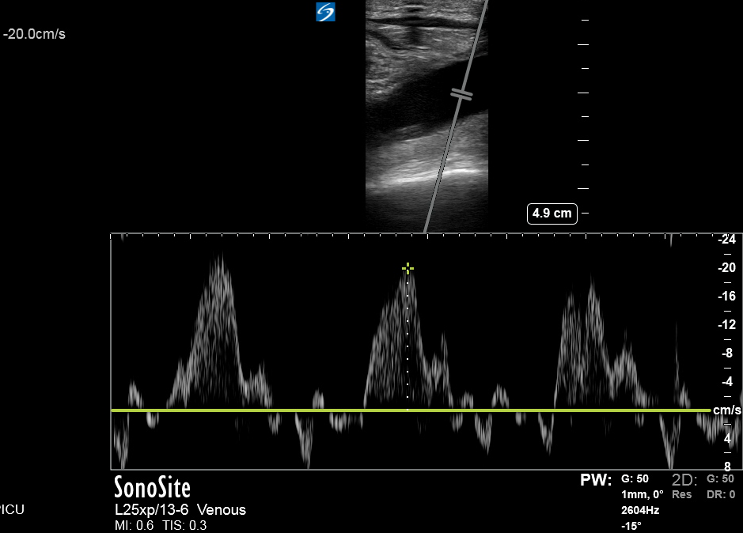
Pulse Wave Doppler

Slide 26
M Mode
Displays Motion
Take a single line through a 2D image and tracks it over time
High sampling rate allowing for higher resolution
Useful for looking at changes in dimensions (ie LV size, valve opening/closing, IVC diameter) over time
Also useful for lung ultrasound.

Slide 27
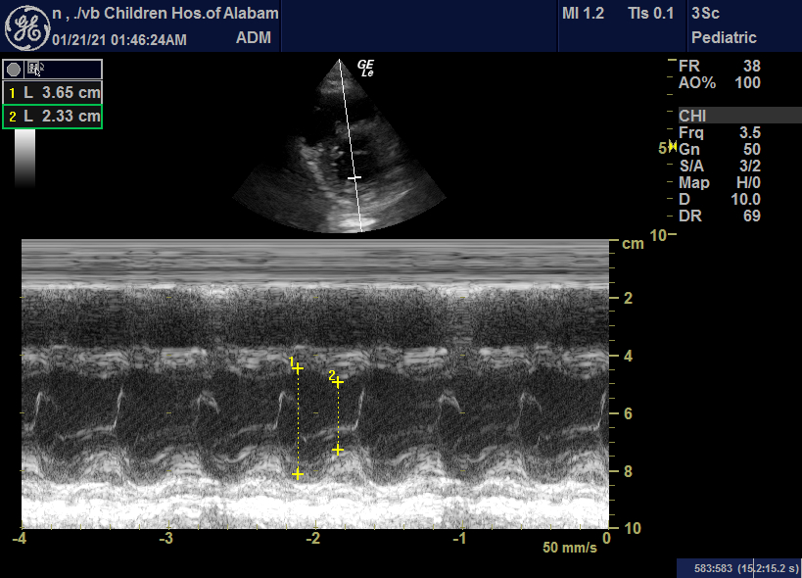

Slide 28
COMMON ARTIFACTS

Slide 29
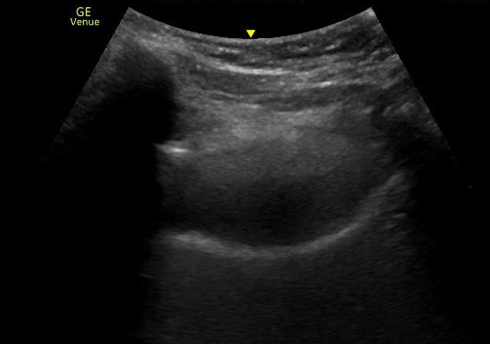
Common Artifacts: Acoustic Shadowing
Notes:
US waves hit a structure that causes near total reflectivity- ie bone, calcifications etc (gallstones renal stones) as a result the structures below appear anechoic giving appearance of fluid filled cavity.

Slide 30
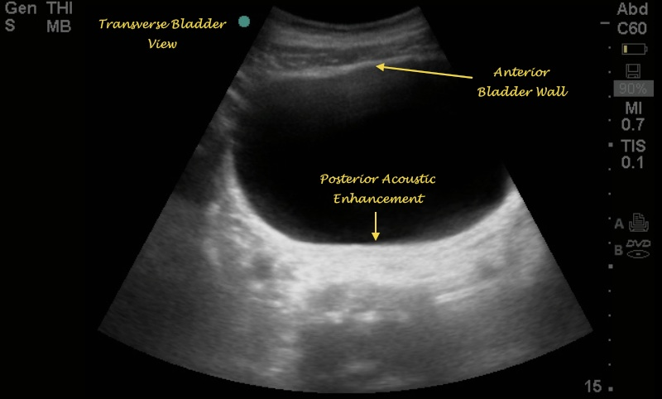
Posterior Acoustic Enhancement
Notes:
US waves move through structures with low resistance with almost no attenuation, get enhancement behind the fluid filled structure. The time gain compensation(TGC) overcompensates through the fluid-filled structure causing deeper tissues to be brighter. Due to posterior acoustic enhancement, free fluid and other structures behind the bladder may not be appreciated. This artifact can be minimized by decreasing the gain in the far field.

Slide 31
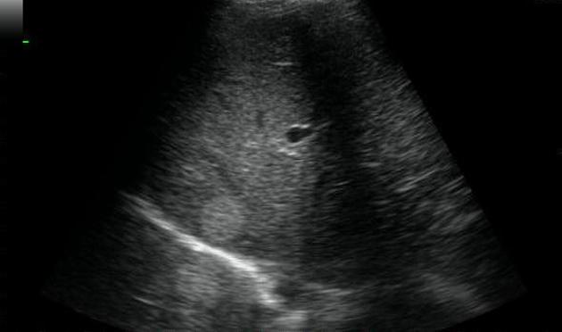
MIRRORING
Notes:
in ultrasonography, highly reflective interfaces, such as lung diaphragm, may result in multiple reverberations of sound waves causing some echoes to be delayed in returning to the transducer so that a more superficial structure may appear deeper.
The ultrasound machine makes a false assumption that the returning echo has been reflected once and hence the delayed echos are judged as if being returned from a deeper structure, thus giving a mirror artifact on the other side of the reflective surface.

Slide 32
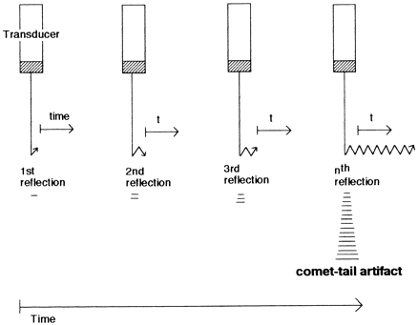
Reverberation Artifact
Parietal pleura
Visceral Pleura
Notes:
Reverberation artifact occurs when an ultrasound beam encounters two strong parallel reflectors.
When the ultrasound beam reflects back and forth between the reflectors ("revereberates"), the ultrasound transducer interprets the sound waves returning from the reverbration as deeper structures since it took longer for the wave to return to the transducer. Reverberation artifacts can be improved by changing the angle of insonation so that reverberation between strong parallel reflectors cannot occur.

Slide 33
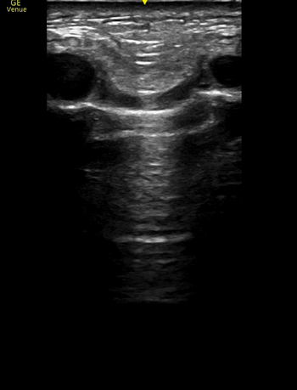
REVERBERATION ARTIFACT

Slide 34
SAVING IMAGES & INTERPRETATION

Slide 35
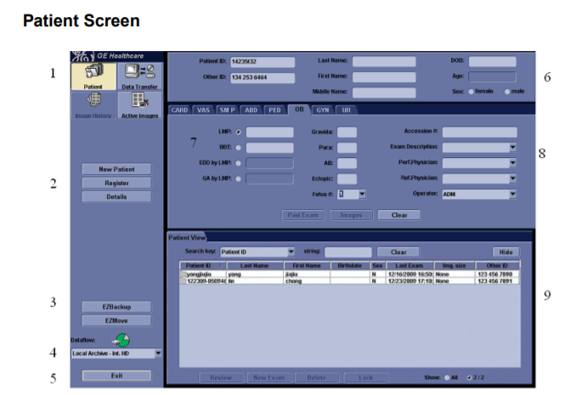
MRN
Provider name
Hit patient exam from the console to get to this screen
Hit B scan mode to get back to scanning mode
Save clips by hitting P1. Wait for the beep to let the clip finish recording
To save a still image, hit freeze button and then hit P1
To end the exam, hit patient exam again and click on new patient
Click this button if no studies are available for review here
Double click on the study to open it

Slide 36
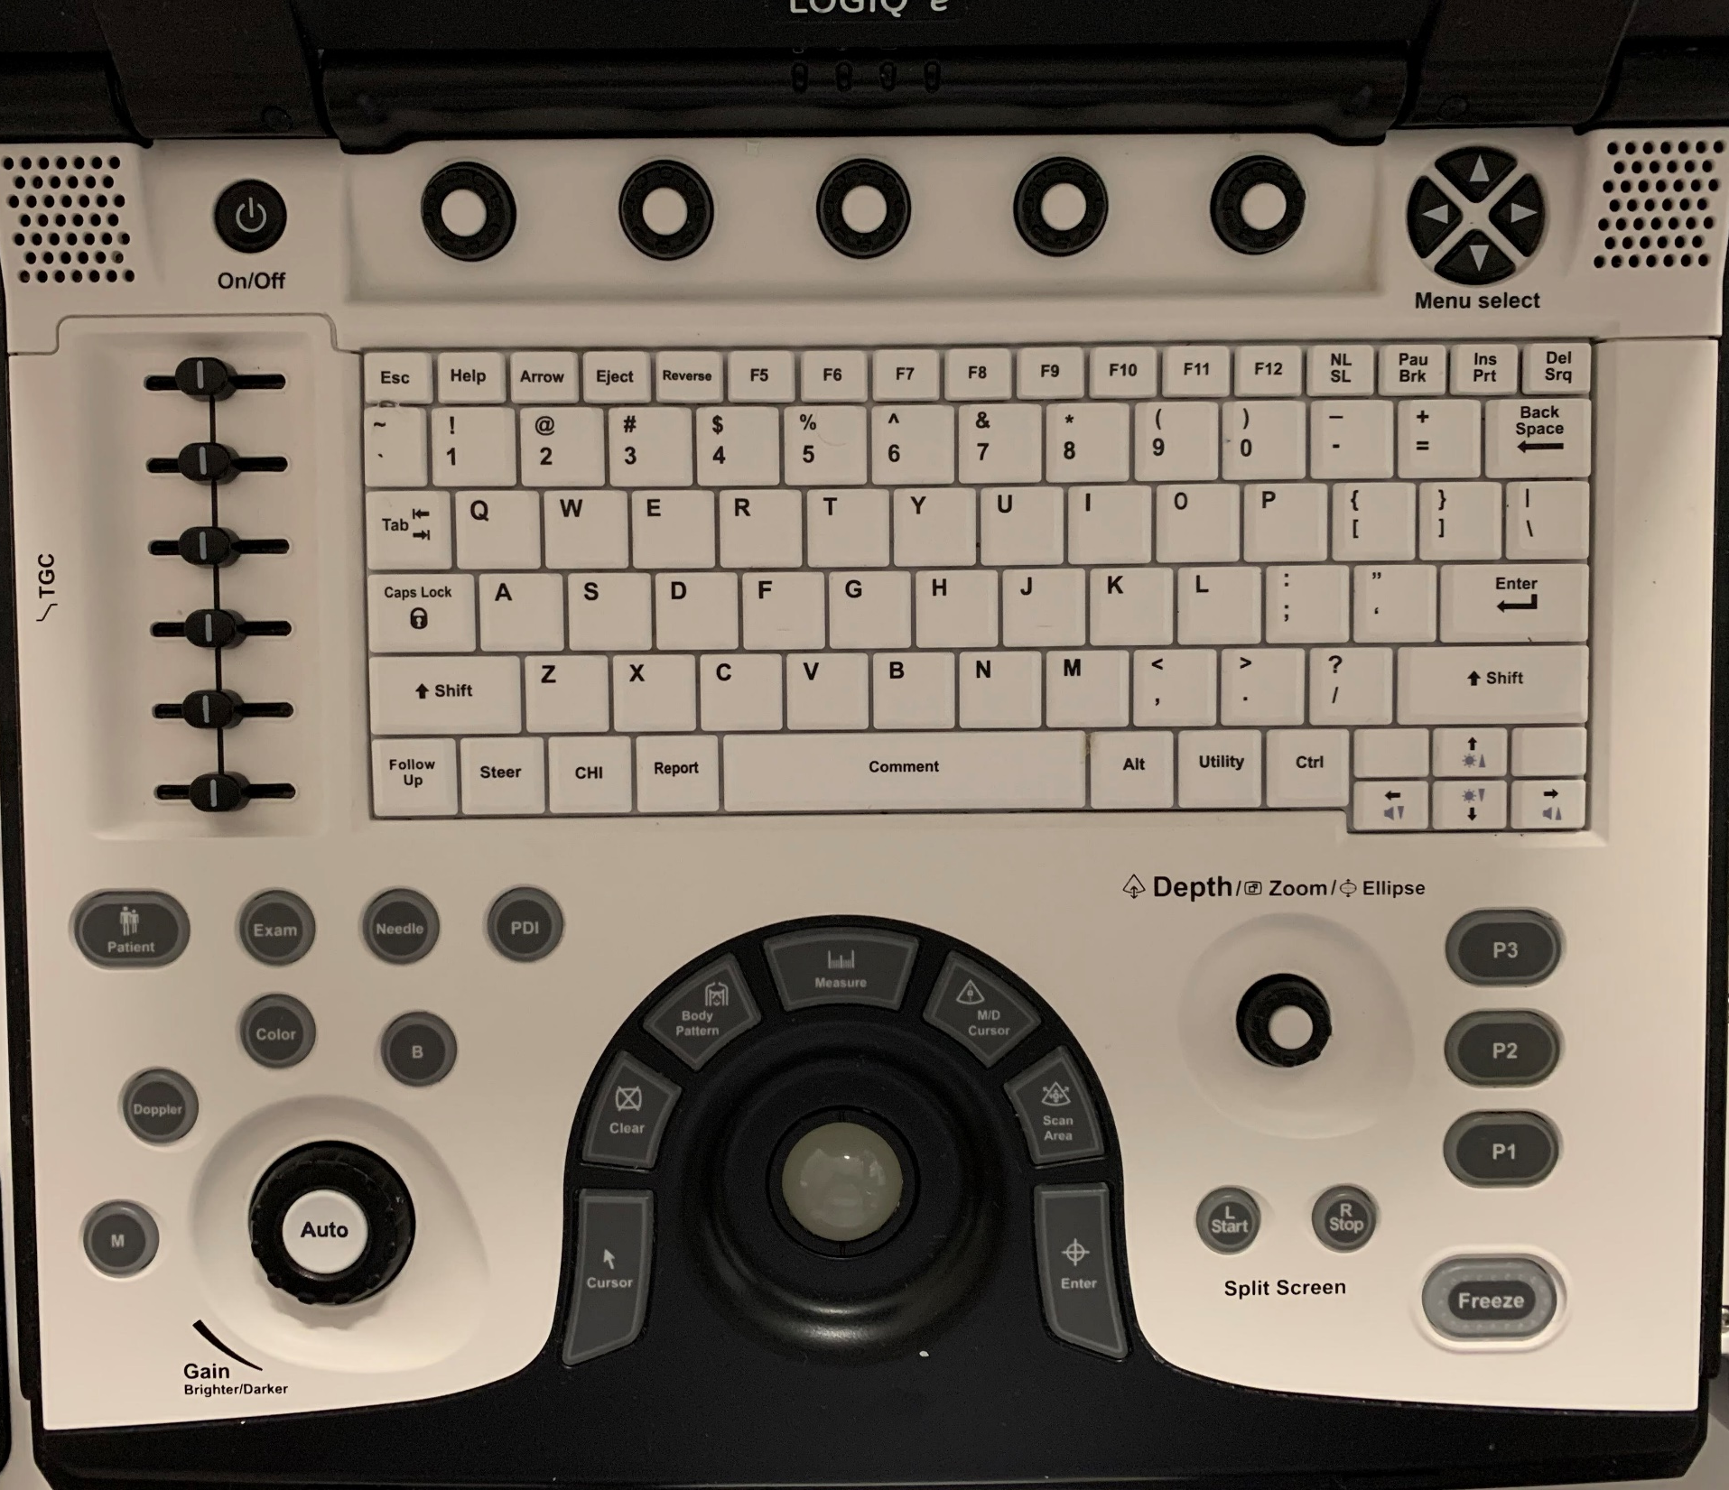
Adjust depth
Adjust gain
Save 6 sec prospective video clip (Hit Freeze & Store to save a still image)

