Slide 1
Point of care ultrasound
Hemodynamic assessment in critically ill patient

Slide 2
OBJECTIVES
Qualitative assessment of LV function
Quantitative assessment of LV function
Gross assessment of pericardial effusion
Dynamic measures of volume assessment

Slide 3
Qualitative Assessment of Left Ventricular Contractility
Evaluate
Evaluate wall motion (How far does a given wall segment move between systole and diastole?)
Evaluate
Evaluate wall thickening during systole (normal LV demonstrates 30%-40% increase in wall thickness)
Correlate
Correlate findings among multiple views

Slide 4
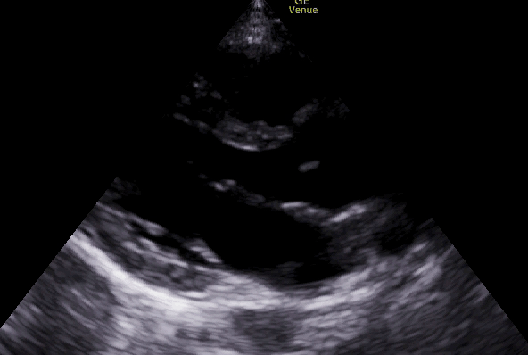
Parasternal long - Good Contractility

Slide 5
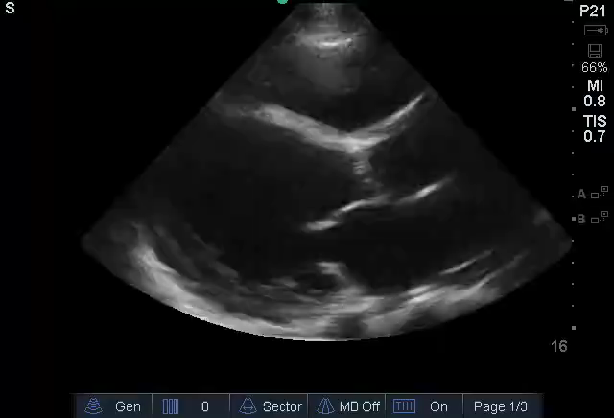
Parasternal Long View
Parasternal long - Poor Contractility
Dilated LV

Slide 6
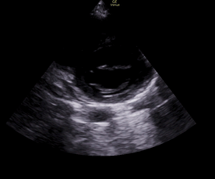
Parasternal short – Good Contractiliy

Slide 7
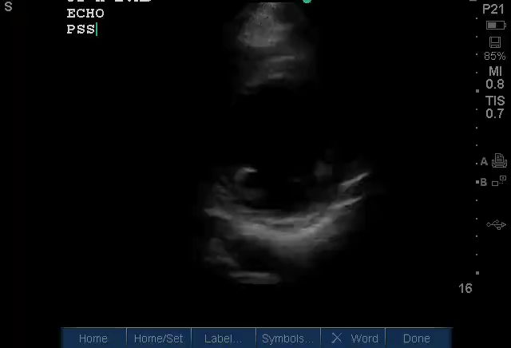
Parasternal Short View
Parasternal short - Poor Contractility

Slide 8
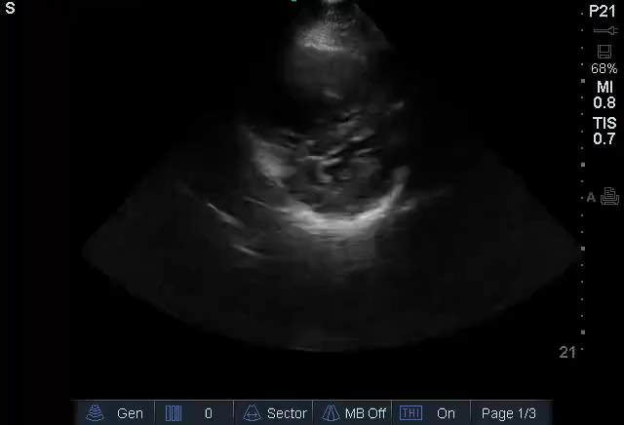
Parasternal Short View
Parasternal short – Septal flattening/elevated RV pressures
Notes:
Increased right sided pressures with flattening of the interventricular septum. Normally, the septum should bow into the low pressure chamber (RV). A similar finding is seen in patient with a large pulmonary embolism.

Slide 9
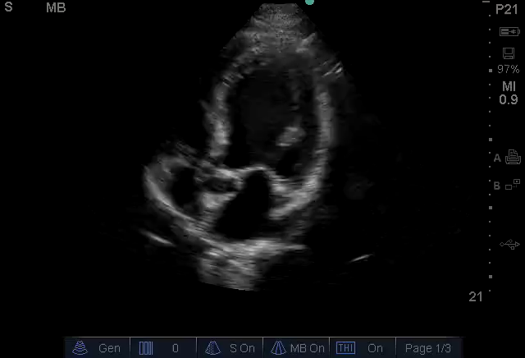
Apical 4 Chamber View – Poor contractility/dilated LV
Notes:
APICAL 5: POOR CTX
HAVE THEM POINT OUT ANATOMY

Slide 10
Quantitative Assessment of Left Ventricular Contractility
EPSS (E- point septal separation)
FS (Fractional shortening)
Simpson’s 2 disc method (Used in formal echocardiographic assessment)

Slide 11
E-Point Septal Separation (EPSS)
Quantitative assessment of LV systolic function
M mode line is placed at the tip of Mitral valve leaflet to assess septal movement in parasternal long axis view
The distance between Mitral valve ‘E’ point and interventricular septum is measured
EPSS > 5 mm is considered abnormal in pediatric patients
(Am J Cardiol 1983;52:1084-1087)

Slide 12
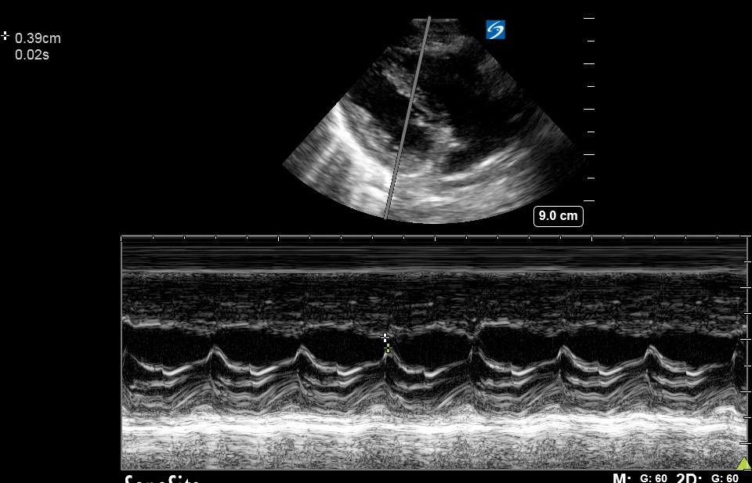
IVS
Mitral valve leaflet tip
Notes:
The M mode line must be placed on Mitral tip leaflet

Slide 13
Fractional Shortening (FS)
Quantitative assessment of LV systolic function
M mode line is placed in the center of LV cavity at the level of papillary muscle in parasternal short axis/long axis view
The LV cavity size at end diastole (LVEDD) & end systole (LVESD) are measured
FS (%) = LVEDD- LVESD x 100
--------------------
LVEDD

Slide 14
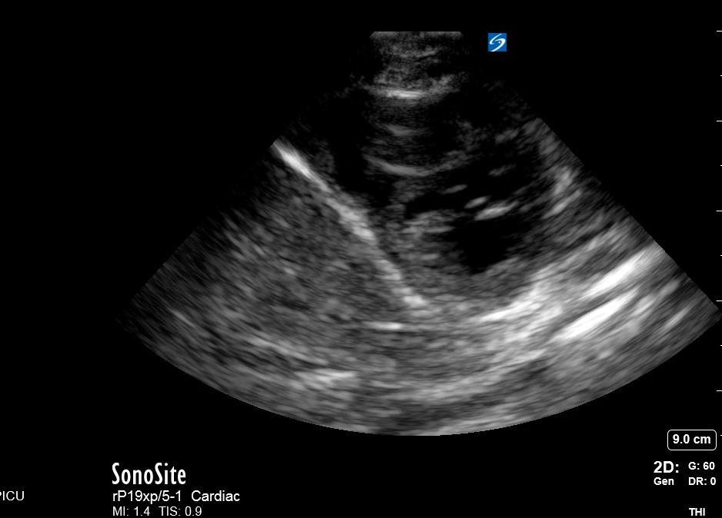
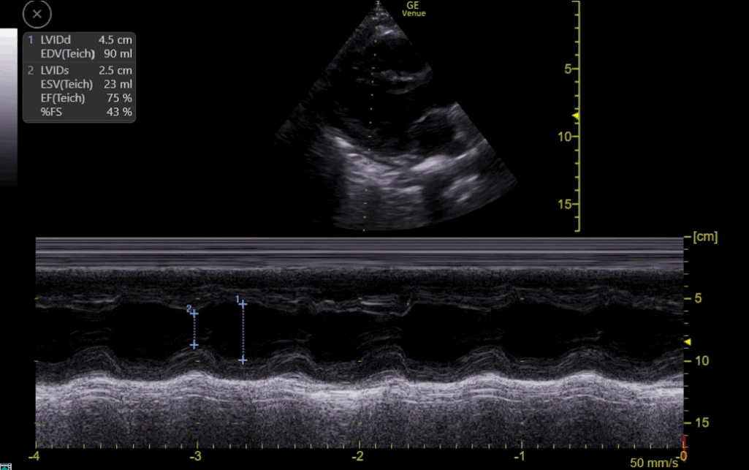
Notes:
Care must be taken to place the M mode line through the mid cavity and not on the papillary muscles or mitral valve.

Slide 15
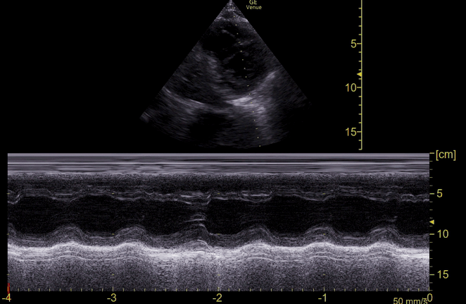
Left ventricle end diastolic diameter
Left ventricle end systolic diameter
Notes:
The M mode line in parasternal long view should be placed mid LV cavity when doing fractional shortening

Slide 16
Fractional Shortening (FS)
Fractional Shortening (FS) < 25 % is considered abnormal
 | Ref Range | Mild abnormal | Mod abnormal | Severe abnormal | Ref Range | Mild abnormal | Mod abnormal | Severe abnormal
Linear method Endocardial FS Midwall FS | 27-45% 15-23% | 22-26% 13-14% | 17-21% 11-12% | < 17% < 10% | 25-43% 14-22% | 20-24% 12-13% | 15-19% 10-11% | < 14% < 10%
2D Method - Ejection Fraction | > 55% | 45-54% | 30-44% | < 30% | > 55% | 45-54% | 30-44% | < 30%

Slide 17
Normative Values
Measurement | Views
LV Fractional Shortening % | PSL. PSS | Change in LV diameter between systole and diastole | 28-46%
Simpson’s Method | A4C, A2C | Change in LV Volume between end systole and diastole | 55-80%
EPSS | PSL (M-Mode) | Distance between ant leaflet of mitral valve and interventricular septum | > 7 mm in adults > 5.5 mm in peds
LV output (Stroke vol) | A5C | Vti x LVOT cross sectional area | Z scores based on ages
MAPSE | A4C | Systolic excursion of mitral annulus towards apex | Z scores based on age Term neonates > 8 mm Adults 12-14 mm or greater
RV output (SV) | PSL sweep | Vti at RVOT x RVOT cross sectional area | Z scores for different ages
TAPSE | A4C | Systolic excursion of tricuspid annulus towards apex | Term neonates > 8 mm Children Z score > 12 mm Adult > 17 mm

Slide 18
Pericardial effusion
Sub-xiphoid view is the best for dependent effusion
Multiple views for co-relation
Right atrium and right ventricle free wall collapse is noticed with large volume pericardial effusion
RV/RA scalloping is an early sign of impending tamponade

Slide 19
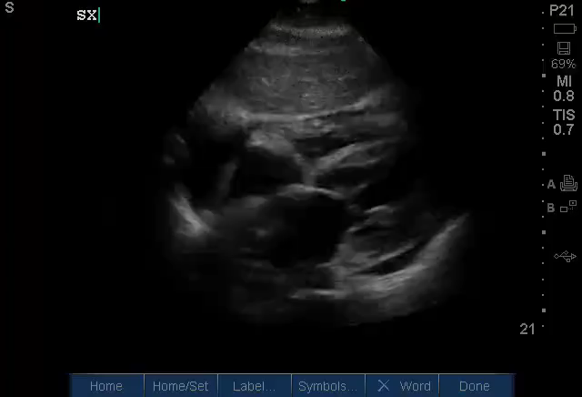

Subxiphoid View – Pericardial effusion
Notes:
MODERATE PERICARDIAL EFFUSION

Slide 20
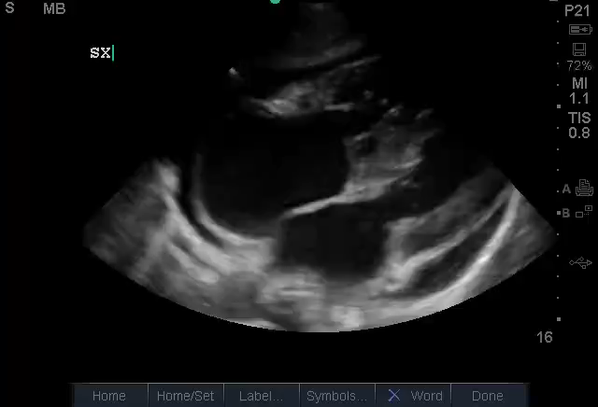
Subxiphoid View – Pericardial effusion
Notes:
PCE WITH ATRIAL ENLARGEMENT

Slide 21
TAMPONADE/SCALLOPING
Tamponade is not an echocardiographic diagnosis
Cardiac ultrasonography is the most sensitive and specific means of detecting pericardial effusion
Hyperdynamic heart with right atrial compression during late diastole and RV collapse during early diastole (“scalloping”)
“Swinging heart” counterclockwise rotational movement of the heart (appears late in tamponade)
Notes:
significant compression of the heart by accumulating pericardial contents and fluid
As little as 150 mL of pericardial fluid can cause tamponade
pulsus paradoxus, hypotension and tachycardia
Beck’s triad: JVD, muffled heart tones, hypotension
Only 1/3 patients with tamponade will have all three features of Beck’s triad and 10% will not have any of them.

Slide 22
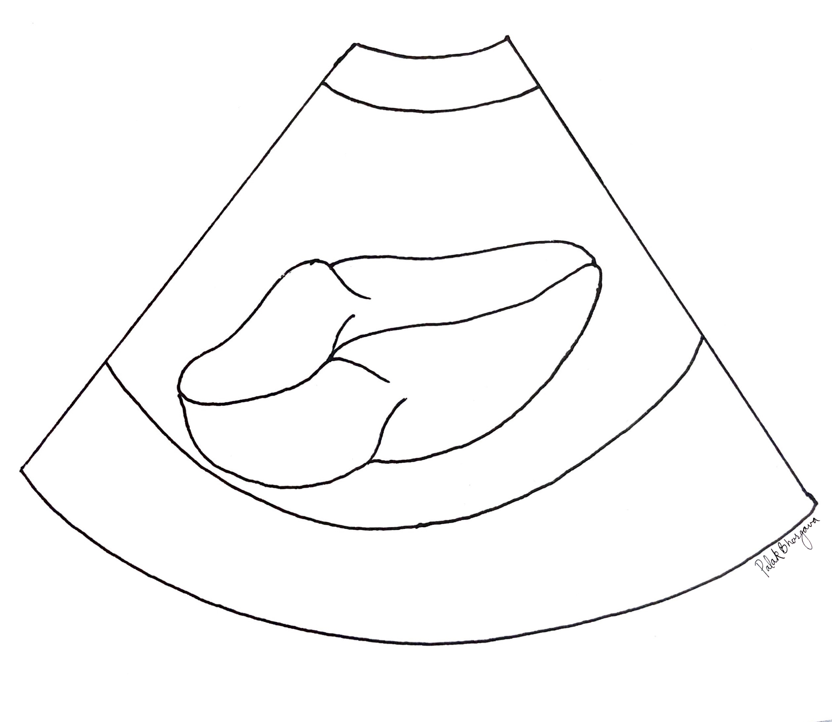
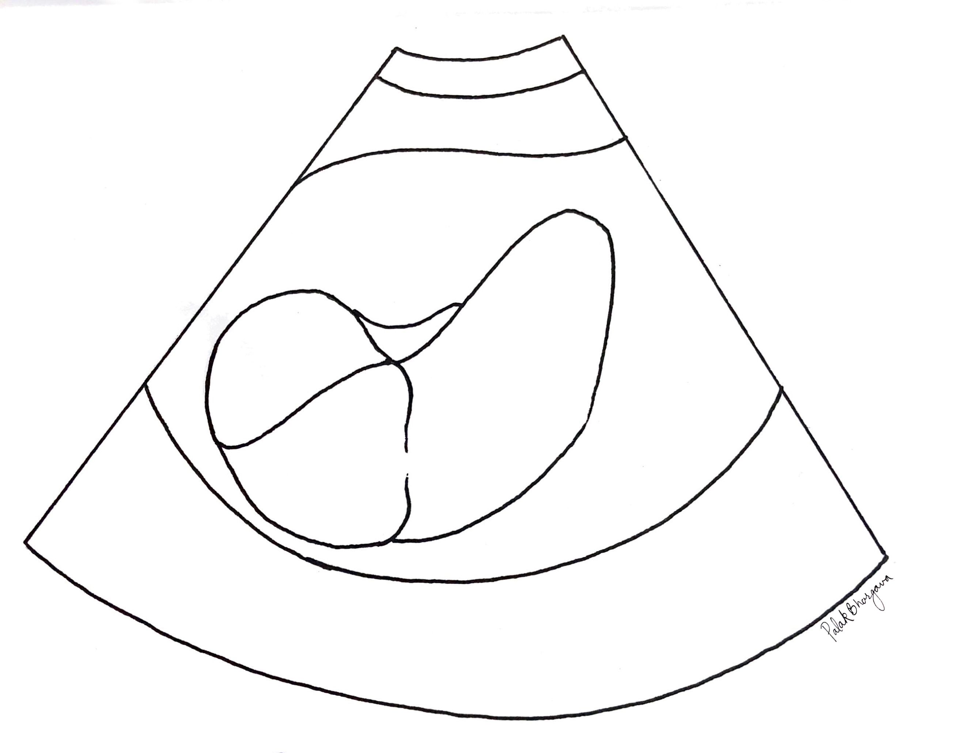
Pericardial Tamponade
Diastole
Systole
Pericardial effusion
RV collapse
RV
RA
LV
RA
LV
Pericardial effusion
LA
LA

Slide 23
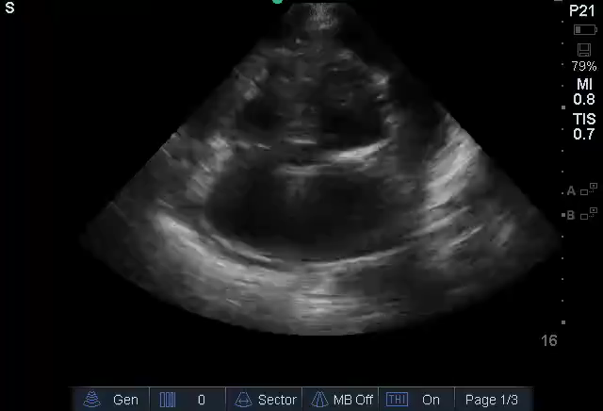
Notes:
ANGRY RV (SCALLOPING) WITH PCE

Slide 24
Hemodynamic Assessment
Dynamic methods of volumetric assessment using POCUS

Slide 25
Volumetric assessment – How good are we?
Physicians’ Estimates of Cardiac Index and Intravascular Volume Based on Clinical Assessment Versus Transesophageal Doppler Measurements Obtained by Critical Care Nurses
Iregui, Manuel G., et al. “Manuel G. Iregui.” American Journal of Critical Care, July 2003, ajcc.aacnjournals.org
Accurate assessment – 30%
Overestimation – 55%
Underestimation – 15%
Notes:
Trans esophageal Doppler measurements were compared to PA catheter data used to measure cardiac output.
The study also looked at physician assessment of cardiac index. Accurate 44%, underestimated in 23% and overestimated in 33%
Doppler measurements of cardiac output correlated with those obtained via pulmonary artery catheterization (r = 0.778; P < .001).

Slide 26
Volumetric Assessment
POCUS can be used for rapid, noninvasive determination of volume status.
Obtaining the data may be easy, interpreting the data correctly is the challenge.
    Pro: noninvasive, quick to obtain
    Con: can be limited due to body habitus, bowel gas, patient intolerance

Slide 27
Volume assessment vs Volume responsiveness
Volume assessment ≠ Volume responsiveness
Volume assessment is the gross estimation of a patient’s fluid status
It does not predict whether fluid administration will lead to increase in cardiac output.
Notes:
Volume assessment can be done using several static measurements such as RA dilation, CVP, IVC diameter. However, IVC diameter using POCUS is one of the easier ones to obtain.

Slide 28
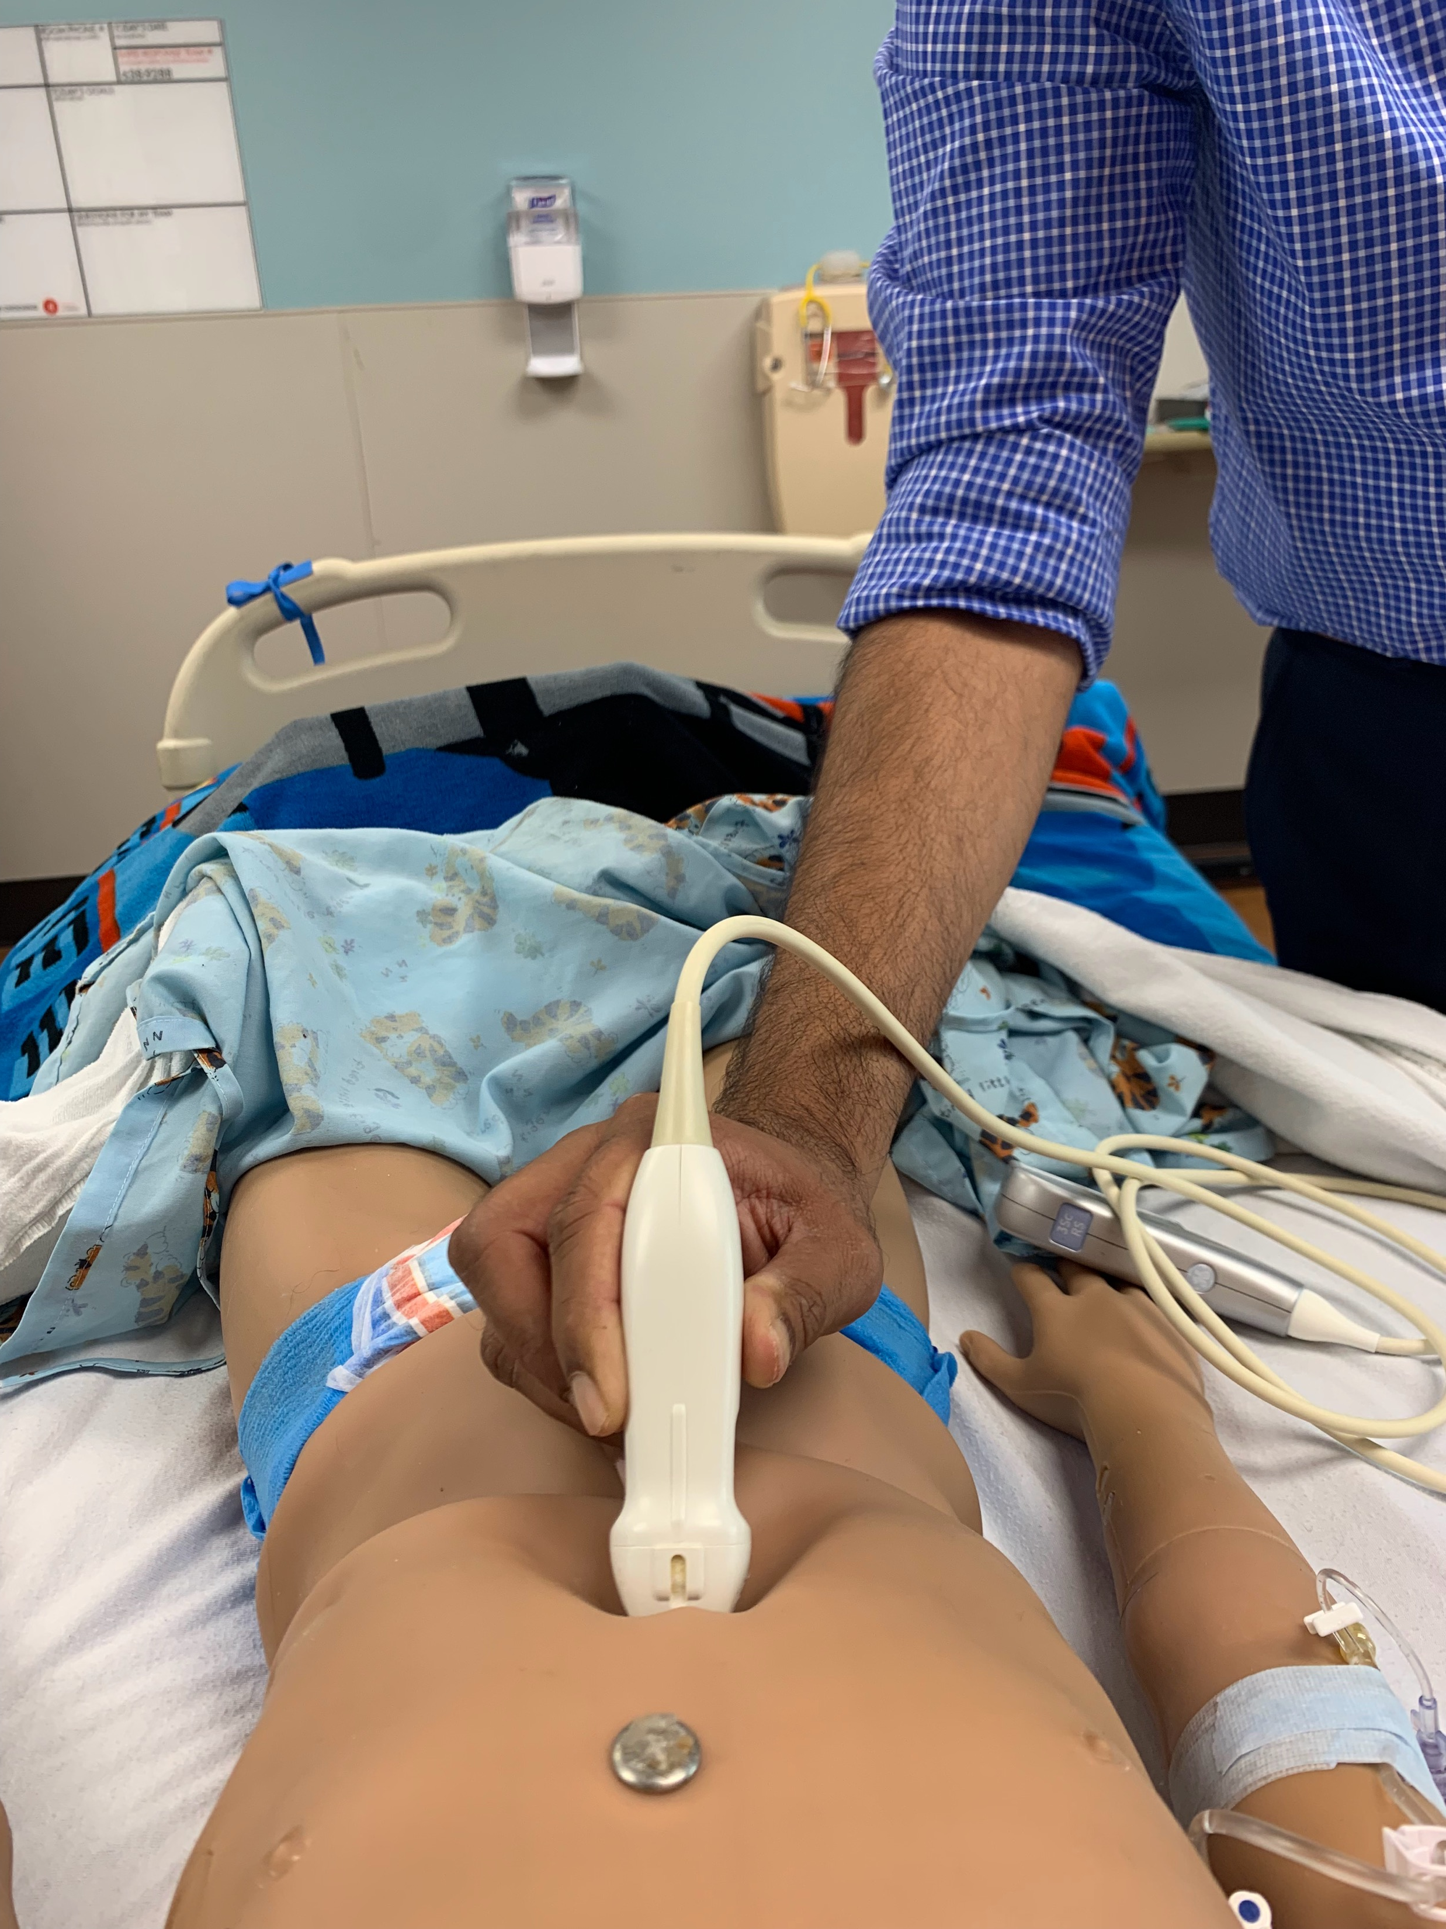
Technique:
Low-frequency- phase-array or curvilinear
Indicator toward the head (rotate from cardiac subxiphoid view)
Measure 2 cm from entrance (at level of hepatic veins
  Patient’s right—> IVC
  Patient’s left—> Aorta
Notes:
Distinguish the IVC from the aorta: thinner walls, does not exhibit pulsations, compressible, exhibits respiratory variation and courses through the diaphragm in its longitudinal view
*In smaller children, aortic pulsations may be transmitted to the IVC, giving the appearance that the IVC has pulsations
Aorta: thick echogenic walls, is pulsatile, exhibits high-flow velocity, is not compressible and does not exhibit respiratory variation

Slide 29
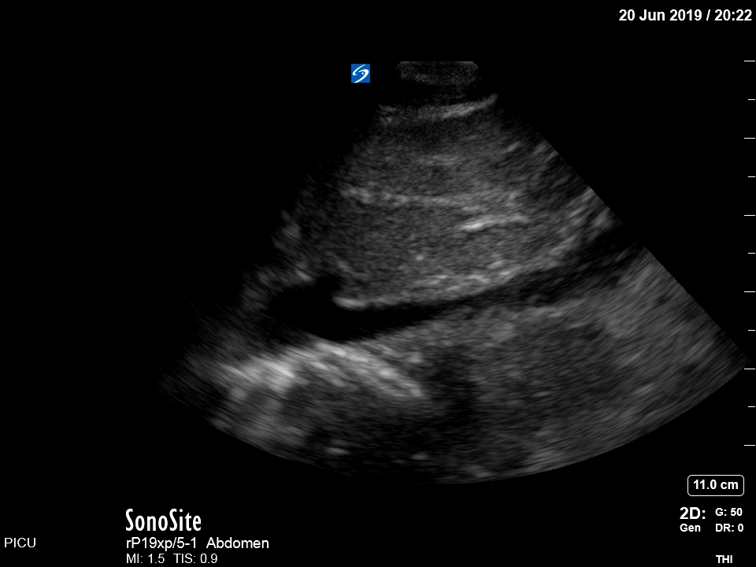
IVC Examination
Cranial
Caudal
Heart
IVC

Slide 30
Dynamic Measurements of Volume responsivess
Collapsibility/Distensibility Index
Aortic flow variability (AFV) Index

Slide 31
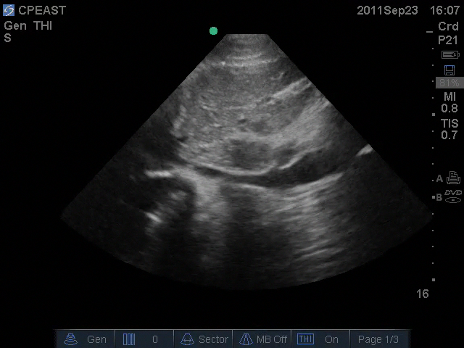
IVC Examination with variability
Caudal
Cranial
Heart
IVC
IVC-Inspiratory Collapse
IVC-No Inspiratory Collapse

Slide 32
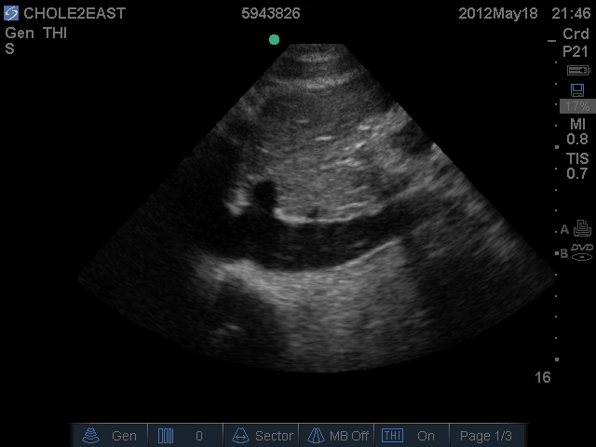
IVC examination without variability
Caudal
Cranial
Heart
IVC

Slide 33
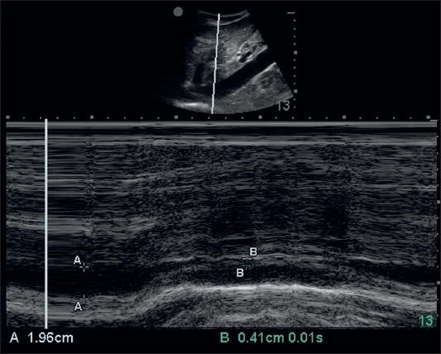
M Mode: IVC Examination with variability
M mode line is placed 1 cm behind the hepatic vein confluence with IVC

Slide 34
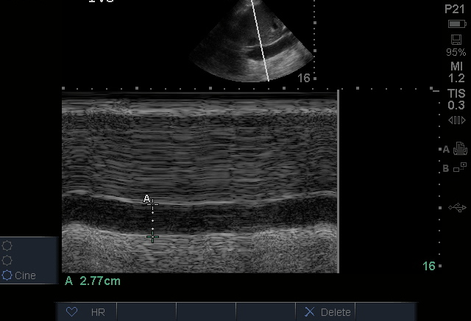
M Mode: IVC Examination without variability

Slide 35
IVC Collapsibility Index
Spontaneously breathing patients, intrathoracic pressure drops with inspiration.
IVC empties rapidly into RA, leading to collapse.
Collapsibility Index = IVC (max) – IVC (min)
                --------------------------------- x 100
                IVC (max)
The number here is unclear!!
Most helpful to classify as Huge versus collapsing!!! Extremes are more important and less error prone towards interpretation.
Notes:
IVC max – Expiratory
IVC min – Inspiratory

Slide 36
IVC Distensibility Index
In ventilated patients, IVC distends upon providing positive pressure esp if IVC is fluid responsive
Distensibility Index = IVC (max) (Insp) – IVC (min) (Exp)
                -------------------------------------------- x 100
                IVC (min) (Exp)
> 18% = Fluid responsiveness (Barbier et al)
Or
Distensibility Index = IVC (max) (Insp) – IVC (min) (Exp)
                ----------------------------------------------------- x 100
                IVC (mean)
> 12% = Fluid responsiveness (Feissel et al)
Notes:
Caveat – patient should be in full sync with the ventilator and should not be taking spontaneous breath during the course of evaluation. Patient must be in sinus rhythm and should not have Right heart failure.

Slide 37
IVC Distensibility Index
Study | Population | ΔIVC Cutoff
Feissel et al. Int Care Med, 2004 | Adult, Intubated patients with septic shock | >12% PPV 93% NPV 92%
Barbier et al. Int Care Med, 2004 | Adult, Intubated patients with septic shock | >18% Sensitivity 90% Specificity 90%
Notes:
Both are adult studies

Slide 38
Aortic blood flow variability (AFV)
Mechanically ventilated patient with volume responsiveness,
Passive inspiration
Increased intrathoracic pressure
Decreased Venous return
Decreased Stroke Volume
(Premise for using AFV to predict volume responsivness)
Notes:
This technique could be considered an echocardiographic equivalent of measuring pulse pressure variation.

Slide 39
Aortic blood flow variability (AFV)
Change in stroke volume can be measured by measuring peak velocity across aortic valve or a surrogate known as Velocity Time Integral (VTI).
AFV = Vpeak max (LVOT max) – Vpeak min (LVOT min)
      ------------------------------------------------------------------------------ x 100
      Vpeak mean (Vpeak max + Vpeak min/2)
> 12 % = Fluid responsive
Or
AFV = VTI (LVOTmax) – VTI (LVOTmin)
      --------------------------------------------------------------------------- x 100
      VTI (LVOTmean)
> 18% = Fluid responsive
Desgranges et al 2016 meta analyses

Slide 40
Aortic blood flow variability - Technique
Pulse doppler gate is placed just outside the aortic outflow tract in the apical 5 chamber view
The doppler angle should be less than 15 deg for accurate assessment of doppler velocities

Slide 41
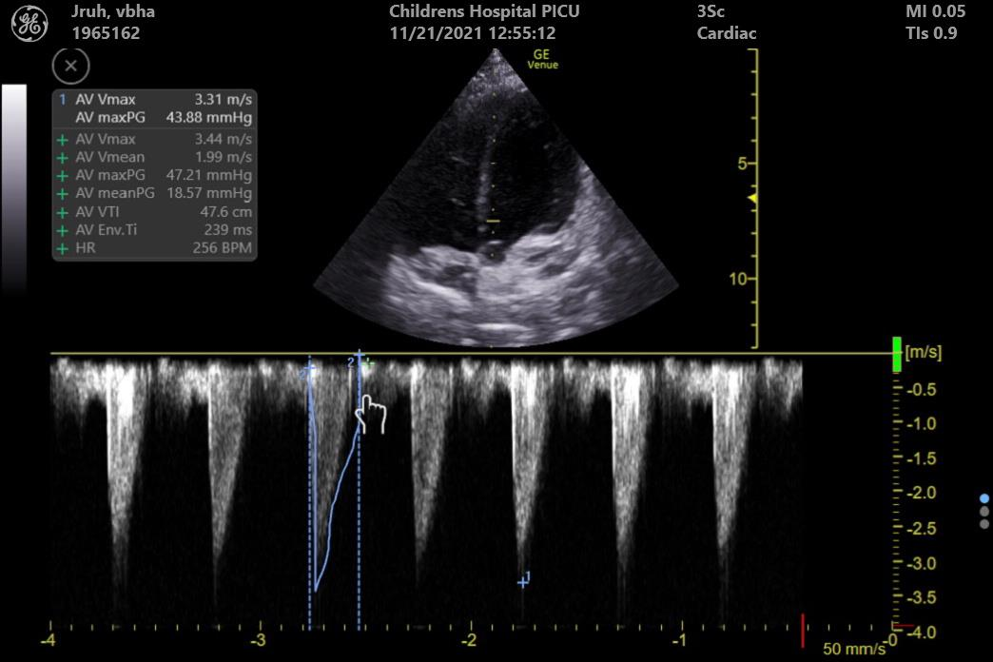
Aortic blood flow variability – Image interpretation
Notes:
Same limitations if technique as the previous one.

Slide 42
Velocity Time Integral (VTI)
Velocity Time Integral:
Doppler ultrasound measurement of blood flow, equivalent to the area under the velocity time curve.
VTI (cm/stroke) X cross sectional area of aortic valve (cm2) = Stroke volume
Stroke volume can then be used to calculated cardiac output
Change in VTI predicts volume responsiveness

Slide 43
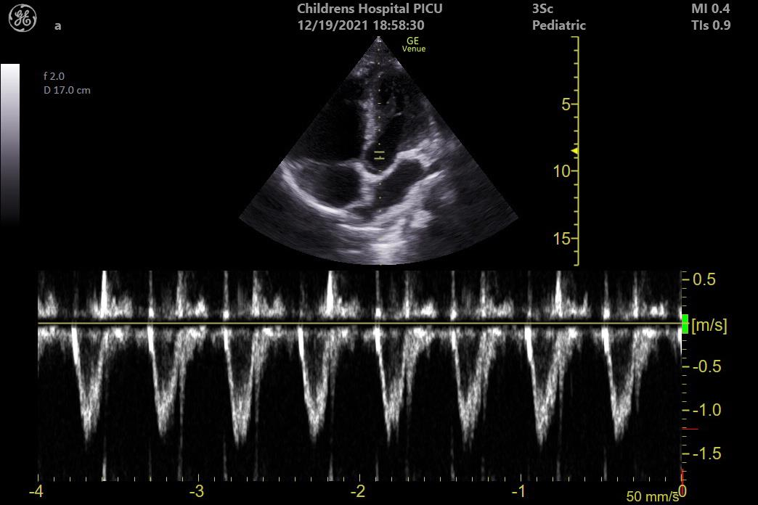

Velocity time integral tracing

Slide 44
Dynamic measurements for volume responsiveness
Echo parameter | AUROC | N | Setting | Study
△V_{peak} | 0.80 0.83 0.85 1.00 1.00 0.92 | 33 21 26 19 11 27 | NEURO OR, TTE CARDIAC PICU, TTE GENERAL PICU, TTE NEURO OR, TTE NEURO OR, TTE CARDIAC OR, TEE | Byon Choi Durand Pereira de Souza Pereira de Souza Renner
△VTI | 0.84 | 27 | Cardiac OR, TEE | Renner
△IVCD | 0.37 0.85 | 33 21 | Neuro OR, TTE Cardiac PICU, TTE | Byon Choi
△CI_{PLR} | 0.71 | 40 | General PICU, TTE | Lukito
△SV_{PLR} | 0.75 | 40 | General PICU, TTE | Lukito
Abbreviations: △V_{peak –} Change in peak aortic velocity; △VTI – Change in velocity time integral; △IVCD – IVC diameter change; △CI_{PLR –} Change in cardiac index with passive leg raise; △SV_{PLR –} Change in stroke volume with passive leg raise

Slide 45
Volume assessment – Take away
Using IVC for volumetric assessment – All hope is not lost.
Dynamic variables of volumetric assessment are more reliable than static variables.
Interpret images in the context of patient’s history.
Avoid premature closure.
Be wary of pitfalls.

Slide 46
SCAN ON!!
Questions?

