Slide 1
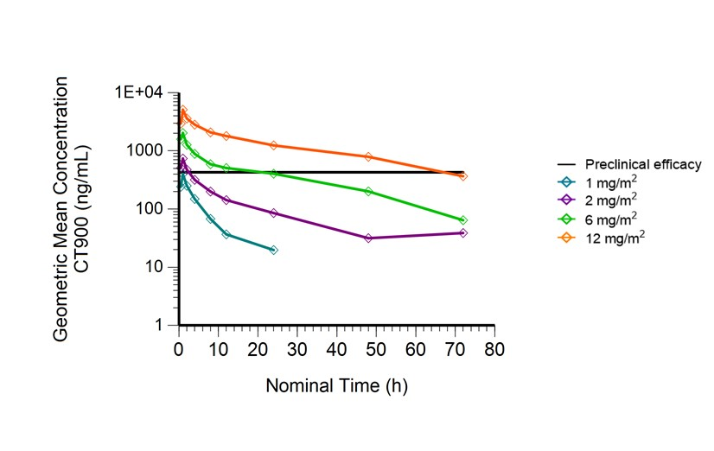
Supplementary Figure 2
Plasma concentration v time profiles from dose escalation phase following IV administration of CT900, Cycle 1 day 1
Plasma levels of >600 nM for more than 65 h was achieved.

