Slide 1
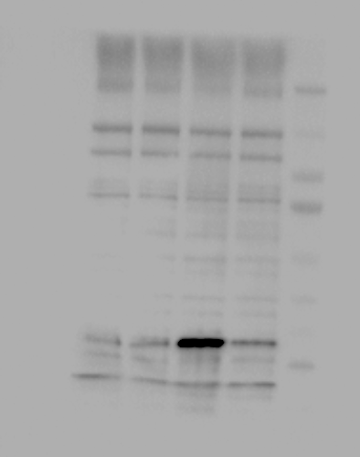
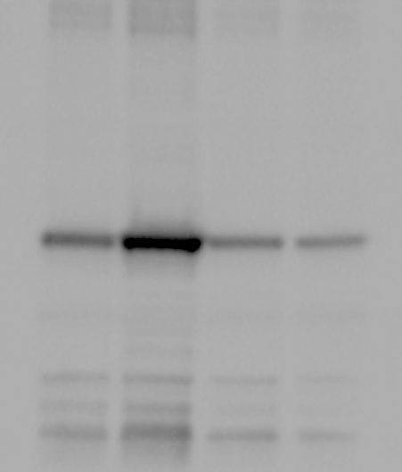
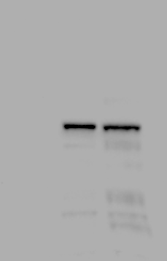
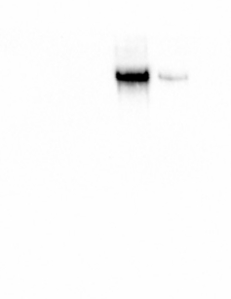
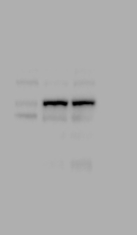
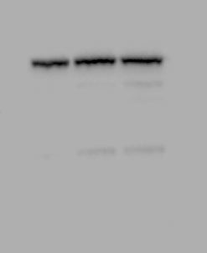
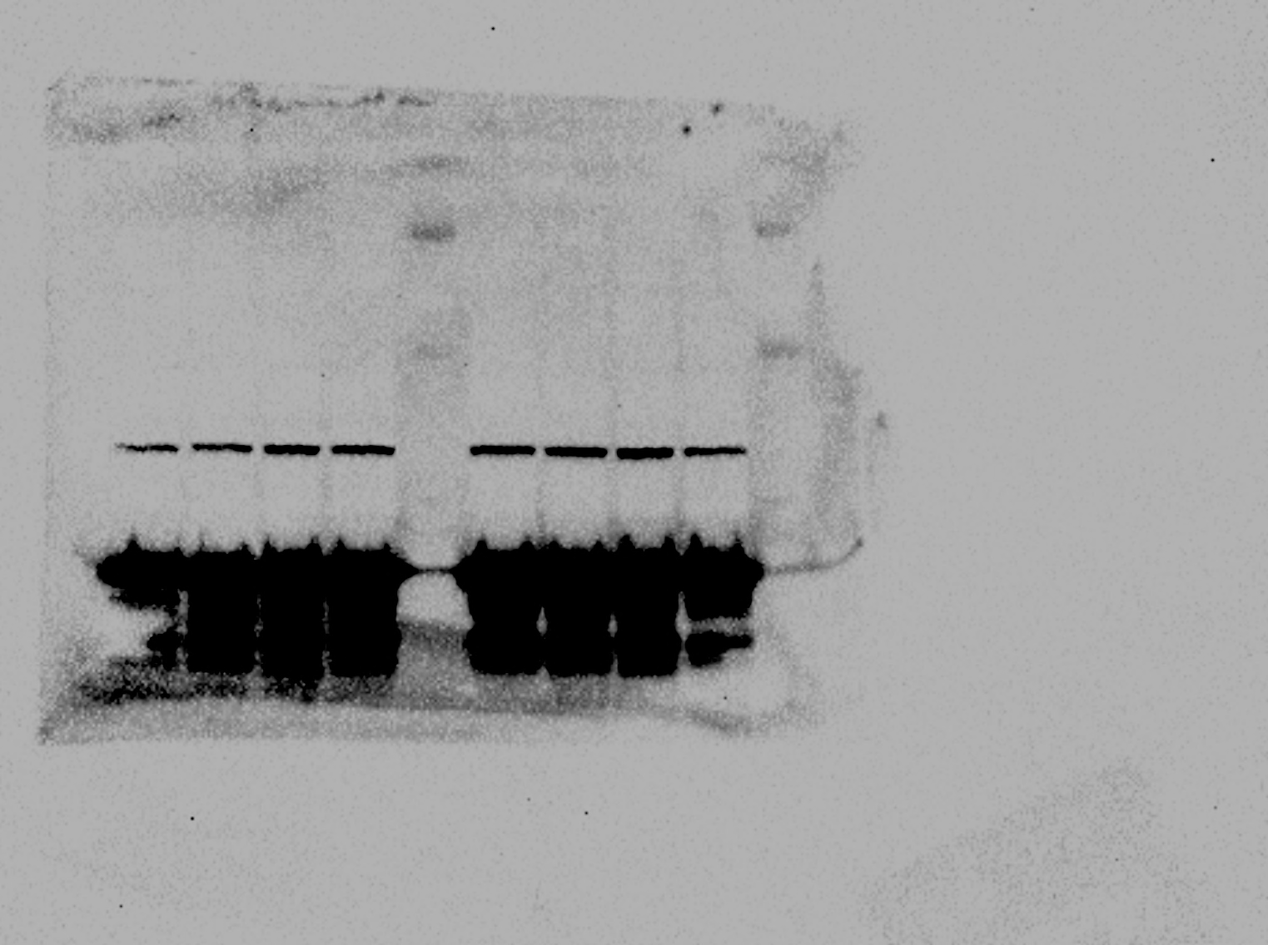
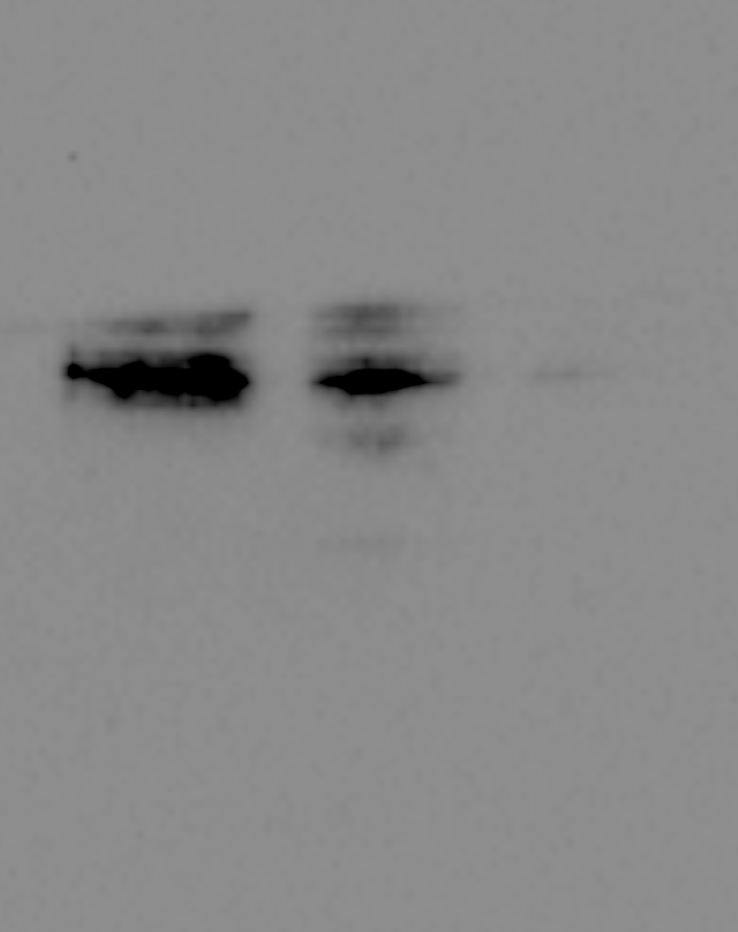
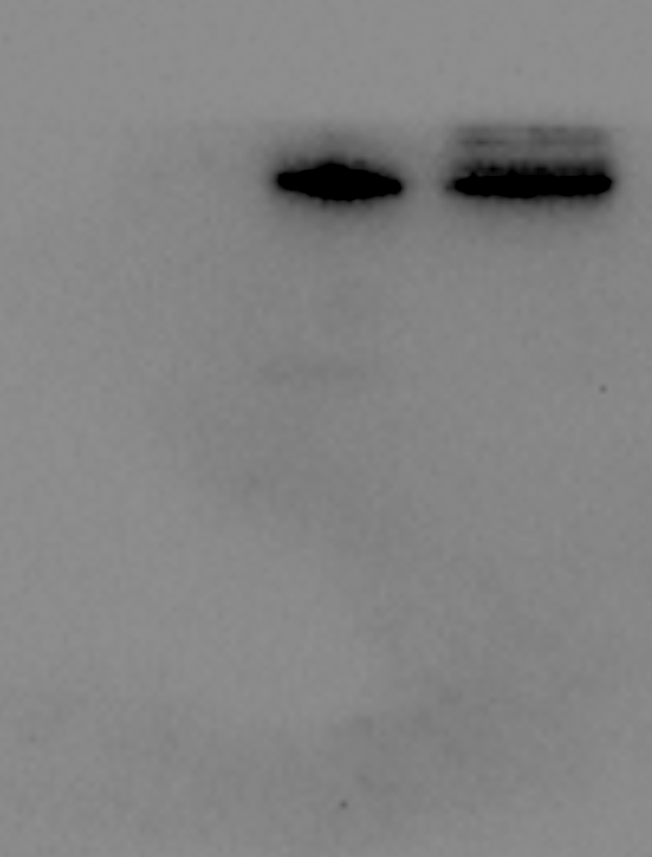
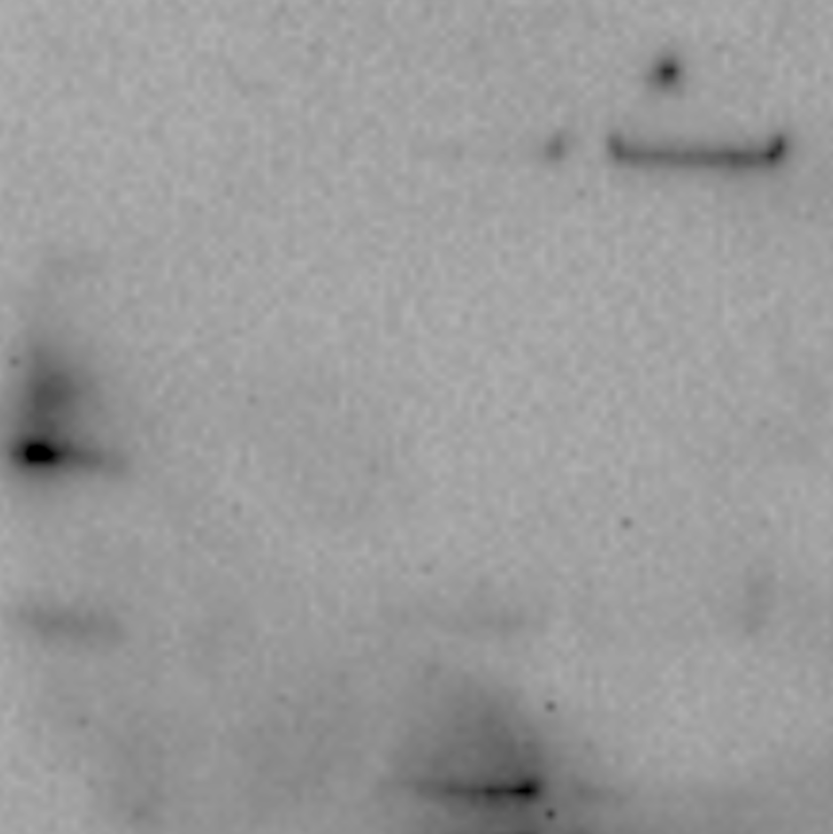
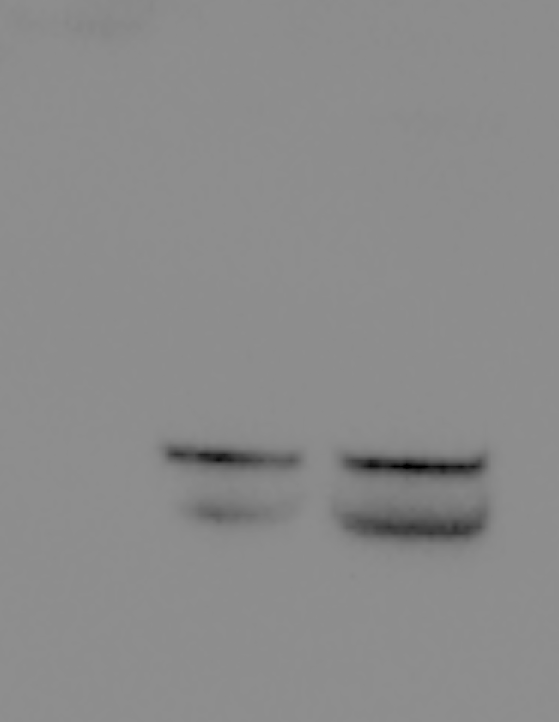
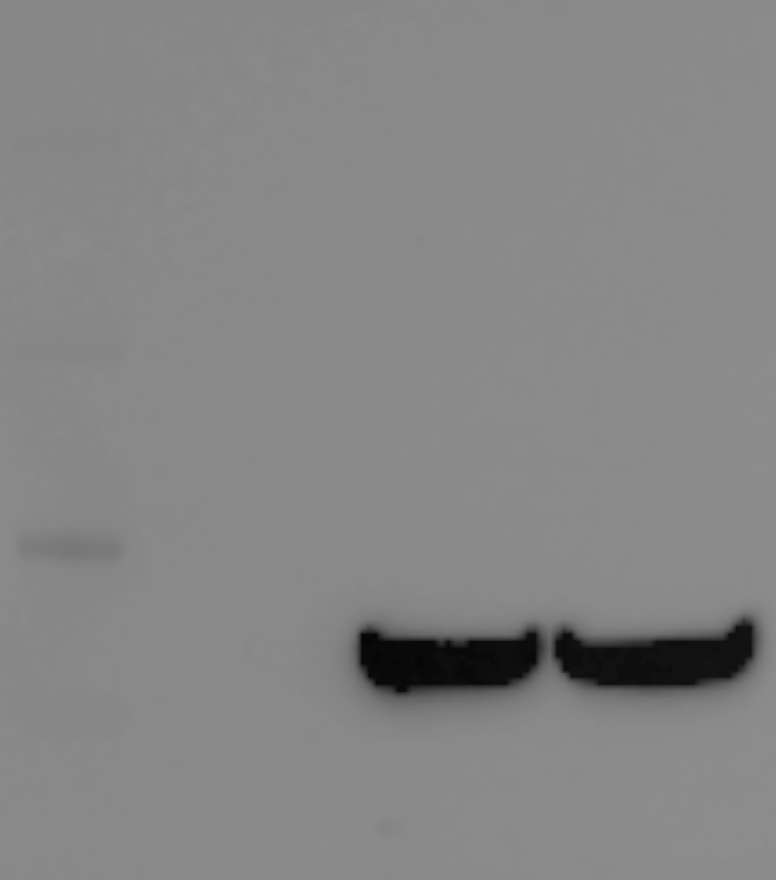
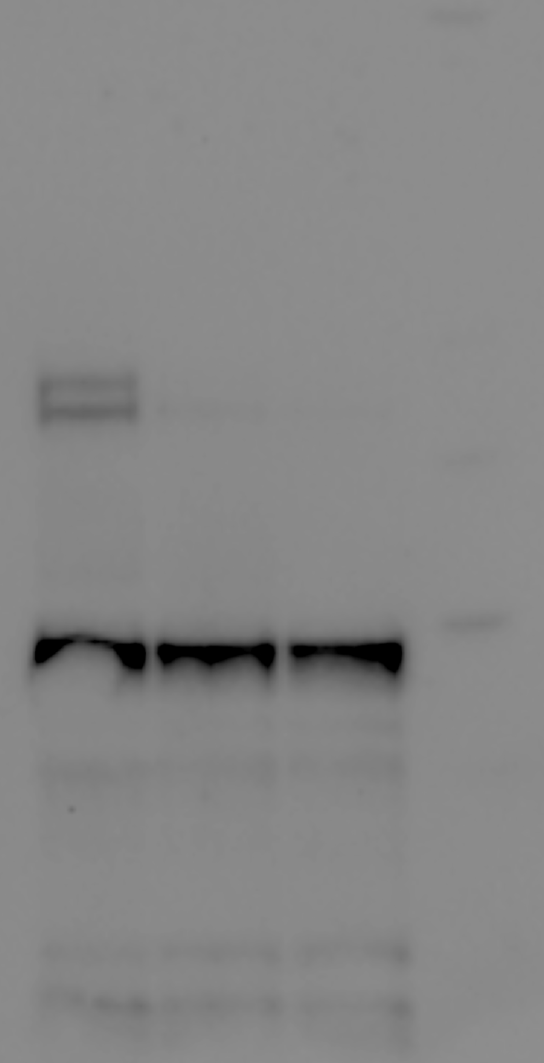
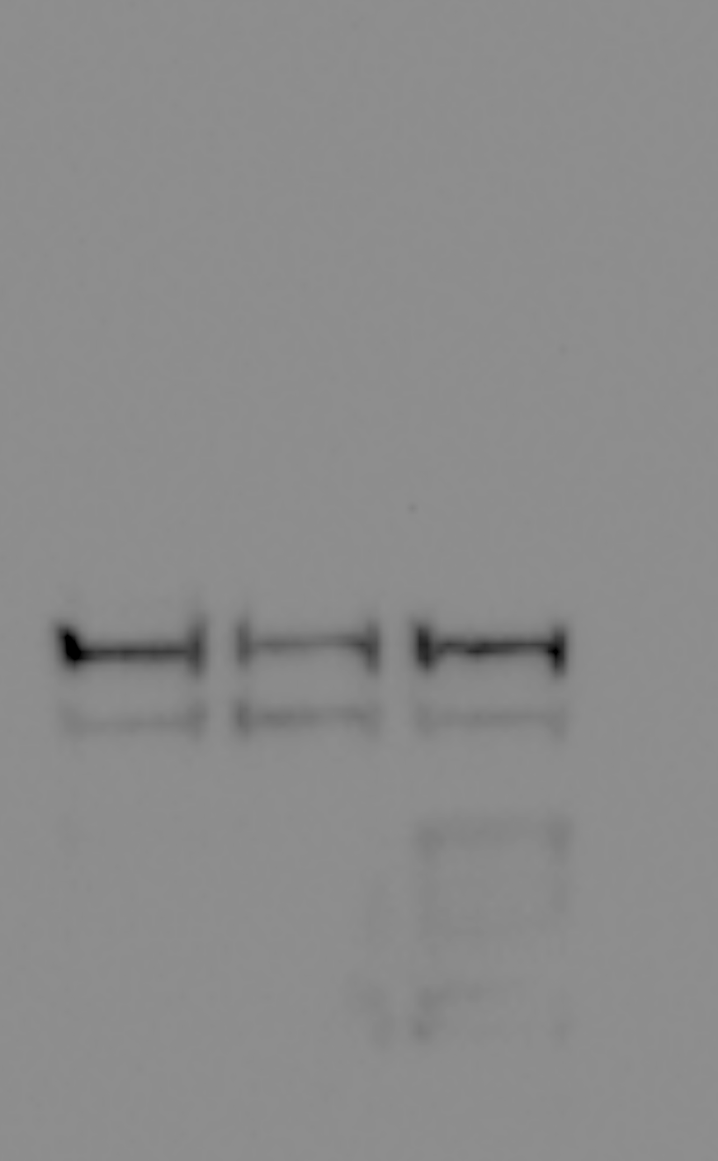
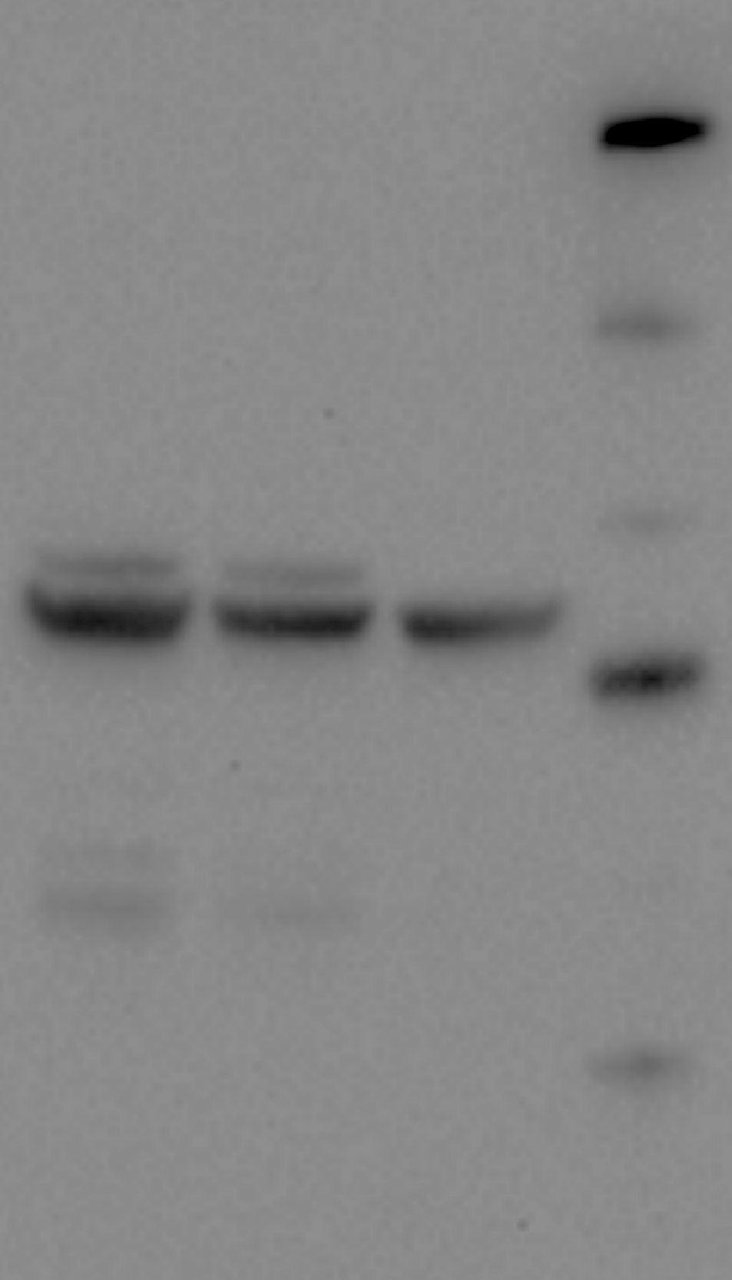
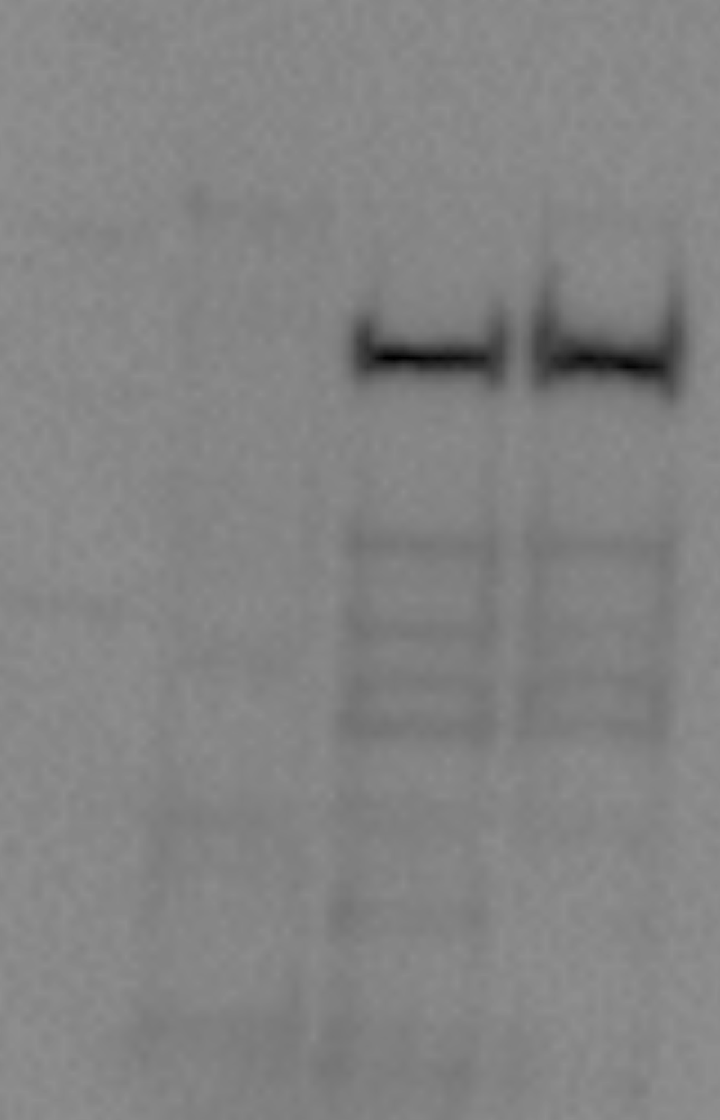
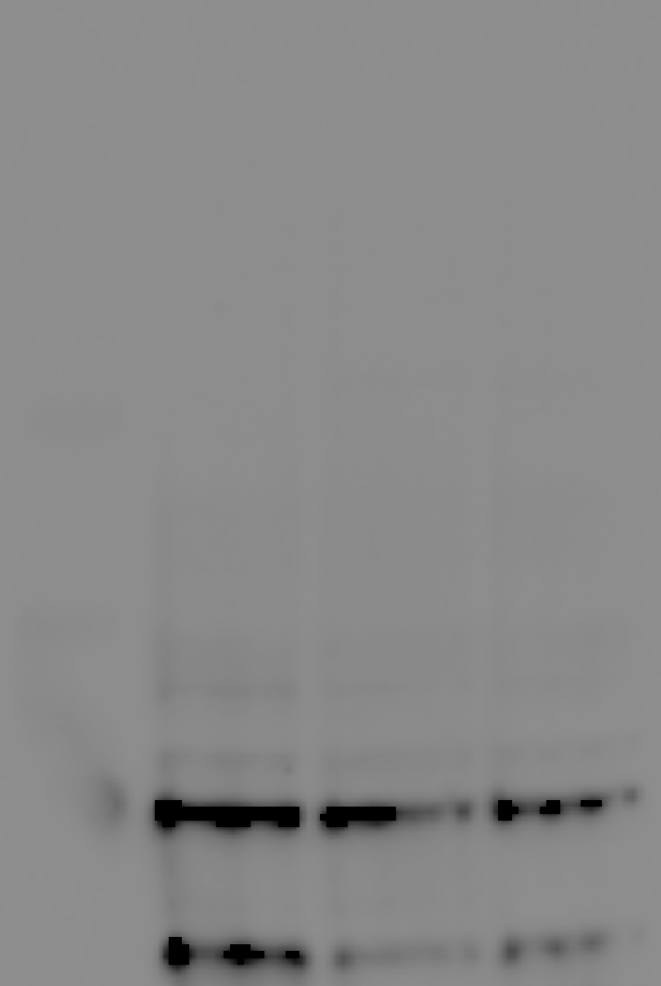
Supplementary figures
Figure 2D
Figure 2G
IP: FLAG
Lysate
HSP26
HSP42
GFP
GFP
FLAG
FLAG
Figure 2H
IP: FLAG
PGK1
GAPDH
Ydj1
Rnr2
HA
FLAG
Lysate
GAPDH
Ydj1
Rnr2
HA
FLAG

Slide 2
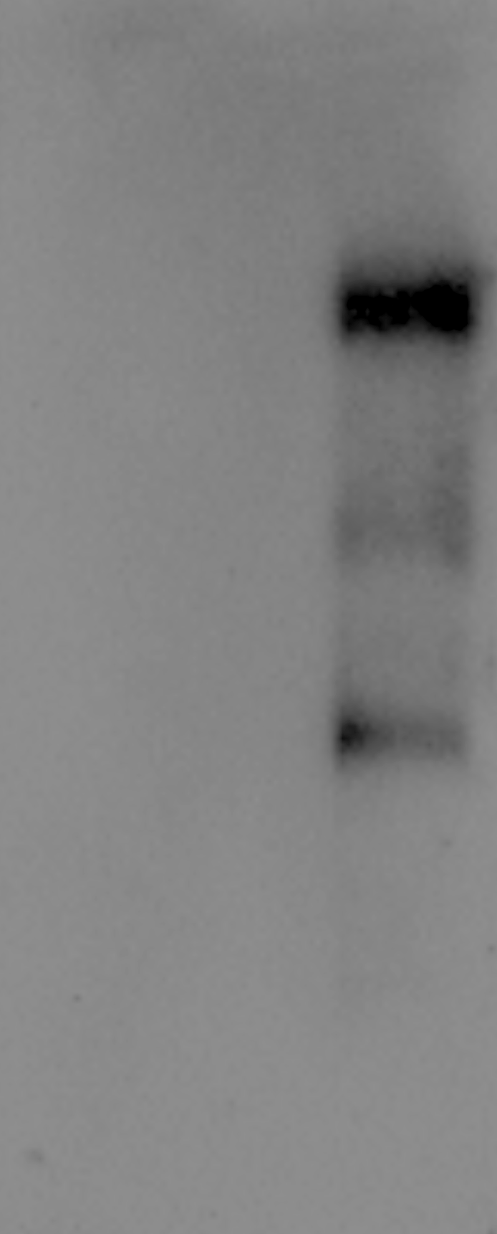

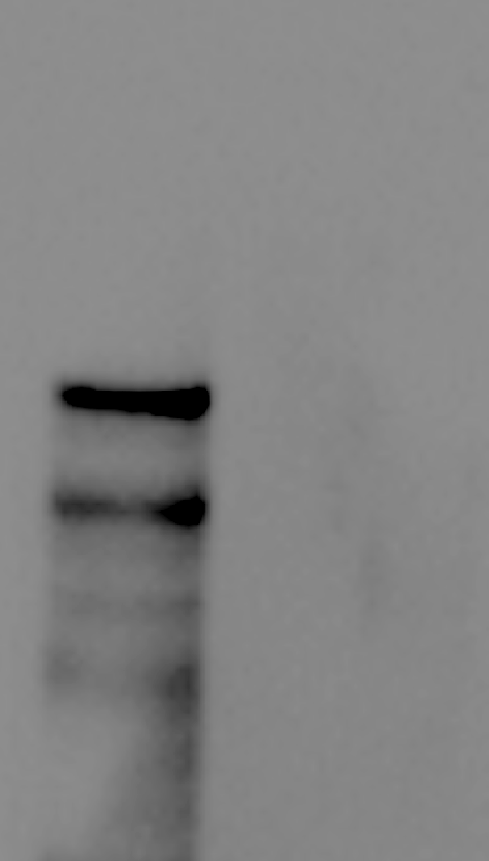
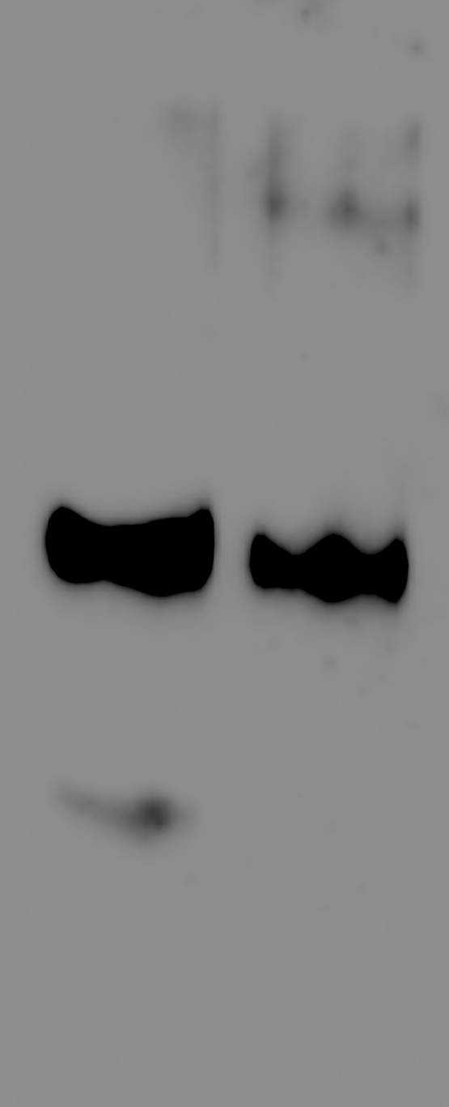



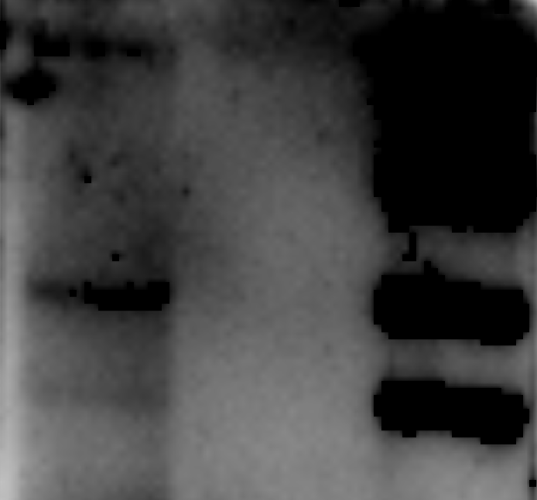
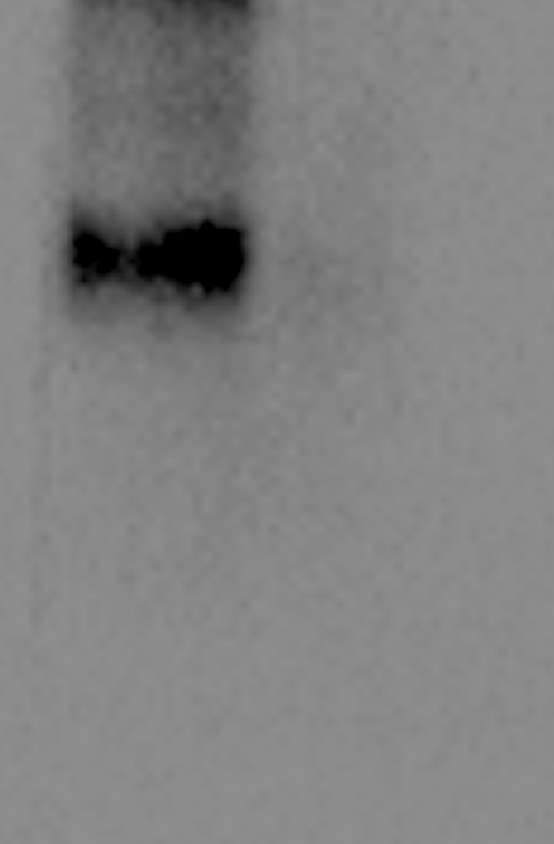
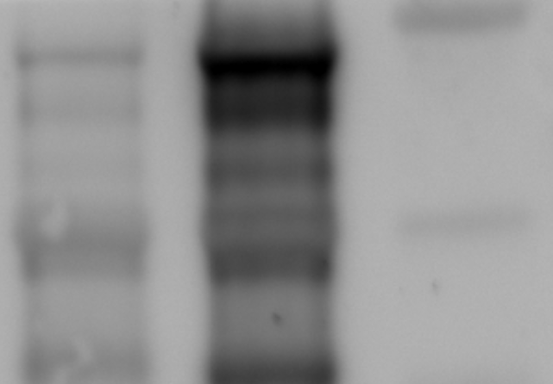
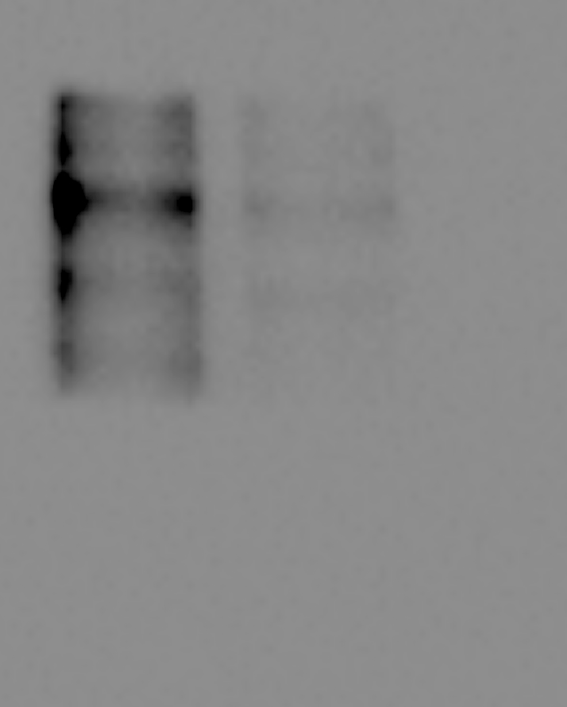
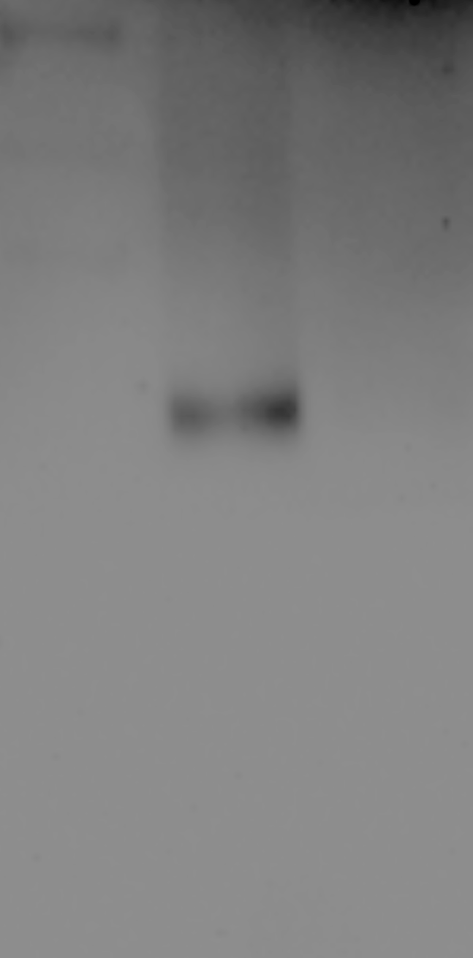
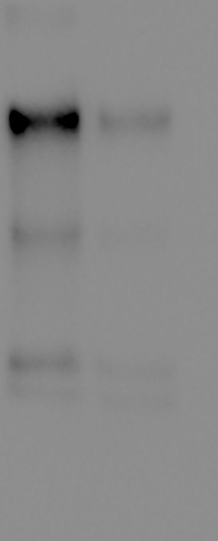
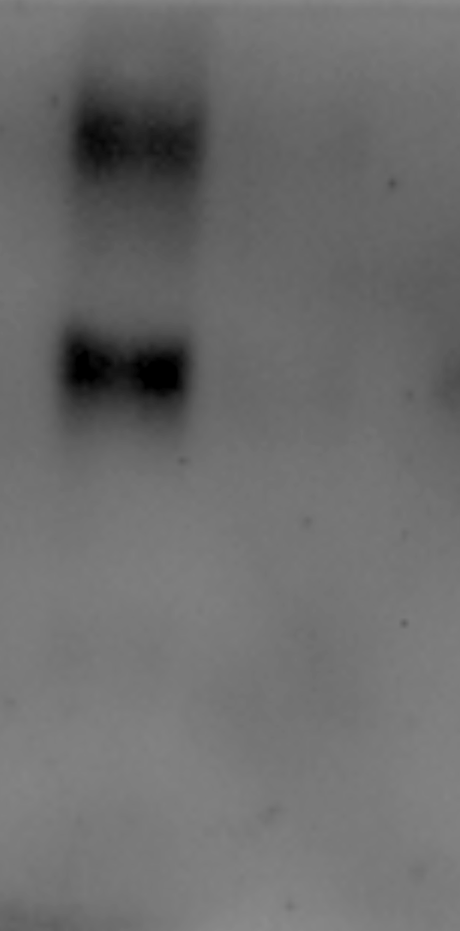
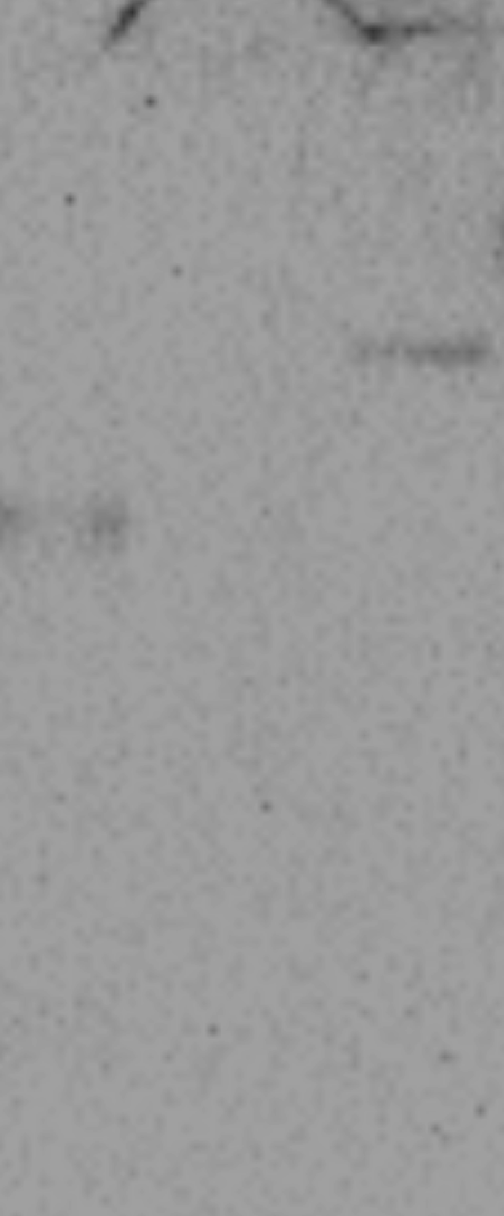
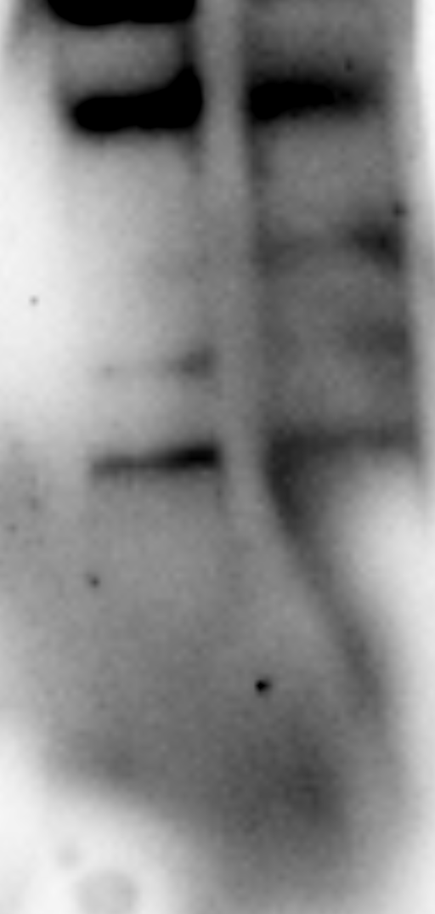
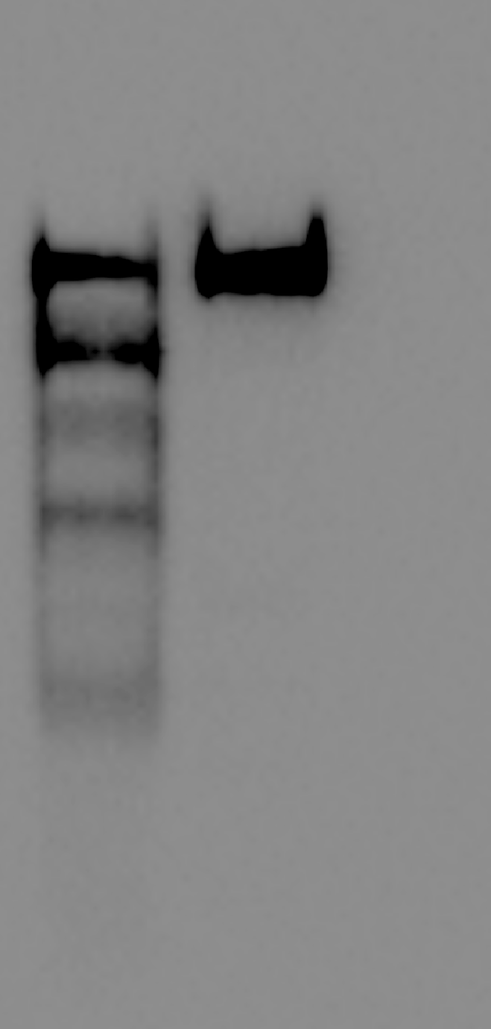

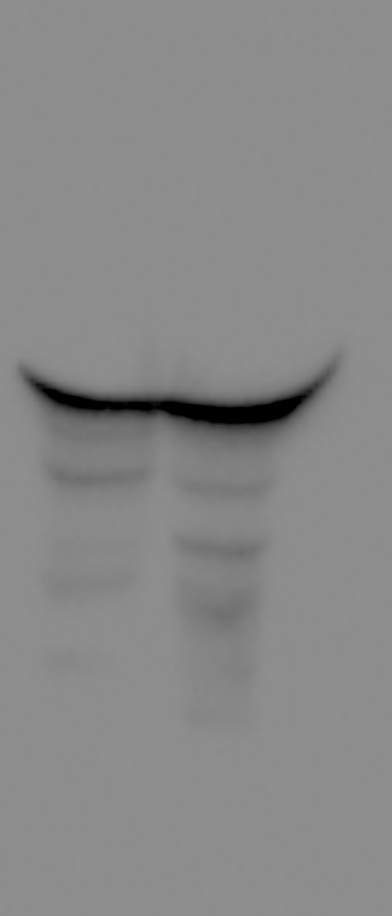
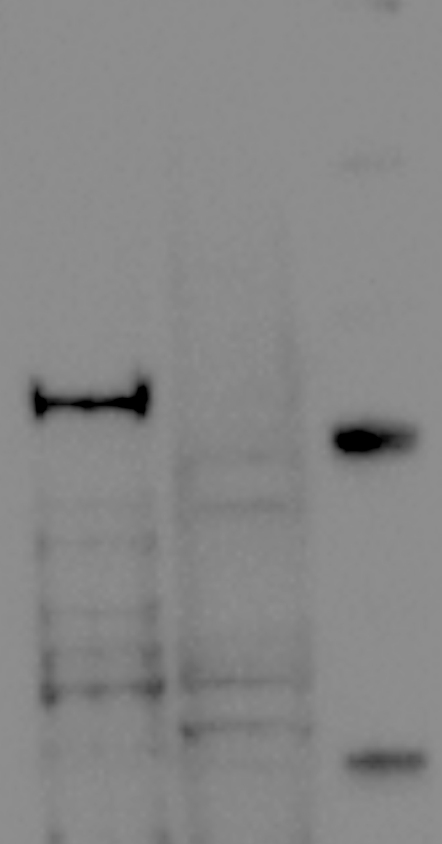
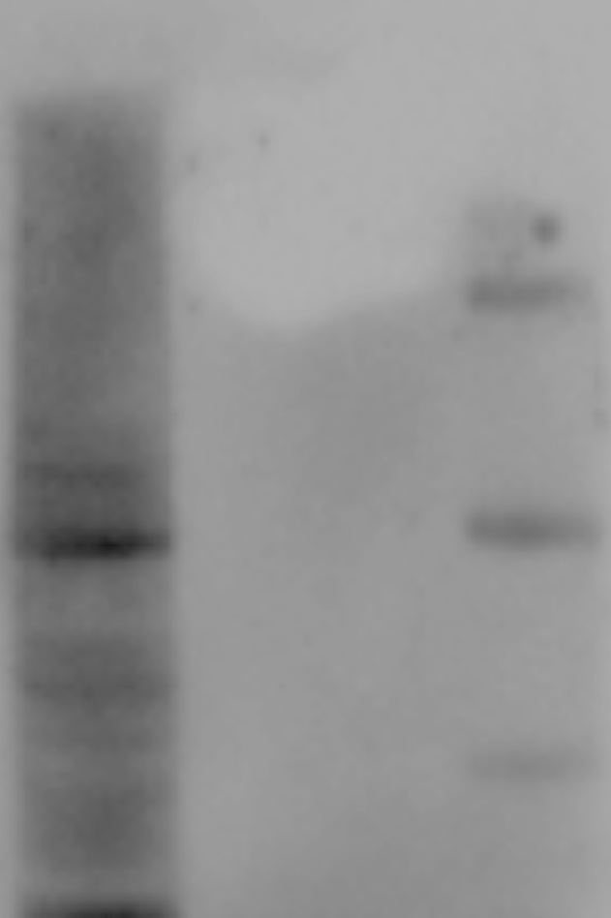

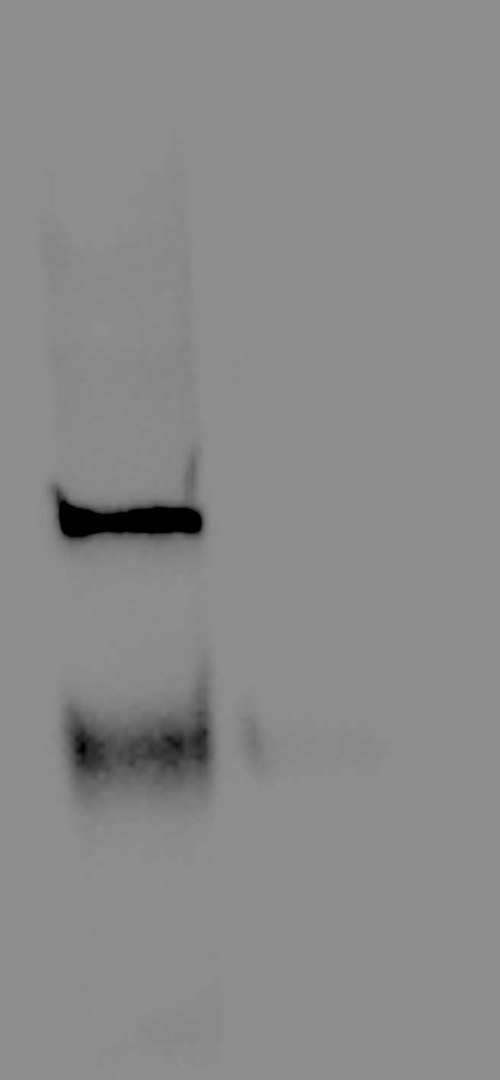
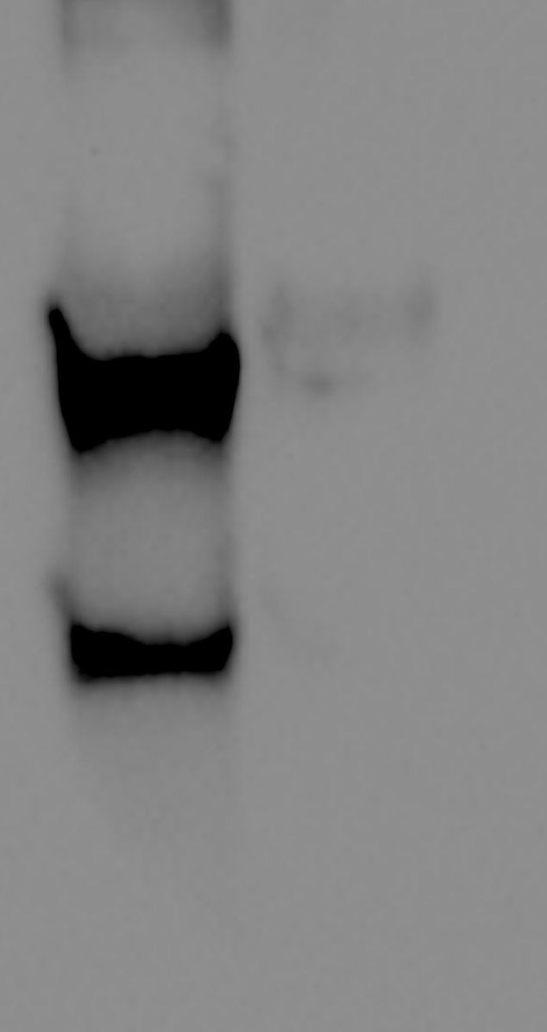
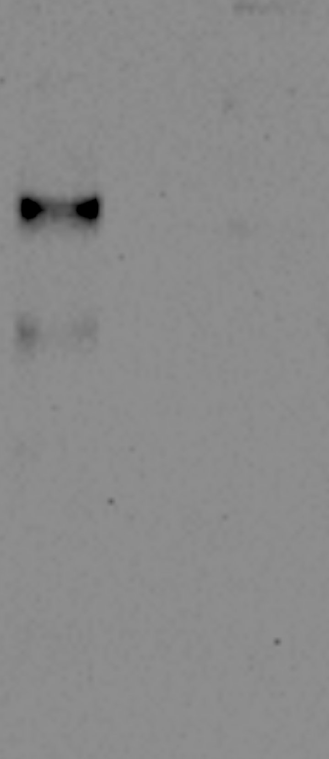

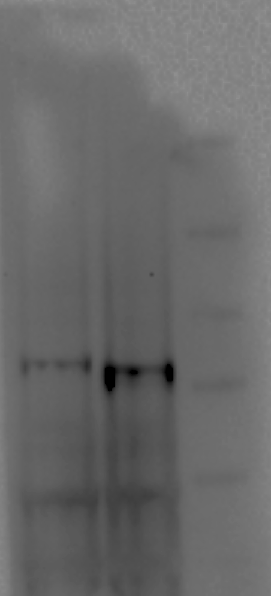
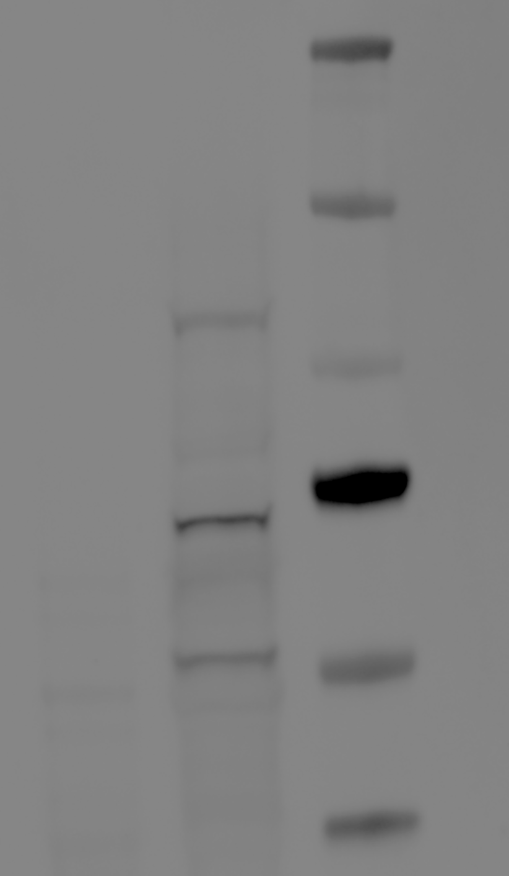

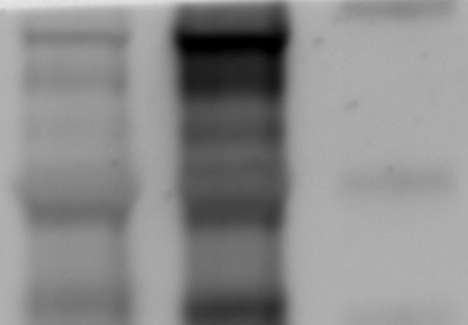
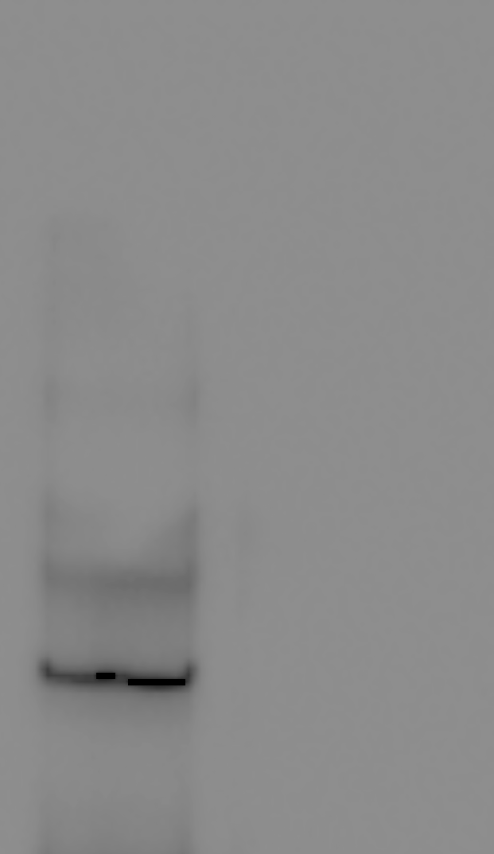
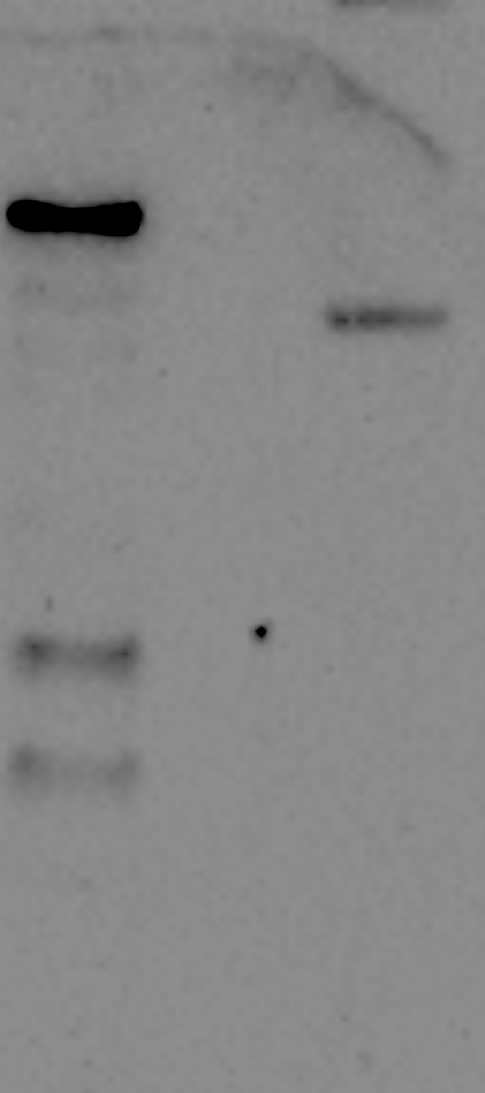
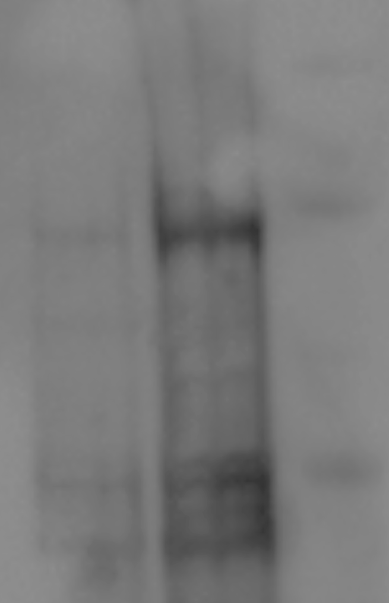

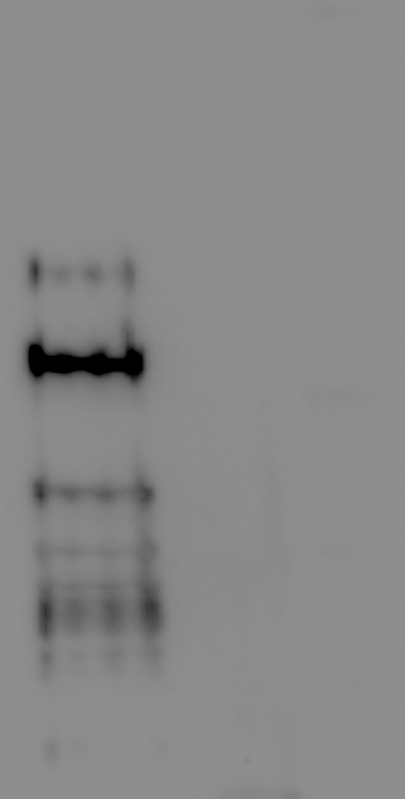
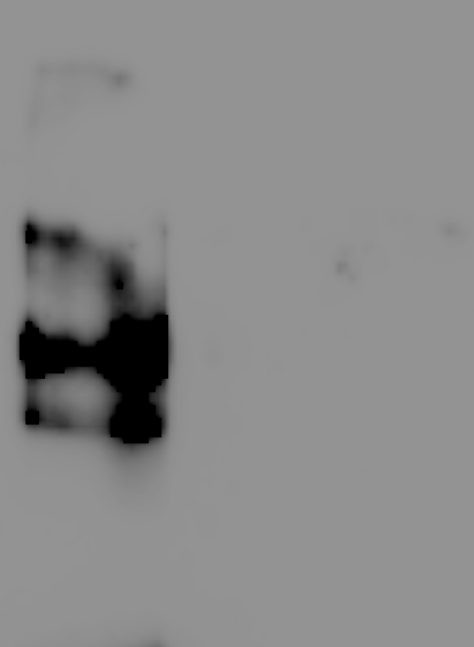
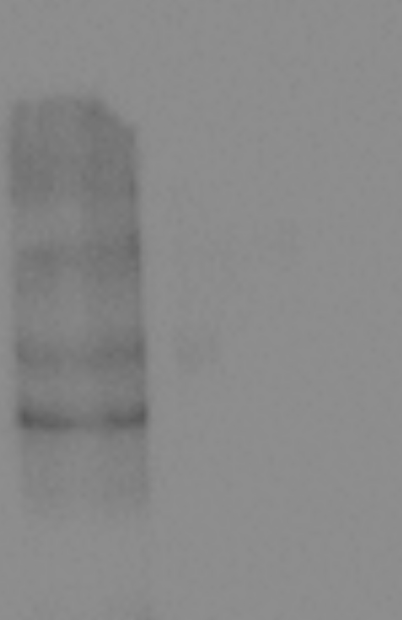
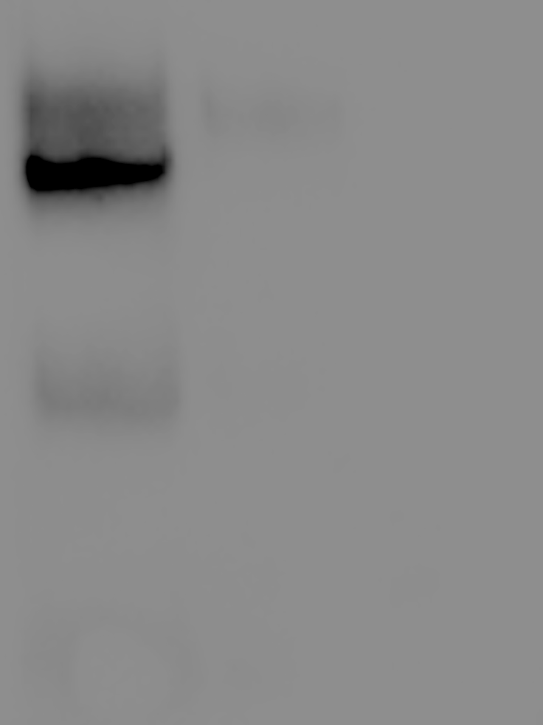
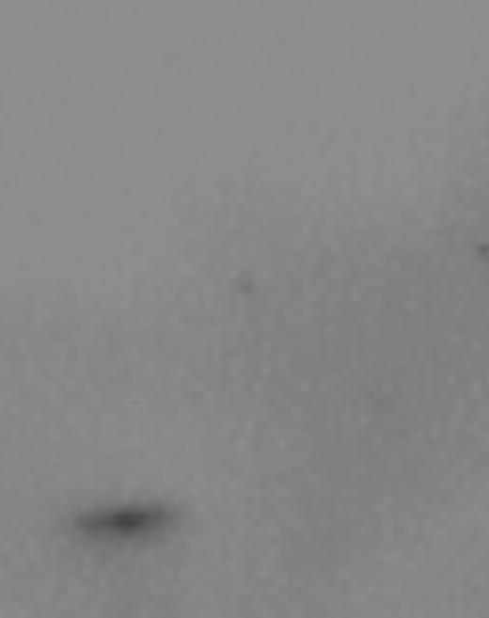
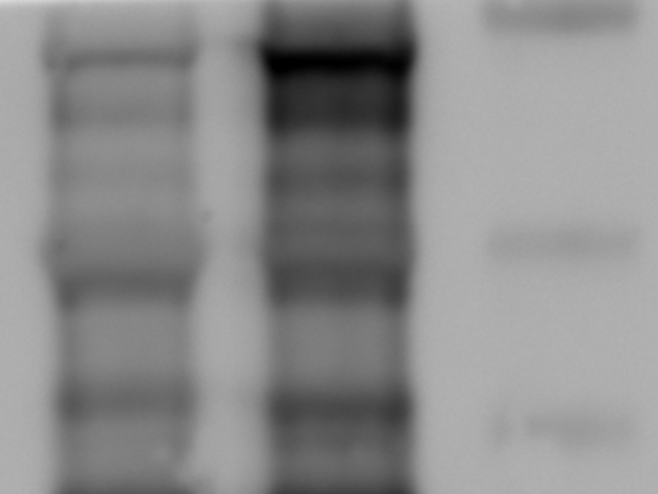
Figure 3C
Cct8
IP: HA
Lysate
Sse1
Hsp82
Ssa1
Ydj1
HA
Sse1
Hsp82
Ssa1
Ydj1
HA
Pcl7
IP: HA
Lysate
Sse1
Hsp82
Ssa1
Ydj1
HA
Sse1
Hsp82
Ssa1
Ydj1
HA
Ura8
IP: HA
Lysate
Sse1
Hsp82
Ssa1
Ydj1
HA
Sse1
Hsp82
Ssa1
Ydj1
HA
Sse1
IP: HA
Lysate
Sse1
Hsp82
Ssa1
Ydj1
HA
Sse1
Hsp82
Ssa1
Ydj1
HA

Slide 3
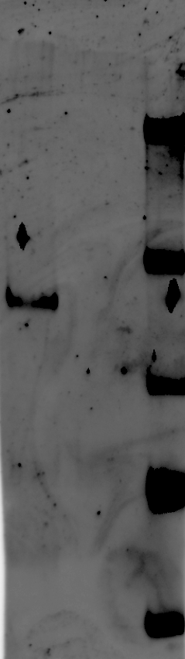
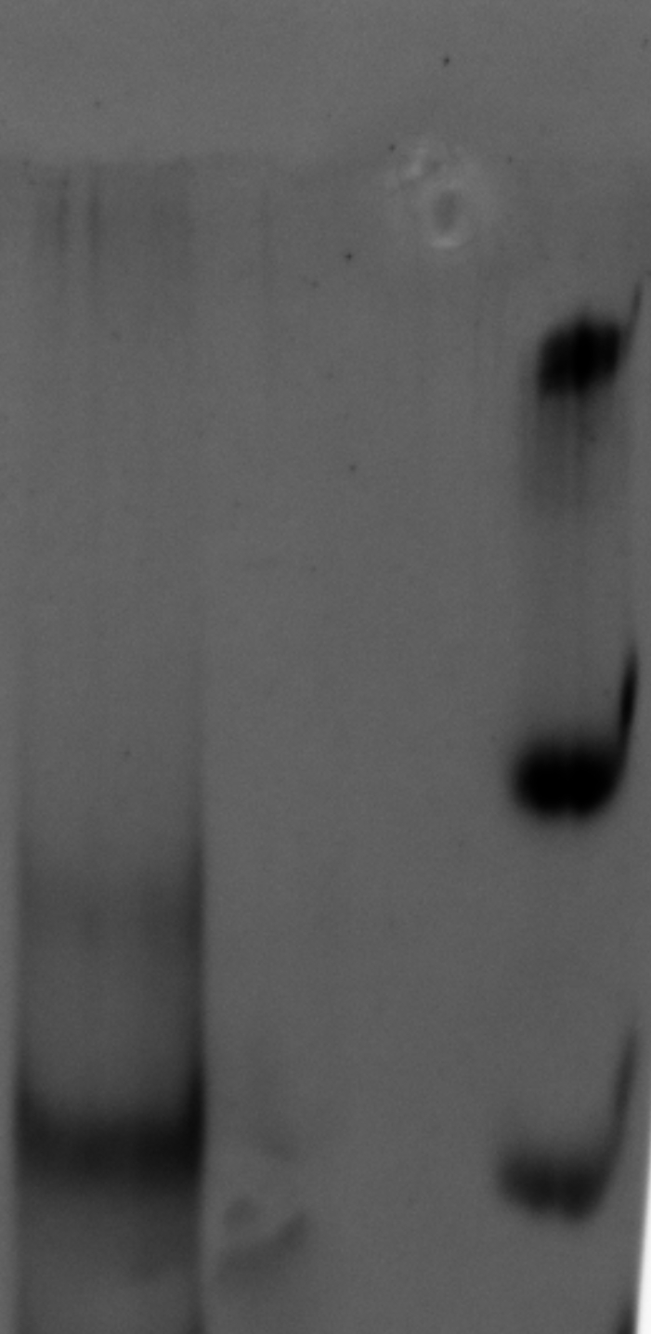








































Figure 4
C
Hir1
IP: HA
Lysate
Sse1
Hsp82
Ssa1
Ydj1
HA
Sse1
Hsp82
Ssa1
Ydj1
HA
C
Hir2
IP: HA
Lysate
Sse1
Hsp82
Ssa1
Ydj1
HA
Sse1
Hsp82
Ssa1
Ydj1
HA
D
E
Hsp110
Hsp90
Hsc70
Dnaja1
HA
Hsp110
Hsp90
Hsc70
Dnaja1
HA
F

Slide 4






































Figure 5
C
Pim1
IP: GFP
Lysate
Sse1
Hsp82
Ssa1
Ydj1
Pim
Sse1
Hsp82
Ssa1
Ydj1
Pim1
D
LONP-1
IP: Flag
Lysate
IP:FLAG
Lysate
Flag
Hsp70
DNAJA1
Hsp90
Hsp110
Flag
Hsp70
DNAJA1
Hsp90
Hsp110
E
I
Lonp-1
GFP
Ssa1
Actin
Hsp82
HSC70
Ydj1
H
J
V5
HIS
PGK1
GFP

Slide 5






































Figure 6
C
Mtw1
IP: Flag
Lysate
Sse1
Hsp82
Ssa1
Ydj1
Flag
Sse1
Hsp82
Ssa1
Ydj1
Flag
IP: GFP
Lysate
D
GFP
Actin
E
Mis12
IP: GFP
Lysate
Hsp110
Hsp90
Hsc70
Dnaja1
GFP
Hsp110
Hsp82
Hsc70
Dnaja1
YFP
F
J
IP: GFP
JG-98
Bortezomib
JG-98+BZ
GFP
Hsc70
Hsp82
Ssa1
Ydj1
YFP
Lysate
Actin
Hsp82
Ssa1
Ydj1
YFP

Slide 6






Figure 7E
Figure 7I
HA
HA
Ssa1
Ssa1
Ydj1
Ydj1

Slide 7



Figure S3C
Pim1-GFP
Ssa1
Pgk1

