Slide 1
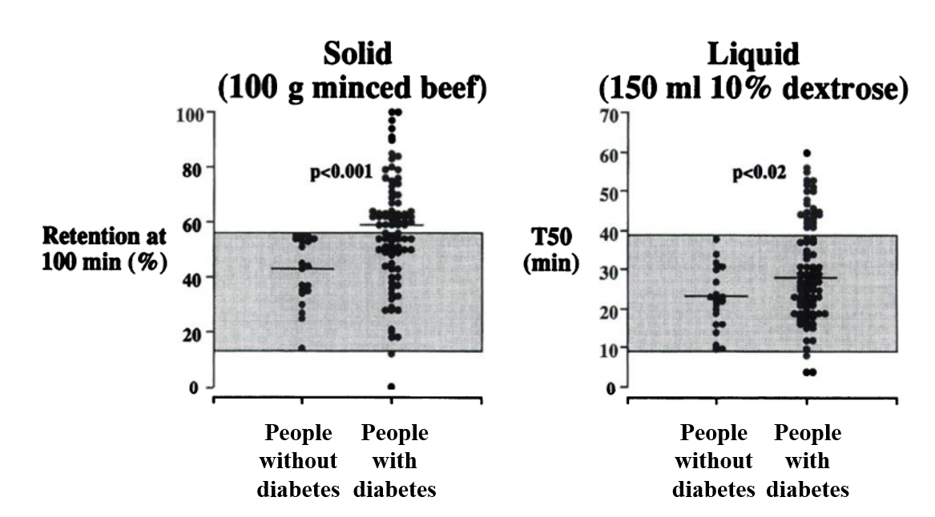
Gastric emptying of solid and liquid nutrients in participants with long-standing type 1 or type 2 diabetes and healthy control participants
Jalleh et al (2022) Diabetologia DOI 10.1007/s00125-022-05796-1
Adapted from Jones et al [8]. © SNMMI

Slide 2
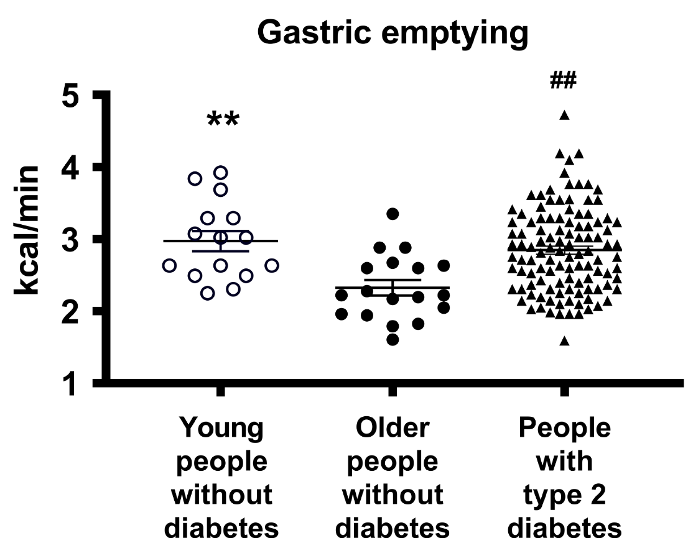
Gastric emptying of a mashed potato meal in people with type 2 diabetes, and in young and older control participants without diabetes, as assessed by ¹³C-octanoic acid breath test
Jalleh et al (2022) Diabetologia DOI 10.1007/s00125-022-05796-1
Adapted from Watson et al [4] by permission of Oxford University Press on behalf of the Endocrine Society. © The Endocrine Society

Slide 3
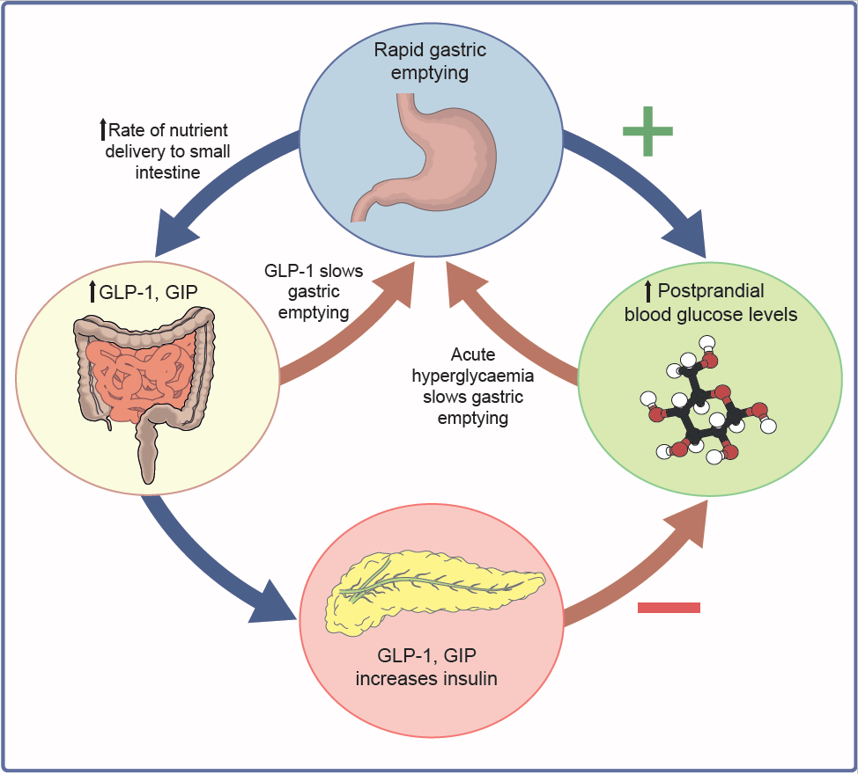
Schema of the interdependent relationships of gastric emptying, incretin hormones and blood glucose
Jalleh et al (2022) Diabetologia DOI 10.1007/s00125-022-05796-1
©The Authors 2022. Distributed under the terms of the CC BY 4.0 Attribution License (http://creativecommons.org/licenses/by/4.0/)

Slide 4
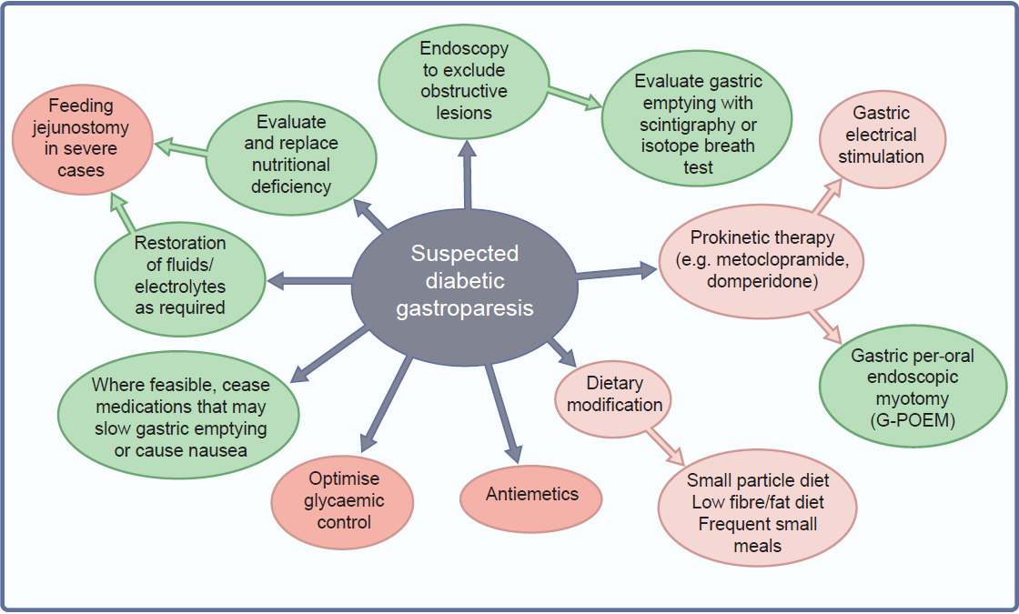
Recommended management of suspected diabetic gastroparesis
Jalleh et al (2022) Diabetologia DOI 10.1007/s00125-022-05796-1
©The Authors 2022. Distributed under the terms of the CC BY 4.0 Attribution License (http://creativecommons.org/licenses/by/4.0/)

