Slide 1
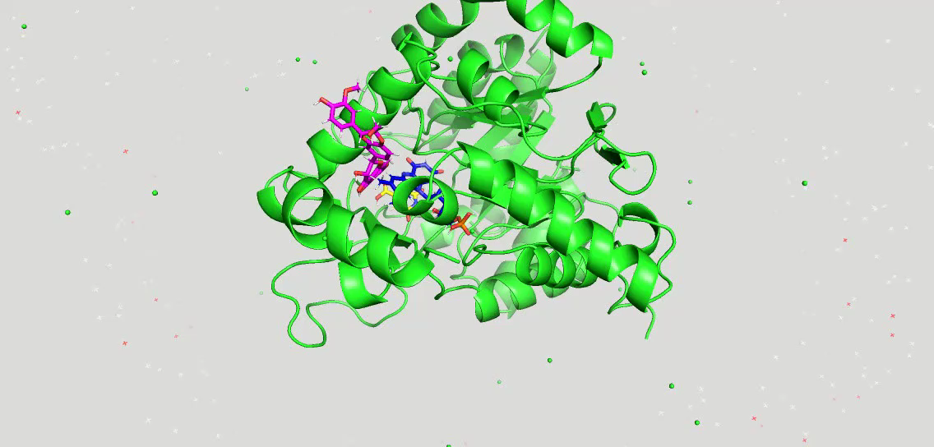
Video 1. MD Simulation animation of 200 snapshots between 0 and 100 ns of hDHODH & silibinin (magenta)

Slide 2
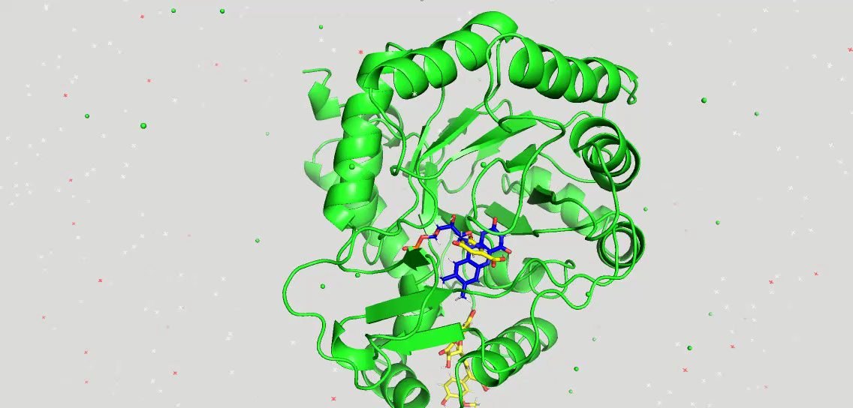
Video 2. MD Simulation animation of 200 snapshots between 0 and 100 ns of hDHODH & silychristin B (yellow)

Slide 3
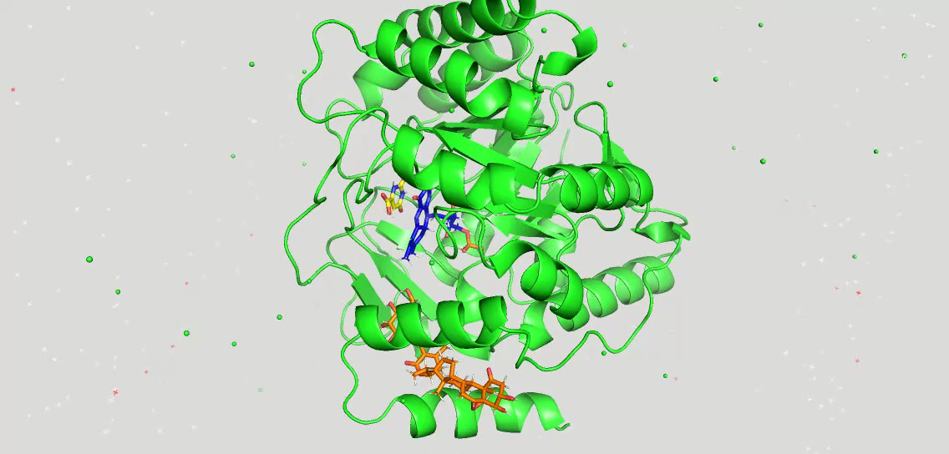
Video 3. MD Simulation animation of 200 snapshots between 0 and 100 ns of hDHODH & 27-O-β-D-glucopyranosyl viscosalactone B (orange)

Slide 4
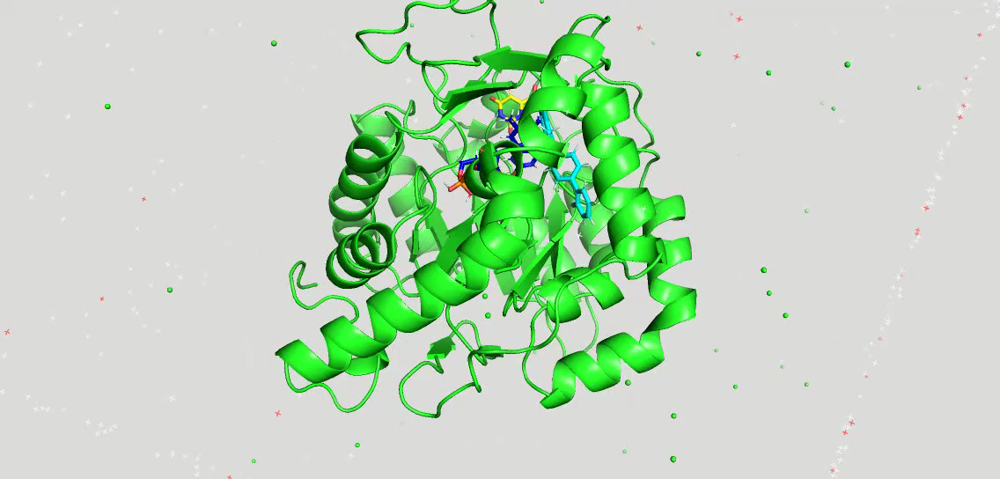
Video 4. MD Simulation animation of 200 snapshots between 0 and 100 ns of hDHODH & brequinar (turquoise)

