Slide 1
Fig2. Forest plots of sociodemographic-related predictors of remission of RA in patients treated with biologics: A, Age >50-year-old. B, female gender. C, BMI >30 kg/m². D, smoking history. E, HAQ score >2. F, presence of comorbidities
Figure in slide 2

Slide 2
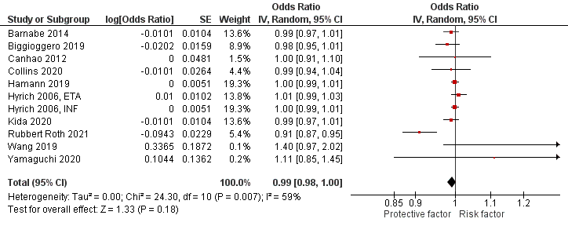
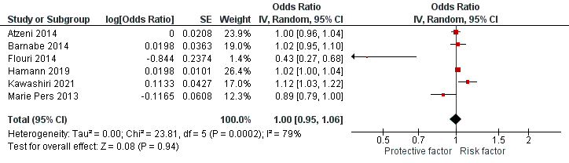
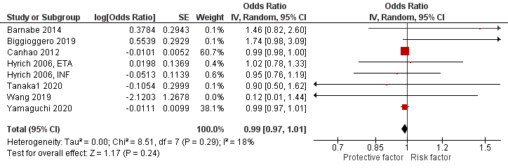
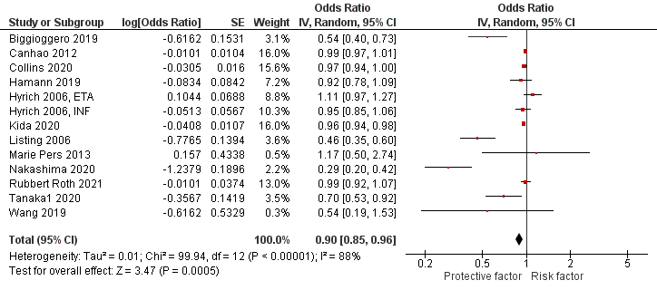
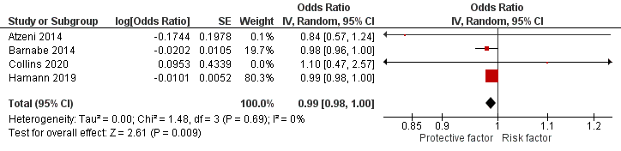
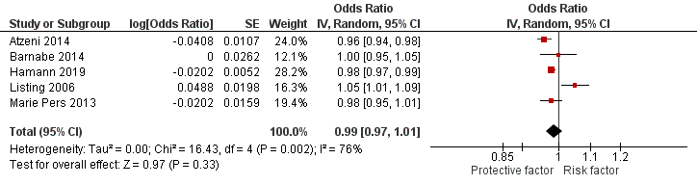
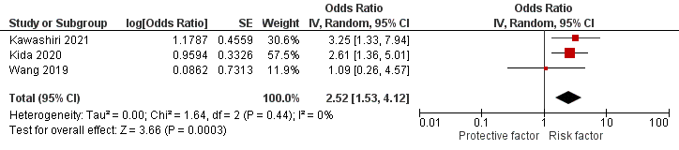
A
D
E
B
F
C
G

Slide 3
Fig3. Forest plots of disease-related predictors of remission in RA patients treated with biologics: A, Disease duration >=10 years. B, DAS28 at time of diagnosis >= 3.2. C, TJC28 >=10. D, SJC28 >=7. E, positive RF. F, ESR >20 mm/hour. G, positive ACPA
Figure in slide 4

Slide 4
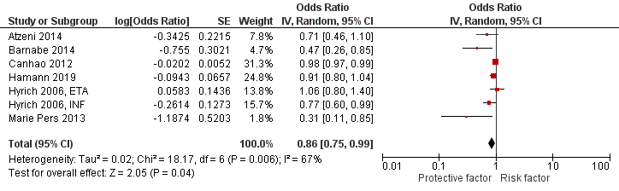
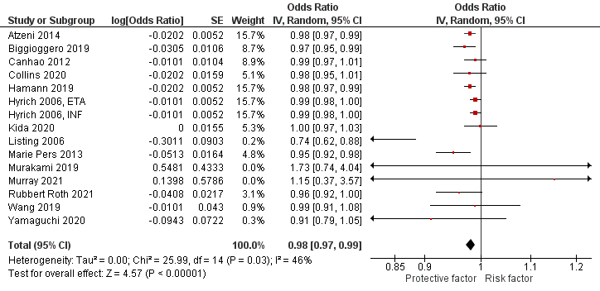
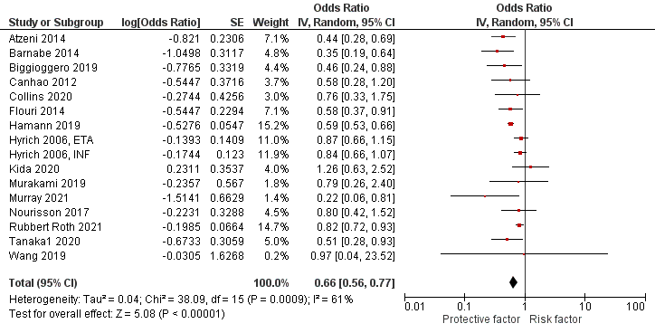
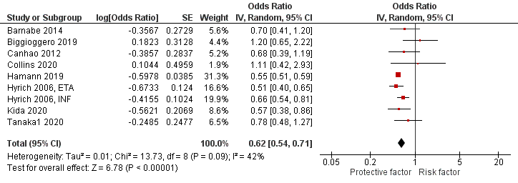
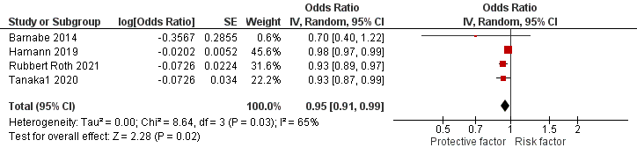
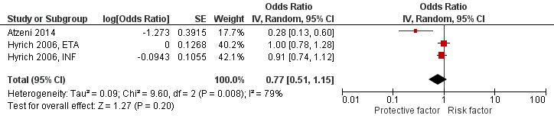
A
D
B
E
F
C

Slide 5
Fig4. Forest plots of treatment-related predictors of remission in RA patients treated with biologics: A, prior or concurrent use of MTX. B, prior or concurrent use of steroids
Figure in slide 6

Slide 6
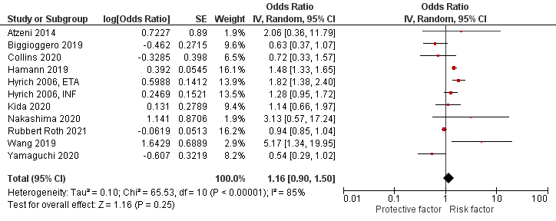
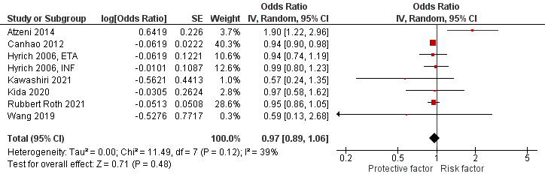
A
B

Slide 7
Fig5. Forest plots for predictors of remission in RA patients treated with TNF-inhibitors alone: A, Age >50-year-old. B, female gender. C, smoking history. D, positive RF. E, prior or concurrent use of MTX. F, prior or concurrent use of steroids
Figure in slide 8

Slide 8
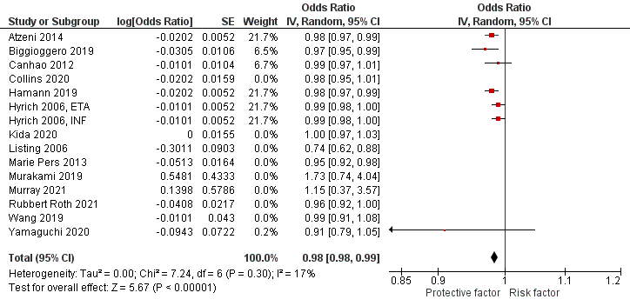
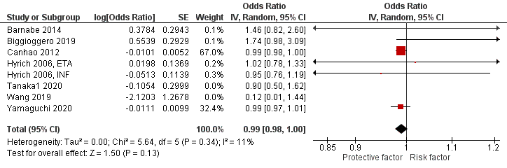
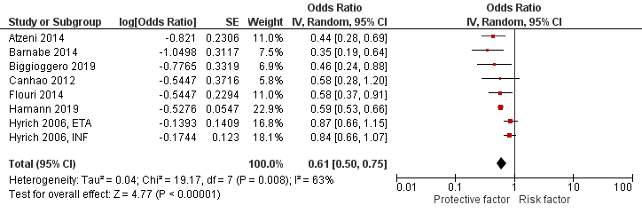
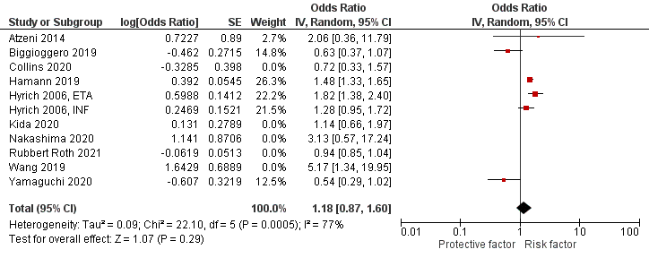
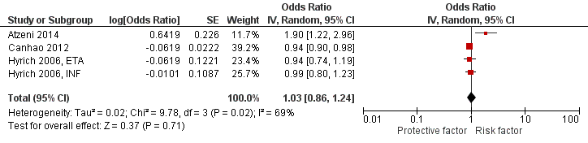
A
D
B
E
C
F

Slide 9
Supplementary Fig6. Sensitivity analysis for: A, age. B, female gender. C, disease activity. D, disease duration. E, prior use of MTX
Figure in slide 10

Slide 10
A
C
B
D
E

