Slide 1
Supplementary Dataset File for Manuscript:
Epithelial membrane protein 2 (EMP2) regulates hypoxia-induced angiogenesis in the adult retinal pigment epithelial cell lines
Michel Sun, Nina Cherian, Lucia Liu, Ann M. Chan, Brian Aguirre, Alison Chu, Jason Strawbridge, Esther S. Kim, Meng-Chin Lin, Irena Tsui, Lynn K. Gordon, Madhuri Wadehra

Slide 2
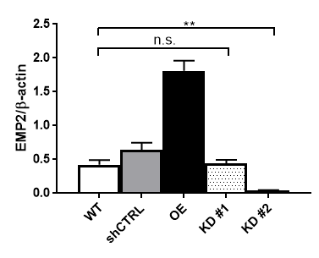
Figure S1
Figure S1: EMP2 expression in ARPE-19 panel under normoxic conditions. Quantification of EMP2 protein expression by densitometry, normalized to beta actin under normal oxygen conditions in WT, shCTRL, OE, shRNA KD #1, and shRNA KD#2 ARPE-19 cells, for a minimum of 3 independent replicates. Statistical significance was established using a Student’s t-test (unpaired, two-tailed).
Notes:
Supplemental Figure 1: EMP2 expression in ARPE-19 panel under normoxic conditions. Quantification of EMP2 protein expression by densitometry, normalized to beta actin under normal oxygen conditions in WT, shCTRL, OE, shRNA KD #1, and shRNA KD#2 ARPE-19 cells, for a minimum of 3 independent replicates. Statistical significance was established using a Student’s t-test (unpaired, two-tailed).

Slide 3
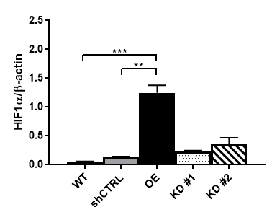

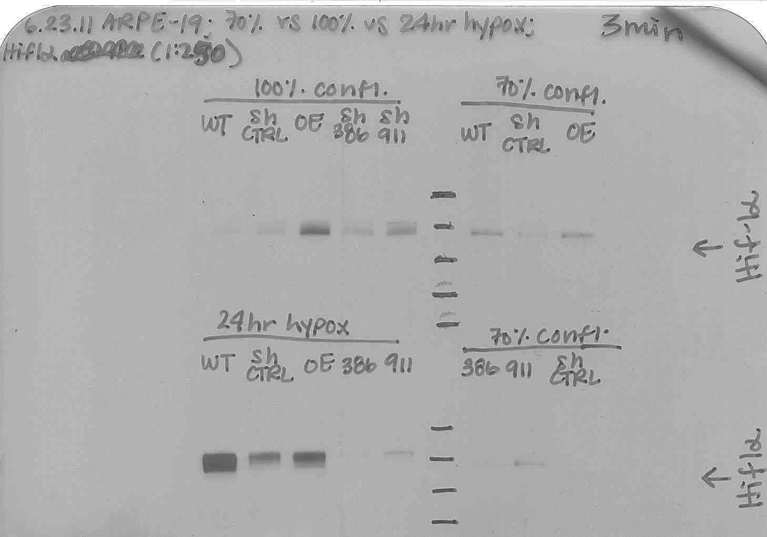

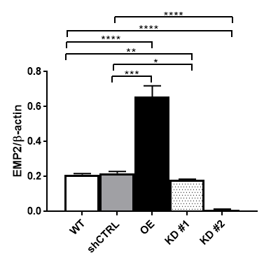




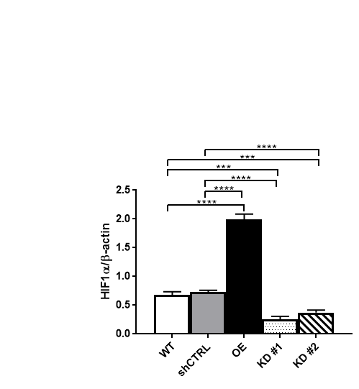
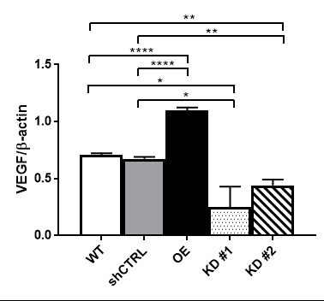
A
Normoxia
Figure S2
Hif1α
shCTRL
KD #1
KD #2
WT
OE
EMP2
Hif1α
β-actin
B
Hypoxia
EMP2
shCTRL
KD #1
KD #2
WT
OE
EMP2
Hif1α
VEGF
β-actin
HIF1α
VEGF
Figure S2: Analysis of EMP2, HIF1α, and VEGF protein expression. (A, B) EMP2, HIF1a, and VEGF protein expression were analyzed in WT, shCTRL, OE, shRNA KD #1, and shRNA KD#2 ARPE-19 cells grown under normoxic conditions or following 2-4 hours of hypoxic stress (0.5% O2). Quantification of protein expression under hypoxic conditions by densitometry normalized to beta actin, for a minimum of 3 independent replicates. Statistical significance was established with multiple student's t-test using the Holm-Sidak method (alpha = 0.05).
Notes:
HIF1α and VEGF expression are induced in ARPE-19 cells under hypoxic conditions when EMP2 is expressed.

Slide 4
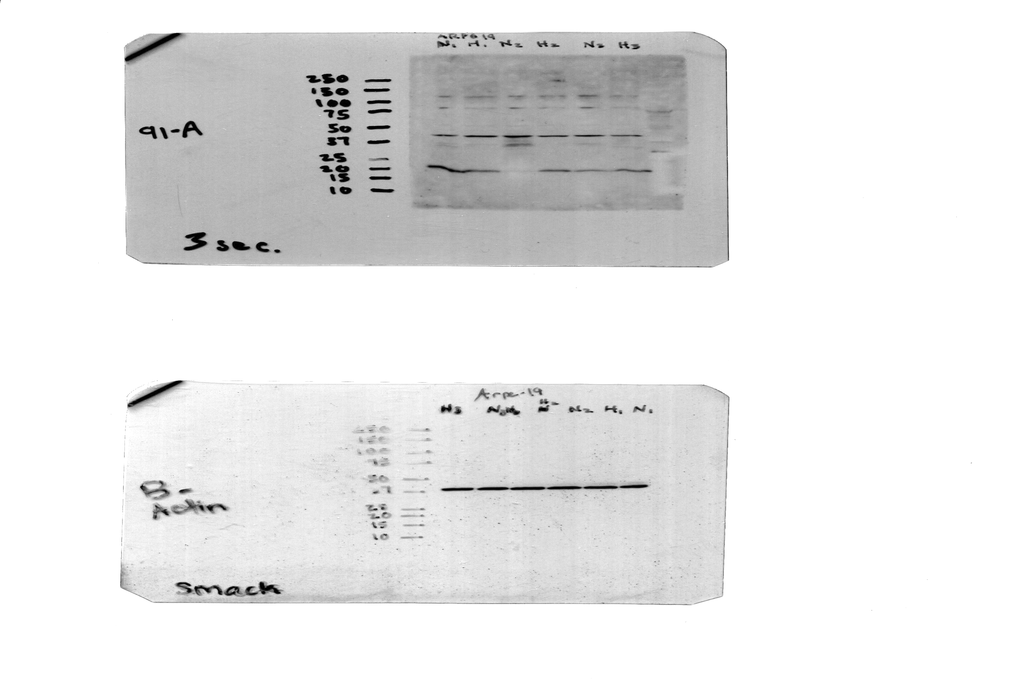
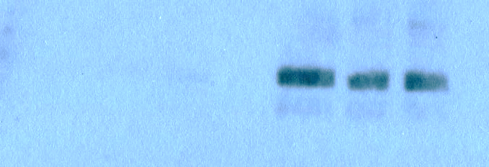
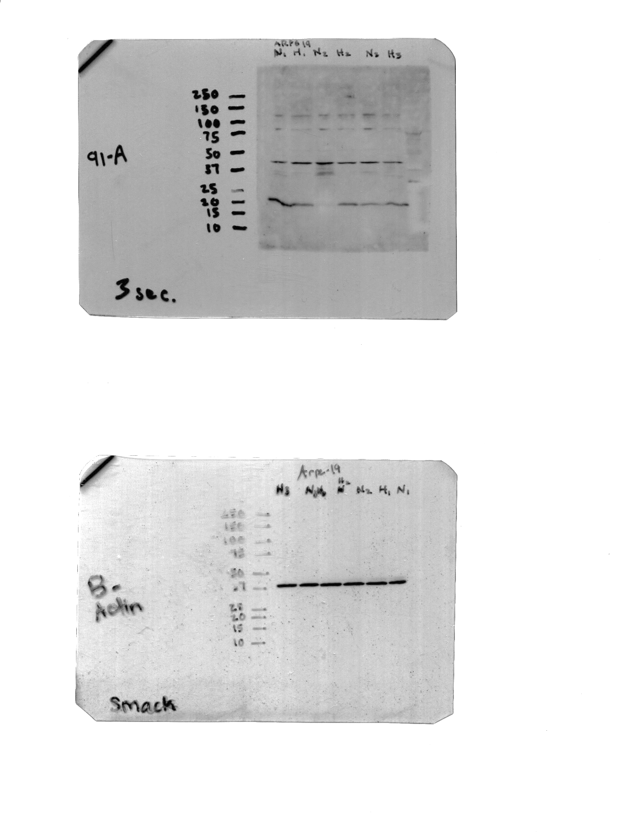
Figure S3
Normoxia
Hypoxia
Normoxia
Hypoxia
Normoxia
Hypoxia
WT
WT
EMP2
EMP2
Hif1α
β-actin
B-Actin

Slide 5

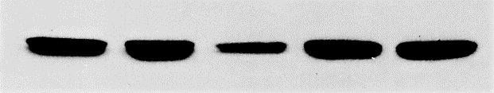
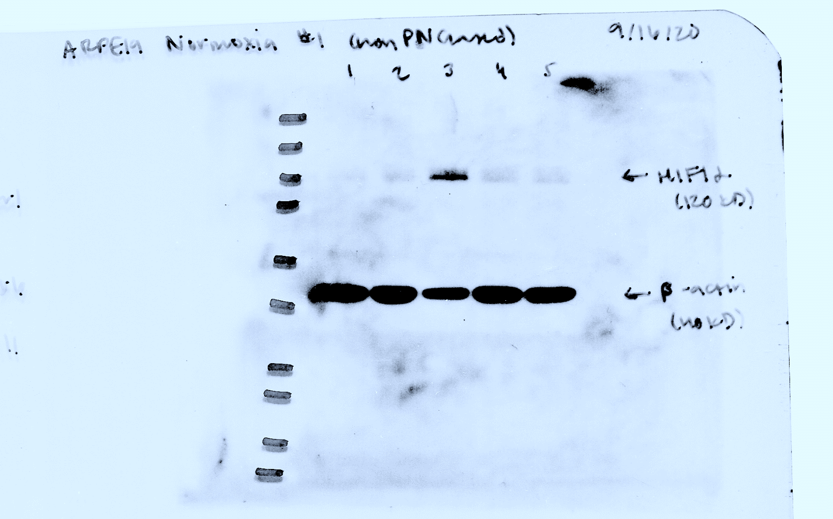
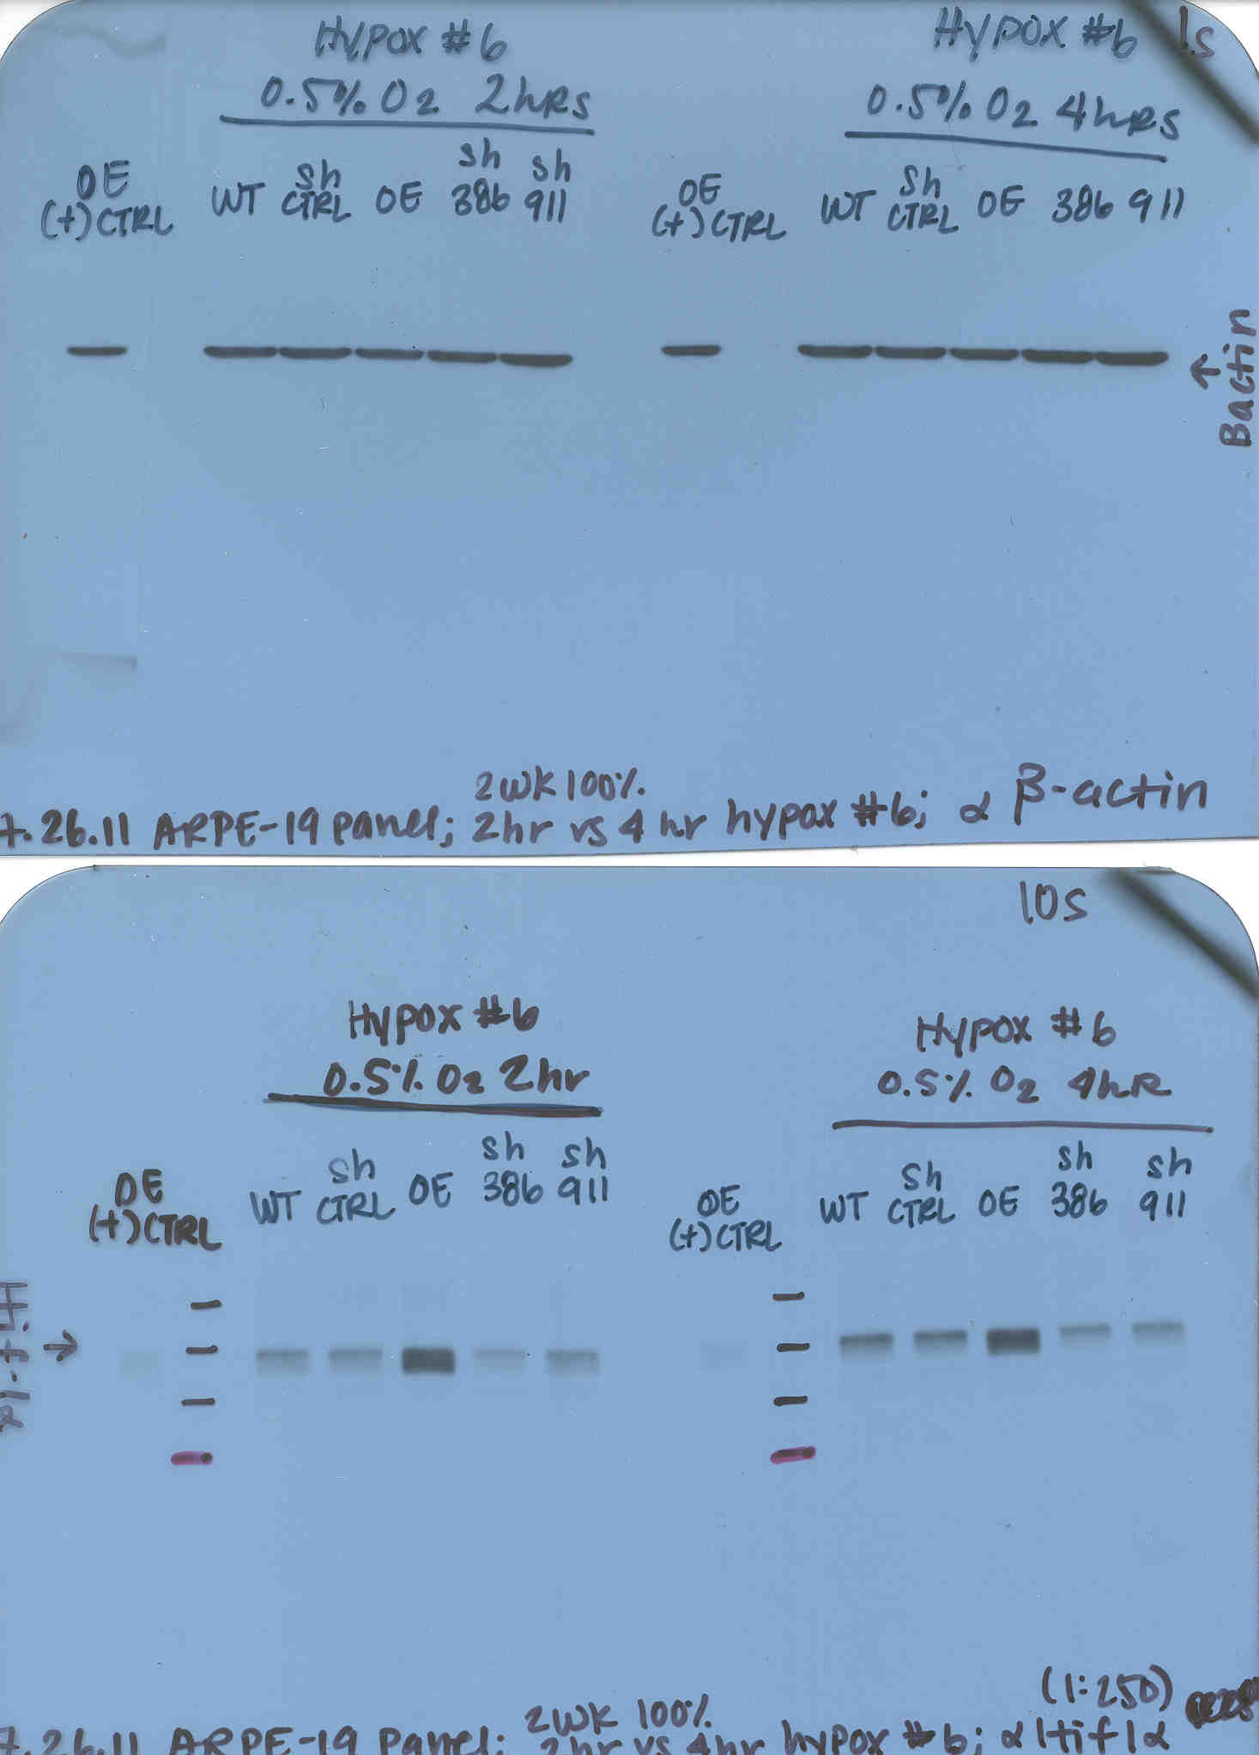
Figure S3
Normoxia
Hypoxia
shCTRL
WT
shCTRL
OE
KD #1
KD #2
WT
OE
KD #1
KD #2
Hif1α
β-actin

Slide 6
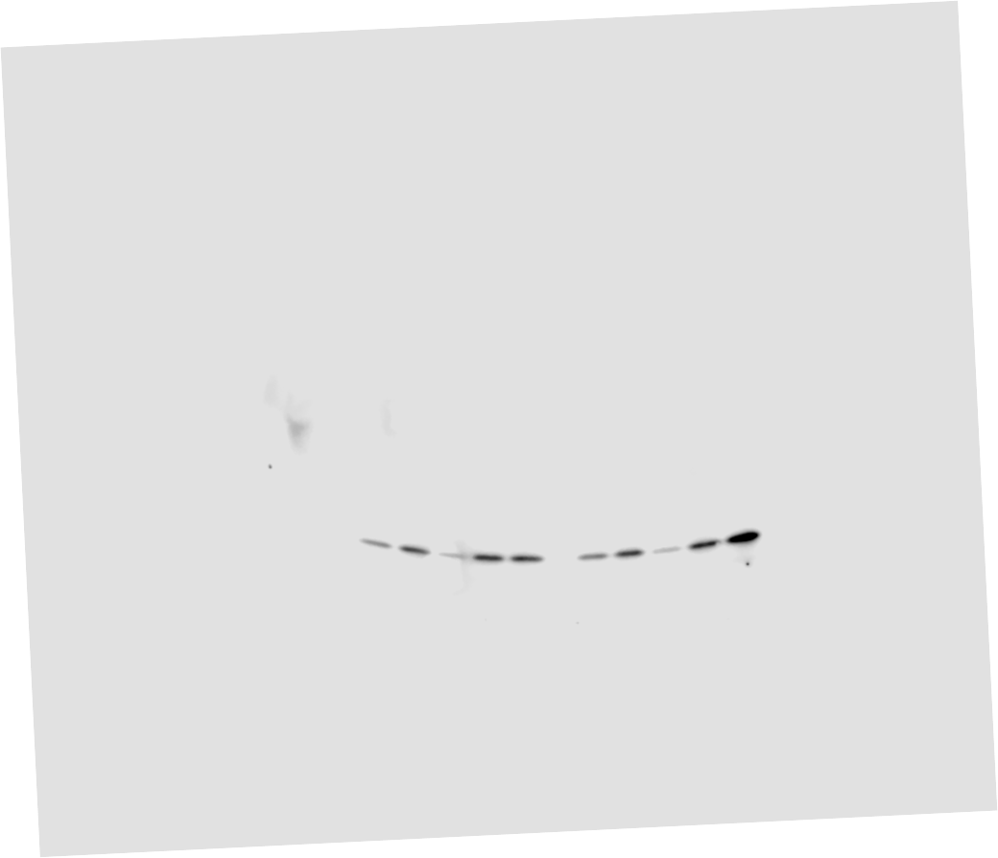
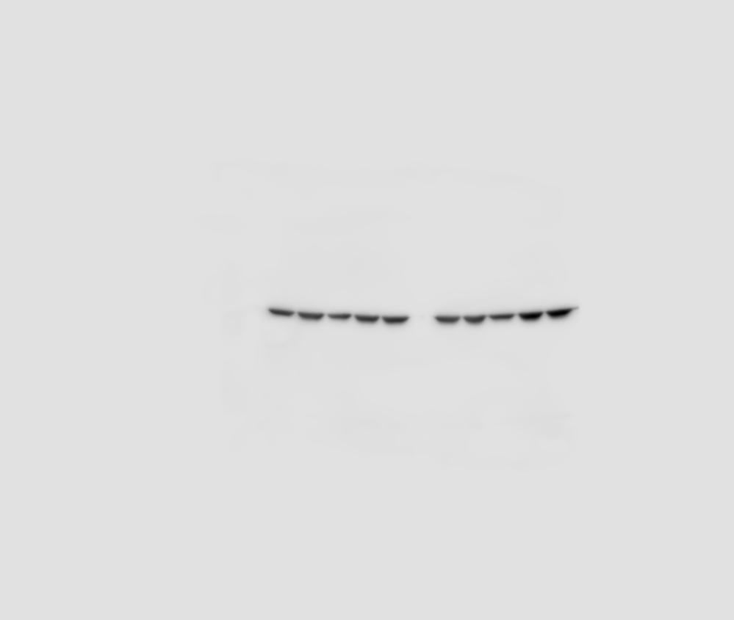
Figure S3
Normoxia
Hypoxia
Normoxia
Hypoxia
WT
shCTRL
OE
KD #1
KD #2
WT
shCTRL
OE
KD #1
KD #2
WT
shCTRL
OE
KD #1
KD #2
WT
shCTRL
OE
KD #1
KD #2
pVHL
β-actin
pVHL
β-actin

Slide 7
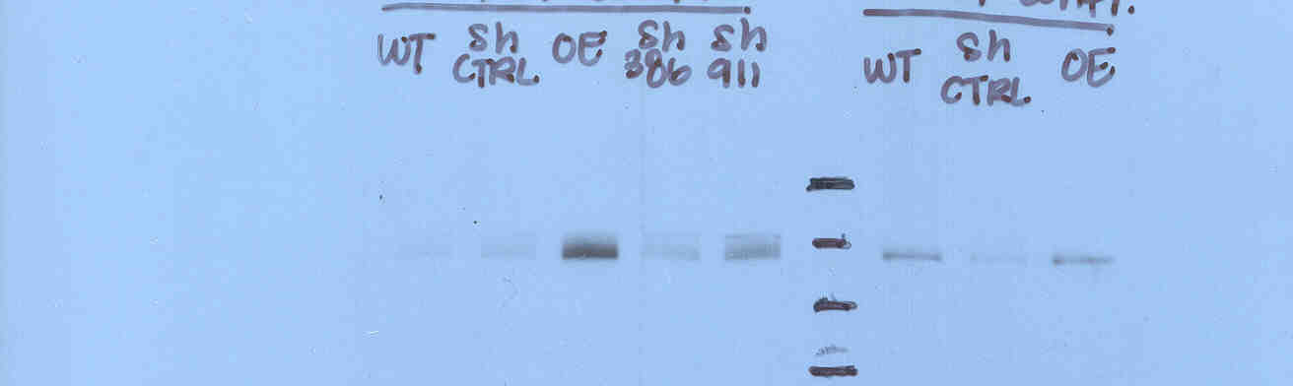
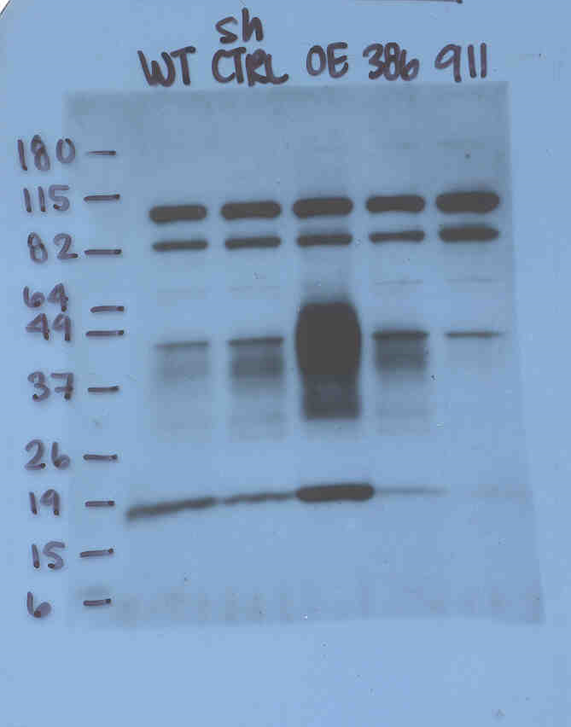
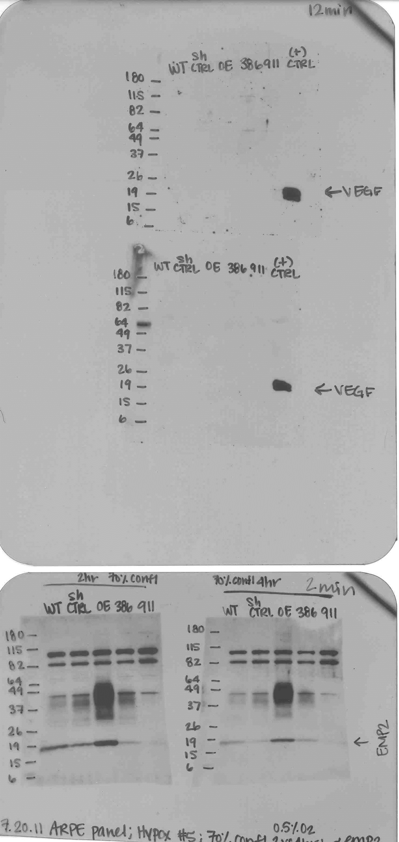
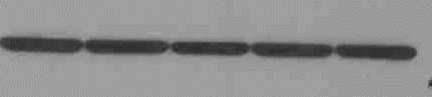
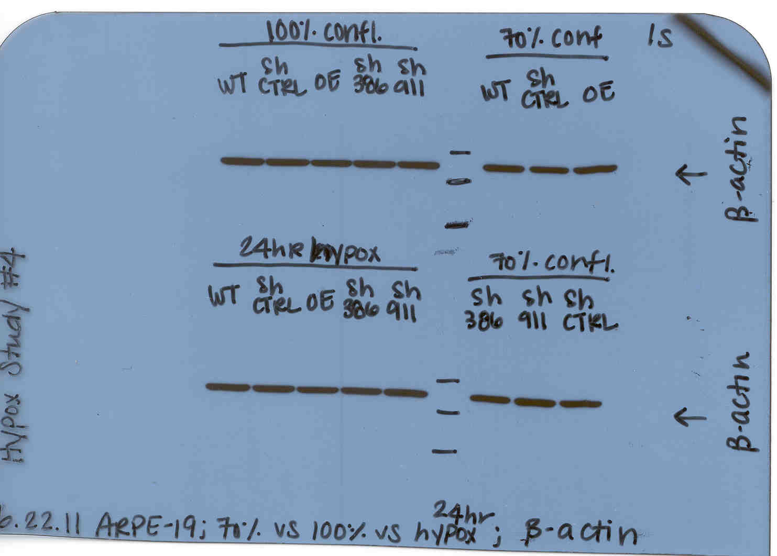
Figure S3
A
Normoxia
shCTRL
KD #1
KD #2
WT
OE
EMP2
HIF1a
HIF-1α
β-actin
EMP2
B-Actin
Parallel blots were run; blot for B-actin and HIF1a were split to allow for simultaneous probing on the same blot.

Slide 8
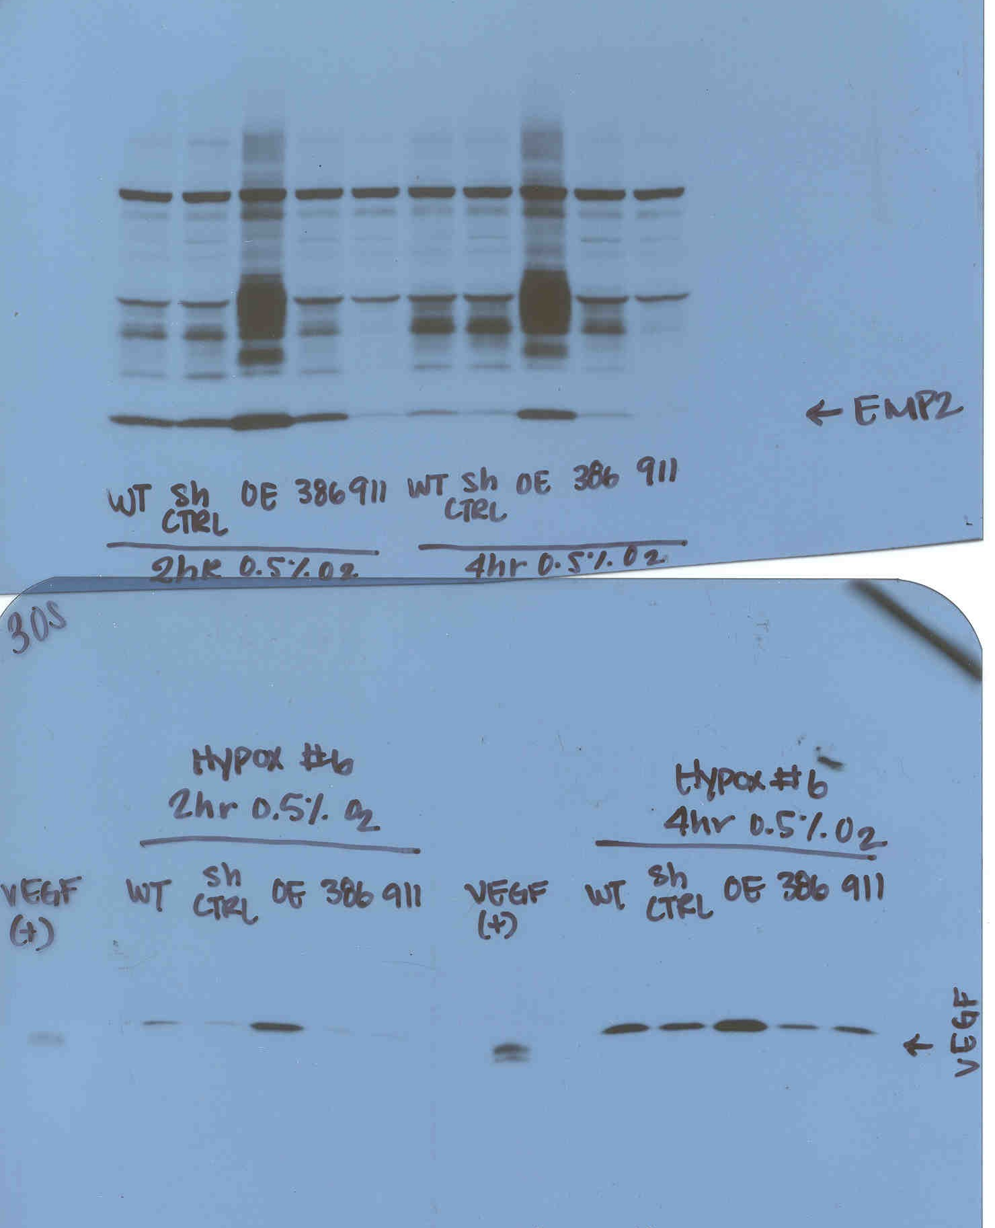
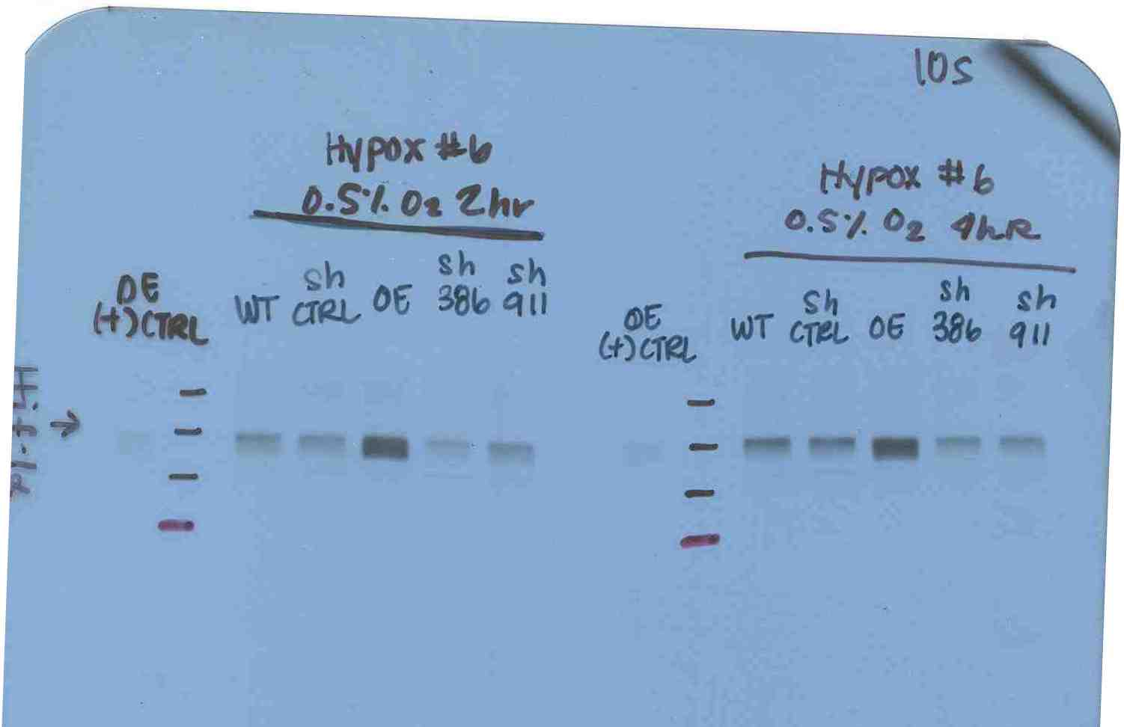
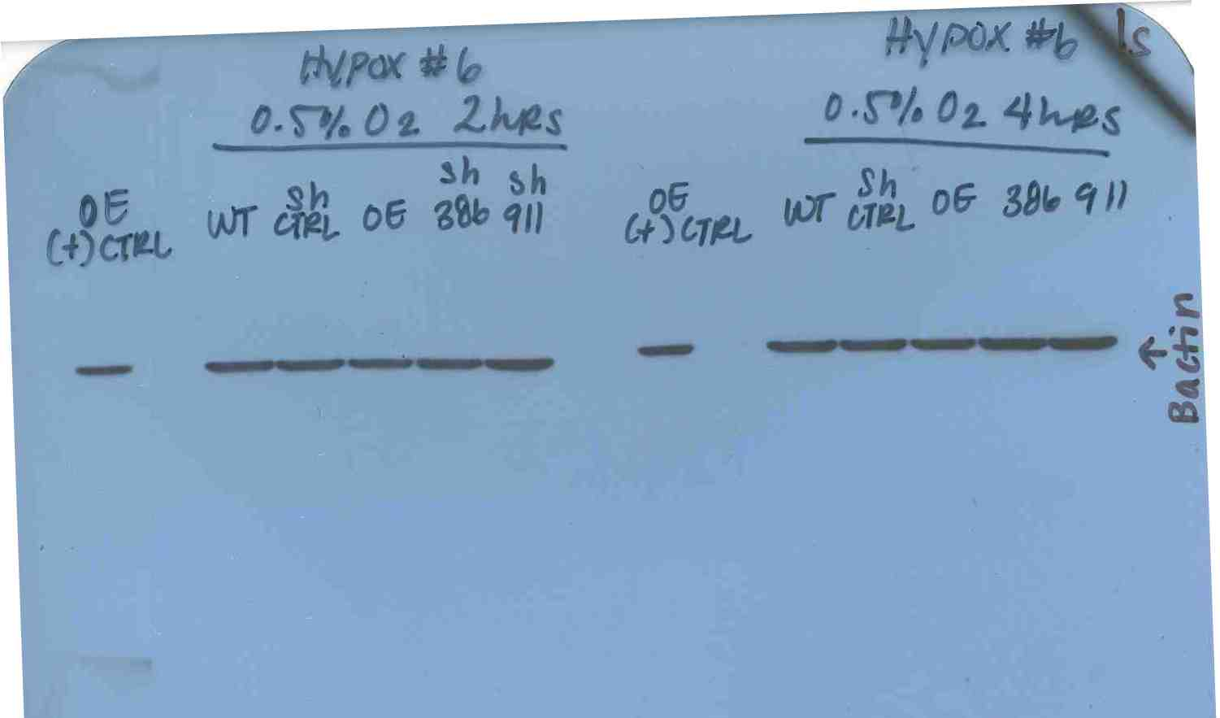
Figure S3
Hypoxia
shCTRL
KD #1
KD #2
WT
OE
EMP2
Hif1α
VEGF
β-actin
HIF1a
VEGF
B-Actin
Parallel blots were run.

