Slide 1
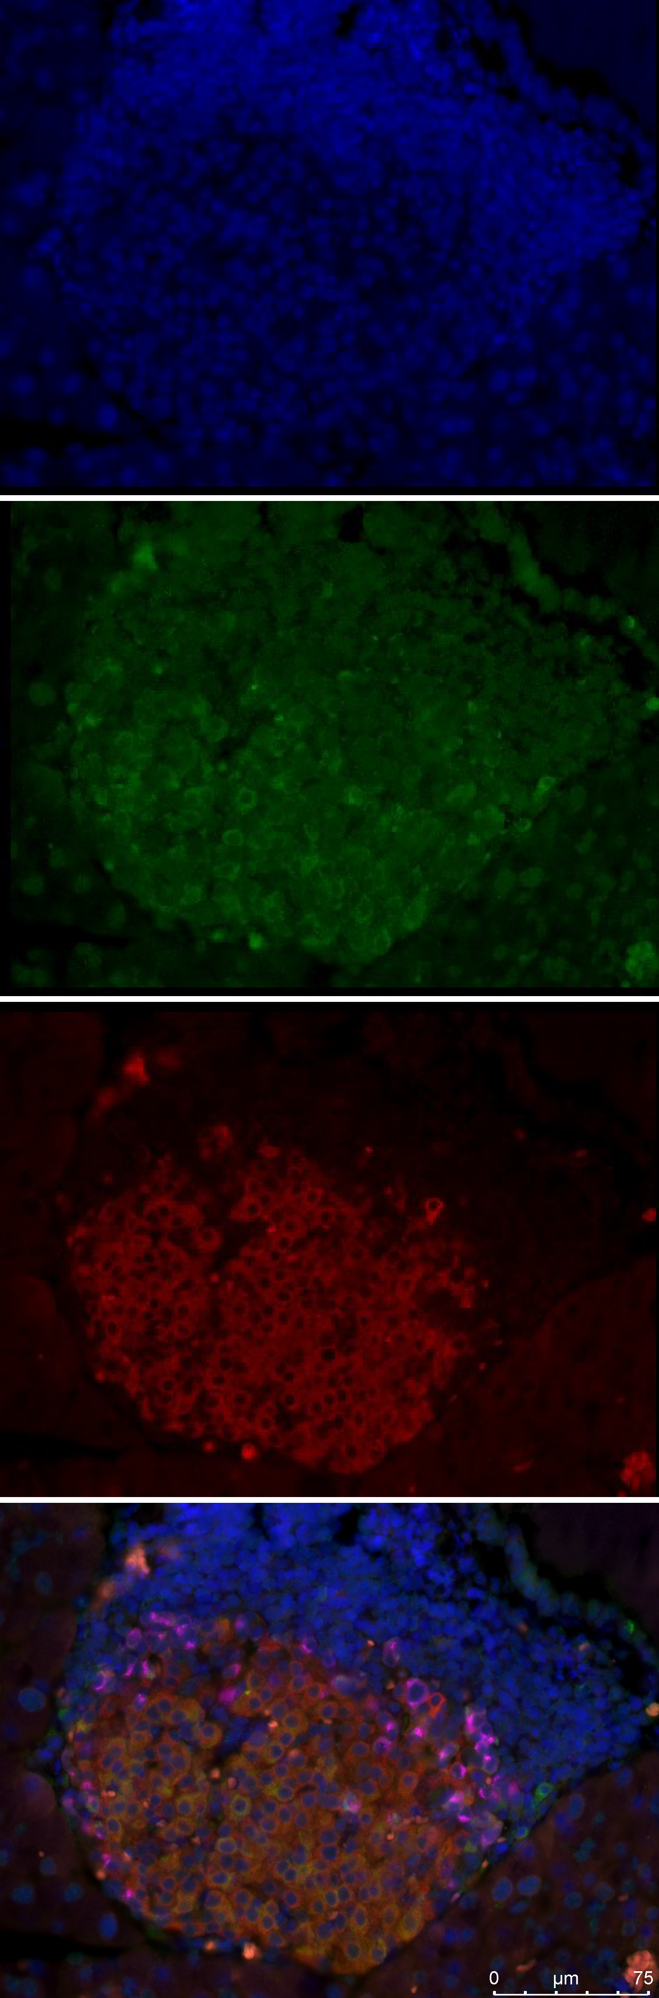
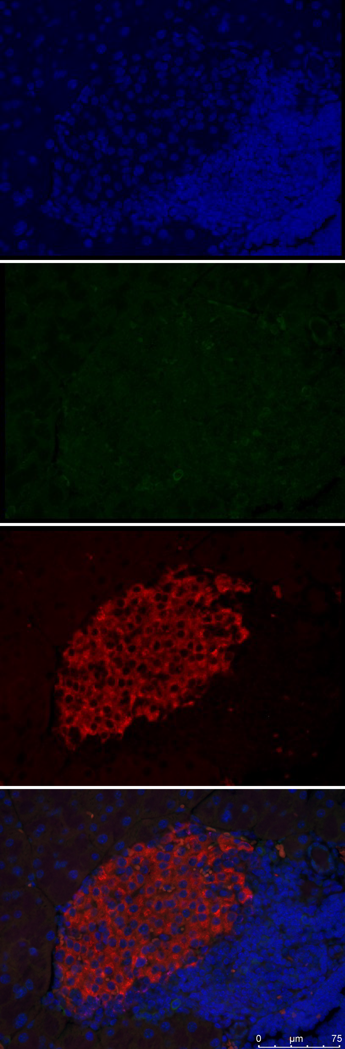
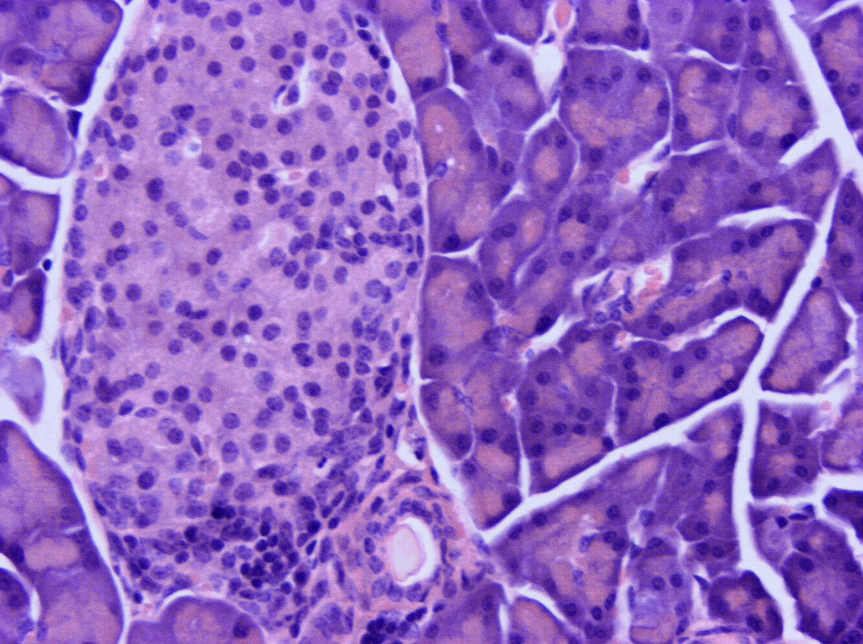
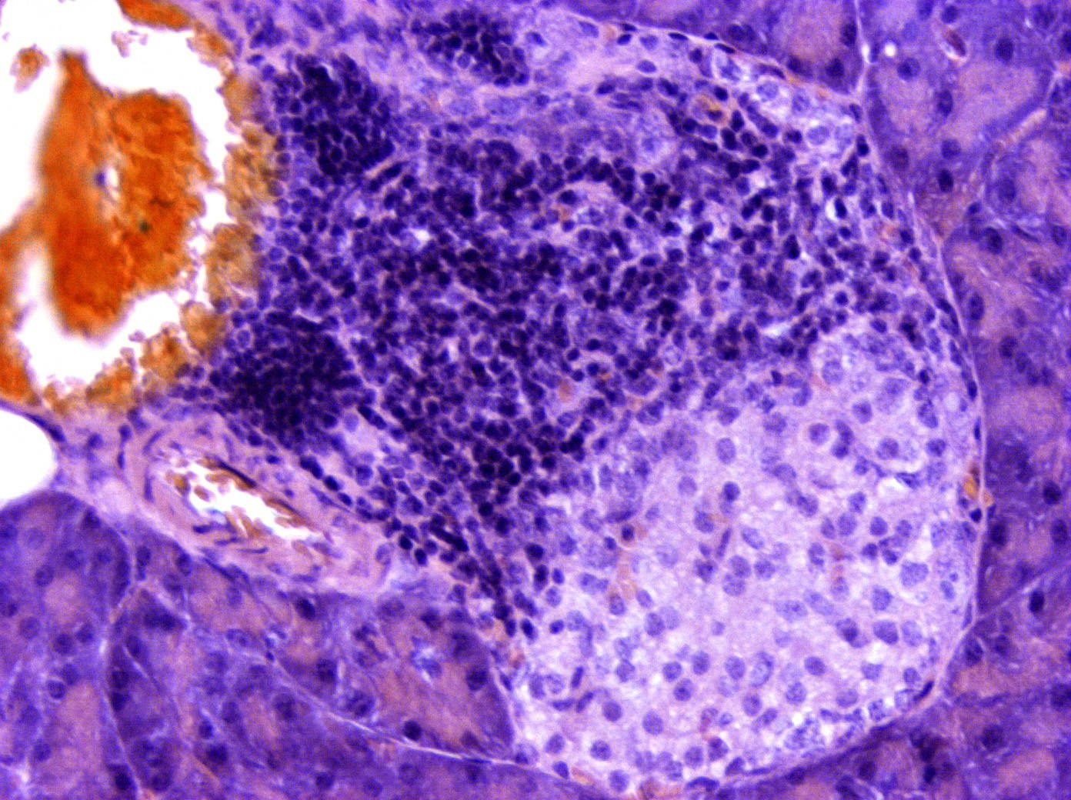
Figure 1
A
B
NOD.ZnT8 WT
NOD.ZnT8 HE
NOD.ZnT8 KO
DAPI
75um
75um
75um
C
ZnT8
75um
75um
75um
Insulin
D
0.8
E
Infiltrate
NOD.ZnT8 HE NOD.ZnT8 KO
NOD.ZnT8 KO NOD.ZnT8 HE
75um
75um
75um
Fraction infiltrated
0.6
*
0.4
0.2
0.0
Merge
75um
75um
75um

Slide 2
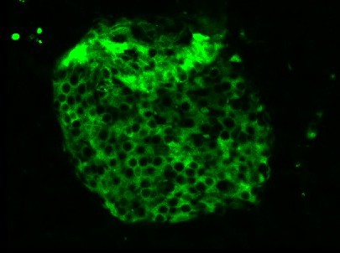
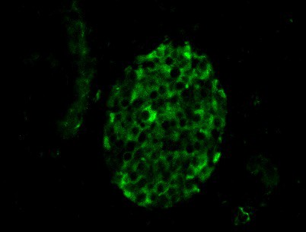

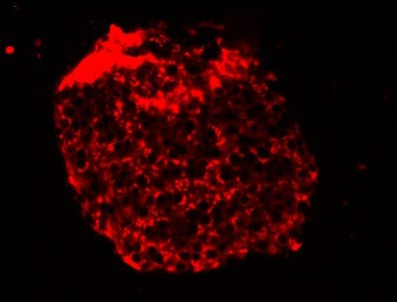
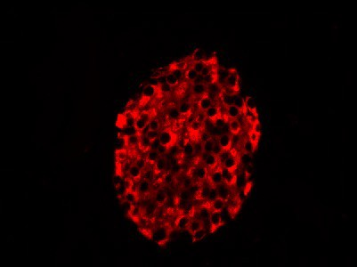
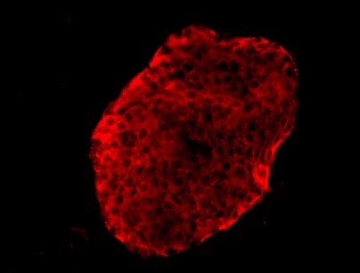
Figure 2
A
B
C
NOD.SCID ZnT8 WT
NOD.SCID ZnT8 HE
NOD.SCID ZnT8 KO
ZnT8
Insulin
D
Low
E
High
F
KCl
G
High
*
***

Slide 3
Figure 3
A
D
HE Cyto
HE Control
KO Cyto
KO Control
WT Cyto
WT Control
Source of variation | Sum Sq | Df | F | P-value
Genotype | 3765450 | 2 | 3.6865 | 0.032 *
Treatment | 720784 | 1 | 1.4113 | 0.240_
Interaction | N/A |  |  | (0.575)
Residuals | 27067764 | 53
B
Control
C
Cytokines

Slide 4
Figure 4
A
Control
B
Cytokine
A
B C
D
A
B C
D
OCR (pmol/min)
OCR (pmol/min)
A : 20mM Glucose B : 4uM Oligomycin C : 4uM FCCP
D : 4uM Rotenone
C
D
E
F
Basal respiration
Maximal capacity
Proton leak
ATP production
***
**

Slide 5
Supplemental Figure 1
A
Censored at 280d
B
Censored at 150d
Figure S1. Incidence of T1D in male NOD.ZnT8 HE and KO mice.
Mice were followed from birth for up to 40 weeks for signs of T1D (polyuria, polydypsia). Beginning at 10 weeks animals were monitored by weekly random blood glucose measurements. Animals with values > 250mg/dl were re-tested the following day, and those with 2 consecutive values >250mg/dl deemed diabetic and euthanized. Data was analyzed by Log-rank (Mantel Cox) test. (A) Data for the entire 40 weeks of follow-up. (B) Incidence over the first 150d of the study.

Slide 6
Supplementary Figure 2
A Males
B Females
C
NOD.SCID ZnT8 WT
NOD.SCID ZnT8 HE
NOD.SCID ZnT8 KO
NOD.SCID ZnT8 WT
NOD.SCID ZnT8 HE
NOD.SCID ZnT8 KO
min
D
E
F
1.5
NOD.SCID ZnT8 WT NOD.SCID ZnT8 HE NOD.SCID ZnT8 KO
NOD.SCID ZnT8 WT
Plasma insulin (ng/ml)
NOD.SCID ZnT8 HE NOD.SCID ZnT8 KO
1.0
0.5
0.0
0
30 min
Low
High
KCl
Figure S2. Female NOD.SCID.ZnT8 HE and KO mice showed comparable metabolic phenotype.
(A-B) Body weights of 14wk male and 15wk female NOD.SCID.ZnT8 mice. N=9 per group. (C) Intraperitoneal glucose tolerance test (IPGTT) of 15wk female NOD.SCID.ZnT8 WT, HE and KO mice. N=9 per group. (D) In vivo glucose stimulated insulin secretion of 15wk old female mice. N=4 per group. (E) Ex vivo glucose stimulated insulin secretion assay in islets isolated from 15wk NOD.SCID.ZnT8 female mice without proinflammatory cytokine treatment. N=5 per group. (F) Insulin content of untreated and cytokine treated male islets (n = 24 [WT], n =30 [HE], n = 27 [KO]. Data are expressed as the mean ± SEM.

Slide 7
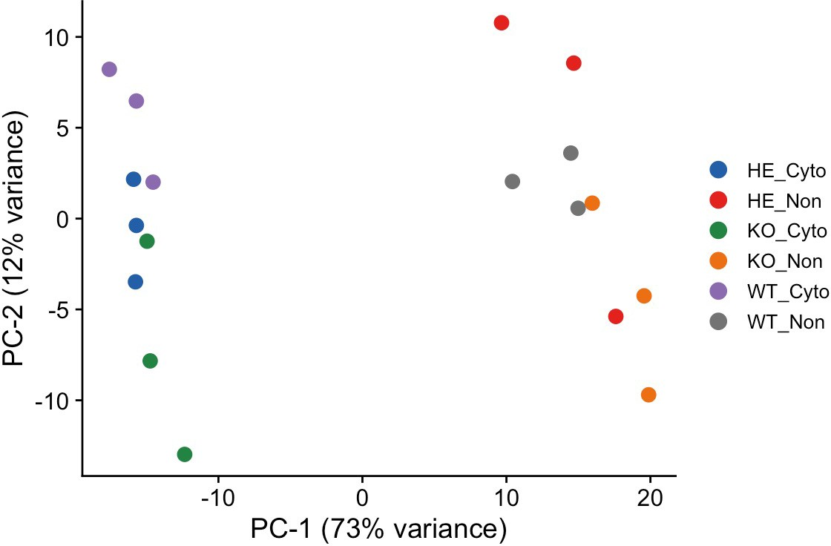
Supplemental Figure 3
A
C
B
Figure S3. Differentially regulated gene expression in islets treated with proinflammatory cytokines.
RNA-Seq analysis of 17 wks NOD.SCID.ZnT8 WT, HE and KO male islets; un-treated and treated with proinflammatory cytokines for 24 hours, N=3 per group.
(A) Selected pathways from gene ontology analysis of genes differentially expressed between the non-treated and cytokine treated samples for each genotype.Color indicates the -log10(pvalue) for the enrichment of each pathway. N=3 per group.
(B) Principal component analysis (PCA) of untreated and treated samples from all genotypes. Each biological replicate was plotted for the indicated samples.
(C) Data was analyzed with rMATs. The distributions of alternative splicing events are shown.

Slide 8
Supplemental Figure 4
A
B
C
NOD.SCID ZnT8 WT Nontreated
NOD.SCID ZnT8 HE Nontreated
NOD.SCID ZnT8 KO Nontreated
D
E
F
NOD.SCID ZnT8 WT+Cytokine
NOD.SCID ZnT8 HE+Cytokine
NOD.SCID ZnT8 KO+Cytokine
Figure S4. Calcium oscillations in glucose stimulated control and cytokine treated islets.
Islets were incubated as described in Methods. Time dependent changes in Fluo-4 fluorescence after addition of medium containing 11mM glucose with or without cytokines (blue bars) are shown. Profiles from male mice are shown in black and from females in red.

Slide 9
Supplemental Figure 5
A
Control
B
Cytokine
80.0
70.0
A B C
D
90.0
80.0
70.0
60.0
50.0
40.0
30.0
20.0
10.0
0.0
A
B C
D
A : 20mM Glucose B : 4uM Oligomycin C : 4uM FCCP
D : 4uM Rotenone
OCR (pmol/min)
OCR (pmol/min)
60.0
50.0
40.0
30.0
20.0
10.0
0.0
0
20
40
60
Time (min)
80
100
120
0
20
40
60
Time (min)
80
100
120
C
Basal respiration
D
Maximal capacity
E
Proton leak
F
ATP production
**
Figure S5. Increased oxygen consumption rate (OCR) upon low dose proinflammatory cytokine treatment in female NOD.SCID.ZnT8 HE islets.
(A) Representative oxygen consumption rate (OCR) analysis in isolated islets without cytokine treatment and (B) treated with low dose cytokines for 24hours. Ten size-matched islets per well were analyzed. Islets were acutely exposed to A: 20mM glucose, B: 4µM Oligomycin, C: 4µM FCCP, D: 4µM Rotenone. (No treatment: n=6 WT, n=12 HE and n=4 KO). (Cytokine treatment: N=12 WT, N=12 HE and N=9 KO). (C-F) Wave 4.0 calculated basal respiration, maximal respiration, proton leak and ATP production for each animal. Data are expressed as the mean ± SEM. ** p<0.01, 2-Way ANOVA analysis.

