Slide 1
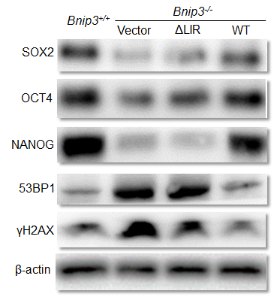
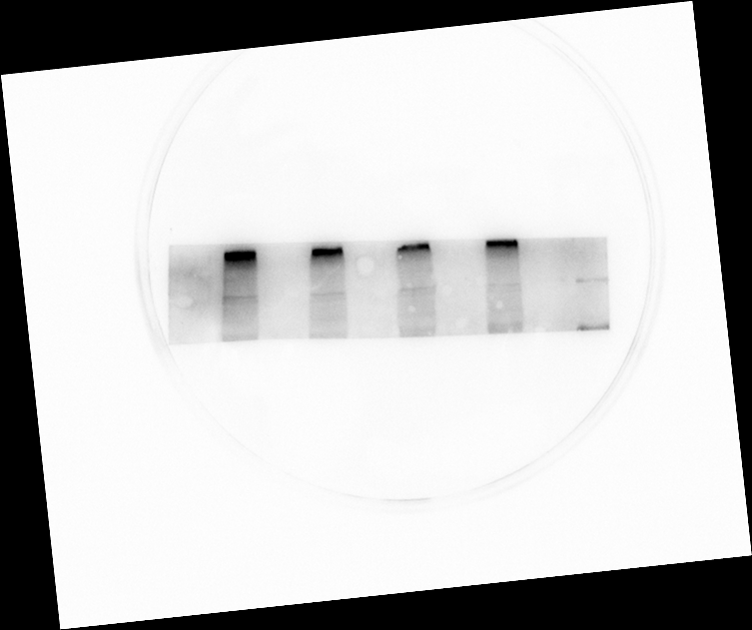
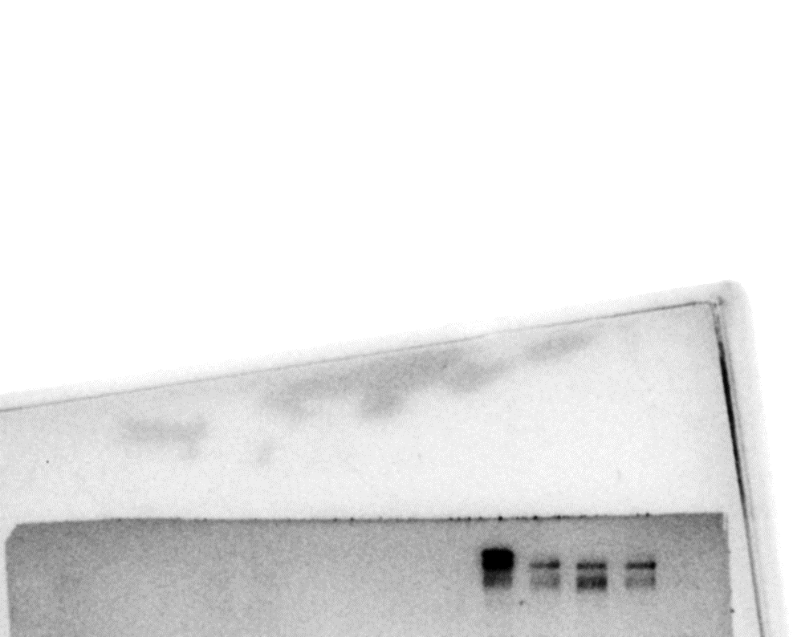
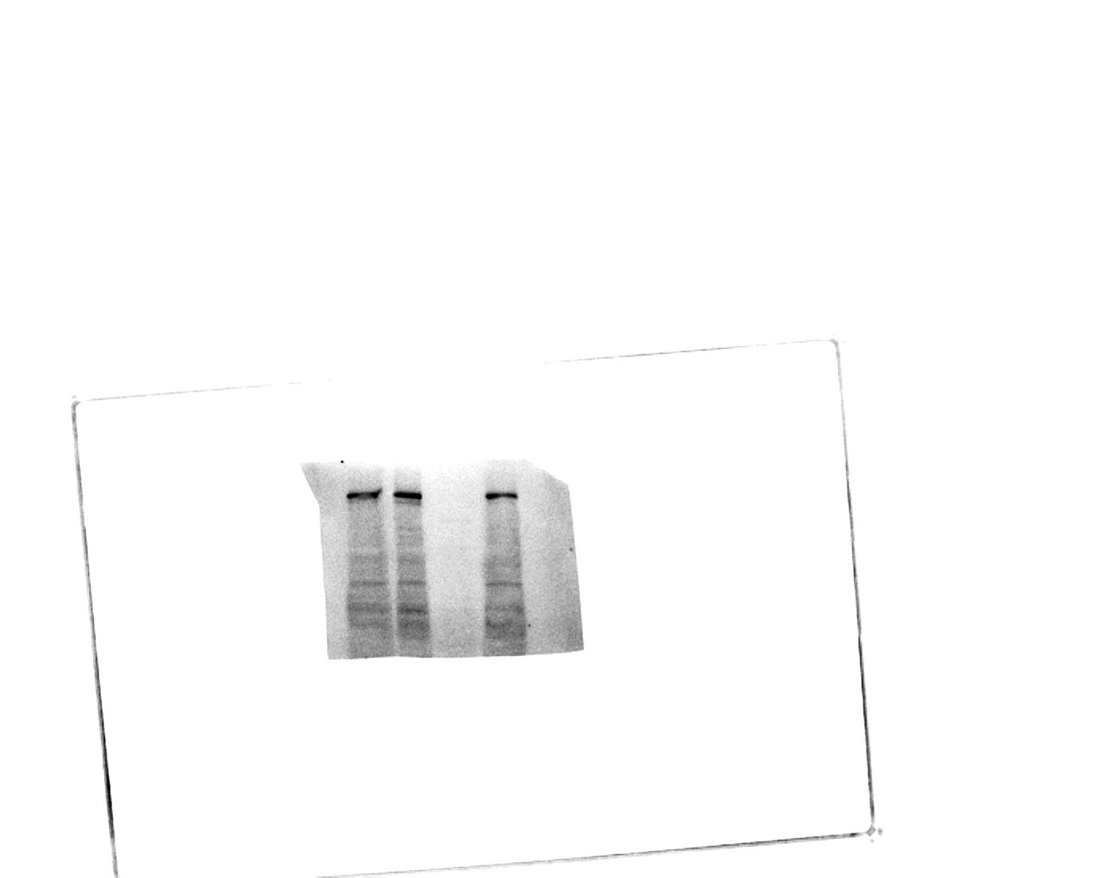
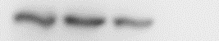
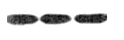
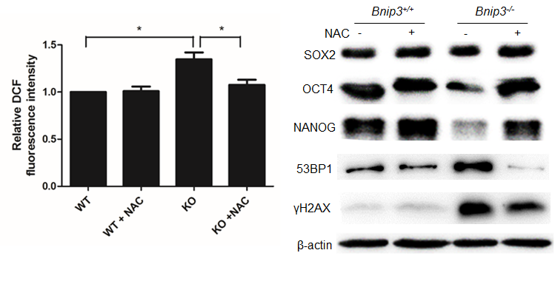
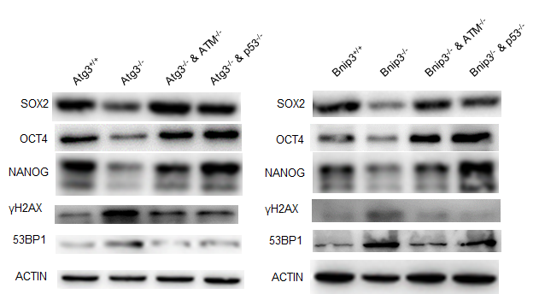
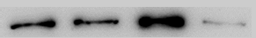
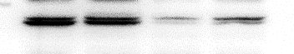


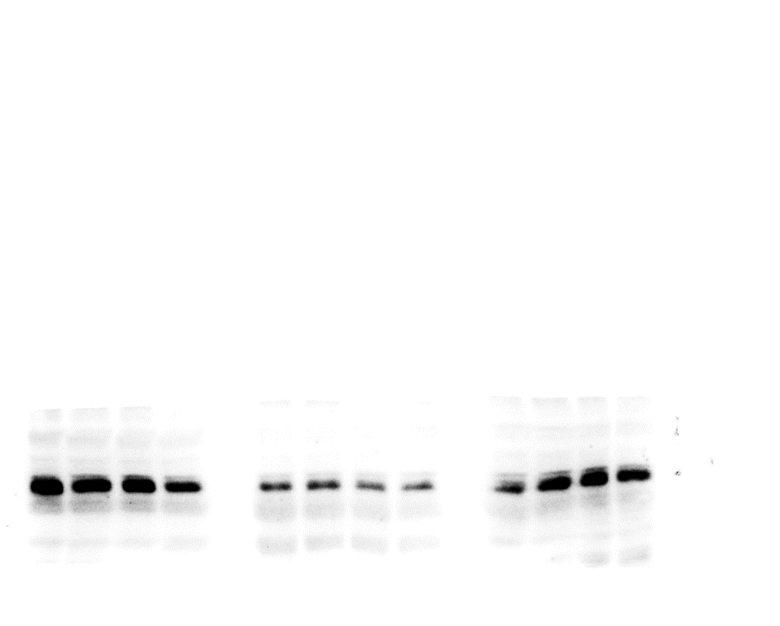
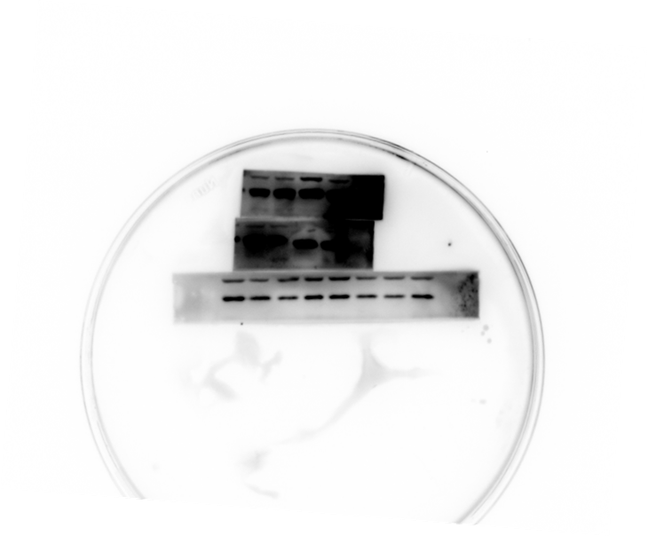
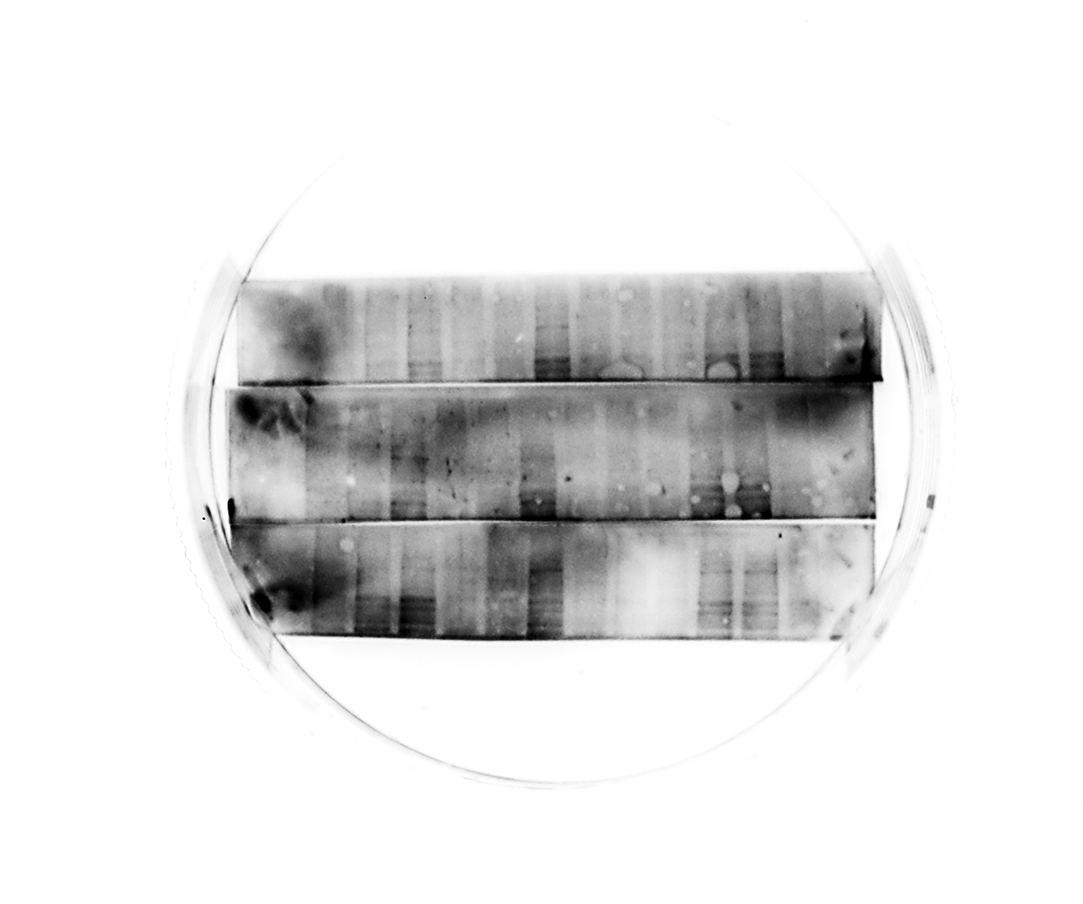

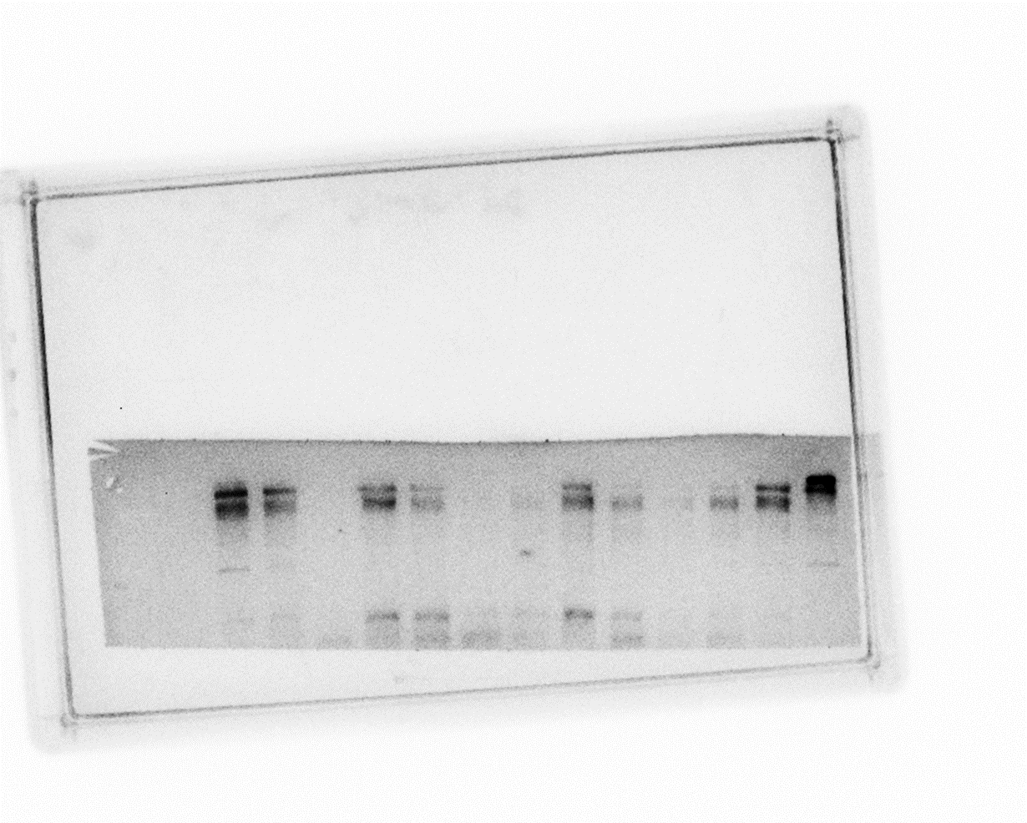
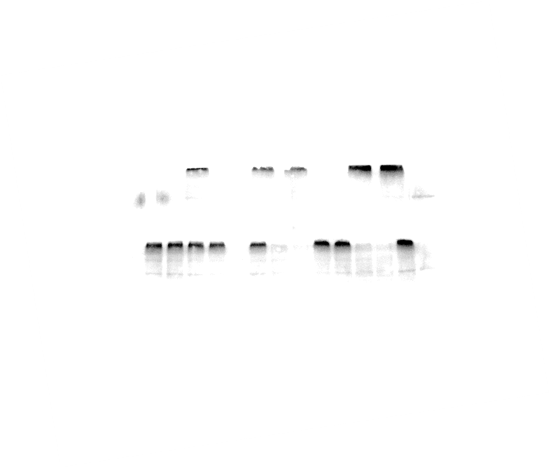
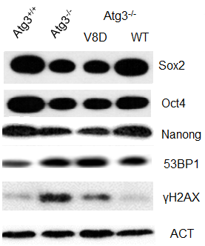
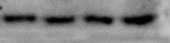
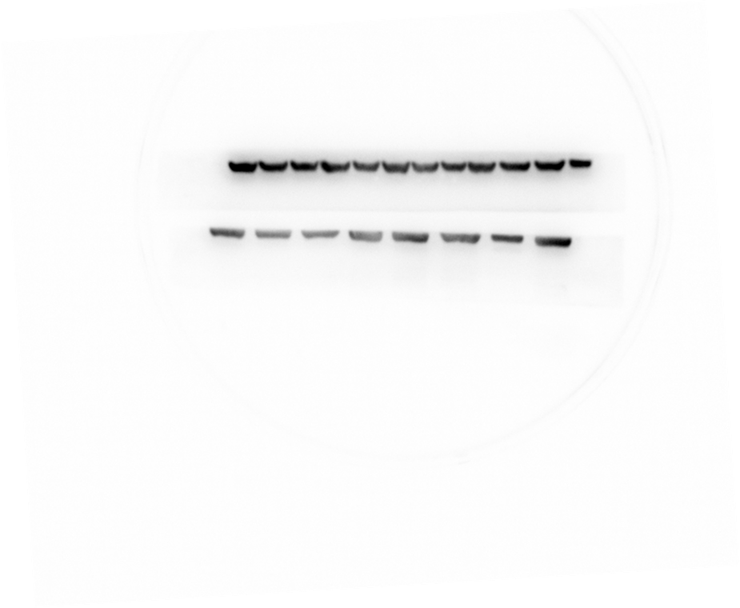
Fig.1C
Fig.2A
Fig.2H
p-ATM
γH2AX
53BP1
ATM
53BP1
ACTIN
p-p53
γH2AX
Fig.2E
p53
γH2AX
SOX2
ACTIN
OCT4
53BP1
NANOG
NANOG
Fig.1E
OCT4
ACTIN
SOX2
SOX2
Fig.3D
ACTIN
OCT4
Fig.2G
RAD51
NANOG
p-ATM
p-AMPK
53BP1
ATM
AMPK
γH2AX
p-p53
ACTIN
ACTIN
p53
ACTIN

Slide 2
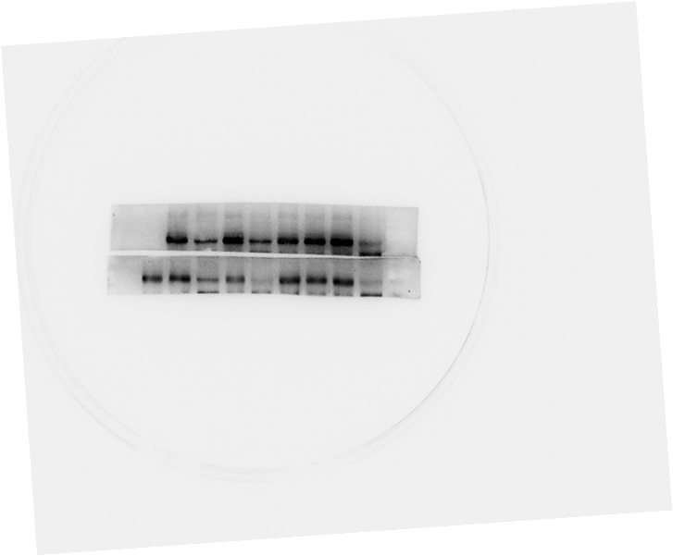
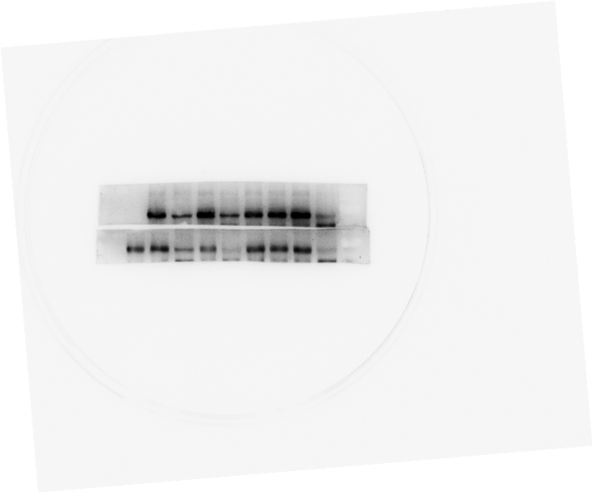
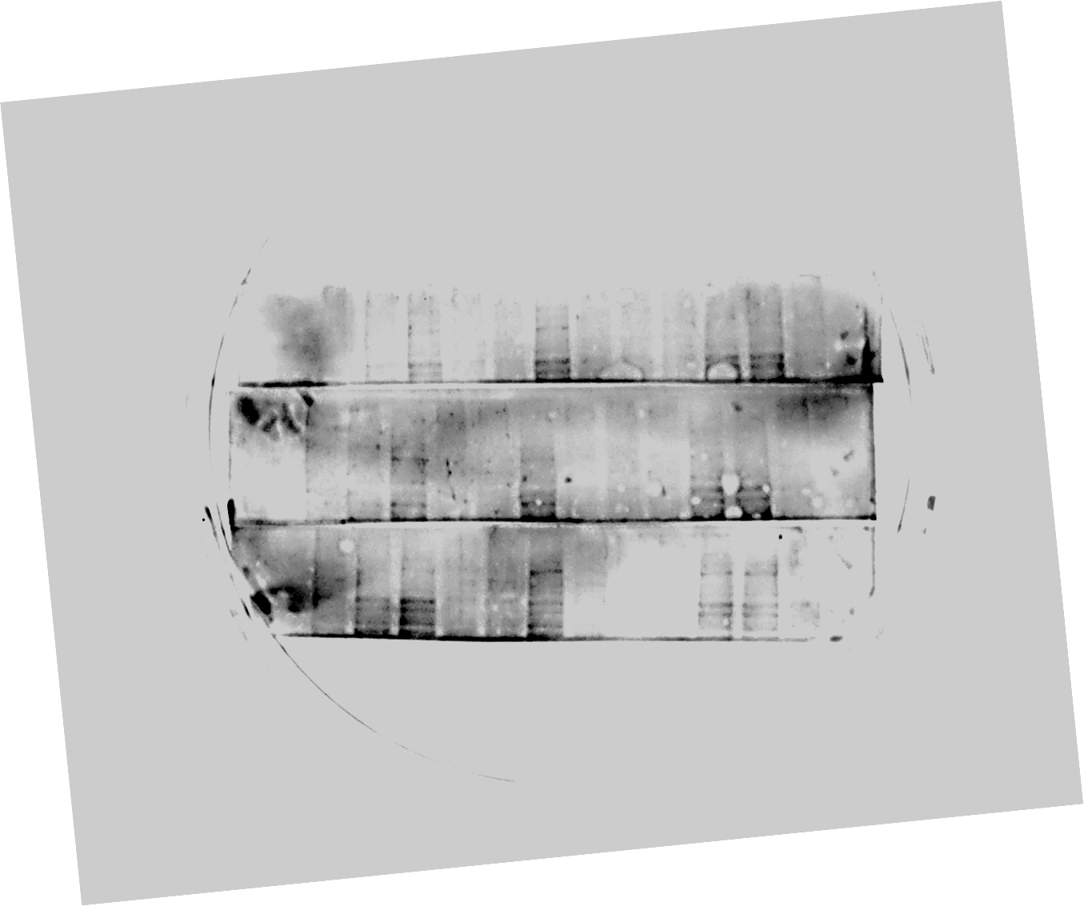
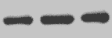

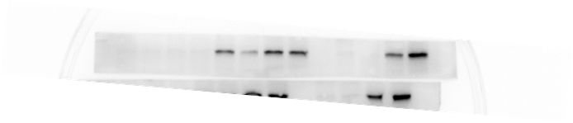
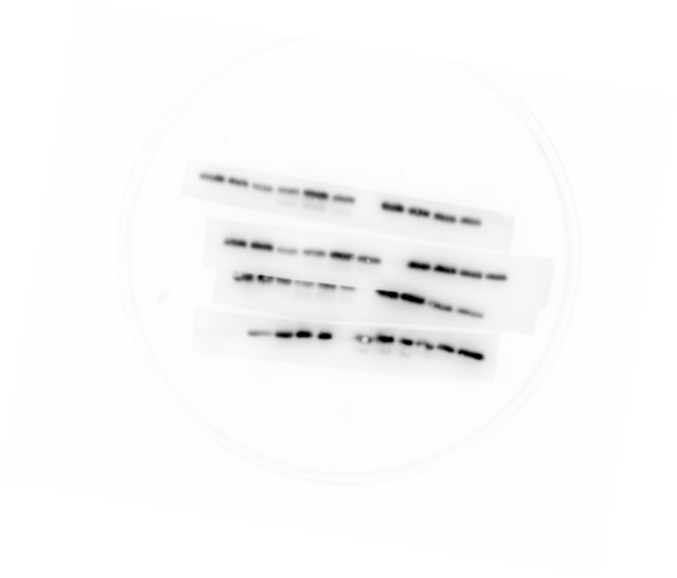
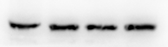
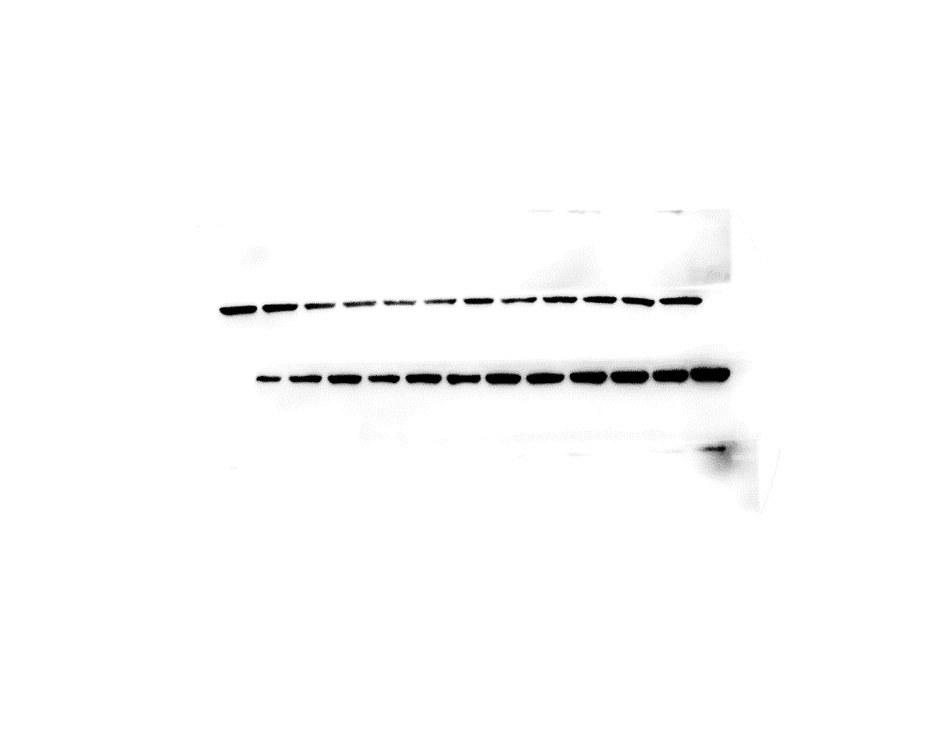
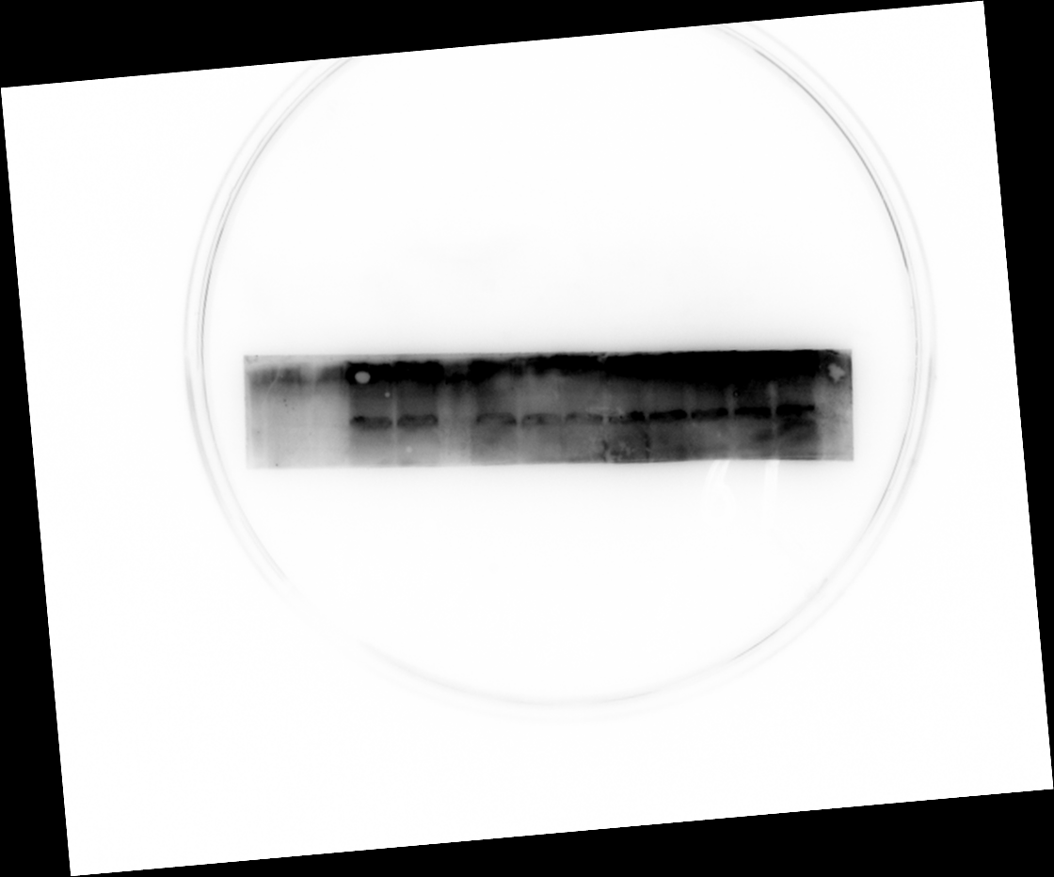
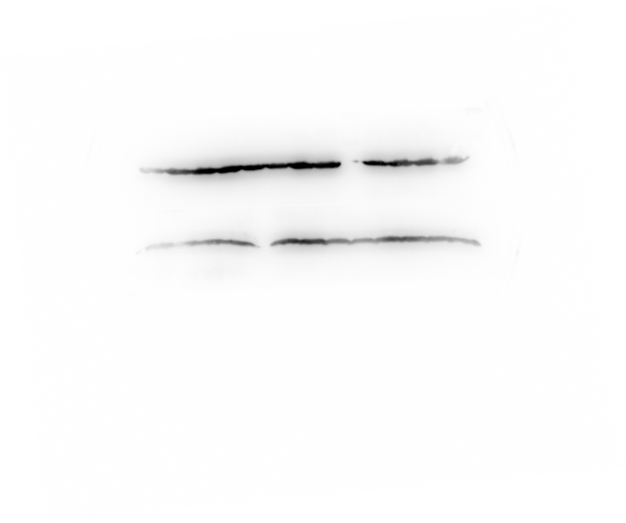

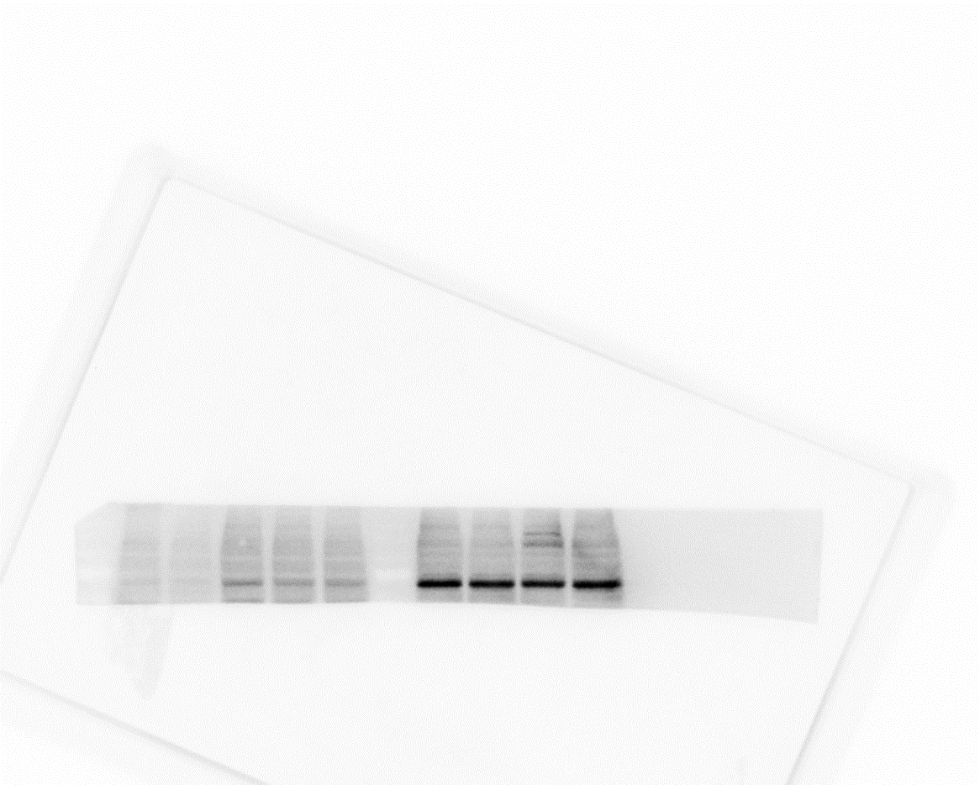
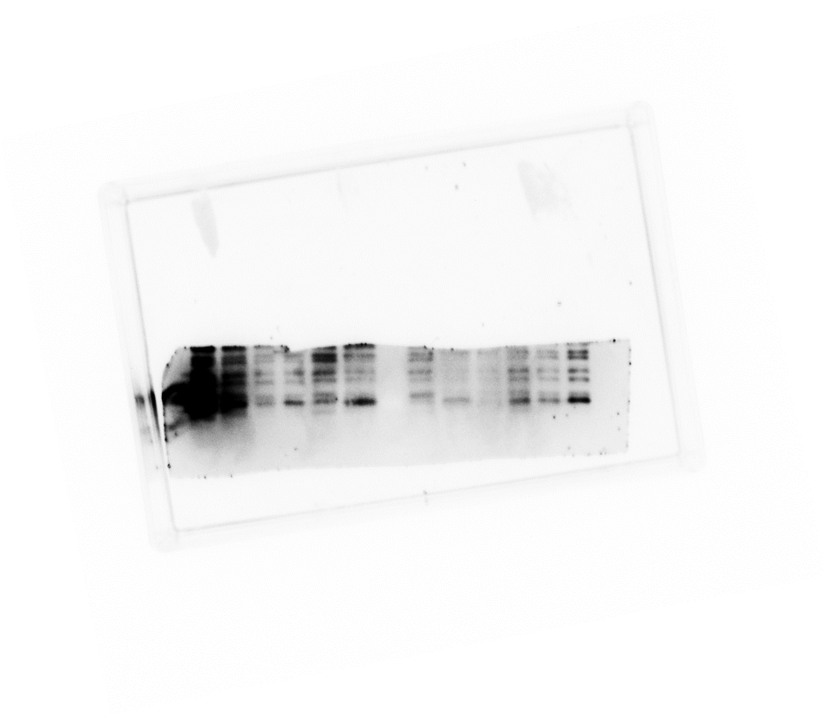

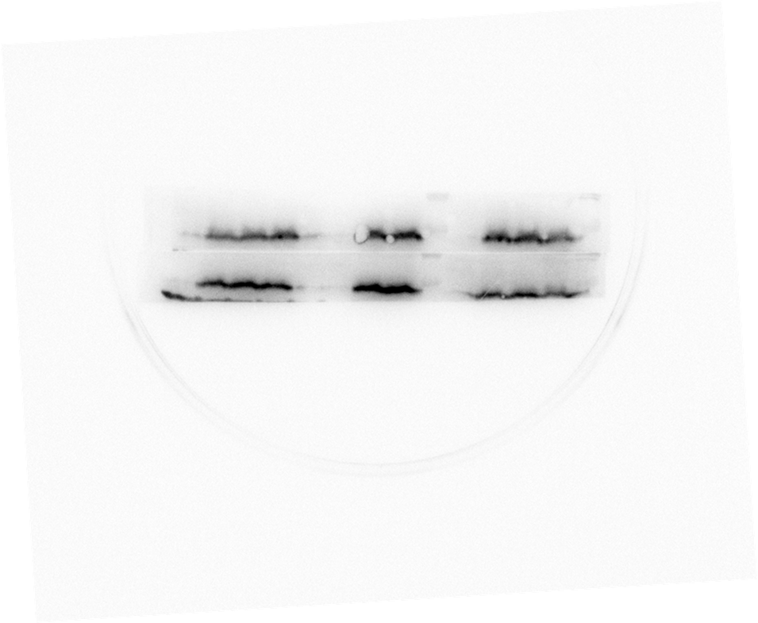
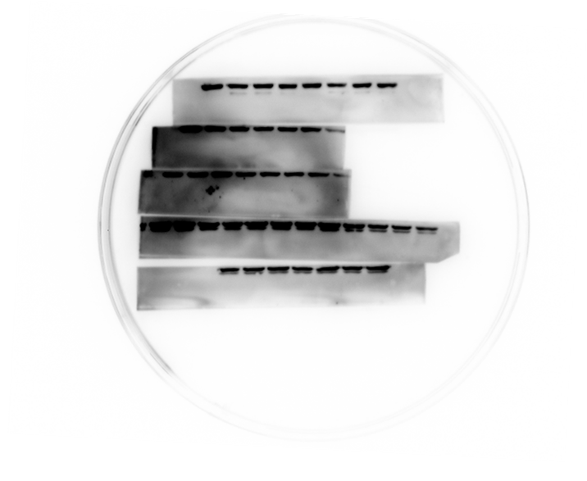
Fig.3E
Supplementary Fig.2D
Supplementary Fig.5D
p-AMPK
p-AMPK
p-ATM
AMPK
AMPK
ATM
RAD51
p-p53
RAD51
γH2AX
p53
γH2AX
ACTIN
ACTIN
ACTIN
Fig.4G
Supplementary Fig.3B
Supplementary Fig.5E
RAD51
P10
P40
P40+C.C
ATM
γH2AX
WT
KO
WT
KO
WT
KO
ACTIN
RAD51
p-AMPK
Supplementary Fig.3D
AMPK
γH2AX
BNIP3
p53
ACTIN
ACTIN
ACTIN

