Slide 1
Supplemental Table I: PDX Information
Time | PDX | Patient Data | PDX information | Molecular information | Previous treatments | Response in hu-CB-BRGS with Cabo/Nivo
Nov 2017 | CRC172 | 50 YO white male | Liver metastasis tissue from moderately differentiated stage IV MSS left-colon cancer | KRAS mutant (c.35G>A, p.G12D, GGT>GAT) | 5-FU/ capecitabine Oxaliplatin | Strong
Oct 2018 | CRC294 | 33 YO white female | Primary tumor tissue from poorly differentiated stage III MSS rectal cancer | KRAS mutant (p.G12D c.35G>A) PIK3CA mutant APC mutant CTNNB1 WT P53 WT | None | Good: Nivo, Cabo and Combo
Jan 2019 | CRC335 | 31 YO white male | Liver metastasis tissue from moderately differentiated stage IV MSS left-colon cancer | KRAS WT PIK3CA WT APC mutant CTNNB1 WT P53 MT | 5-FU/ capecitabine Oxaliplatin VEGF inhibitor | No difference – poor growth overall
May 2019 | CRC307M | 66 YO white male | Liver metastasis tissue from moderately differentiated stage IV MSS right-colon cancer | KRAS mutant (p.G12S) PIK3CA WT APC mutant P53 mutant | 5-FU/ capecitabine Oxaliplatin VEGF inhibitor | Good
Jan 2020 | CRC307P | 66 YO white male | Primary tumor tissue from moderately differentiated stage IV MSS right-colon cancer | KRAS mutant (p.G12S) PIK3CA WT APC mutant P53 mutant | 5-FU/ capecitabine Oxaliplatin VEGF inhibitor | Strong
Notes:
Supplemental Table 1: Patient and molecular information of PDXs implanted into HIS-BRGS mice and treated with cabozantinib and nivolumab. Far right column indicates relative tumor growth response in the HIS-model to combination treatment (Cabo/Nivo).

Slide 2
Supplemental Table II: Experimental Details
PDX | Time Qtr/Yr | Age Tumor Inj | # mice | Tum Take Rate | Days to Tx | Age Harvest (wks) | PBL Chim Hu/T pre-tumor | SP Chim Hu/T
CRC172 | 3/2017 | 21-23 | Inj: 18 Harv: 18 | 94% | 17 | 25-28 | 52% Hu 56% T | 24% Hu 78% T
CRC294* | 3/2018 | 19-21 | Inj: 23 Harv: 17 | 67% | 42-61 | 29-36 | 62% Hu 27% T | 47% Hu 73% T
CRC335 | 1/2019 | 20-21 | Inj: 28 Harv: 20 | 100% | 21 | 24-26 | 45% Hu 23% T | 32% Hu 80% T
CRC307M# | 2/2019 | 18-20 | Inj: 27 Harv: 22 | 92% | 17 | 22-26 | 55% Hu 14% T | 22% Hu 40% T
CRC307P | 1/2020 | 18-20 | Inj: 33 Harv: 28 | 98% | 20 | 23-25 | 52% Hu 28% T | 55% Hu 69% T
*very bony, calcified tumor; slow-grower
#Fewer T cells and LNs in this HIS-BRGS cohort
Notes:
Experimental Details for CRC MSS PDXs implanted into HIS-BRGS mice including experimental kinetics and human chimerism details as measured in peripheral blood (PBL) prior to tumor injection and in the spleen (SP) at harvest.

Slide 3
Supplemental Table III: Flow cytometric Abs and Reagents
Species | Target | Flurochrome | Clone | source | Species | Target | Flurochrome | Clone | source
anti-human | CD4 | BUV395 | RPA-T4 | BD Bioscience | anti-human | HLA-DR | BV480 | G48-6 | BD Bioscience
anti-human | CD45 | BUV395 | HI30 | BD Bioscience | anti-human | CD56 | BV650 | 3G8 | biolegend
anti-human | Granzyme B | Fitc | QA16A02 | biolegend | anti-human | CD45RA | BV650 | HI100 | biolegend
anti-human | CD3 | Fitc | HIT3a | biolegend | anti-human | CD4 | BV785 | RPA-T4 | biolegend
anti-human | CD4 | Fitc | OKt4 | biolegend | anti-human | CD19 | APC | HIB19 | biolegend
anti-human | CD5 | Fitc | UCHT2 | biolegend | anti-human | FoxP3 | APC | 236A/E7 | biolegend
anti-human | CD8 | Fitc | RPA-T8 | biolegend | anti-human | FoxP3 | AF647 | 259D | biolegend
anti-human | CD14 | Fitc | 63D3 | biolegend | anti-human | Granzyme B | AF647 | GB11 | biolegend
anti-human | CD25 | Fitc | M-A251 | biolegend | anti-human | PD-1 | APC | EH12.2H7 | biolegend
anti-human | CD33 | Fitc | HIM3-4 | biolegend | anti-human | CD45RA | APC | HI100 | biolegend
anti-human | Epcam | Fitc | 9C4 | biolegend | anti-human | CD197/ CCR7 | APC | GO43H7 | biolegend
anti-human | CD3 | PE | HIT3a | biolegend | anti-human | TNFa | APC | Mab11 | biolegend
anti-human | CD8 | PE | Hit8a | biolegend | anti-human | HLA-DR | APC | L243 | biolegend
anti-human | CD11b | PE | ICRF44 | biolegend | anti-human | HLA-DR | APCFire | L243 | biolegend
anti-human | CD14 | PE | 63D3 | biolegend | anti-human | CD8 | APCFire | RPA-T8 | biolegend
anti-human | CD33 | PE | P67.6 | biolegend | anti-mouse | mCD45 | APCCY7 | 30-F11 | biolegend
anti-human | CD197/ CCR7 | PE | GO43H7 | biolegend | human | FCR Block |  |  | miltenyi
anti-human | CD11c | PE | s-hcl-3 | biolegend | Mouse | CD32 |  | 2.4G2
anti-human | CD45RO | PE | UCHL1 | biolegend | Species |  |  |  | source
anti-human | TIM-3 | PE | F38-2E2 | biolegend | Zombie Green |  |  |  | biolegend
anti-human | CD3 | PERCP | HIT3a | biolegend | 780 Ghost Dye |  |  |  | Tonbo
anti-human | CD4 | PERCP | Okt4 | biolegend | Rec Hu IL6 |  |  |  | R&D systems
anti-human | CD20 | PERCP | 2H7 | biolegend | Rec Hu SCF |  |  |  | R&D systems
anti-human | CD45 | PERCP | HI30 | biolegend | Rec Hu FLT3L |  |  |  | R&D systems
anti-human | CD197/ CCR7 | PERCP | GO43H7 | biolegend | FCS |  |  |  | Gibco
anti-human | HLA-ABC | PERCP | W6/32 | biolegend | FCS CD34+ media |  |  |  | Stemcell
anti-human | CD3 | PeCy7 | HIT3a | biolegend | HBSS |  |  |  | Gibco
anti-human | CD11b | PeCy7 | ICRF44 | biolegend | IMDM |  |  |  | Gibco
anti-human | CD45 | PeCy7 | HI30 | biolegend | Golgi Stop |  |  |  | BD Bioscience
anti-human | IFNg | PeCy7 | 4S.B3 | biolegend | Cell Stim Cocktail |  |  |  | Invitrogen
anti-human | CD11c | PacB | s-hcl-3 | biolegend | Saponin |  |  |  | Sigma
anti-human | CD45 | PacB | HI30 | biolegend | BSA (Bovine serum Albumin) |  |  |  | Sigma
anti-human | CD11c | BV421 | s-hcl-3 | biolegend | Formaldehyde |  |  |  | Fisher
anti-human | CD25 | BV421 | M-A251 | biolegend
anti-human | PD-L1 | BV421 | 29E.2A3 | biolegend
anti-human | TIM-3 | BV421 | F38-2E2 | biolegend

Slide 4
Supplemental Figure 1
CRC172
CRC294
All PDX
CRC335
CRC307M
Notes:
Supplemental Figure 1. Frequency of total Human (hCD45+ of mouse +human CD45, closed symbols) and human T cells (hCD3+ of hCD45+, open symbols) in blood at 14-16 weeks post engraftment, and prior to injection of PDX, as indicated in graph title. Each dot represents data from a single HIS-BRGS mouse and allocated into their study treatment groups (V=vehicle, black; N=Nivolumab, blue; Ca=cabozantinib, green; Ca/N=combination of nivolumab and cabozantinib, red). “All PDX” illustrate data from the 4 PDX studies plotted on one graph.

Slide 5
Supplemental Figure 2
A
Spleen
hCD11b, 14 or 33
Tumor
SS
FS-A
mCD45
hCD45
hCD3
FS
FS-W
hCD45
ZG
hCD19
hCD4
hCD11c
B
mCD45+
TIL
Cell # per g
Cell #
C
LN
SP
hCD45+
hCD3+
LN
Spleen
Cell #
LN
SP
LN
SP
CD4+
CD8+
CD4+
CD8+
Notes:
Supplemental Figure 2: Analysis of human immune subsets in HIS-CRC-BRGS mice bearing CRC tumors. A) Flow cytometry gating examples in a spleen and tumor of a HIS-mouse showing gating for mouse (mCD45+), human (hCD45+), human T (hCD3+ and CD4+ subset), B (CD19+), and myeloid cells (hCD11b/CD11c/CD14/CD33) lineages. Arrows indicate the parent gate. B) Fewer mouse CD45+ cells in the spleen (left) but not the tumor (right) of HIS-mice treated with cabozantinib, alone or in combination with nivolumab. C) The number of human (hCD45+), CD3+ total T and CD4+ and CD8+ T cell subsets in the lymph nodes (LN) and spleens (SP) of HIS-CRC-BRGS-mice showing combined data of the four PDX studies. Each dot represents data from an individual HIS-CRC-mouse, lines represent mean±SEM. *p<0.05, ** p<0.01, ***p<0.001 [Welch’s two-tailed, unpaired t-test].

Slide 6
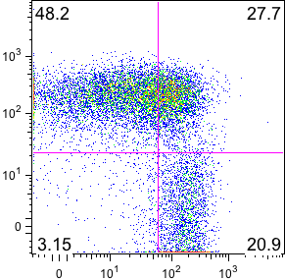
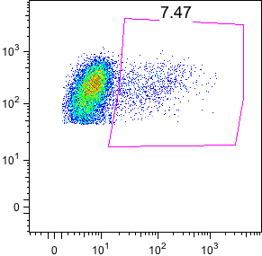
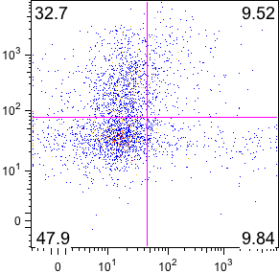
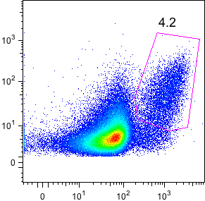
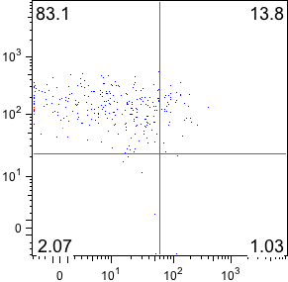
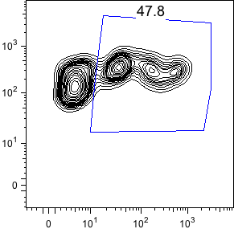
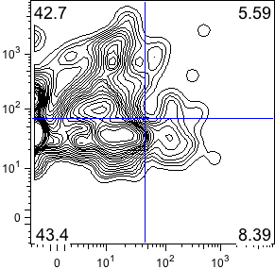
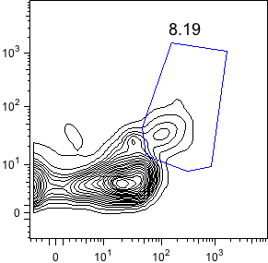
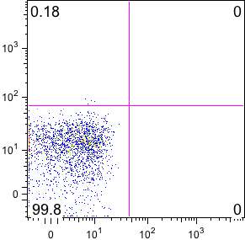
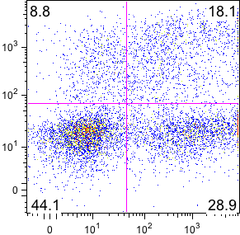
Supplemental Figure 3
A
B
C
D
E
CD3+CD4+
CD3+CD4+
CD3+CD8+
CD3+CD8+
CD3+CD4+
Spleen
CD45RA
Tumor
CD3
CD3
IFNγ
CD25
HLA-DR
CCR7
Granzyme B
TNFα
FoxP3
B cells
CD19
Spleen
PC Unst
CD11b, 11c, 14 or 33
Myeloid
Spleen
PC Stim
IFNγ
HLA-DR
TNFα
Notes:
Supplemental Figure 3: Flow cytometric examples illustrating analyses of distinct human T cell phenotypes in spleen and tumor of HIS-CRC-BRGS mouse. A) Activated T cells expressing HLA-DR, B) T naïve and memory populations defined by CCR7+CD45RA+ (Naïve), CCR7+CD45RA- (Tcm), CCR7-CD45RA- (Tem) and CCR7-CD45RA+ (TEMRA), T cells producing cytotoxic Granzyme B (C), TNFα or IFNγ (D) molecules, or E) Tregs (CD25+FoxP3+). Population above graph indicates the parent gate. Expression of HLA-DR MHC Class II on human B and myeloid cells are shown on bottom plots in (A). Positive Control”PC” human PBMCs, either unstimulated or stimulated with mitogen, to assess production of IFNγ and TNFα are shown in Column D, bottom two panels.

Slide 7
Supplemental Figure 4
A
CRC307P: Tumor take rate = 98.1%
B
Group | # Injec | # died | # low chim | #mice final | # tumors
Ctrl | 7 | 1 |  | 6 | 12
Atezo | 5 | 1 | 0 | 4 | 8
Cobi | 5 | 0 | 1 | 4 | 8
Co/A*# | 8 | 1 | 0 | 6 | 12
Ca/N* | 8 | 1 | 0 | 7 | 13
HIS-CRC307P-BRGS
SGR
Tumor weight
Tumor Volume (mm3)
SGR
(g)
*1 tumor removed (very small)
# 1 mouse dying (limited data)
C
hCD4+
D
E
pDC TIL
F
Rel Cell #
PD-1 Tumor
Rel Cell #
mCD45+ Tumor
hCD8+
MFI
DR+ Myeloid TIL
%
Rel Cell #
%
LN
SP
Notes:
Supplemental Figure 4. Comparison of TKI and ICB inhibitor combinations, cobmetinib+atezolizumab and cabozantinib+nivolumab, for CRC treatment in HIS-BRGS PDX models. A) Experimental replicates including number of HIS-BRGS mice injected with PDX CRC307P in each flank for each treatment group, number that died, removed due to low chimerism at end of study. B) Tumor growth as measured by tumor volumes (left), SGR (middle) and tumor weights at harvest (right). C-E) Immune correlates as measured in tumor or lymph at harvest: C) frequency of mouse CD45+ (myeloid) cells in tumor, D) Relative cell # of human CD4+ and CD8+ T cells in lymph nodes (LN) and spleen (SP); E) # of plasmacytoid dendritic cells (pDC, Lin-, HLA-DR+) and frequency of HLA-DR+ human myeloid cells in tumor; and F) mean fluorescence intensity of PD-1 on tumor cells (EpCam+). Each dot represents data from an individual HIS-CRC307P-mouse, lines represent mean±SEM. *p<0.05, ** p<0.01, ***p<0.001 [Welch’s two-tailed, unpaired t-test].

Slide 8
Supplemental Figure 5
A
mCD45+ TIL
%
V
N
Ca
Ca/N
B
hCD4+
GrB+
Tem
Tcm
TIM-3
R²=0.032
P=0.324
R²=0.007
P=0.674
R²=0.009
P=0.630
*
R²=0.149
P=0.012
%
hCD8+
R²=0.0001
P=0.955
R²=0.012
P=0.486
%
*
R²=0.129
P=0.044
R²=0.024
P=0.437
Notes:
Supplemental Figure 5. A) Frequency of mouse CD45+ myeloid cells in tumors of HIS-CRC-BRGS mice according to treatment (V=vehicle, N=nivolumab, Ca=cabozatinib, Ca/N=cabozatinib+nivolumab) among responding and non-responding tumors. Each dot represents data from an individual HIS-CRC-mouse, lines represent means±SEM. *p<0.05, ** p<0.01, ***p<0.001 [Welch’s two-tailed, unpaired t-test]. B) Immunotypes among CD4+ T cells (top) and CD8+ T cell (bottom) populations relative to tumor specific growth rate (SGR) for expression of Granzyme B (GrB+), CD45RA-CCR7- (Tem), CD45RA-CCR7+ (Tcm) or TIM-3. Data from mice treated with combination therapies. [linear regression analysis, R-squared score (R²) and P value (P) in bold if P<0.05.]

Slide 9
Supplemental Figure 6
hCD45+
hCD3+
hCD8+ (T)
hCD19+
Myeloid
HLA-DR^{lo} (Myeloid)
R²=0.173
P=0.031*
R²=0.018
P=0.498
R²=0.045
P=0.276
R²=0.078
P=0.168
R²=0.409
P=0.034*
R²=0..750
P=0.003**
%
hCD4+
GrB+
Tem
Tcm
PD-1
TIM-3
IFNγ+TNFα+
R²=0.296
P=0.036*
R²=0.259
P=0.133
R²=0.527
P=0.017*
R²=0.069
P=0.168
R²=0.025
P=0.411
R²=0.226
P=0.086
%
hCD8+
R²=0.124
P=0.199
R²=0.050
P=0.536
R²=0.625
P=0.007**
R²=0.014
P=0.554
R²=0.110
P=0.085
R²=0.354
P=0.019*
%
Tumor
HLA-ABC MFI
HLA-DR MFI
PD-L1 MFI
CD4+ Treg
Norm MFI
R²=0.024
P=0.430
R²=0.062
P=0.203
R²=0.083
P=0.136
R²=0.031
P=0.470
(for all the X axes)
SGR
Notes:
Supplemental Figure 6. Correlation of immunotypes and tumor growth rates (SGR) in HIS-CRC-BRGS mice treated with single-agent cabozatinib. Immune parameters were measured in CRC PDXs (172, 295, 335, 307M) explanted from HIS-BRGS mice using flow cytometry and plotted versus the tumor specific growth rate (SGR). Individual immune parameters are indicated above each plot and are gated on (top row): total human cells unless otherwise indicated in parenthesis or as indicated by population underlined for each row. T effector (Tem) and central memory (Tcm) populations were determined by CCR7 and CD45RO/RA staining. The MFI of MHC HLA Class I and II as well as PD-L1 was restricted to the EpCAM+ tumor cells and normalized to expression on human B cells from same day. [linear regression analysis, R-squared score (R²) and P value (P) in bold if P<0.05.]

