Slide 1
Supplementary Figure 1. vvDD-IL2 treatment increases the number of T cells in the tumor.

Slide 2
Supplementary Figure 2. There are fractions of TILs recognizing tumor antigen-specific epitope and viral protein epitope. TILs were incubated with naïve splenocytes pulsed with epitope peptides for ~12 h at 5% CO2, 37°C incubator, and flow cytometry was run for IFN-γ+ CD8+ T cells. p15E is cancer-specific antigen, while B8R is a vaccinia virus antigen.

Slide 3
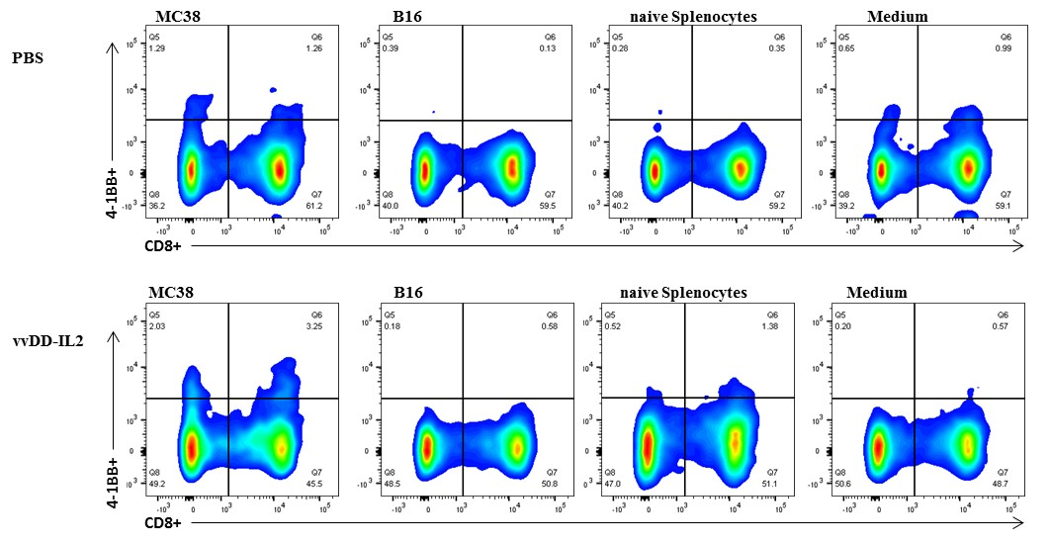
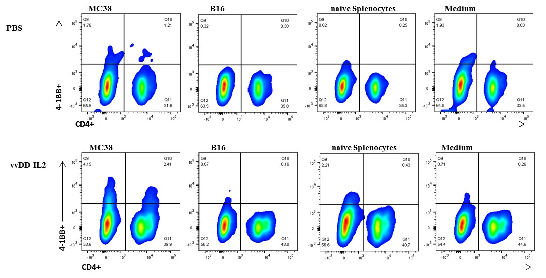
Supplementary Figure 3. Representative flow cytometry plot of CD8⁺ 4-1BB⁺ and CD4⁺ 4-1BB⁺ T cells of one sample from each group.

Slide 4
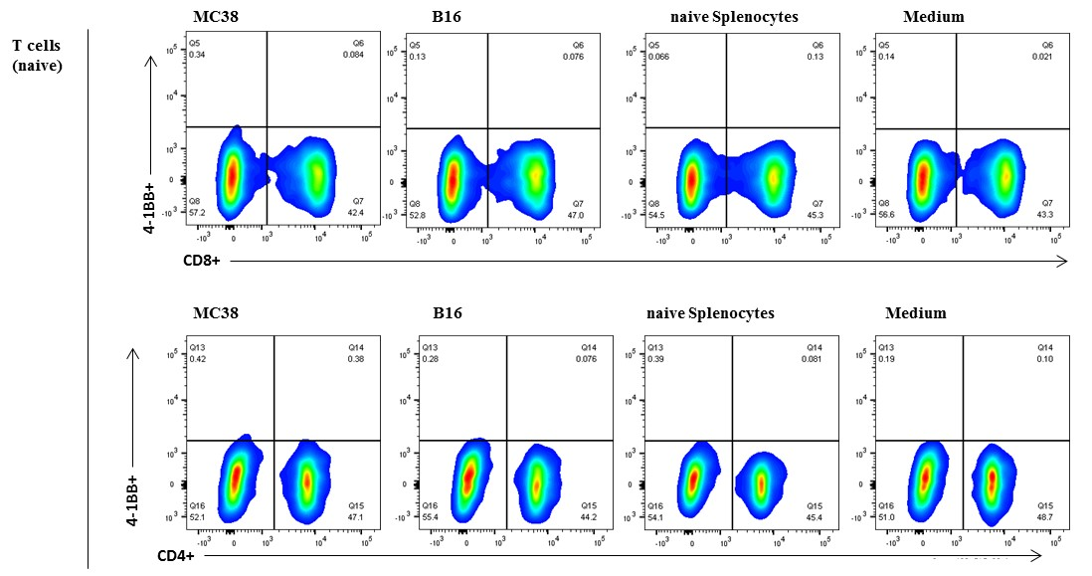
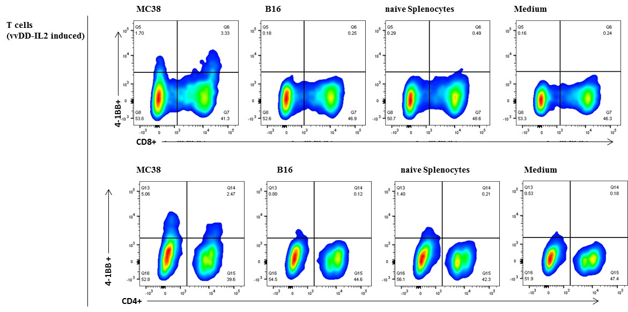
Supplementary Figure 4. Representative flow cytometry plot of CD8⁺4-1BB⁺ and CD4⁺4-1BB⁺ T cells of one sample from each group.

