Slide 1
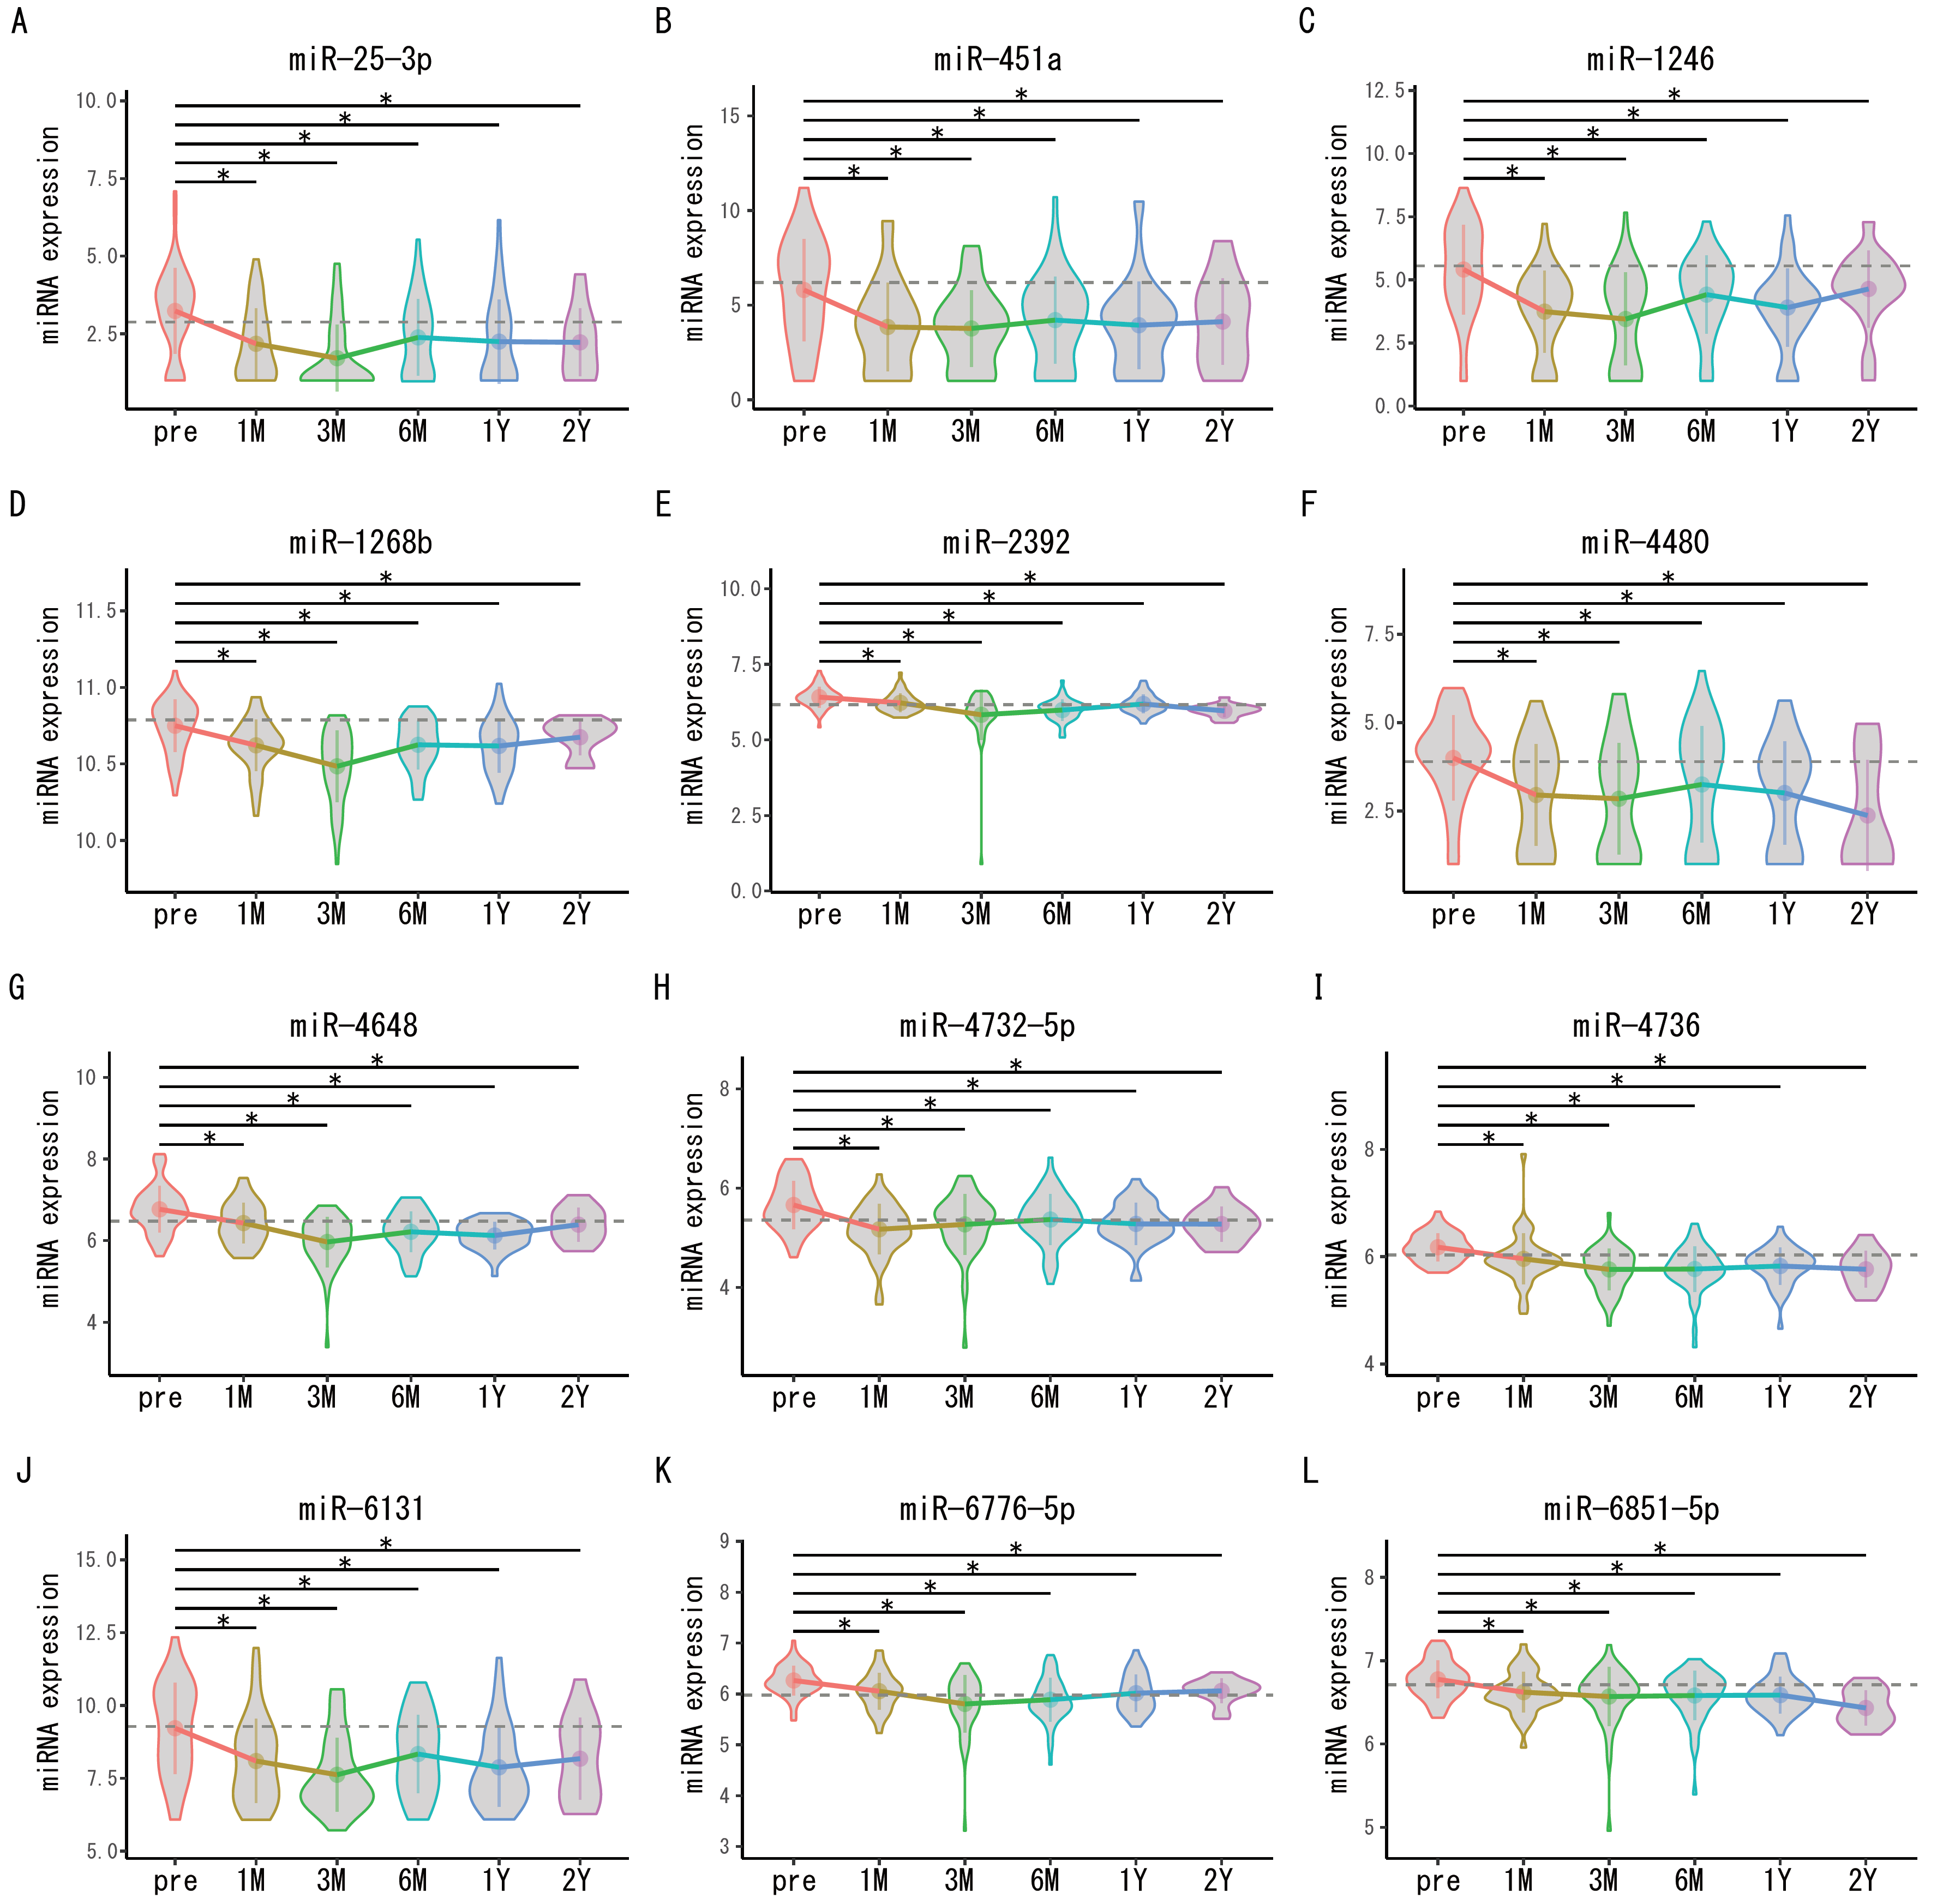
Notes:
Figure 2: Timeline of 12 miRNAs expression in no recurrence cases

