Slide 1
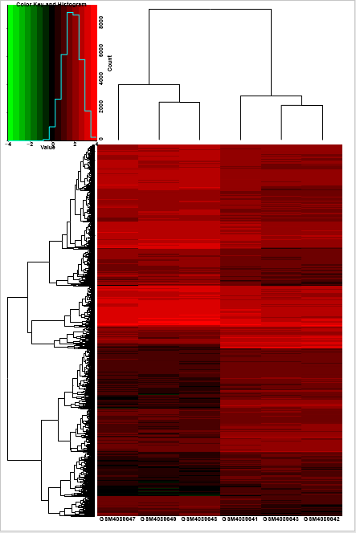
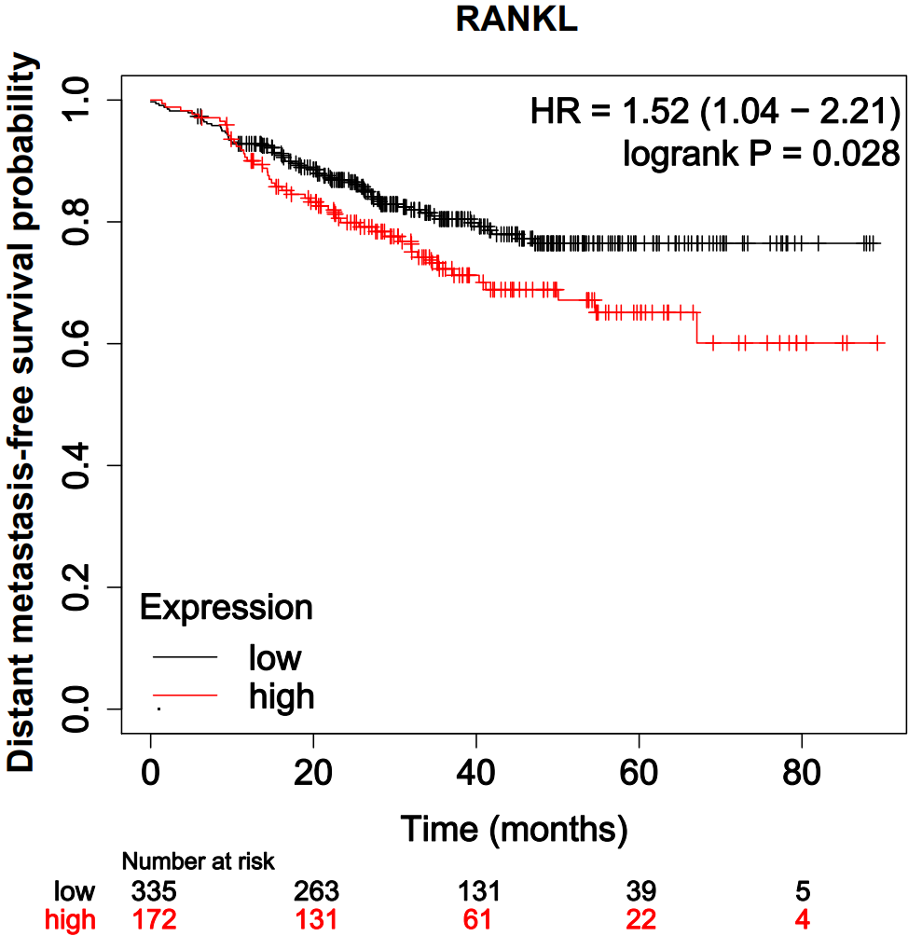
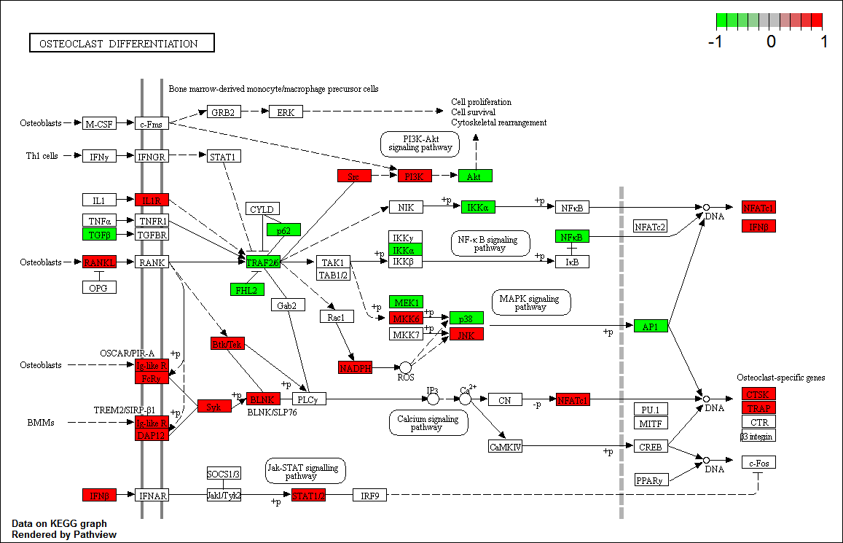
Supplemental Fig. 2
a
GSE137842
c
Primary
tumor
Bone metastasis
b
RANKL

