Slide 1
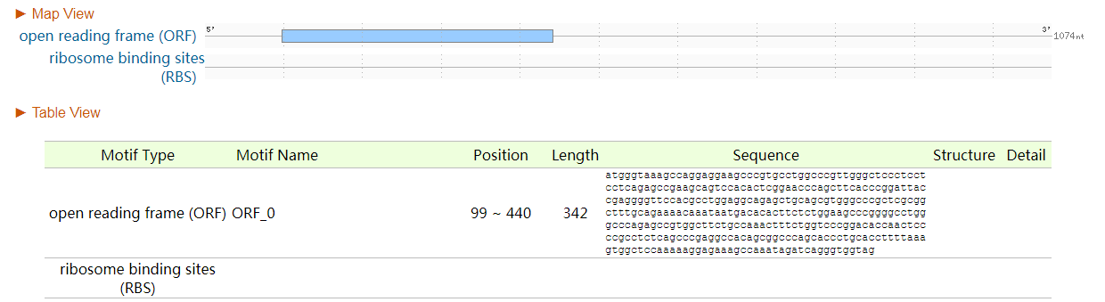
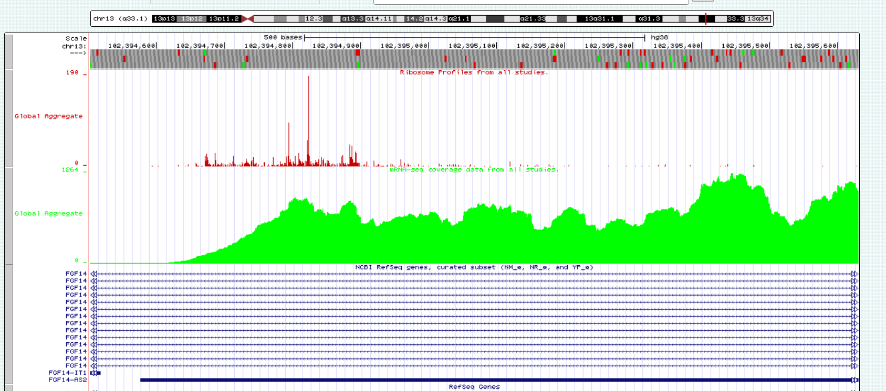
Supplemental Fig. 3
a
Reg RNA 2.0
b
Ribosome binding scores
0
FGF14-AS2
1074

