Slide 1
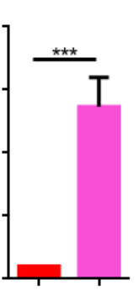
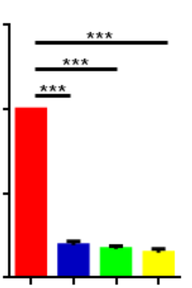
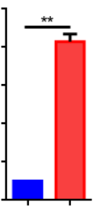
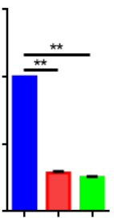
Supplemental Fig. 5
a
b
MDA-MB-231
MDA-MB-231
20.0
1.5
si-EIF2AK2(#3)
si-EIF2AK2(#2)
EIF2AK2
si-EIF2AK2(#1)
15.0
1.0
pcDNA3.1
si-NC
EIF2AK2 mRNA
Relative expression
EIF2AK2 mRNA
Relative expression
10.0
0.5
EIF2AK2
EIF2AK2
5.0
β-actin
β-actin
0.0
0.0
pcDNA3.1
si-NC
si-EIF2AK2(#1)
EIF2AK2
si-EIF2AK2(#3)
si-EIF2AK2(#2)
c
MDA-MB-468
d
MDA-MB-468
10.0
1.5
si-EIF2AK2(#1)
pcDNA3.1
si-NC
si-EIF2AK2(#2)
8.0
EIF2AK2
6.0
1.0
EIF2AK2
EIF2AK2
EIF2AK2 mRNA
Relative expression
EIF2AK2 mRNA
Relative expression
β-actin
β-actin
4.0
0.5
2.0
0.0
0.0
pcDNA3.1
EIF2AK2
si-NC
si-EIF2AK2(#1)
si-EIF2AK2(#2)

